Slide 1
What Do “Social-Media” Features Encode?
A Data Audit and Explainable Prediction of Museum Visitor Volume Across 323 Korean Museums
Presenter: Rana Muhammad Amir Latif
Muhammad Arfan Jaffar*, Jawad Ahmad, Umar Raza, Muhammad Babar, Farhan Ullah
Superior University Lahore | Manchester Metropolitan University | Prince Mohammad Bin Fahd University
9th International Conference on Culture Technology (ICCT 2026) | *Corresponding author
Notes:
[0:30] Good morning everyone. I am Rana Muhammad Amir Latif from Superior University Lahore, presenting on behalf of my co-authors. Our paper started as a plan to forecast museum visitors from social media and sentiment signals. What we found is more important: we first had to audit what the public dataset actually contains. This talk is about that audit, and what we can and cannot say after it.

Slide 2



Museums plan around visitor numbers, and web signals look like a shortcut
Counts arrive late
Web signals help
But they are fragile
Staffing, opening hours and programs depend on expected visitors, but official counts arrive late.
Search data improves estimates of museum visits [1] and tourism demand forecasts [2].
Online-signal models can fail without warning [3], and leakage quietly inflates accuracy [4].
[1] Botta et al., 2020 [2] Li et al., 2017 [3] Lazer et al., 2014 [4] Kaufman et al., 2012
Notes:
[1:00] Museums need to know how many visitors to expect, yet official counts come late. Earlier work shows that search data can help nowcast museum visits and tourism demand. At the same time, big-data signals are fragile and leakage is a known trap. That is the background to our study: a public dataset claims to offer social media, sentiment and news features for predicting museum visitors, so we asked whether it really does.

Slide 3
The dataset promised social-media signals; the data tell a different story
What the repository describes
What we found
323 museums, public, CC BY 4.0
12 features labelled as social media likes, article views, sentiment and news polarity
Target: visitor volume
Intended for DNN, LSTM and Transformer models
One 2023 snapshot: no time axis, so no forecasting
Most “social media” columns are log transforms of facility and operations fields
One column almost duplicates the target
So we audited first, then modelled
Notes:
[0:45] On paper, the repository offers 323 museums with twelve features described as social media likes, article views, sentiment and news polarity, meant for deep-learning models. When we opened the files, the picture changed. There is only one time point, so forecasting over time is impossible. Many columns do not look like social media measures. And one column almost duplicates the target. So we decided to audit the data first and model second.

Slide 4
Four research questions guided the study
RQ1
How accurately can log annual visitors be predicted from the non-leaking features?
RQ2
Do neural networks beat classical and tree models at this sample size?
RQ3
Which features carry signal, and do the sentiment and news variables add anything?
RQ4
Do the repository's variable descriptions match where the data come from?
Notes:
[0:30] We refined four questions after inspecting the data: how accurately visitors can be predicted, whether neural networks help at this sample size, which features matter and whether sentiment and news add anything, and whether the repository's descriptions match the raw data. I will answer each one in the conclusion.

Slide 5
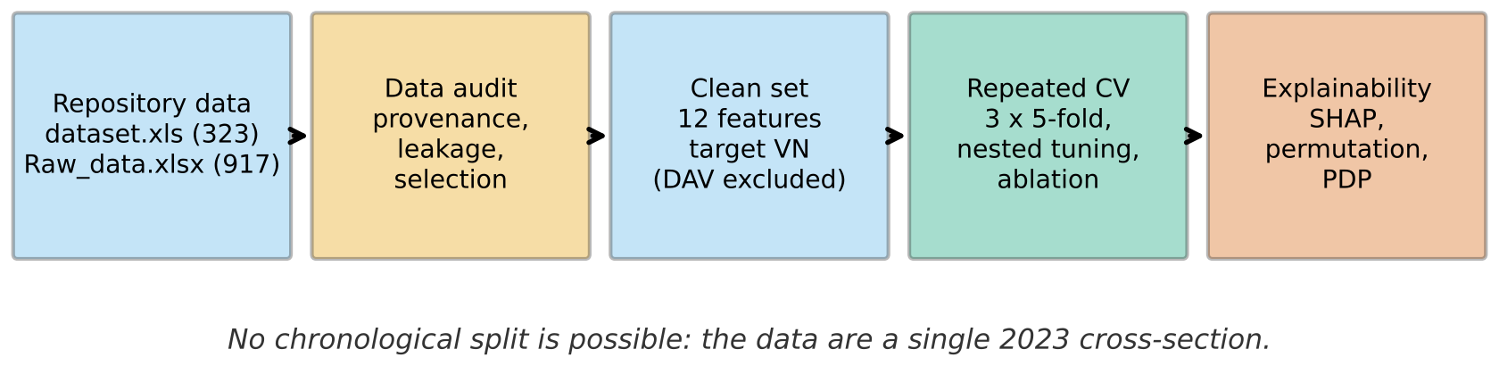
We audited the data first, then built a leakage-free benchmark
Audit
Protect
Reproduce
Provenance, leakage, selection
DAV excluded; no test-fold leakage
Fixed seed 42, code and data shared
Notes:
[0:30] This is our workflow. We start from the repository's dataset and raw file, audit provenance and leakage, build a clean set of twelve features with the leaking column removed, and then evaluate five models with repeated cross-validation, followed by explanation with SHAP, permutation importance and ablation. Everything uses a fixed seed and the code and data are shared.

Slide 6
Ten of 14 numeric columns are exact log transforms of unlabelled raw columns
10 of 14
README label | What the numbers show
SLV “social media likes” | = ln(1+a); raw header is only “a”
EDA “domain authority” | r = 0.96 with DSPY_AR_CN, an area column
TPN “topic centrality” | r = 0.72 with number of experience programs
AOD “domain age” | never exceeds 365: looks like operating days
columns match a raw column exactly: ln(1+x), difference 0.0
4 of 14
columns (CHN, CIP, NEWS, COMMENTS) have no raw source
These patterns fit areas, program counts and operating days, not likes or sentiment. Raw headers are only a to l, so meanings are inferred.
Notes:
[1:30] This is our first main finding. We compared every numeric column of the dataset with every numeric column of the raw file. Ten of the fourteen are exact log one-plus-x transforms of raw columns whose headers are just letters a to l. Four columns, CHN, CIP, NEWS and COMMENTS, cannot be traced to any raw column at all. Looking at the values: the column labelled domain authority correlates 0.96 with an area column, the topic centrality column correlates 0.72 with the number of experience programs, and the column labelled domain age never exceeds 365, which looks like operating days. We stress that these meanings are inferred, because the raw headers are anonymous.

Slide 7
One column leaks the target and inflates R² from 0.58 to 0.95
r = 0.97
DAV versus the target VN (log annual visitors)
DAV = ln(1+l), where l is within 2% of visitors ÷ days for 74% of museums
Looks like average daily visitors, built from the target
Excluded from every model
Notes:
[1:15] Our second finding is leakage. The column DAV has a correlation of 0.97 with the target. It equals the log of a value that is within two percent of visitors divided by operating days for 74 percent of museums, so it is essentially average daily visitors, which is built from the target. Adding it lifts cross-validated R squared from 0.58 to 0.95 for XGBoost and from 0.54 to 0.95 for ridge. That jump says nothing about real predictive signal, so we excluded DAV from all models. Any published result that includes it should be read with this in mind.

Slide 8
Five models, nested repeated cross-validation, no test-fold leakage
Models
Protocol
Mean predictor (reference)
Ridge regression (linear baseline)
Random Forest and XGBoost
Feed-forward neural network
No LSTM or Transformer: they need sequences
3×5-fold cross-validation, seed 42
Inner 3-fold tuning inside each training fold
MAE, RMSE, R² and Spearman ρ on the log scale
Paired Wilcoxon tests as a rough guide only
Notes:
[0:45] We compare a mean predictor, ridge regression, Random Forest, XGBoost and a feed-forward neural network. Tree ensembles are a natural fit for small tabular data. We did not run LSTM or Transformer models because there are no sequences. Evaluation uses three repeats of five-fold cross-validation with seed 42, and hyperparameters are tuned in an inner three-fold loop so no test information leaks. We report MAE, RMSE, R squared and Spearman on the log scale.

Slide 9
Random Forest is best, but the top three models are statistically close
R² 0.585
Random Forest; XGBoost 0.580, ridge 0.536, neural network 0.499
×2.4
typical error factor on visitor counts: ranks museums well (ρ = 0.76), not exact counts
RF vs ridge p = 0.07; XGBoost vs ridge p = 0.21; neural network worse than ridge (p = 0.05)
Notes:
[1:30] Here are the results with the twelve non-leaking features. Random Forest has the lowest error, MAE 0.883 on the log scale, followed closely by XGBoost and ridge. The neural network is worse than ridge. All models beat the mean predictor. The three best models are not clearly separable: the paired test p-values are 0.07 to 0.21, and they are optimistic because folds overlap. An error of about 0.9 log units means a typical prediction is off by a factor of about 2.4, so the models rank museums fairly well, with Spearman 0.76, but are not accurate enough for exact counts. So for RQ2: no, neural networks do not help at this sample size.

Slide 10
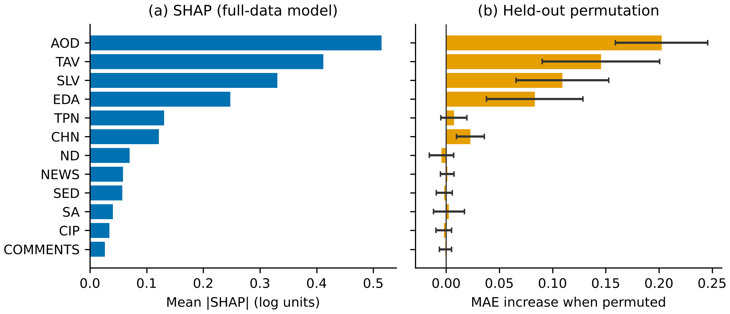
AOD, TAV, SLV and EDA drive predictions; sentiment and news do not
Shuffling AOD raises MAE by 0.20, TAV 0.15, SLV 0.11 and EDA 0.08. SED, SA, CIP, ND, NEWS and COMMENTS stay within 0.004, which is noise.
Notes:
[1:15] To see what drives the predictions we used SHAP on the left and held-out permutation importance on the right. They agree. AOD, TAV, SLV and EDA come first. Shuffling AOD raises the error by 0.20, TAV by 0.15, SLV by 0.11 and EDA by 0.08. Shuffling the sentiment, news and comment variables changes the error by no more than 0.004, which is within noise. These are associations in a model, not causes of attendance.

Slide 11
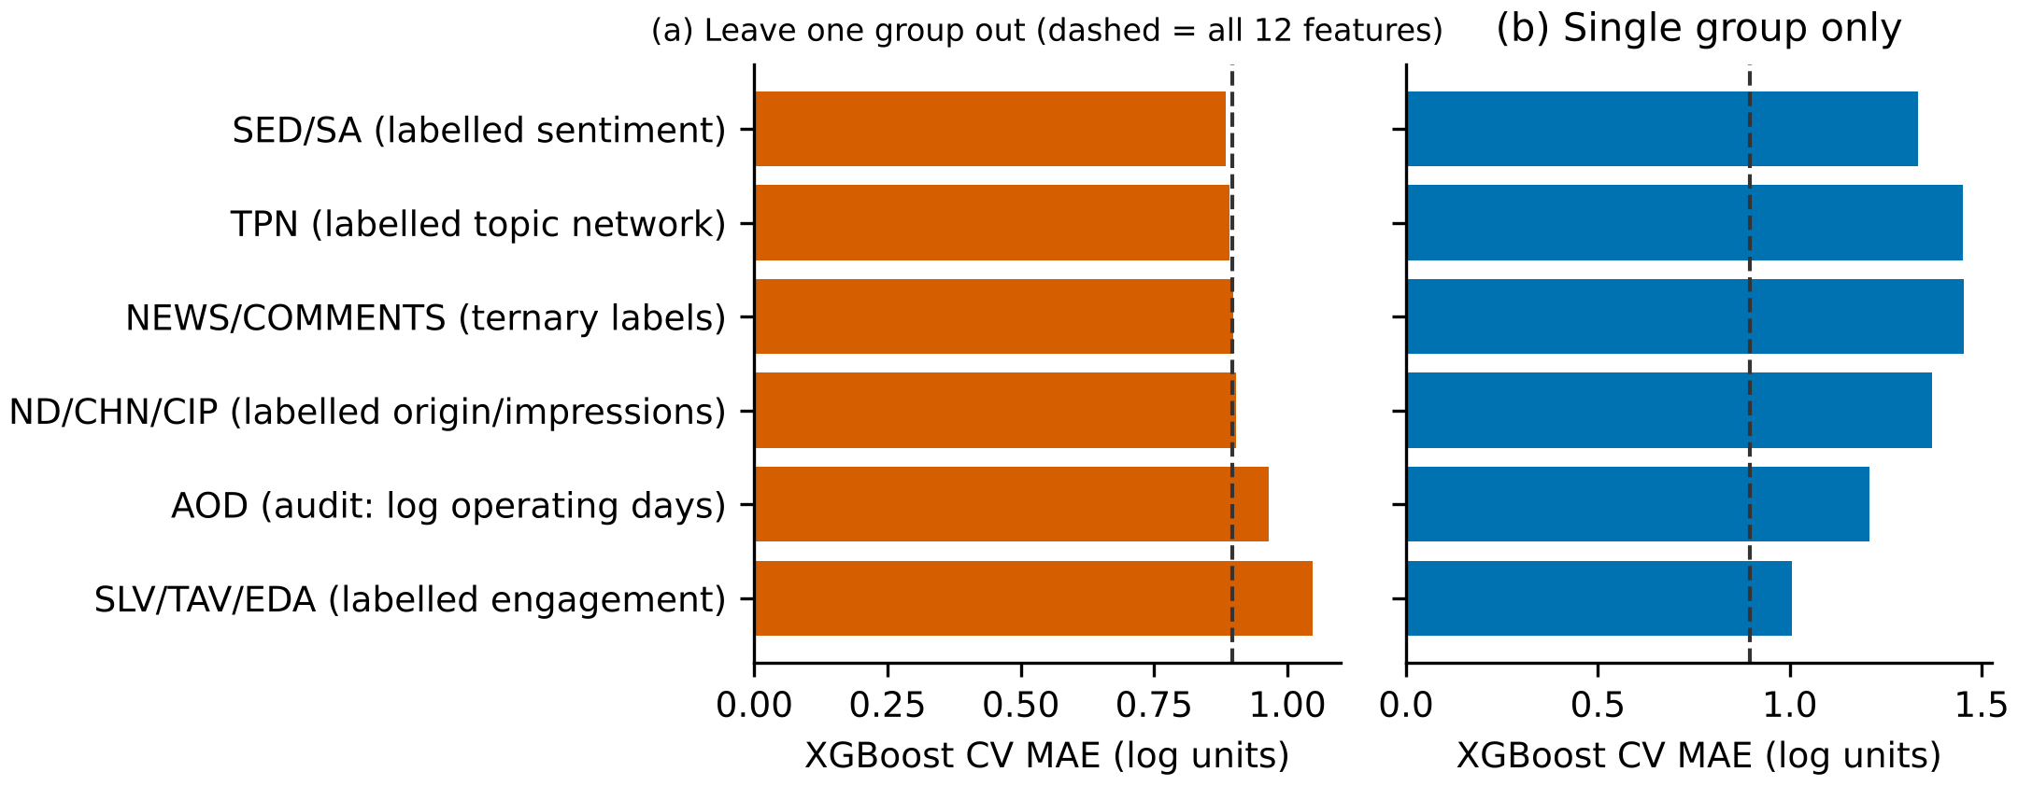
Ablation confirms it: engagement and operating features matter, sentiment labels add nothing
+0.150
MAE when SLV/TAV/EDA are dropped
+0.068
MAE when AOD is dropped
Dropping any other group changes MAE by at most 0.012, with inconsistent direction.
R² −0.04
NEWS and COMMENTS alone: no better than the mean
Notes:
[1:15] Group ablation tells the same story. Dropping the SLV, TAV and EDA group raises the error by 0.150, and dropping AOD raises it by 0.068. Dropping any other group changes the error by at most 0.012, and the sign is inconsistent. NEWS and COMMENTS on their own give an R squared of about minus 0.04, which is no better than predicting the mean. So for RQ3: the signal sits in AOD and in SLV, TAV and EDA. We could not run the originally planned ablation of attendance history versus history plus social media, because the data contain no attendance history.

Slide 12




What this means for museums and data users
Operations predict volume
Check provenance first
Facility and operating features, not sentiment labels, predict annual visitors here.
Before a column labelled “social media” enters a dashboard, verify its source.
Test signals over time
Explanations are associations
Judging social or news sentiment needs visitor counts over time and aligned signals [1], [2].
AOD matters partly because yearly totals build up over open days. This is not causal.
Notes:
[1:00] For museum managers the message is one of caution. First, in this dataset the size and operating features of a museum predict annual visitors, not the sentiment labels. Second, check the provenance of any column described as social media before you build a dashboard on it. Third, to judge whether social media or news sentiment really helps, you need visitor counts over time and signals aligned with them, as in earlier work. Fourth, our explanations are associations. AOD matters partly because yearly totals accumulate over open days.

Slide 13
Limitations are real; the next step is time-aligned data
Limitations
Future work
One year, 323 museums; selection rule undocumented and favours larger museums
Raw column meanings inferred; four columns untraceable
Museums at the same site are not independent across folds
Small tuning grids; tests and intervals are optimistic; not causal
Ask the dataset authors for documentation
Collect true monthly attendance with search, social and news signals aligned in time
Then test sequence models with rolling-origin evaluation
Notes:
[0:45] The study has clear limits. It covers one year and 323 museums, chosen by an undocumented rule that favours larger museums. We inferred the raw column meanings and could not trace four columns. Museums at the same site are not independent, our tuning grids are small, and our tests are optimistic. Nothing here is causal. The next step is to ask the dataset authors for documentation, collect real monthly attendance with time-aligned search, social and news signals, and only then test sequence models.

Slide 14
Conclusions: answers to the four research questions
RQ1
About 58% of variance in log annual visitors explained (MAE 0.88 log units).
RQ2
No: the neural network is no better than ridge or tree models at n = 323.
RQ3
Signal sits in AOD and SLV/TAV/EDA; sentiment and news add nothing detectable.
RQ4
No: at least ten columns do not match their descriptions; four have no source.
Notes:
[0:45] To conclude, the answers to our questions. RQ1: leakage-free models explain about 58 percent of the variance in log annual visitors. RQ2: neural networks do not beat ridge or tree models at this sample size. RQ3: the signal sits in AOD and in SLV, TAV and EDA, while sentiment and news add nothing detectable. RQ4: at least ten columns do not match their descriptions and four have no traceable source. The broader lesson is to audit open datasets before trusting their labels.

Slide 15


Thank you. Questions?
Audit your data before you trust its labels
ranaamir10611@gmail.com (presenter)
arfan.jaffar@superior.edu.pk (corresponding author)
Code and clean data: github.com/Rana64/A-Data-Audit-and-Explainable-Prediction-of-Museum-Visitor-Volume-Across-323-Korean-Museums
Data: Jae Ho Lee repository (CC BY 4.0), from KCISA records.
Notes:
[0:30] Thank you. The code, the clean dataset and every table and figure are in our GitHub repository, and the original data come from the public repository by Jae Ho Lee under CC BY 4.0. I am happy to take questions. Likely questions: why not LSTM or Transformer (no sequences, single snapshot); how sure are you about what the raw columns mean (inferred, we asked for documentation); is AOD just operating days (yes, probably, and we flag it); can you say sentiment does not matter (only that this dataset's sentiment columns add nothing).

