Slide 1

The 9th International Conference on Cultural Technology 2026
Privacy and Equity of Federated Personalization for Immersive Cultural Experiences in Autonomous Vehicles
Authors: Shahbaz Khan, Kamlesh Kumar Soothar,,Asad Khan, Kamran Ali Memon, Muhammad Asghar Khan
Presented By: Kamlesh Kumar Soother
Postdoctoral Researcher
School of Electronic and Information Engineering
Beihang University Beijing, China,
October 30, 2026
Notes:
Good morning, everyone. I'm Kamlesh Kumar Soothar from Beihang University. Today I'll be presenting our work on privacy and equity of federated personalization for immersive cultural experiences in autonomous vehicles.
This is joint work with colleagues from Beijing University of Posts and Telecommunications, Beihang University, Hazara University in Pakistan, and Prince Mohammad Bin Fahd University in Saudi Arabia.
Hello everyone. I’m Kamlesh Kumar Soothar from Beihang University, presenting our work on privacy and equity of federated personalization for immersive cultural experiences in autonomous vehicles. This is joint work with colleagues from BUPT, Beihang, Hazara University, and Prince Mohammad Bin Fahd University. In the next ten minutes, I’ll show that federated learning with record-level differential privacy defeats membership inference but does not prevent inference of a passenger’s content preference, and that delivery-time exposure remains an open problem.

Slide 2
Outline
Motivation + Problem
Gap and Questions
System & Threat Model
Record-Level DP Does Not Bound What an RSU Can Infer About Content Category
Experimental Setup
Experimental Results
Implications and Limitations
Conclusion & Future Work

Slide 3
Motivation
🚗 The Opportunity
⚠️ The Problem: Three Coupled Sensitivities in One Record
Automated driving turns the cabin into free time
VR already lets audiences tour museums and heritage sites remotely ^{[1]}
Streaming 360° video to a moving car means predicting where you look + where the car goes, then pre-caching tiles at roadside units (RSUs) ^{[7]}
Biometric
  head motion can identify individuals ^{[8]}; gaze can qualify as biometric data ^{[9]}
Cultural
  What you watch can reveal religion, ethnicity, or political opinion (GDPR Art. 9) ^{[10]}
Spatial
  Trajectories reveal home, workplace, and routine (PIPL Art. 28) ^{[11]}
Notes:
Why does this matter? As driving becomes automated, the cabin becomes free time, and a new space for cultural experience. VR already lets people tour museums and heritage sites remotely, so an autonomous vehicle could become a new channel for cultural institutions to reach audiences.
To stream 360° video to a moving car without stalling, the system predicts where the passenger will look and where the car will go, and pre-caches the right tiles at a roadside unit before they are requested. This is proactive caching.
But the data behind this prediction is unusually sensitive, in three coupled ways. First, biometric: head-motion traces identify individuals. Miller and colleagues re-identified 95% of 511 users from under five minutes of head and body tracking, and gaze from eye-tracking headsets can qualify as biometric data under GDPR. Second, cultural: what a passenger watches can reveal religious belief, ethnic origin, or political opinion, which are special categories under GDPR Article 9. Third, spatial: trajectories reveal home, workplace, and routine, and China’s PIPL Article 28 lists biometrics, religious belief, and whereabouts as sensitive personal information.
Each is sensitive alone, but combined in one record they enable cultural profiling that neither stream allows alone: a person, a place, and beliefs. So our question is: does federated learning protect these attributes?

Slide 4
Gap and Questions
The Gap
Our Three Questions
FL trains on vehicles and shares only model updates ^{[12]}
FedVR360 ^{[13]} was tested against membership inference, black-box attribute inference, and gradient inversion
Record-level DP bounds what one training sequence reveals, not a property shared across many records, such as content category ^{[20]}
DP-SGD can reduce accuracy more for underrepresented groups ^{[21]}, and this is not yet measured for vehicular VR
Leakage
  Can the serving RSU, which sees individual updates, infer what kind of content a passenger watched?
Equity
  Does private personalization distribute accuracy fairly across content categories and passengers?
Persistence
  Which exposures remain after FL and DP, especially in delivery-time content requests?
Notes:
Federated learning is the natural answer to this problem. Training happens on the vehicle, and only model updates are shared. Our earlier work, FedVR360, takes this approach and was evaluated against membership inference, black-box attribute inference, and gradient inversion.
But there is a gap. FedVR360 uses record-level differential privacy, which bounds what a single training sequence reveals. A passenger’s preferred content category is not a single record. It is a property shared across many of their records, and prior work shows that record-level DP does not prevent inference of such properties. Also, the serving roadside unit sees each vehicle’s individual update, so it is a stronger adversary than the ones we tested before. On top of that, DP is known to hurt underrepresented groups more, and nobody has measured this for vehicular VR.
So, using FedVR360 without modification, we ask three questions. First, can the roadside unit infer what kind of content a passenger watched? Second, does private personalization serve all content categories and passengers comparably? Third, what stays exposed even after FL and DP, in particular in the content requests a vehicle must send at delivery time?
To stream 360° video to a moving car without stalling, the system predicts where the passenger will look and where the car will go, and pre-caches the right tiles at a roadside unit before they are requested. This is proactive caching.
But the data behind this prediction is unusually sensitive, in three coupled ways. First, biometric: head-motion traces identify individuals. Miller and colleagues re-identified 95% of 511 users from under five minutes of head and body tracking, and gaze from eye-tracking headsets can qualify as biometric data under GDPR. Second, cultural: what a passenger watches can reveal religious belief, ethnic origin, or political opinion, which are special categories under GDPR Article 9. Third, spatial: trajectories reveal home, workplace, and routine, and China’s PIPL Article 28 lists biometrics, religious belief, and whereabouts as sensitive personal information.
Each is sensitive alone, but combined in one record they enable cultural profiling that neither stream allows alone: a person, a place, and beliefs. So our question is: does federated learning protect these attributes?

Slide 5
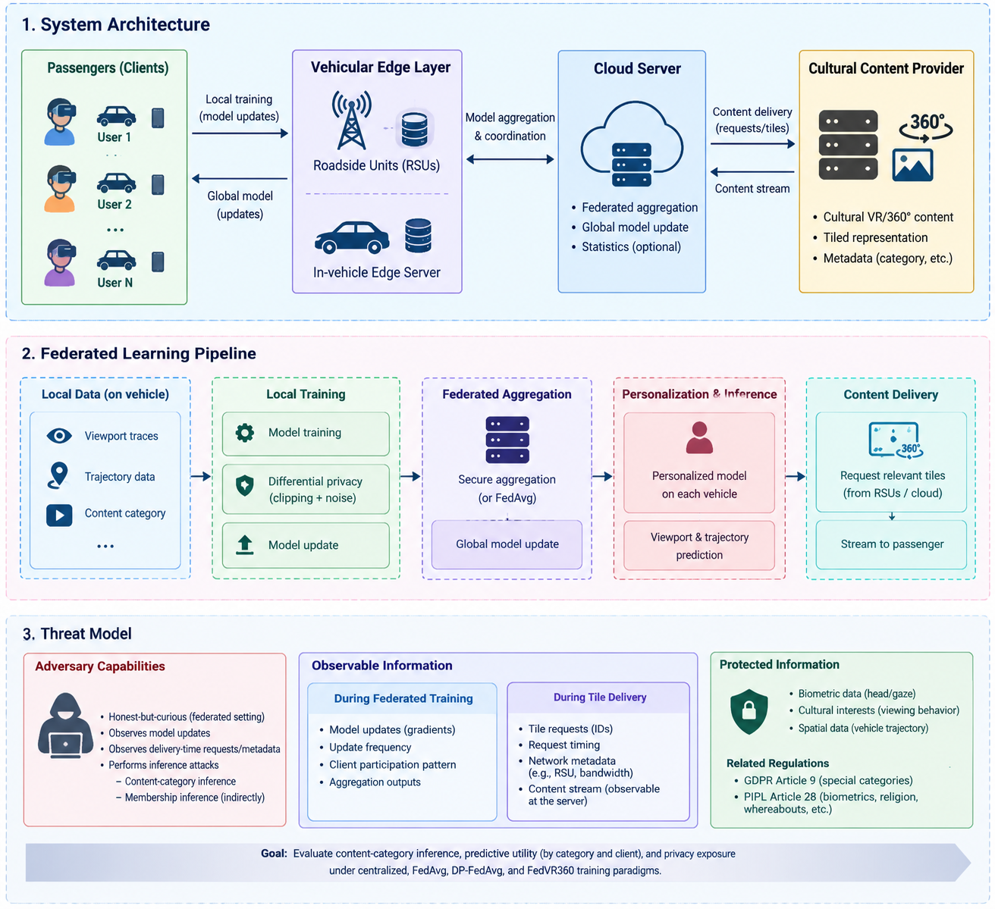
System and Threat Model
Table 1 : Exposure points in federated cultural streaming
Exposed item | Observer | Protection | Residual risk
Raw records | None external | Stay on vehicle | Leak only via updates
Client update | Serving RSU | Record-level DP-SGD | Inference of content category ^{[20]}
RSU aggregate | Cloud | ≥ K_min clients + DP | Reduced with larger K_min
Global model | Any querier | Record-level DP | Membership inference ^{[19]}
Tile and content requests | RSU, content server | None from FL | Content and viewport revealed
Figure 1: System architecture and privacy threat model
Notes:
Here is the setting. A content provider supplies tiled 360° video. Roadside units cache the tiles and stream them to vehicles on request. Each vehicle records head orientation and position and trains the predictor locally. RSUs aggregate their vehicles’ updates, and a cloud coordinator aggregates across RSUs.
Our adversaries are honest-but-curious. They follow the protocol, but they try to infer private information. That includes the RSU, the cloud, and anyone who can query the released model.
The table shows where information is exposed. Raw records never leave the vehicle. The RSU aggregate and the global model are protected by aggregation and differential privacy. The weak points are two rows. First, the client update. The serving RSU sees each vehicle’s individual update, and this is where content category can leak. Second, the tile and content requests. A vehicle has to ask for what it wants to watch, and federated learning does nothing to hide that. This is the key distinction in our paper: training-time exposure, which federated learning addresses, versus delivery-time exposure, which it does not.
We evaluate two attacks. Membership inference asks whether a specific training sequence was used. Content-category inference, the focus of this paper, asks whether the RSU can recover the dominant category a passenger watches, just from their updates. Random guessing gives one over the number of categories.

Slide 6
Record-Level DP Does Not Bound What an RSU Can Infer About Content Category
Why record-level DP is not enough
Our attack (honest-but-curious)
Guarantee: neighboring datasets differ in one training sequence, so (ε, δ)-DP bounds what a single sequence reveals, and hence membership inference
Content category cᵢ is shared by many of a client’s sequences, so record-level DP does not bound it ^{[20]}
Bounding it needs client-level DP ^{[18]}
Two further caveats: overlapping windows weaken per-time-step protection, and the reported ε covers shared-parameter updates, not end-to-end (personal layers are noiseless)
The RSU controls auxiliary clients with known categories (12 test vehicles)
It reproduces local training with the same DP-SGD (C, σ) as the targets (R = 20 replicates per client per round)
Per round: flatten the updates, reduce with PCA (50 components), classify with logistic regression
Each target’s category = majority vote over the rounds it participated in
Whether prototype fusion, hierarchical aggregation, and personalization suppress this leakage is an empirical question.
Notes:
Why would DP not be enough? Record-level differential privacy says that adding or removing one training sequence barely changes what the RSU sees. That is exactly what defeats membership inference. But a passenger’s content category is not one sequence. It is a pattern across many of their sequences, and bounding that requires client-level DP. Two more caveats: overlapping windows weaken protection for individual time steps, and our reported epsilon covers the shared-parameter updates, not the noiseless personal layers, so it is not an end-to-end guarantee. That is why we measure leakage empirically.
The attack follows Melis and colleagues. The RSU controls a few auxiliary vehicles with known categories. Because the training procedure is public, it reproduces local training on them with the same clipping and noise as the targets, and learns how updates differ by category. For each round it compresses the updates with PCA, classifies them with logistic regression, and then takes a majority vote over the rounds in which each target participated.

Slide 7
Experimental Setup
Data and clients
Training and privacy
Compared methods and metrics
Viewport: Wu et al. ^{[23]}, 48 participants, 18 videos, HTC Vive, 10 Hz, 8×8 tile grid
Mobility: SUMO ^{[24]}, 3 km arterial corridor, mixed fleet, 5 RSUs
Clients: 48 (one participant + one trajectory each); 12 auxiliary, 36 attack targets
Categories: Sports, Performance, Talkshows (proxy for cultural categories); 80% of each client’s sequences come from its dominant category; chance = 33.3%
Input w = 20 steps, horizon H = 30 steps (3 s)
20 rounds, 10 clients per round, 1 local epoch, B = 32
DP-SGD: C = 1.0, δ = 10⁻⁵, σ ∈ {0.3, 0.5, 0.8, 1.2}
Main setting: σ = 0.5, ε ≈ 3.0
3 seeds, mean ± std
Methods
  Centralized, FedAvg, DP-FedAvg, FedVR360 with and without personalization
Utility
  F1@10, trajectory MAE, category gap Δ_C, worst-20% F1
Privacy
  Category-attack accuracy (one-sided binomial test vs. chance), membership inference (50% = chance)
Notes:
Here is the setup. For viewing behavior we use real 360° traces from 48 participants watching 18 videos. For mobility we simulate vehicles in SUMO along a 3 kilometer corridor with five roadside units. Each participant is paired with one trajectory, which gives 48 clients.
We use the dataset’s video genres, Sports, Performance, and Talkshows, as a proxy for cultural categories. Genre preference is less sensitive than religious or ethnic preference, but it plays the same statistical role in the attack. Each client gets a dominant category, and 80 percent of its sequences come from it. Twelve clients act as the adversary’s auxiliary vehicles, and the other 36 are the attack targets. Chance is one third.
Training runs for 20 rounds with 10 sampled clients per round. Our main setting is sigma of 0.5, which gives an epsilon of about 3, and we sweep sigma for the privacy-accuracy curve. We compare centralized training, FedAvg, DP-FedAvg, and FedVR360 with and without personalization, over three seeds.
One caveat, which I will repeat at the end: no public dataset has viewing and mobility from the same subjects, so these results are a controlled proof of concept, not field estimates.

Slide 8
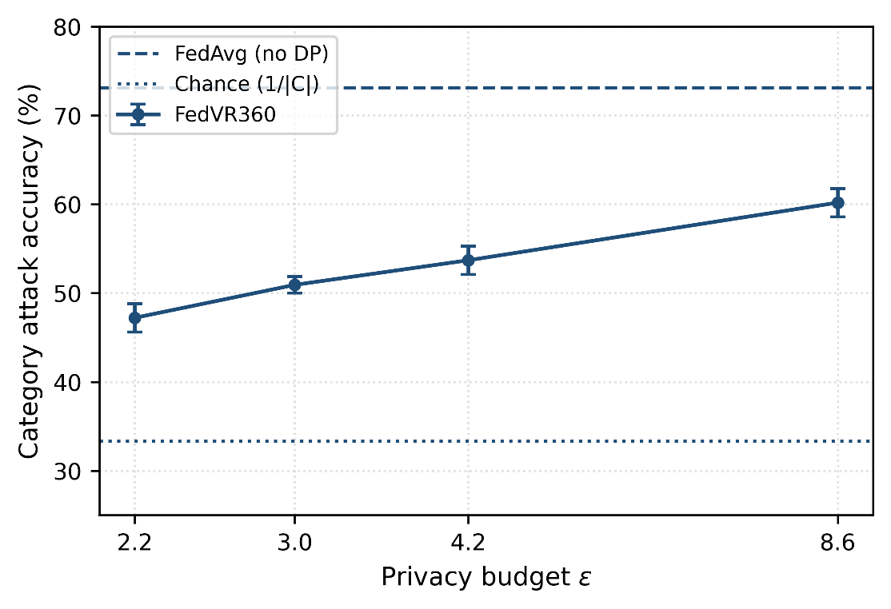
Experimental Results
Leakage
Category Attack Accuracy
Table 2 : DP Drives Membership Inference to Chance, but Content Category Still Leaks
Method | Category attack (%) | p_max | MIA (%)
Centralized | exposed by construction | n/a | 78.70
FedAvg | 73.15 | < 0.001 | 62.04
DP-FedAvg | 58.33 | 0.002 | 53.70
FedVR360 w/o pers. | 53.70 | 0.007 | 50.93
FedVR360 | 50.93 | 0.017 | 50.00
Figure 2: Attack accuracy versus ε, with chance (33.3%) and FedAvg without DP labeled directly on the plot.
Membership inference: 62.04% → 50.00% (chance)
Category inference: 50.93% vs. 33.3% chance (p ≤ 0.017 in every seed)
Lowest ε swept (2.2): 47.22%, still above chance (p = 0.038), while F1@10 drops 5.0 point
Notes:
This is our main result. The table shows leakage at epsilon of 3. Without any privacy, the RSU recovers the category of 73 percent of passengers, and membership inference is at 62 percent. Moving to FedVR360 brings membership inference down to 50 percent, which is chance, exactly as the DP definition predicts.
But the category attack is still at 50.9 percent against 33.3 percent chance, and this is significant in every seed. So protecting individual sequences does not protect content preference, the attribute that exposes cultural identity.
Figure 2 shows what happens if we add more noise. At the strongest setting we swept, epsilon of 2.2, the attack falls to 47.2 percent, which is still above chance, while viewport F1 drops by another 5 points. So suppressing category leakage through noise alone is costly. This is a three-genre proxy, so the absolute numbers are a proof of concept, but the gap between the two attacks is the point.
Our adversaries are honest-but-curious. They follow the protocol, but they try to infer private information. That includes the RSU, the cloud, and anyone who can query the released model.
The table shows where information is exposed. Raw records never leave the vehicle. The RSU aggregate and the global model are protected by aggregation and differential privacy. The weak points are two rows. First, the client update. The serving RSU sees each vehicle’s individual update, and this is where content category can leak. Second, the tile and content requests. A vehicle has to ask for what it wants to watch, and federated learning does nothing to hide that. This is the key distinction in our paper: training-time exposure, which federated learning addresses, versus delivery-time exposure, which it does not.
We evaluate two attacks. Membership inference asks whether a specific training sequence was used. Content-category inference, the focus of this paper, asks whether the RSU can recover the dominant category a passenger watches, just from their updates. Random guessing gives one over the number of categories.

Slide 9
Experimental Results
Equity
Table 3 : Personalization Recovers Most of the Utility Lost to DP and Narrows the Category Gap
Method | F1@10 ↑ | MAE ↓ | Δ_C ↓
Centralized | 0.840 | 0.274 | 0.041
FedVR360 | 0.795 | 0.297 | 0.046
FedVR360 w/o pers. | 0.758 | 0.312 | 0.058
FedAvg | 0.735 | 0.324 | 0.052
DP-FedAvg | 0.712 | 0.338 | 0.069
Utility: FedVR360 is only 4.5 points below centralized F1@10 (8.2 without personalization, 10.5 FedAvg, 12.8 DP-FedAvg)
DP widens the gap: Δ_C rises from 0.052 (FedAvg) to 0.069 (DP-FedAvg), consistent with ^{[21]}
Personalization narrows it: Δ_C falls from 0.058 to 0.046, and worst-20% F1 rises from 0.712 to 0.741
Notes:
Now the second question: does private personalization serve everyone comparably? We measure F1 at top-10 tiles, trajectory error, and two equity measures. The first is the gap between the best- and worst-served content categories. The second is the average F1 of the worst-served 20 percent of clients.
On utility, FedVR360 reaches an F1 of 0.795, only 4.5 points below centralized training, which exposes raw data. Without personalization the gap is 8 points, and DP-FedAvg is almost 13 points below.
On equity, there are two findings. First, record-level DP widens the gap between categories, from 0.052 to 0.069, consistent with what Bagdasaryan and colleagues found in other settings. Second, on-device personalization narrows it, from 0.058 to 0.046, and lifts the worst-served clients from 0.712 to 0.741. So private personalization can serve passengers more evenly when the personal layers stay on the vehicle.

Slide 10
Implications: Delivery-Time Requests Remain the Open Problem
What institutions can do
Delivery-time Exposure
Limitations
Personalize without holding raw data
Content preference is still inferable from updates (even at ε = 3.0)
Treat it as exposed: do not log or act on inferred categories
Tile requests reveal content, viewport, and location
Options: full-title caching, request mixing, private information retrieval
Not evaluated here, left as future work
Genres as proxy (48 participants, 3 categories)
Viewport and trajectory data from different subjects
Honest-but-curious adversary; ε not end-to-end
Results are a controlled proof of concept, not field estimates.
Notes:
What does this mean in practice? Federated learning lets an institution personalize without holding raw data, since raw records and personal layers stay in the vehicle. But content preference is still inferable from the updates, even at epsilon of 3, so institutions should treat that signal as exposed, for example by not logging or acting on inferred categories. This matters because museums have traditionally let visitors choose what to view without being individually recorded.
The second point is delivery-time exposure. Federated learning does not hide what is streamed. Tile requests and prefetching reveal content, predicted viewport, and location to the roadside unit and the content server. Caching complete popular titles, mixing requests across vehicles, and private information retrieval can all reduce this, at a bandwidth or latency cost. Full-title caching looks most practical near term, while private information retrieval is the strongest but too costly for real-time VR. We do not evaluate these here, and we identify delivery-time request privacy as the main open problem for private cultural streaming.
On limitations: our categories are generic video genres from 48 participants, a proxy that cannot represent real cultural content. Viewport and trajectory data come from different subjects and are paired synthetically. The adversary is honest-but-curious, and our epsilon is not end-to-end. Client-level DP would bound category inference formally, and secure aggregation would hide individual updates, but each has costs we leave to future work. So please read our numbers as a proof of concept.

Slide 11
Conclusion & Future Work
Conclusion
Future Work
Leakage: record-level DP brings membership inference to chance (50.00%), but an RSU still infers content category at 50.93% vs. 33.3% chance
Utility: FedVR360 stays within 4.5 points of centralized F1@10
Equity: DP widens the category gap; on-device personalization narrows it
Delivery: content requests remain exposed, the main open problem
Delivery-time request privacy
Client-level DP and secure aggregation against curious edge nodes
Culturally diverse in-vehicle datasets, built with cultural institutions
Thank you. Questions? (contact: shahabzkhan@bupt.edu.cn)
Notes:
To conclude. We asked whether federated learning protects the cultural attributes exposed when immersive experiences are personalized in autonomous vehicles. Record-level differential privacy suppressed membership inference to chance, but not content-category inference: a curious roadside unit recovered the dominant category with about 51 percent accuracy against 33 percent chance, while FedVR360 stayed within 4.5 points of centralized utility. DP widened the accuracy gap across categories, and on-device personalization narrowed it.
So privacy-preserving personalization is a precondition for deploying cultural services, and it must cover both what passengers’ data reveals during training and what their requests reveal during delivery. Because the roadside unit sees individual updates, record-level DP cannot bound category inference, and client-level DP and secure aggregation are the natural next step. Future work will also address delivery-time request privacy and culturally diverse in-vehicle datasets. Thank you, I am happy to take questions.

Slide 12
THANK YOU

