Slide 1

Title: “Bio-Inspired Adaptive Ensemble for Smart Fertilizer Recommendation”
Paper ID: 1779
PRESENTED BY
Om Prakash Suthar, Gaganpreet Kaur, Harsh Bhalodiya, Shonak Bansal, Manas Jakasania, Gautam Srivastava
(Marwadi University; Chitkara University; Chandigarh University; Brandon University)

Slide 2
Table of Contents
Introduction and research motivation
Literature survey and research gap
Proposed system architecture
Dataset and experimental setup
Bio-Inspired Adaptive Ensemble methodology
Results and comparative analysis
Conclusion
Limitations and future work
References

Slide 3
Introduction
The problem
Fertilizer selection based on experience or limited soil testing may lead to inappropriate nutrient application.
Over-fertilization increases costs and contributes to nutrient runoff and environmental pollution.
Under-fertilization can reduce crop productivity and soil fertility.
Soil conditions vary with moisture, temperature, pH, nutrient availability and weather.
Research motivation
Use soil and environmental data to support data-driven fertilizer selection.
Combine complementary machine learning models to improve classification performance.
Adaptively optimize the contribution of each model using Particle Swarm Optimization (PSO).
Key objective: Recommend the appropriate fertilizer category from soil and environmental characteristics.

Slide 4
Research Gap and Contributions
Research gap
Individual classifiers may differ in their ability to model complex soil–environment relationships.
Equal-weight ensemble averaging does not adapt to the relative predictive performance of individual models.
Overall accuracy alone may conceal weaker predictions for less-represented fertilizer categories.
The selected PSO-weighted combination requires empirical comparison against conventional classifiers.
Contributions
Integrates soil and environmental features with nitrogen-to-phosphorus (N/P) and phosphorus-to-potassium (P/K) ratios.
Combines Random Forest, XGBoost and LightGBM using PSO-optimized probability weights.
Compares the proposed method with seven conventional machine learning classifiers.
Evaluates overall accuracy, class-wise performance and reported ROC-AUC results.
Identifies minority-class performance and deployment efficiency as important improvement areas.

Slide 5
Literature Survey
1. IoT-Based Soil Monitoring
Soil sensors provide measurements such as moisture, pH, temperature and nutrient levels for agricultural decision support.
2. Machine Learning for Fertilizer Recommendation
KNN, SVM, decision trees and probabilistic classifiers offer alternative approaches to agricultural classification. Tree-based and boosting models can capture nonlinear feature relationships.
3. Ensemble Learning and Optimization
Ensemble learning combines predictions from multiple classifiers. PSO searches for suitable model weights against a validation objective.

Slide 6
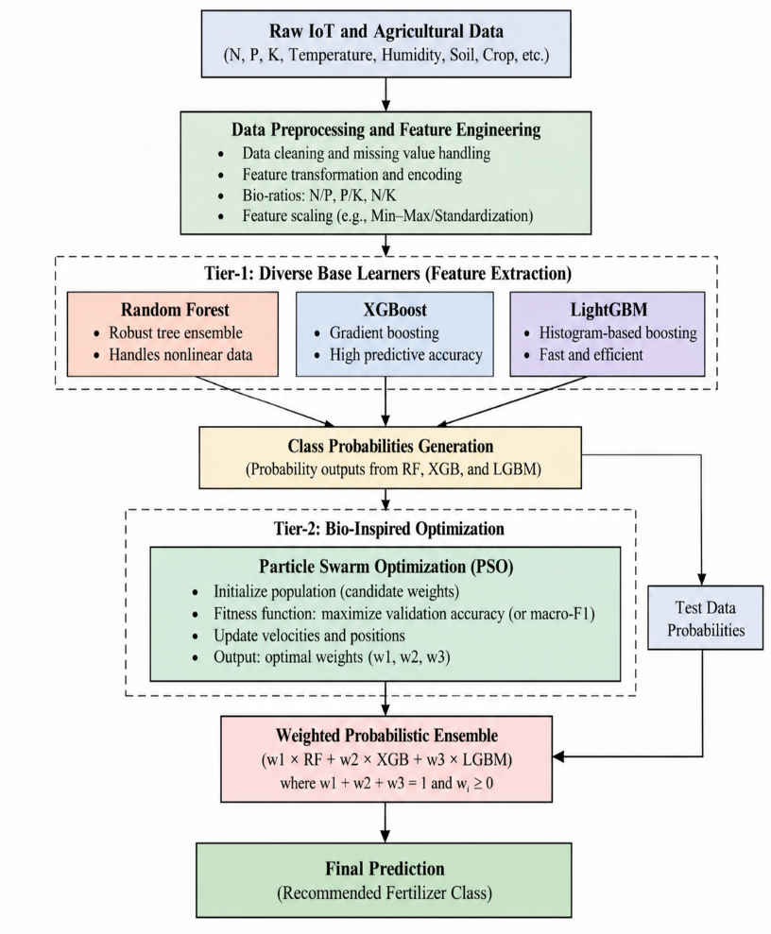
Proposed System Architecture

Slide 7
Dataset Description
Dataset overview
Total records: 98,616
Reported feature count: 19
Prediction task: Six-class fertilizer classification
Data characteristics: Soil and environmental measurements
Objective: Predict the fertilizer category corresponding to the input conditions
Important input features
Feature group | Variables
Soil properties | pH, moisture, organic carbon, electrical conductivity (EC)
Macronutrients | Nitrogen (N), phosphorus (P), potassium (K)
Environmental factors | Temperature, humidity, rainfall
Additional information | Yield history and other recorded attributes

Slide 8
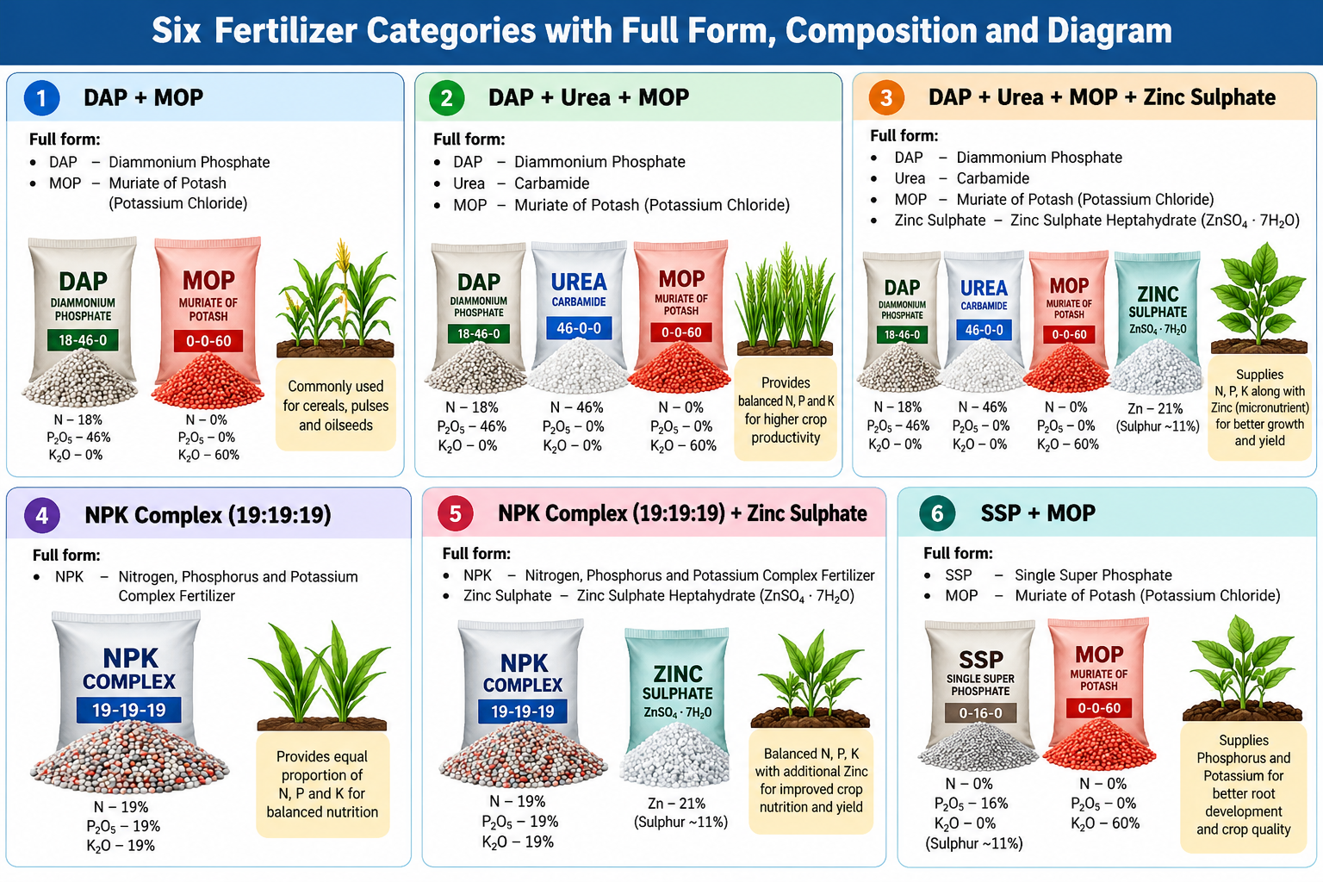
Six Fertilizer Categories

Slide 9
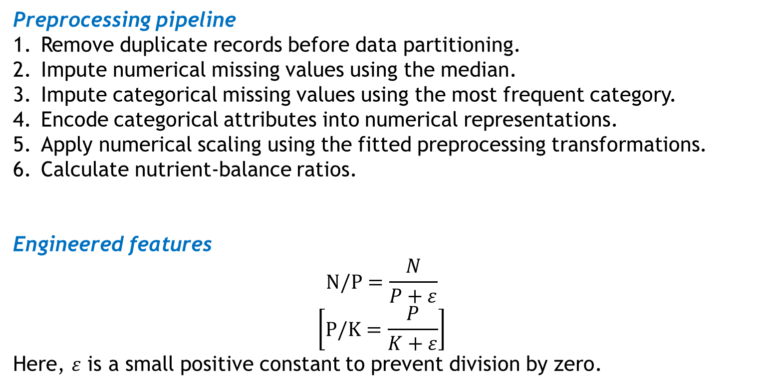
Data Preprocessing and Feature Engineering
Preprocessing pipeline
Remove duplicate records before data partitioning.
Impute numerical missing values using the median.
Impute categorical missing values using the most frequent category.
Encode categorical attributes into numerical representations.
Apply numerical scaling using the fitted preprocessing transformations.
Calculate nutrient-balance ratios.
Engineered features
$$\text{N/P}=\frac{N}{P+ε}$$
$$\left[\text{P/K}=\frac{P}{K+ε}\right]$$
Here, $ε$ is a small positive constant to prevent division by zero.

Slide 10
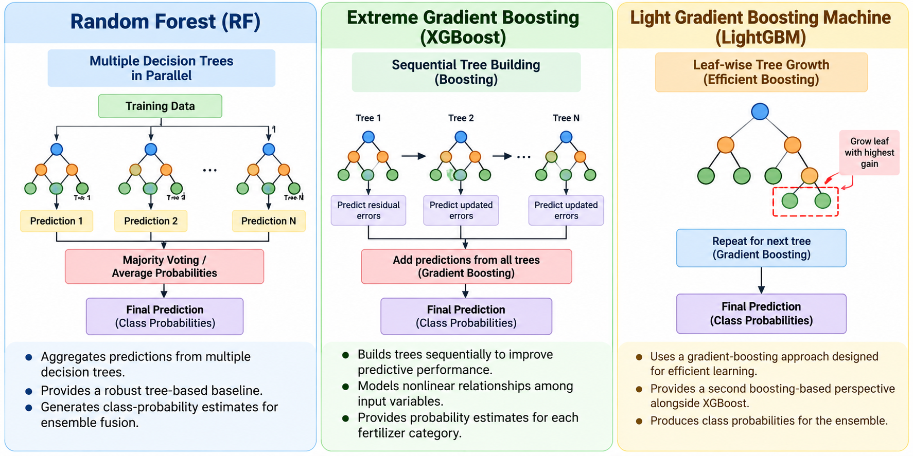
Proposed Methodology: Base Classifiers

Slide 11
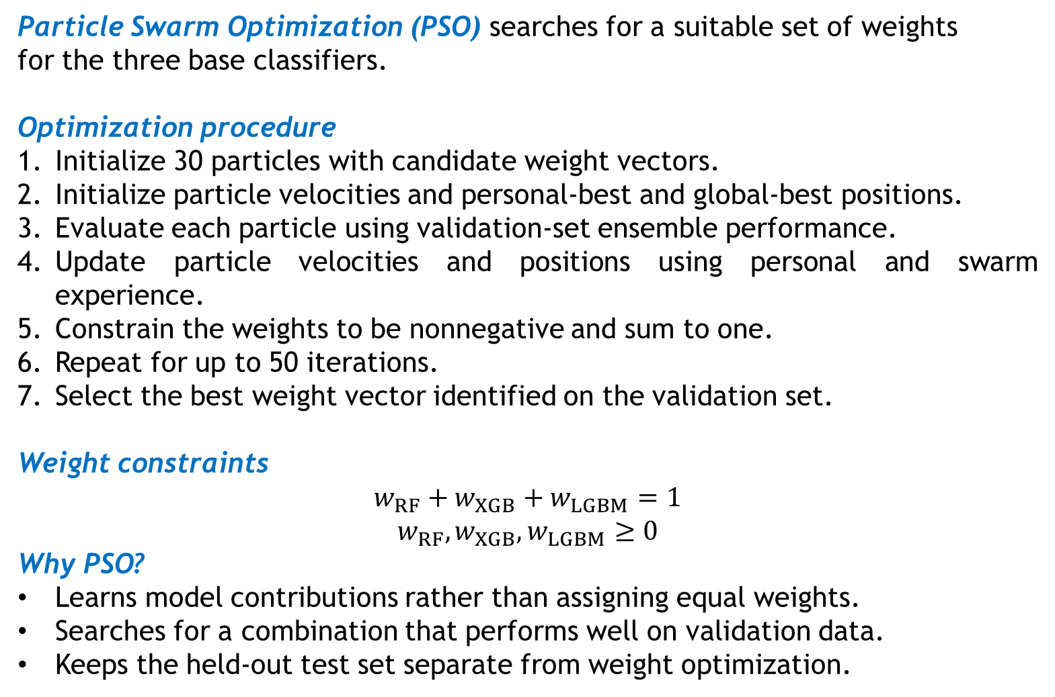
Bio-Inspired Optimization Using PSO
Particle Swarm Optimization (PSO) searches for a suitable set of weights
for the three base classifiers.
Optimization procedure
Initialize 30 particles with candidate weight vectors.
Initialize particle velocities and personal-best and global-best positions.
Evaluate each particle using validation-set ensemble performance.
Update particle velocities and positions using personal and swarm experience.
Constrain the weights to be nonnegative and sum to one.
Repeat for up to 50 iterations.
Select the best weight vector identified on the validation set.
Weight constraints
$$w_{RF}+w_{XGB}+w_{LGBM}=1$$
$$w_{RF},w_{XGB},w_{LGBM}≥0$$
Why PSO?
Learns model contributions rather than assigning equal weights.
Searches for a combination that performs well on validation data.
Keeps the held-out test set separate from weight optimization.

Slide 12
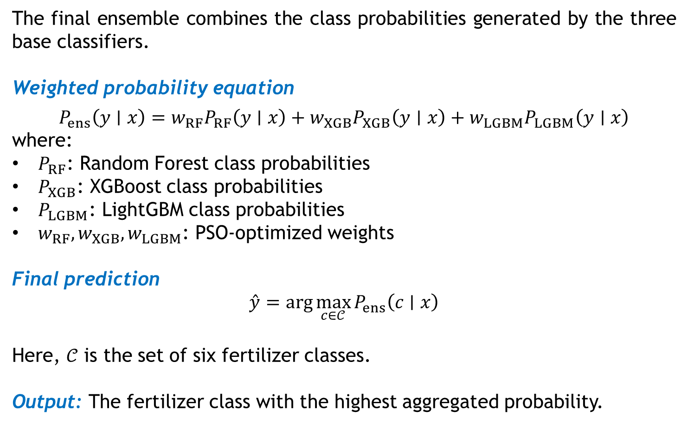
Weighted Ensemble and Prediction
The final ensemble combines the class probabilities generated by the three base classifiers.
Weighted probability equation
$$P_{ens}\left(y∣x\right)=w_{RF}P_{RF}\left(y∣x\right)+w_{XGB}P_{XGB}\left(y∣x\right)+w_{LGBM}P_{LGBM}\left(y∣x\right)$$
where:
$P_{RF}$: Random Forest class probabilities
$P_{XGB}$: XGBoost class probabilities
$P_{LGBM}$: LightGBM class probabilities
$w_{RF},w_{XGB},w_{LGBM}$: PSO-optimized weights
Final prediction
$$\overset{ˆ}{y}=\arg{\max_{c∈𝒞}{P_{ens}\left(c∣x\right)}}$$
Here, $𝒞$ is the set of six fertilizer classes.
Output: The fertilizer class with the highest aggregated probability.

Slide 13
Experimental Setup
Component | Manuscript details
Programming language | Python 3.10
Development platform | Google Colab
Operating system | Ubuntu 20.04
GPU | NVIDIA Tesla T4
ML libraries | Scikit-learn, XGBoost, LightGBM
Dataset | 98,616 records; 19 features
Models evaluated | Seven baselines and the proposed ensemble
PSO configuration | 30 particles; 50 iterations

Slide 14
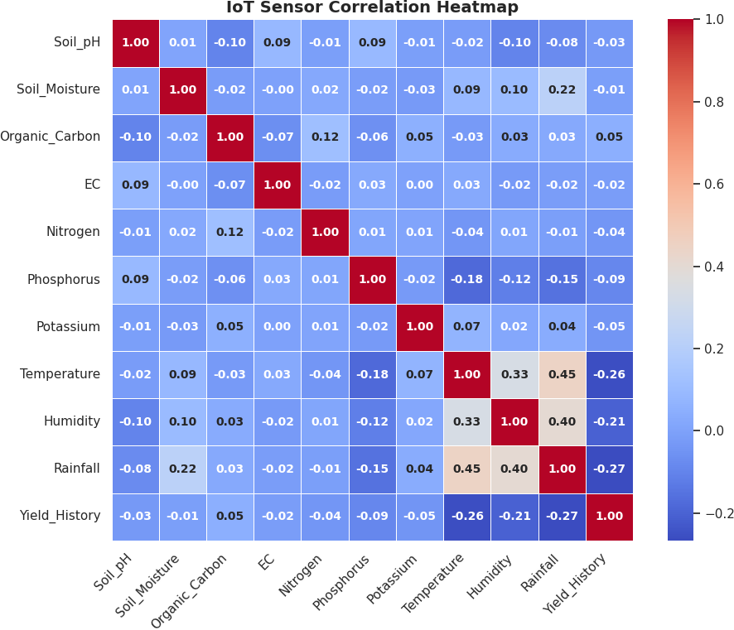
Results: Correlation heatmap
Fig. Correlation heatmap showing how strongly each pair of soil and weather features is related.

Slide 15
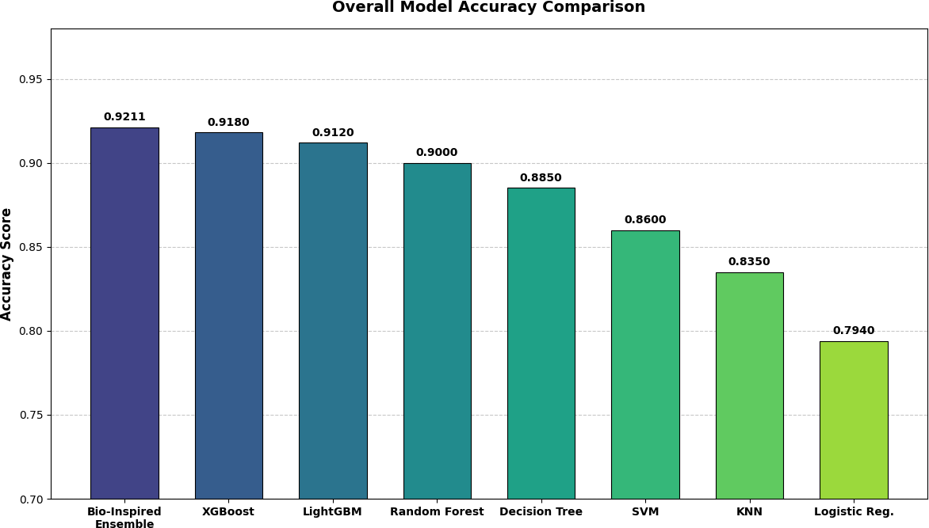
Results: Overall Accuracy Comparison
Fig. Accuracy comparison of the proposed ensemble against seven baseline models..

Slide 16
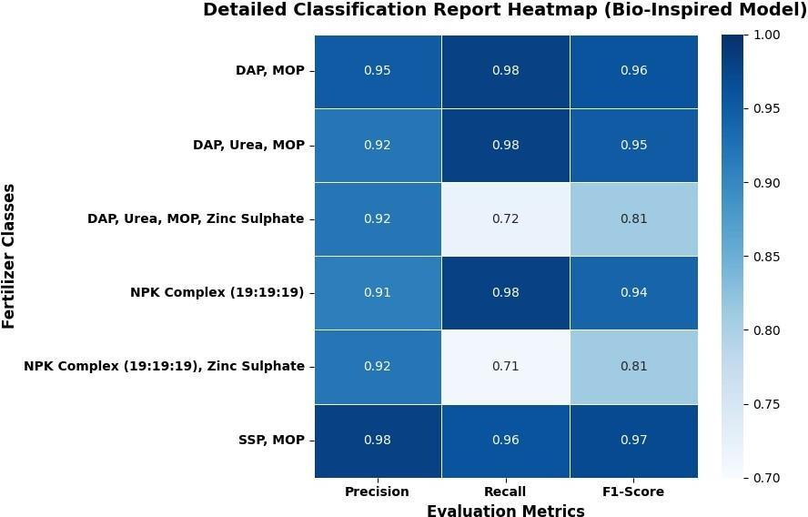
Results: Detailed Classification Report
Fig. Detailed Classification Report (Bio-Inspired Model).

Slide 17
Result Per Class Prediction Counts
Fertilizer Class | TP | TN | FP | FN
DAP, MOP | 642 | 28895 | 23 | 25
DAP, Urea, MOP | 10271 | 18177 | 805 | 332
DAP, Urea, MOP, Zinc S. | 2564 | 25884 | 332 | 805
NPK Complex | 9428 | 18896 | 945 | 316
NPK Complex, Zinc S. | 2153 | 26226 | 292 | 914
SSP, MOP | 2077 | 27397 | 53 | 58

Slide 18
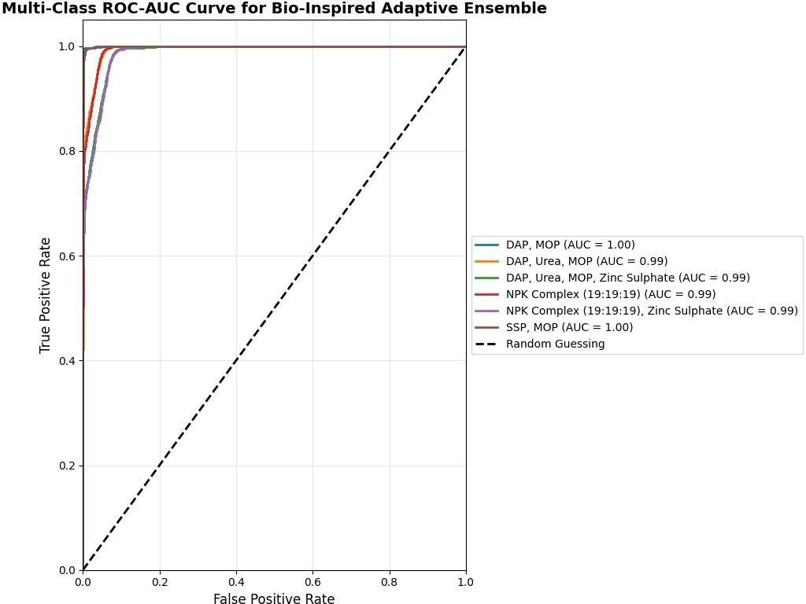
Results: ROC-AUC and Testing Outcomes
Fig. : Multi-class ROC-AUC curve of the proposed Bio-Inspired Adaptive Ensemble

Slide 19
Conclusion
Presented a Bio-Inspired Adaptive Ensemble for smart fertilizer-category recommendation.
Combined Random Forest, XGBoost and LightGBM using PSO-optimized probability weights.
Incorporated N/P and P/K nutrient-balance ratios into the feature-engineering pipeline.
Evaluated the framework on 98,616 records and compared it with seven baseline classifiers.
Achieved a reported overall accuracy of 92.11%, exceeding the best reported individual baseline, XGBoost, by 0.31 percentage points.
Identified class imbalance and deployment efficiency as important areas for further investigation.

Slide 20
Limitations and Future Work
Current limitations
Evaluation relies on the dataset used in the study; generalization to other regions and climates remains unverified.
Less-represented zinc-sulphate categories show lower recall.
The three-model ensemble requires more computation than a single lightweight classifier.
The output identifies a fertilizer category, not a crop-specific dosage or application rate.
Future research directions
Validate the model on independent datasets from different geographic and climatic conditions.
Investigate class balancing and synthetic sample generation for minority classes.
Optimize inference cost for resource-constrained or edge devices.
Integrate reliable real-time weather and satellite information.
Develop farmer-friendly explanations of recommendations.
Validate recommendations with agronomic experts and field trials before practical deployment.

Slide 21
References
S. Sundaresan, S. Daniel Johnson, V. Mani Bharathy, P. Mohan Pavan Kumar, and M. Surendar, “Machine learning and IoT-based smart farming for enhancing the crop yield,” Journal of Physics: Conference Series, vol. 2466, no. 1, Art. no. 012028, Mar. 2023, doi: 10.1088/1742-6596/2466/1/012028
M. Sunandini, K. Hema Sree, R. Deepiga, and A. Gokulapriya, “Smart Soil Fertilizer Monitoring and Crop Recommendation System by Using IoT and Machine Learning Technology,” International Journal of Engineering Research & Technology (IJERT), vol. 12, no. 3, Mar. 2023.
R. Prabavathi, P. Sundaravadivel, M. Bhuvaneswari, V. Sharvani, and K. Roshini, “IoT Based Soil pH Detection and Crop Recommendation System,” International Journal of Innovative Science and Research Technology (IJISRT), 2024. [Online]. Available: https://api.semanticscholar.org/CorpusID:269287620
G. Saha, S. H. Suvo, F. T. Tonmoy, J. B. Asad, M. T. Imran and A. A. M. Azad, "Smart Soil Monitoring System With Crop and Fertilizer Recommendation Features," 2024 IEEE 13th International Conference on Communication Systems and Network Technologies (CSNT), Jabalpur, India, 2024, pp. 1190-1196, doi: 10.1109/CSNT60213.2024.10545921.
G. Vijender Reddy, M. Venkata Krishna Reddy, K. Spandana, Y. Subbarayudu, A. Albawi, R. Chandrashekar, A. Singla, and Praveen, “Precision farming practices with data-driven analysis and machine learning-based crop and fertiliser recommendation system,” E3S Web of Conferences, vol. 507, Art. no. 01078, 2024, doi: 10.1051/e3sconf/202450701078.
P. Ediga, H. Cheemakurthy, M. Kaslavada, M. Hajari, H. Alabdeli, V. Revathi, M. Gupta, and B. Pratap, “Smart Cultivation with IoT Monitoring and Fertilizer Recommendation System with Climatic Conditions,” E3S Web of Conferences, vol. 507, Art. no. 01054, 2024, doi: 10.1051/e3sconf/202450701054.

Slide 22
References
Y. Paliwal and S. K. Upadhyay, “Crop and Fertilizer Recommendation System Using Machine Learning,” in Proceedings of Data Analytics and Management (ICDAM 2025), A. Swaroop, B. Virdee, S. D. Correia, and Z. Polkowski, Eds., Lecture Notes in Networks and Systems, vol. 1600. Cham, Switzerland: Springer, 2026, doi: 10.1007/978-3-032-03072-6_45
H. Sugeru, E. P. Wibowo, P. Musa, R. K. Harahap, and S. Harmanto, “Integrating IoT and machine learning for real-time soil-based crop and fertilizer recommendations: The UG-AgroPlan system,” Preprints.org, Sep. 24, 2025. [Online]. Available: https://doi.org/10.20944/preprints202509.2044.v1
C. K. Shettigar, D. Pemmaiah K., Kiran, S. K. S., and S. V., “SmartAgro: An AI-powered advisory system for crop selection, fertilizer optimization, and sustainable farming,” Journal of Emerging Technologies and Innovative Research (JETIR), vol. 12, no. 7, Jul. 2025, Art. no. JETIRGX06159. [Online]. Available: https://www.jetir.org/papers/JETIRGX06159.pdf
B. S. Bere and V. B. Tamhane, “Review on AI-driven smart agriculture: An integrated approach for soil analysis, irrigation, and crop-fertilizer recommendations,” International Journal of Innovative Research in Technology (IJIRT), vol. 12, no. 6, p. 1361 et seq., Nov. 2025. [Online]. Available: https://ijirt.org/publishedpaper/IJIRT186626_PAPER.pdf
G. Saravanan, M. Amshavalli, T. Lithan, M. Manoj Kumar, and S. M. Rohith Kumar, “Machine Learning–Based Fertilizer Recommendation System Using Soil and Climate Parameters,” International Journal of Engineering & Extended Technologies Research (IJEETR), vol. 8, no. 2, pp. 699–706, Mar. 2026, doi: 10.15662/IJEETR.2026.0802024
S. Iniyan, M. S. Raja, R. Srinivasan, C. Santhanakrishnan and A. Srinivasan, "Crop and Fertilizer Recommendation System Applying Machine Learning Classifiers," 2023 International Conference on Emerging Research in Computational Science (ICERCS), Coimbatore, India, 2023, pp. 1-6, doi: 10.1109/ICERCS57948.2023.10433972.
A. Inuganti and J. Vankara, “Crop and Fertilizer Recommendation System,” International Journal of Emerging Technologies and Innovative Research (JETIR), vol. 11, no. 8, pp. a204–a213, Aug. 2024. [Online]. Available: https://www.jetir.org/papers/JETIR2408023.pdf.

Slide 23
Thank You
Any Questions ???

