Slide 1
Attention-Augmented Transfer Learning Framework for Explainable Plant Disease Classification
EXPLAINABLE AI IN AGRICULTURE
Richa Sharma, Prabhjot Kaur, Charanjit Singh, Naveen Bhatnagar, Gautam Srivastava
Chandigarh University · Galgotia University · Brandon University

Slide 2
Motivation and research gap
Problem
Gap
Goal
Plant diseases cut crop yield and quality
Heavy economic losses for farmers and industry
Threat to global food security
Manual diagnosis is slow, subjective and hard to scale
Studies chase accuracy, with limited interpretability
Attention models are often not explainable
XAI work rarely uses advanced feature learning
Few frameworks unify transfer learning, attention and XAI
Accurate and robust disease diagnosis
Transparent, trustworthy predictions
Low computational cost
Ready for precision agriculture
Attention-Augmented Transfer Learning for Plant Disease Classification · 2

Slide 3
Related work
Ref. | Author & Year | Focus | Methodology | Dataset | Key Achievement | Limitation
[1] | Alramli and Tekerek (2025) | Plant disease classification | Transfer Learning + Self-Attention | PlantVillage | Lightweight and accurate classification framework | Limited explainability
[15] | Alhammad et al. (2025) | Explainable disease diagnosis | CNN + XAI | Potato Leaf Dataset | Improved model transparency | Focused on a single crop
[16] | Ahmad et al. (2020) | Tomato disease detection | Optimized Pretrained CNNs | Tomato Leaf Dataset | Effective transfer learning strategy | No attention mechanism
[20] | Tiwari et al. (2021) | Multiclass disease classification | Dense CNN | Plant Leaf Images | Improved feature extraction | Computationally intensive
[18] | Ashwinkumar et al. (2022) | Lightweight disease recognition | MobileNet-based CNN | Plant Leaf Dataset | Fast inference and deployment | Reduced interpretability
[21] | Thakur et al. (2023) | Transformer-based classification | CNN + Vision Transformer | PlantVillage | Enhanced global feature learning | High computational cost
[22] | Hemalatha et al. (2024) | Disease localization and classification | Multitask Vision Transformer | Plant Disease Images | Simultaneous localization and classification | Limited explainability support
[14] | Nigar et al. (2024) | Explainable disease prediction | Deep Learning + XAI | Plant Disease Dataset | Better transparency and trust | No attention-guided transfer learning
TABLE I. Comparative analysis of recent plant disease classification studies
Attention-Augmented Transfer Learning for Plant Disease Classification · 3

Slide 4
Key contributions
1 Framework
2 Explainability
3 Evaluation
4 Deployability
EfficientNetV2-based transfer learning enhanced with a self-attention block to improve plant disease classification.
Grad-CAM heat maps show Grad-CAM visualizations give transparent interpretation by showing the diseased regions behind each prediction. leaf regions drive each prediction.
99.12% accuracy on PlantVillage, a 2.02% gain over the base self-attention transfer learning model.
High accuracy, low computational cost and explainability in one framework for future smart agriculture deployment.
Attention-Augmented Transfer Learning for Plant Disease Classification · 4

Slide 5
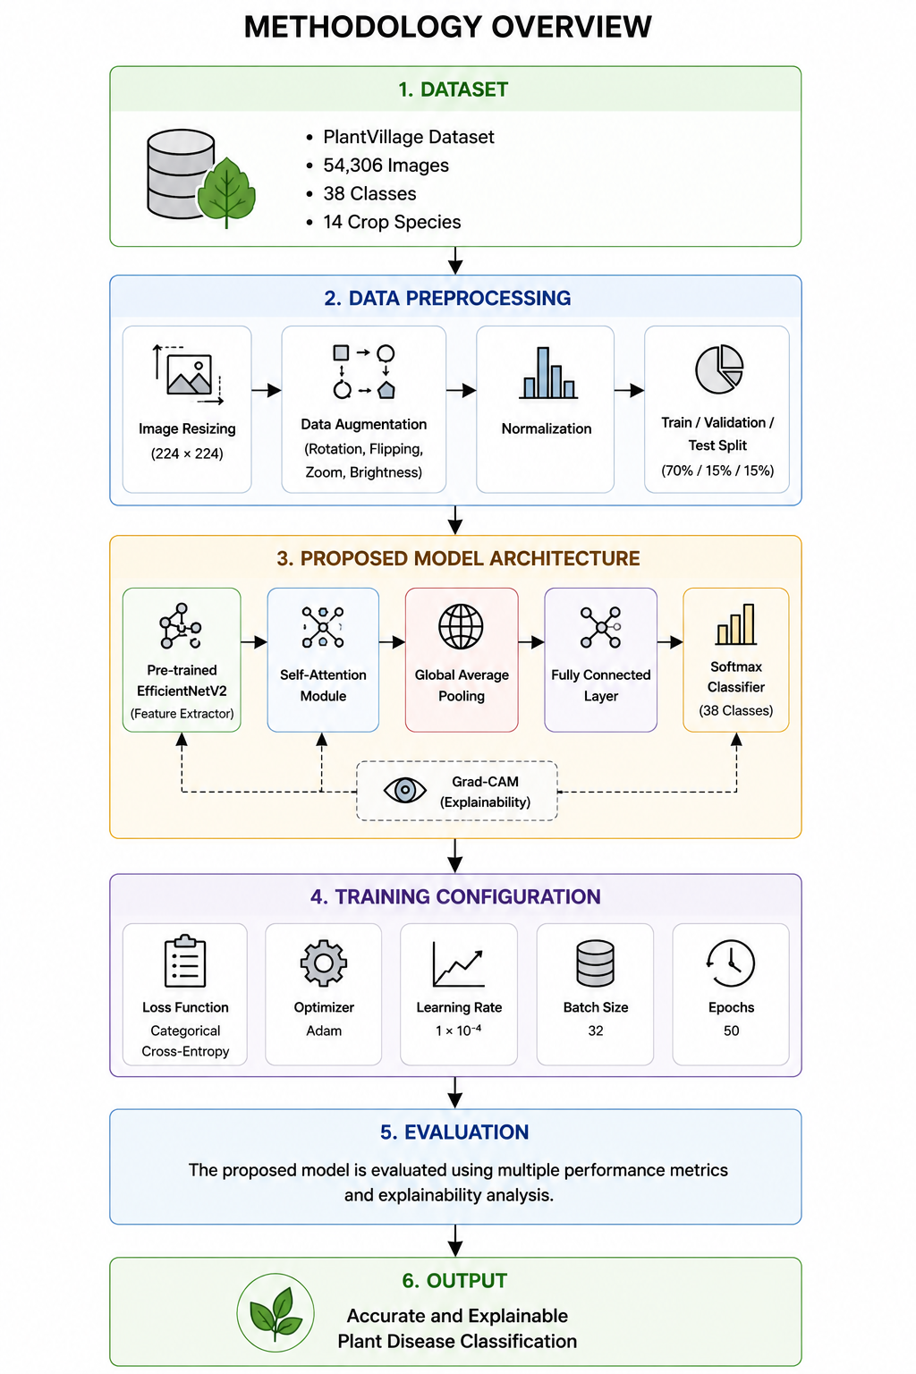
Methodology overview
Six stages
Data acquisition
Preprocessing
Transfer-learning feature extraction
Self-attention enhancement
Classification
Explainable prediction (Grad-CAM)
Attention-Augmented Transfer Learning for Plant Disease Classification · 5
Fig. 1. Proposed Attention-Augmented Transfer Learning Framework for Explainable Plant Disease Classification.

Slide 6
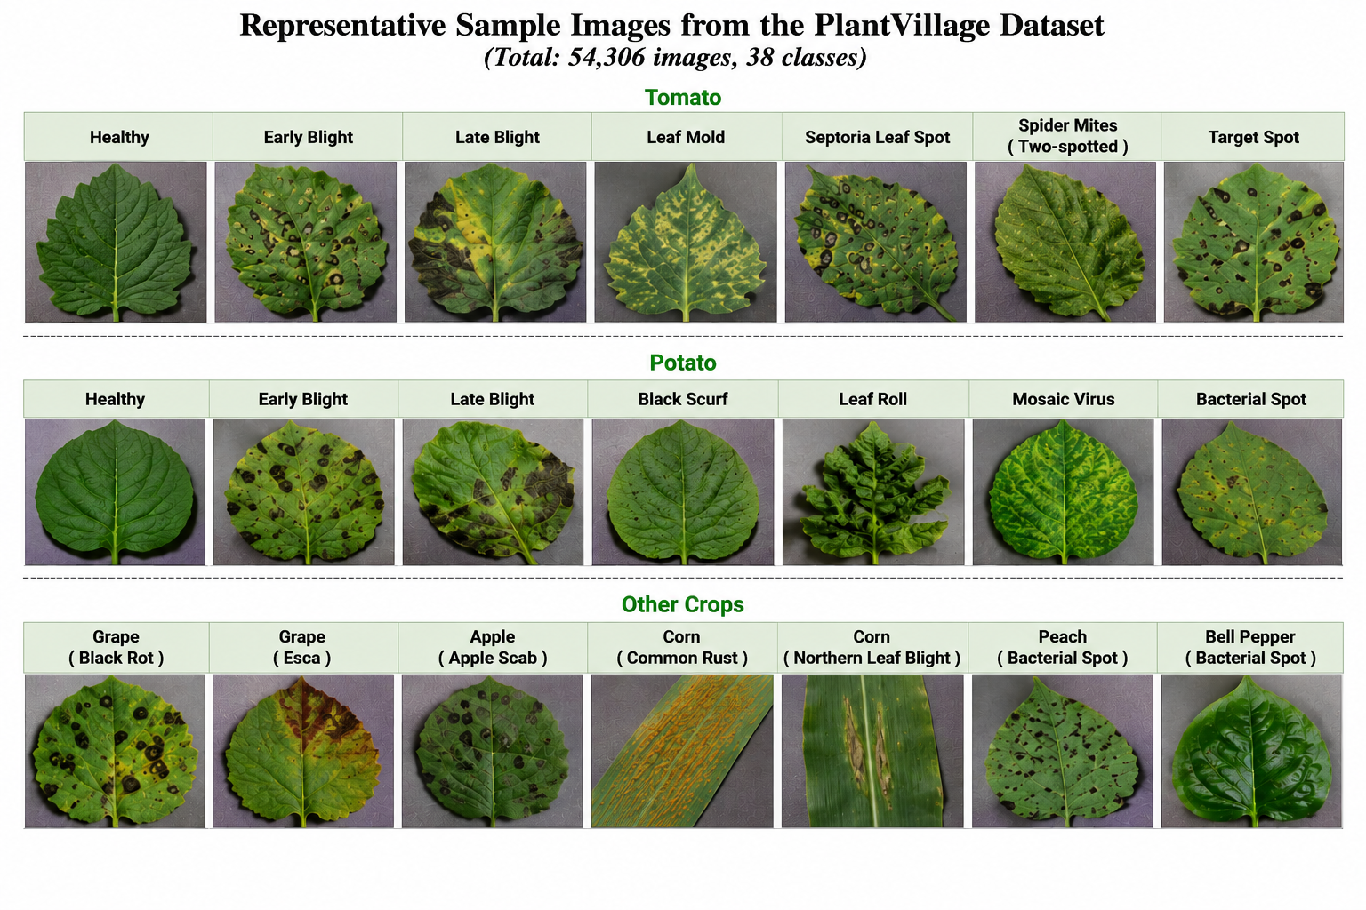
Dataset and preprocessing
PlantVillage: about 54,306 RGB leaf images
38 classes across 14 crop species
Resized to 224 × 224, normalized to [0, 1]
Augmentation: rotation, flip, zoom, brightness
Split 70 : 15 : 15 (train / validation / test)
Fig. 2. Representative sample images from the PlantVillage dataset: healthy and diseased leaves.
Attention-Augmented Transfer Learning for Plant Disease Classification · 6

Slide 7
Model architecture
EfficientNetV2 backbone
Self-attention module
Pretrained feature extractor: F = f(X) (Eq. 1)
Chosen for best accuracy per parameter
Transfer learning cuts training cost and time
Attention(Q, K, V) = Softmax(QKᵀ/√dₖ) V (Eq. 2)
Q, K, V: query, key, value; dₖ: key dimension
Focuses on infected areas, suppresses background
Classifier head
Training loss
Global average pooling, fully connected layers, then softmax over C = 38 classes.
Categorical cross-entropy: L = −Σ yᵢ log(ŷᵢ) (Eq. 4)
Optimized with Adam, learning rate 0.001
Bayesian-inspired tuning of learning rate, batch size, dropout
Attention-Augmented Transfer Learning for Plant Disease Classification · 7

Slide 8
Experimental setup
Training
Environment
Evaluation
Adam optimizer, learning rate 0.001
Categorical cross-entropy loss
Bayesian optimization-inspired tuning: learning rate, batch size, dropout
70 : 15 : 15 data split
Python 3.11
TensorFlow and Keras
Scikit-learn, NumPy, Pandas
Matplotlib and OpenCV
GPU-accelerated training
Accuracy, precision, recall, F1-score
Training and validation accuracy curves
Confusion matrix for per-class behaviour
Grad-CAM attention maps for explainability
Attention-Augmented Transfer Learning for Plant Disease Classification · 8

Slide 9
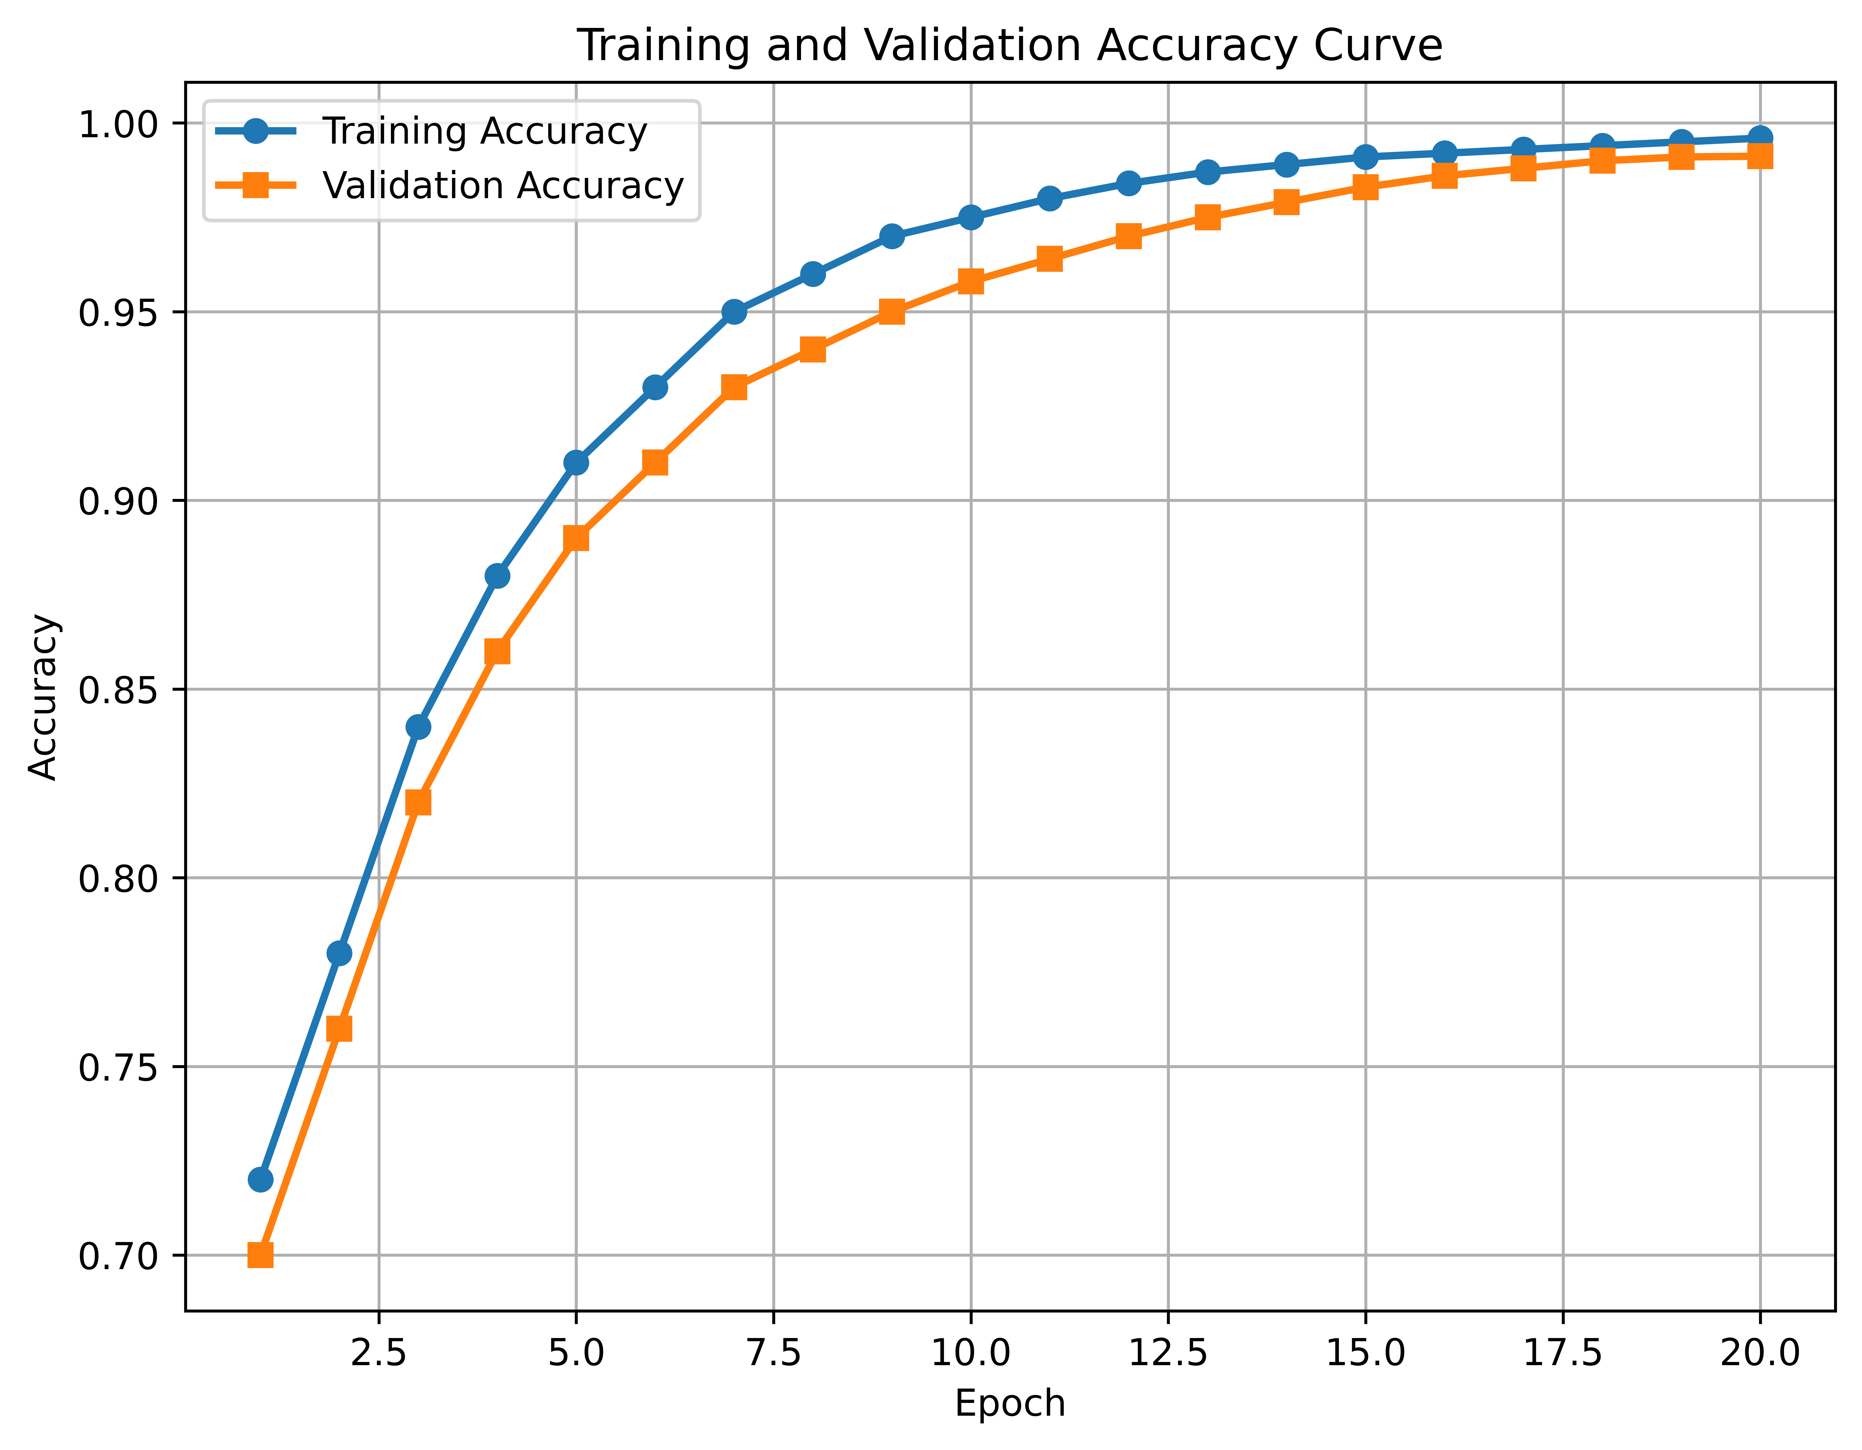
Results: comparison with the base paper
Method | Acc. | Prec. | Rec. | F1
Base paper [1] | 97.10 | 96.80 | 96.70 | 96.75
Proposed | 99.12 | 98.94 | 98.87 | 98.90
All values in %. Accuracy gain of +2.02% and gains across precision, recall and F1.
Fig. 3. Training and validation accuracy curves.
Attention-Augmented Transfer Learning for Plant Disease Classification · 9

Slide 10
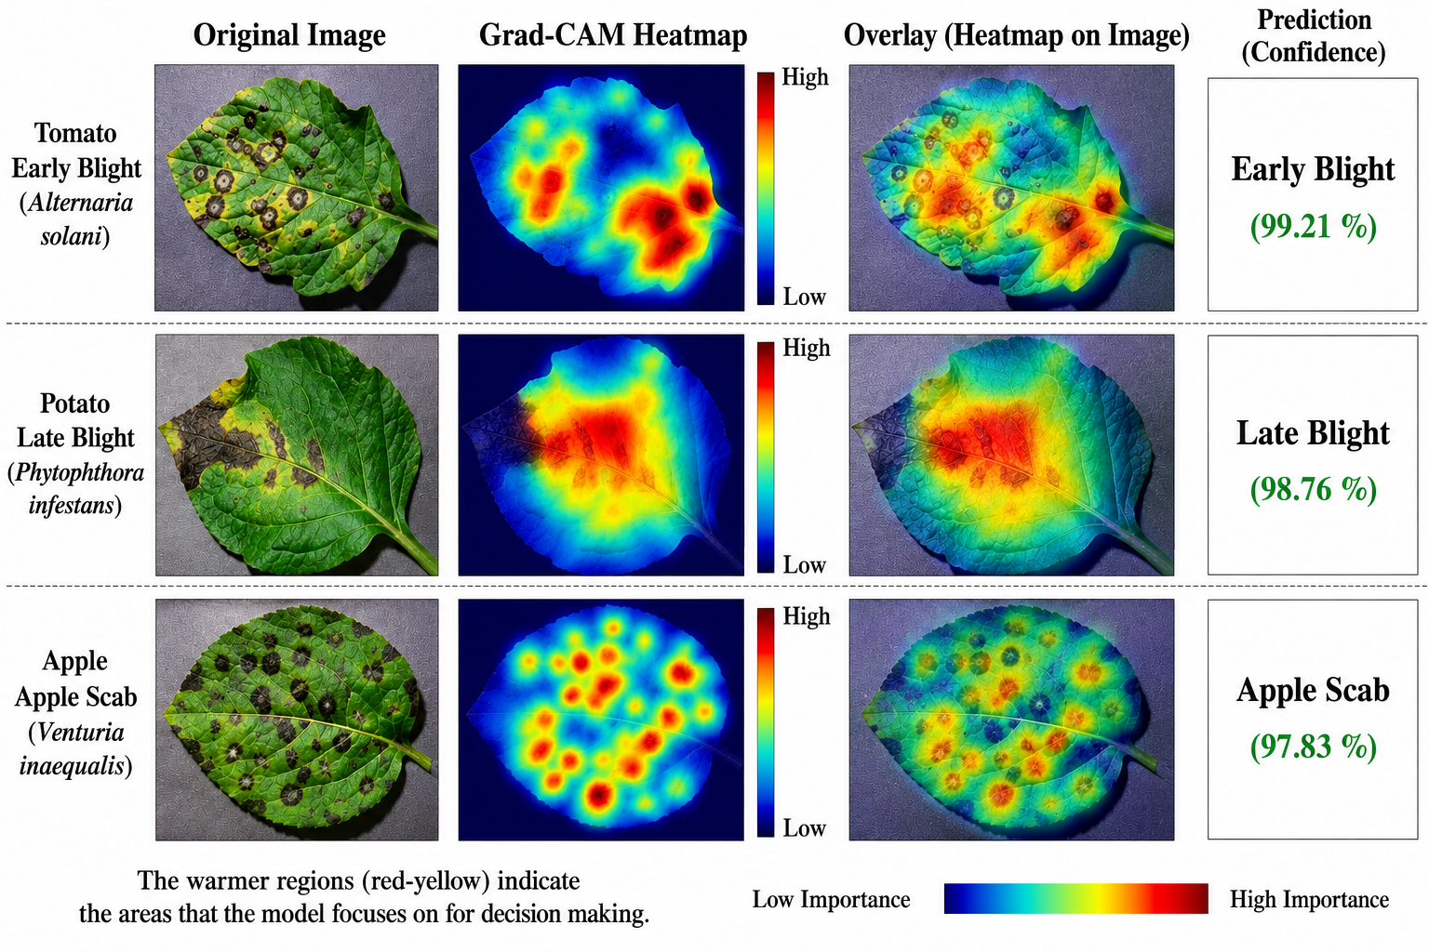
Explainability with Grad-CAM
Heat maps align with observed infection symptoms
Warm (red-yellow) areas mark high importance
Tomato early blight: 99.21% confidence
Potato late blight: 98.76% confidence
Apple scab: 97.83% confidence
Builds user trust in smart farming use
Fig. 4. Grad-CAM visualization highlighting disease-affected leaf regions.
Attention-Augmented Transfer Learning for Plant Disease Classification · 10

Slide 11
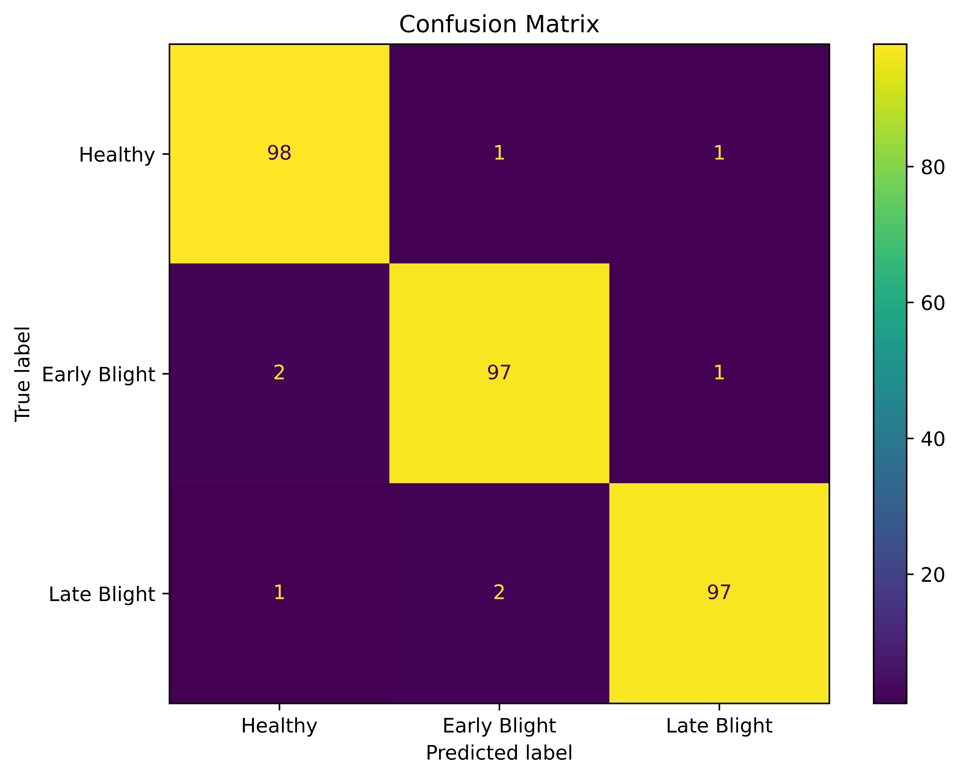
Classification performance
Diagonal dominates: about 97–98 correct per class shown
True-positive rates high for most classes
Only minor confusion between visually similar diseases
Training and validation curves converge without large gaps
Good generalization on unseen test samples
Fig. 5. Confusion matrix of the proposed framework.
Attention-Augmented Transfer Learning for Plant Disease Classification · 11

Slide 12
Conclusion and future work
Conclusion
Future work
The paper proposed an Attention-Augmented Transfer Learning Framework that combines an EfficientNetV2 backbone, self-attention feature enhancement and Grad-CAM.
It reaches 99.12% accuracy, 98.94% precision, 98.87% recall and 98.90% F1 on PlantVillage.
Accuracy is 2.02% higher than the base paper (97.10%).
Grad-CAM heat maps highlight the infected leaf regions, which builds user trust in the predictions.
Pretrained features speed up convergence, attention focuses on diseased areas, and explainability makes the model more reliable and interpretable.
IoT sensor integration: combine leaf images with environmental and soil sensor data for better disease prediction.
Edge deployment: run the model in real time on smartphones, drones and edge devices.
Multimodal analysis: add weather, humidity and temperature to the image data for more robust classification.
Attention-Augmented Transfer Learning for Plant Disease Classification · 12

Slide 13
THANK YOU

