Slide 1

From Benchmark Saturation to Model Discrimination Evaluating Ten Open-Source Embedding Models for Thai Dense Retrieval
Natdanai Kiewwath¹ · Rattasit Sukhahuta²
¹ Faculty of Business Administration, Maejo University, Thailand
² Faculty of Science, Chiang Mai University, Thailand
The 9th International Conference on Culture Technology 2026, Shanghai University of Engineering Science, Shanghai, China
Notes:
Good morning everyone. I’m Natdanai Kiewwath from Maejo University, Thailand. Today, I’d like to share a research experience that my coauthor and I found quite interesting. Our study started with a simple goal: comparing open-source embedding models for Thai dense retrieval. But during our initial experiments, we noticed something unexpected: many models were getting very high scores. That made us wonder, are all these models really that good, or is our benchmark simply too easy? And that is the main story I would like to share today.

Slide 2

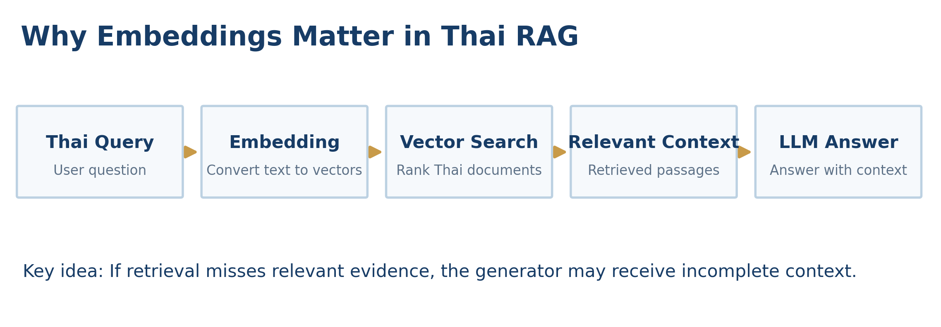
Why Thai Dense Retrieval Matters
Reliable RAG Starts with Reliable Retrieval
• Retrieval supplies relevant context before LLM answer generation
• Thai has word-boundary and document-processing challenges
• Model selection requires reliable evaluation
Notes:
Let me start with a little background. Today, Retrieval-Augmented Generation, or RAG, helps language models answer questions using external documents. But before a language model generates an answer, the system needs to find relevant information. This is where embedding models play an important role. Thai brings additional challenges, because words are not consistently separated by spaces and documents can have different formatting patterns. We also have many open-source choices: multilingual, regional and lightweight models. So the practical question is, which model should we choose for Thai retrieval? To answer that question, we first need a reliable evaluation.

Slide 3

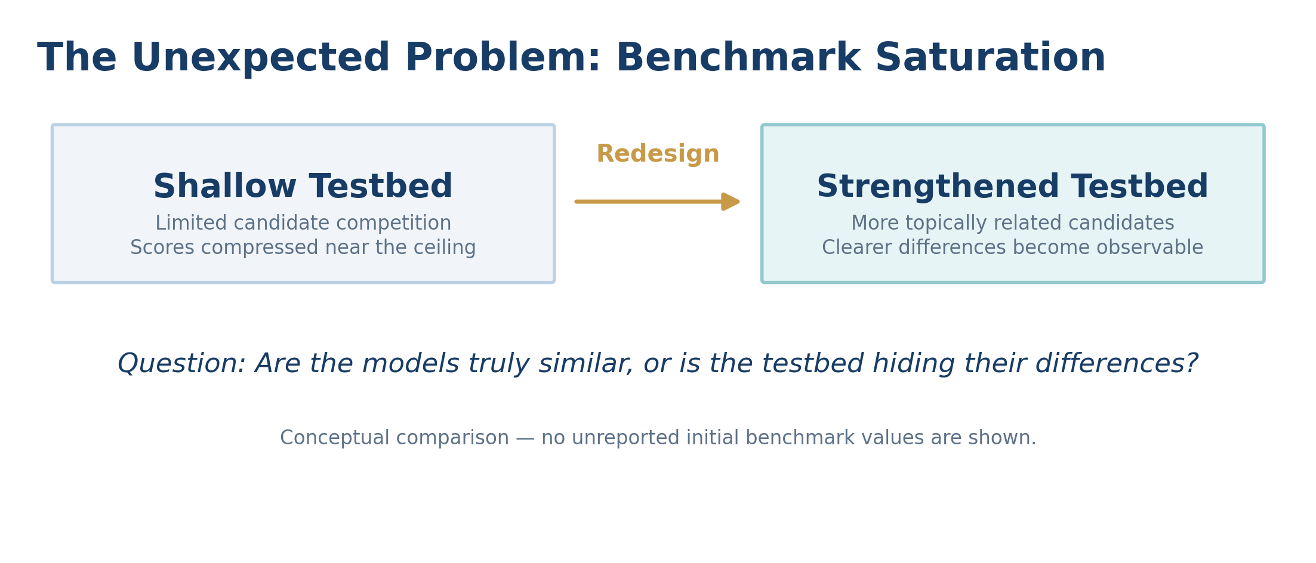
The Unexpected Problem: Benchmark Saturation
When High Scores Become Misleading
A shallow benchmark can hide meaningful differences.
“High scores do not necessarily mean strong model discrimination.”
Notes:
When we began evaluating the models, the scores for many systems approached their maximum values. At first that might sound like good news. But if almost every model performs very well, it becomes difficult to identify meaningful differences. Imagine a classroom where nearly every student receives a perfect exam score. Does that mean all students have the same ability? Not necessarily; the exam may simply be too easy. We realized the same problem could affect embedding evaluation. In the initial setting, the candidate pool was too shallow relative to the evaluation depth, leaving too few opportunities for ranking errors to become visible. We call this benchmark saturation. Rather than immediately declaring a winner, we decided to improve the benchmark first.

Slide 4
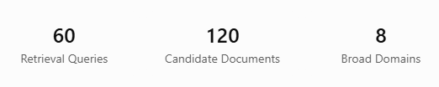
From Saturation to Discrimination
Strengthening the Retrieval Benchmark
• More topically related competitors
• More opportunities for ranking errors
• More informative comparisons
Notes:
So what did we change? We strengthened the benchmark by expanding the retrieval testbed to 60 queries and 120 candidate documents across eight broad domains. We also included multiple topically related documents within those domains. This matters because a model must distinguish truly relevant documents from others that sound similar. By increasing competition among candidates, the benchmark offers more opportunities for differences in ranking quality to appear. Our goal was not simply to make the dataset larger. It was to make the evaluation more informative: to move from saturation toward model discrimination.

Slide 5
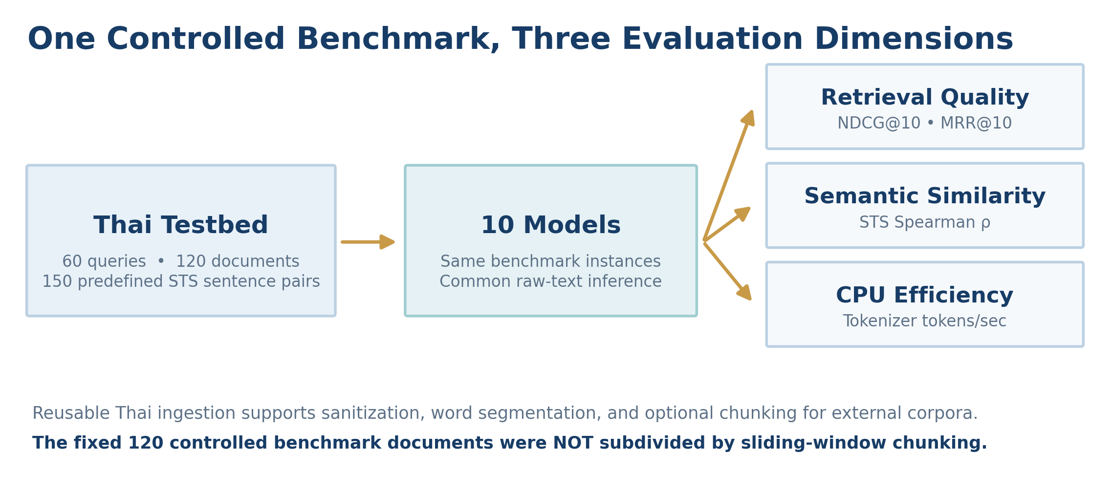
Our Evaluation Framework
One Controlled Benchmark, Three Evaluation Dimensions
10 Open-Source Embedding Systems
Dense Retrieval (NDCG, MRR) · Semantic Textual Similarity (150 pairs) · CPU Inference Efficiency
Same fixed documents, queries and raw-text protocol
Notes:
ข้อความเน้นด้านล่าง:
“High scores do not necessarily mean strong model discrimination.”
Let me briefly explain our framework. We selected ten open-source embedding systems from different families: multilingual, regional, Thai-native and lightweight. All ten were evaluated on the same controlled collection. We considered three dimensions: dense retrieval effectiveness, using ranking metrics such as NDCG and MRR; Semantic Textual Similarity, using 150 predefined Thai sentence pairs; and CPU inference efficiency. Our harness also supports Thai sanitization, segmentation and optional chunking for external corpora. However, the fixed 120 benchmark documents were evaluated directly, without additional sliding-window subdivision. This distinction helps preserve a common comparison.

Slide 6
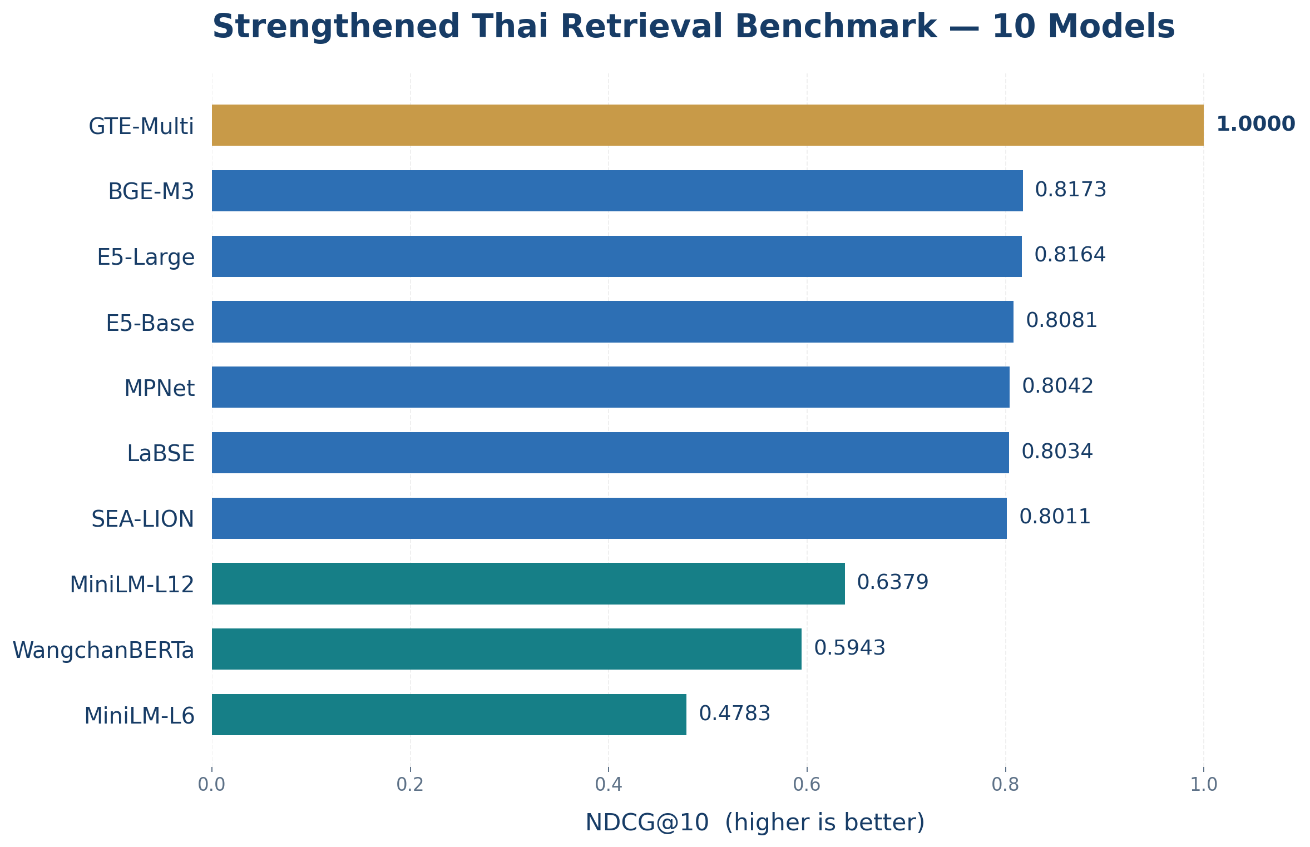
What Changed in the Results?
Clearer Differences After Strengthening the Benchmark
NDCG@10 range: 0.4783–1.0000
GTE reached the ceiling of this controlled testbed; other models separated.
Notes:
“GTE reaches the ceiling of this controlled benchmark, while the remaining models show wider performance differences.”
ใจความภาษาไทย: ให้กราฟเป็นตัวเล่าเรื่อง ไม่ต้องอ่านค่าของทุกโมเดล แนะนำให้เน้น GTE ที่ได้คะแนนเต็ม, BGE-M3/E5-Large ที่ได้คะแนนใกล้กัน และกลุ่มโมเดลอื่นที่มีคะแนนลดหลั่นกัน
ช่วงนี้ควรเน้นว่า คะแนนเต็มของ GTE เป็นผลเฉพาะ Benchmark นี้ ไม่ใช่หลักฐานว่าเป็นโมเดลที่ดีที่สุดสำหรับทุกงานภาษาไทย
Now let us look at the results. After strengthening the benchmark, we observed much clearer differences among the ten models. NDCG at ten ranged from around 0.48 to 1.00. GTE Multilingual Base reached the maximum score on this controlled collection. BGE-M3 and Multilingual-E5 Large were close to 0.82, several multilingual models were around 0.80, and others scored lower. This separation was largely concealed in the initial shallow setting. But I want to emphasize one point. GTE reaching 1.00 does not mean it is perfect for every Thai retrieval task. It means the model reached the ceiling on this specific benchmark. We reduced saturation across the model pool, while a model-specific ceiling remained.

Slide 7
What Did We Learn About the Models?
Same Dimension, Different Retrieval Performance
Model | Dimensions | NDCG@10 | STS ρ
GTE-Multilingual | 768 | 1.0000 | 0.9287
E5-Base | 768 | 0.8081 | 0.4991
WangchanBERTa | 768 | 0.5943 | 0.2790
Training Objectives Matter
General language models and retrieval-specialized encoders are not directly equivalent.
Notes:
Beyond the benchmark, we learned something interesting about the models. Embedding dimensionality alone did not explain retrieval quality. Several systems generated 768-dimensional vectors, yet performed very differently. GTE reached the benchmark ceiling, whereas E5-Base, MPNet, LaBSE and SEA-LION were around 0.80 in NDCG. WangchanBERTa scored lower in our standardized evaluation. But this does not mean Thai-specific language modeling is ineffective. WangchanBERTa is a Thai foundation model, not a sentence encoder specifically optimized for retrieval. In the STS task, GTE also led with Spearman correlation around 0.93, while BGE-M3 and E5-Large were both around 0.52. The practical lesson is that model size, language coverage and embedding dimensions cannot replace task-specific evaluation.

Slide 8
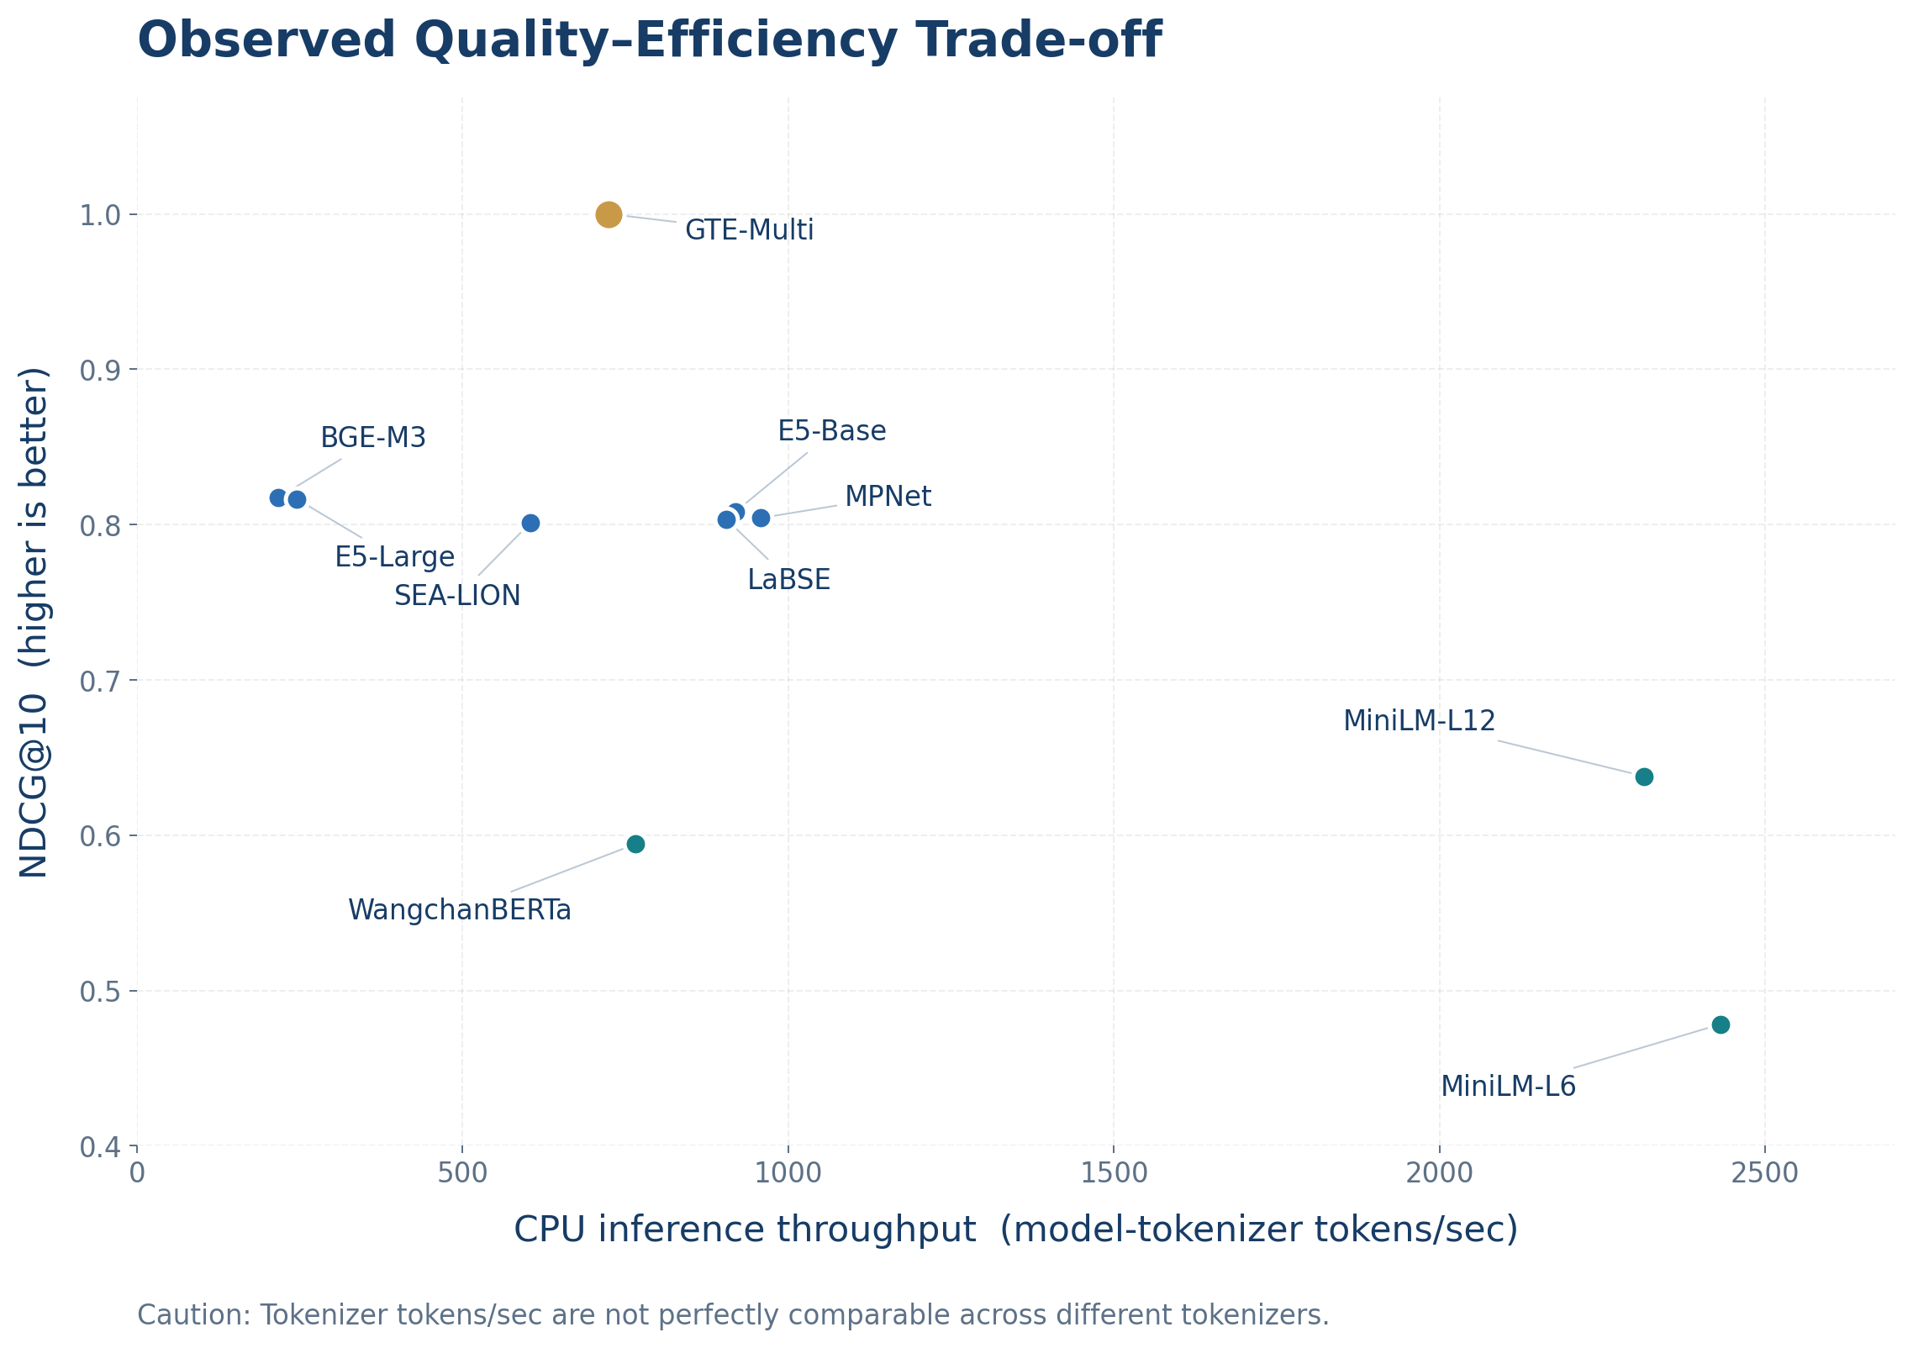
Accuracy and Efficiency Lead to Different Choices
MiniLM: >2,300 tokenizer tokens/s; lower retrieval effectiveness
BGE-M3 / E5-Large: strong retrieval, lower CPU throughput
GTE: benchmark-ceiling retrieval, intermediate CPU throughput
Retrieval Quality VS CPU Efficiency
Notes:
“Model selection depends on the application’s retrieval quality and computational requirements.”
Of course, retrieval quality is not the only concern in real deployments. We also have to consider computational cost. The MiniLM models reached over 2,300 tokenizer tokens per second, but showed lower retrieval quality. BGE-M3 and E5-Large performed strongly on retrieval, yet had much lower measured CPU throughput. GTE offered another operating point, combining the strongest observed retrieval scores with intermediate throughput. One caution is that tokens per second are tokenizer-dependent: different models may split the same Thai text into different numbers of tokens. These values characterize our common CPU workload, not a universally normalized speed comparison. The best choice therefore depends on the target application.

Slide 9
What Our Benchmark Can and Cannot - Tell Us
Current Limitation | Future Direction
Small controlled dataset | Larger candidate pool and harder queries
Researcher-defined relevance and STS scores | Independent human annotation and inter-rater agreement
No validated paired significance test | Query-level statistical testing
Our study provides methodological evidence, not a universal Thai retrieval leaderboard.
Notes:
Before concluding, let me mention the limitations. Although our strengthened benchmark reveals clearer differences, it remains a small controlled collection of 120 documents, 60 retrieval queries and 150 STS pairs. Relevance labels and STS reference scores were researcher-defined, not independently judged by multiple annotators. We also did not establish statistically significant differences among closely matched systems. BGE-M3 and E5-Large, for example, differ only slightly in NDCG. Finally, we measured embedding inference on one CPU environment, not full end-to-end RAG latency. Future work should use larger collections, harder within-domain negatives, varied queries, independent judgments with inter-rater agreement and valid paired statistical tests. This study is a methodological investigation, not a final Thai retrieval leaderboard.

Slide 10
Takeaways & Future Directions
1. Benchmark design matters.
An easy benchmark can hide meaningful model differences.
2. A perfect score is benchmark-specific.
Ceiling performance does not imply universal superiority.
3. Model selection requires multiple criteria.
Retrieval quality, semantic similarity and efficiency.
“Before asking which model is better, we should first ask whether our benchmark is good enough to reveal the difference.”
Notes:
Let me finish with three takeaways. First, benchmark design matters. A testbed that is too easy can hide meaningful model differences. Second, a perfect score does not establish universal model superiority; it may reflect a model-specific ceiling on the current benchmark. Third, practical model selection should consider retrieval quality, semantic similarity and computational efficiency together. Our next step is to expand the collection, introduce harder examples, and obtain independent annotations with stronger statistical validation. I would like to leave you with one thought: before asking which model is better, we should first ask whether our benchmark is good enough to reveal the difference. Thank you very much, and I look forward to your questions.

Slide 11
Thank you..

