Slide 1
Layer Selection for Balanced Partial
Federated Learning in Vehicular Networks
Chaehyeon Kim, Youngjoon Yang, Seungwoo Lee, Dongkyun Kim
Computer Science and Engineering, Kyungpook National University
The 9th International Conference on Culture Technology 2026 (ICCT 2026)
Presentation date : 2026.10.31
Presenter: Chaehyeon Kim

Slide 2

01
Background
02
Introduction
03
Problem Definition
CONTENTS
04
Related Work
05
Challenging Issue
06
Proposed Scheme
07
Evaluation
08
Conclusion
2

Slide 3
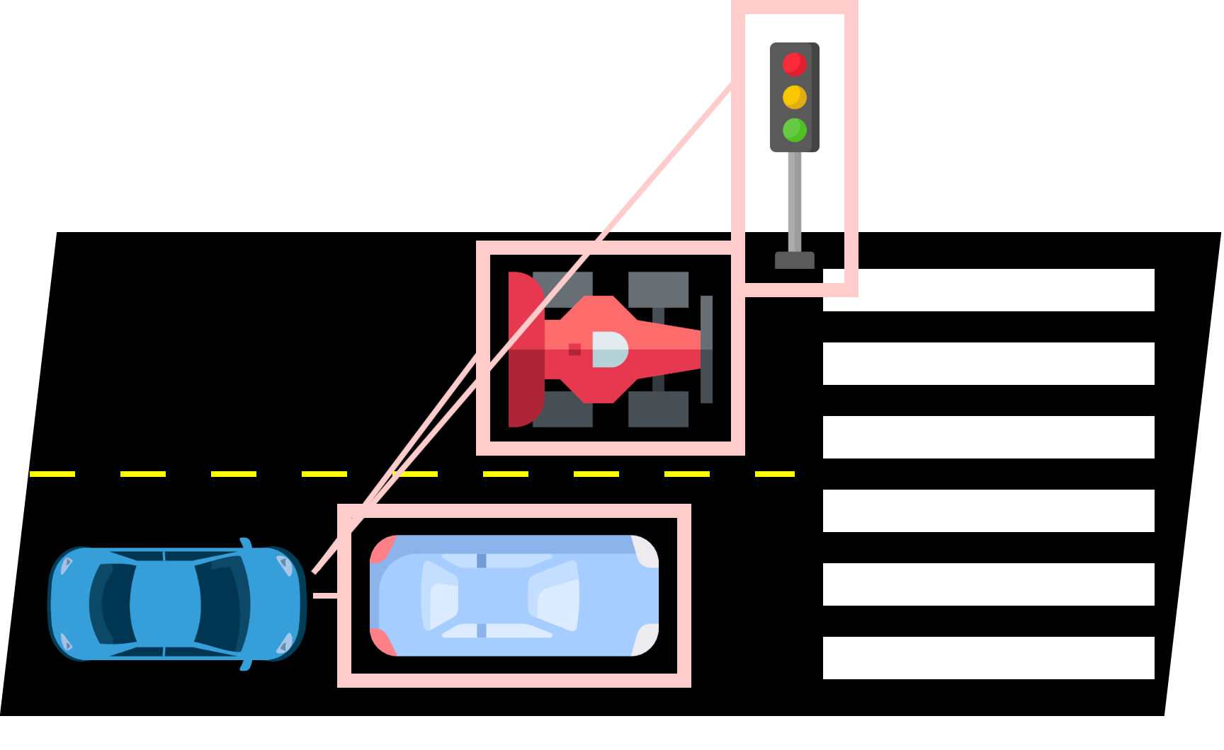
Background
Data Limitation in Autonomous Driving
Object recognition in autonomous driving
  Vehicles recognize objects from camera images
  Recognition accuracy is directly related to safety
Limits of individual vehicle data
  Each vehicle drives in particular regions and time periods
  Collected data covers only a limited range of traffic environments
Need for collaborative training
  Data from other vehicles should also be utilized
  Raw data sharing
    Large volume + Privacy risk
▲ Object recognition of an autonomous vehicle

Slide 4
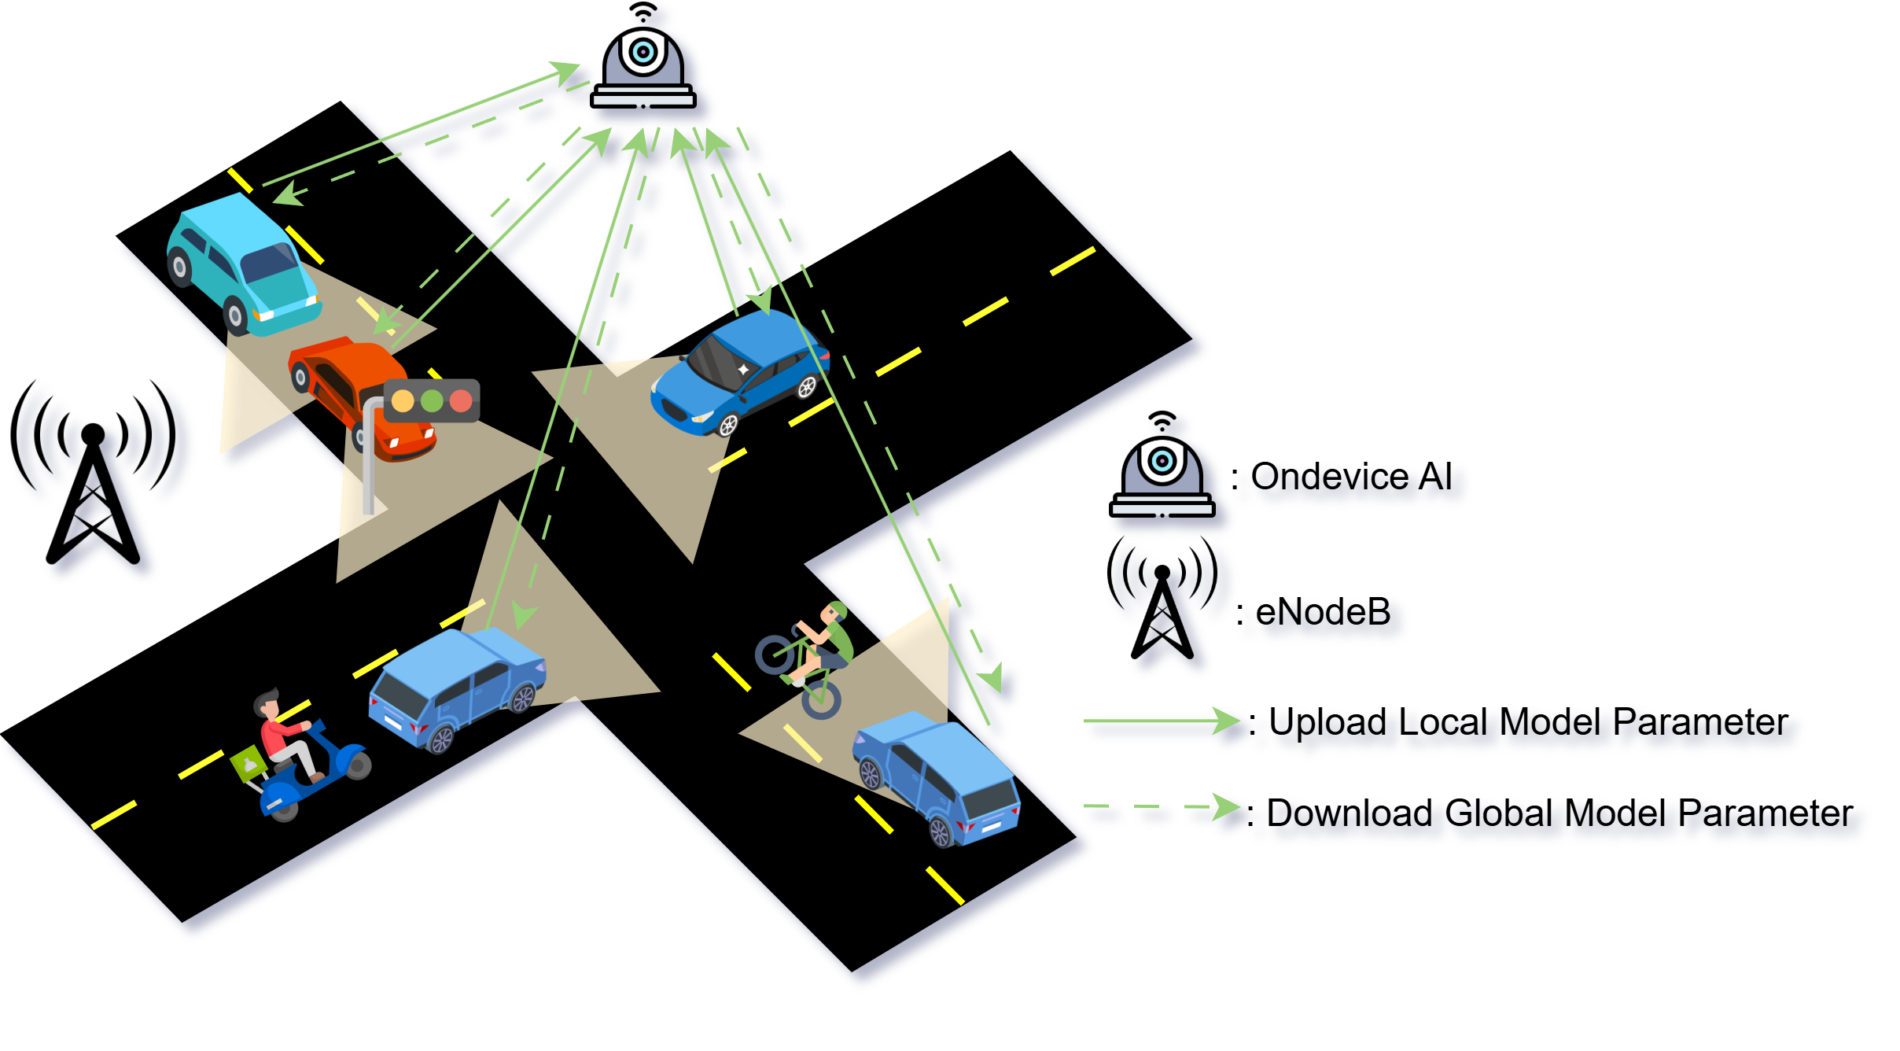
Background
Federated Learning
Federated Learning
  Each client trains the model on its own data
  Only model parameters are exchanged, raw data stays on device
Training Procedure
  Server distributes the global model
  Each client trains on its local data
  Clients upload local parameters
  Server aggregates
Advantages
  Privacy Preservation
  Reduce Communication overhead
▲ Federated learning between vehicles and the on-device AI

Slide 5
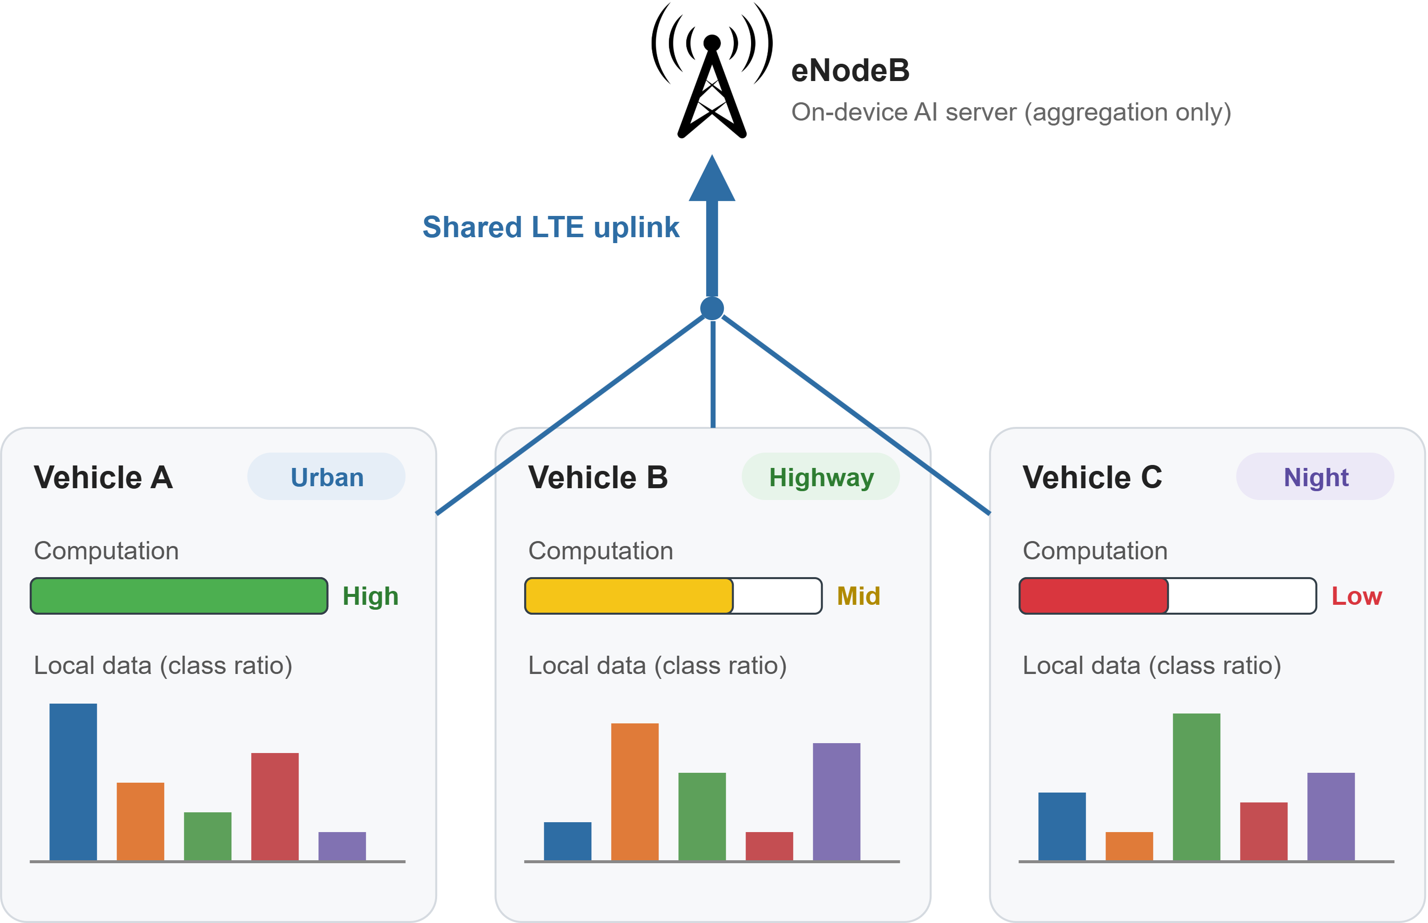
Introduction
Federated Learning in Vehicular Networks
Target scenario
  Vehicles train an object classification model with FL
  Server aggregates local models, does not participate in training
Characteristics of vehicular FL
  Heterogeneous computational capability across vehicles
  Non-IID data
    Each vehicle drives in different environments
  Vehicles in the same cell share the LTE uplink
Focus of this work
  Vehicles have different computational resources
▲ Federated learning in vehicular networks

Slide 6
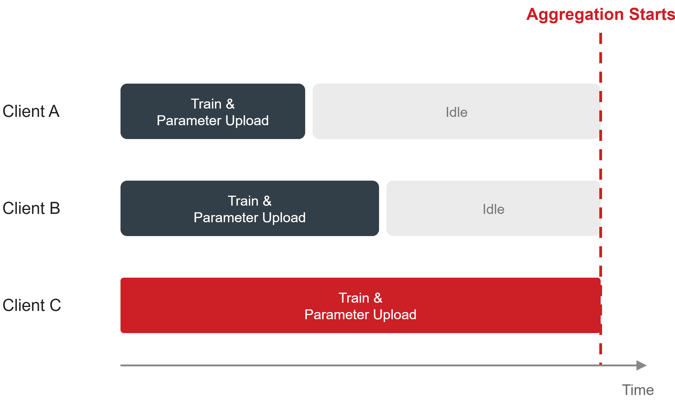
Problem Definition
Aggregation Delay in Heterogeneous FL
Synchronous aggregation
  Server aggregates only after receiving all local models
  Round time is determined by the slowest vehicle
Straggler problem
  Fast vehicles finish early but must wait
  Waiting time grows with the disparity in computational resources
Impact
  Models reflecting new objects are delivered to vehicles later
  Recognition accuracy for new objects is degraded in the meantime
▲ Parameter reception at the server

Slide 7
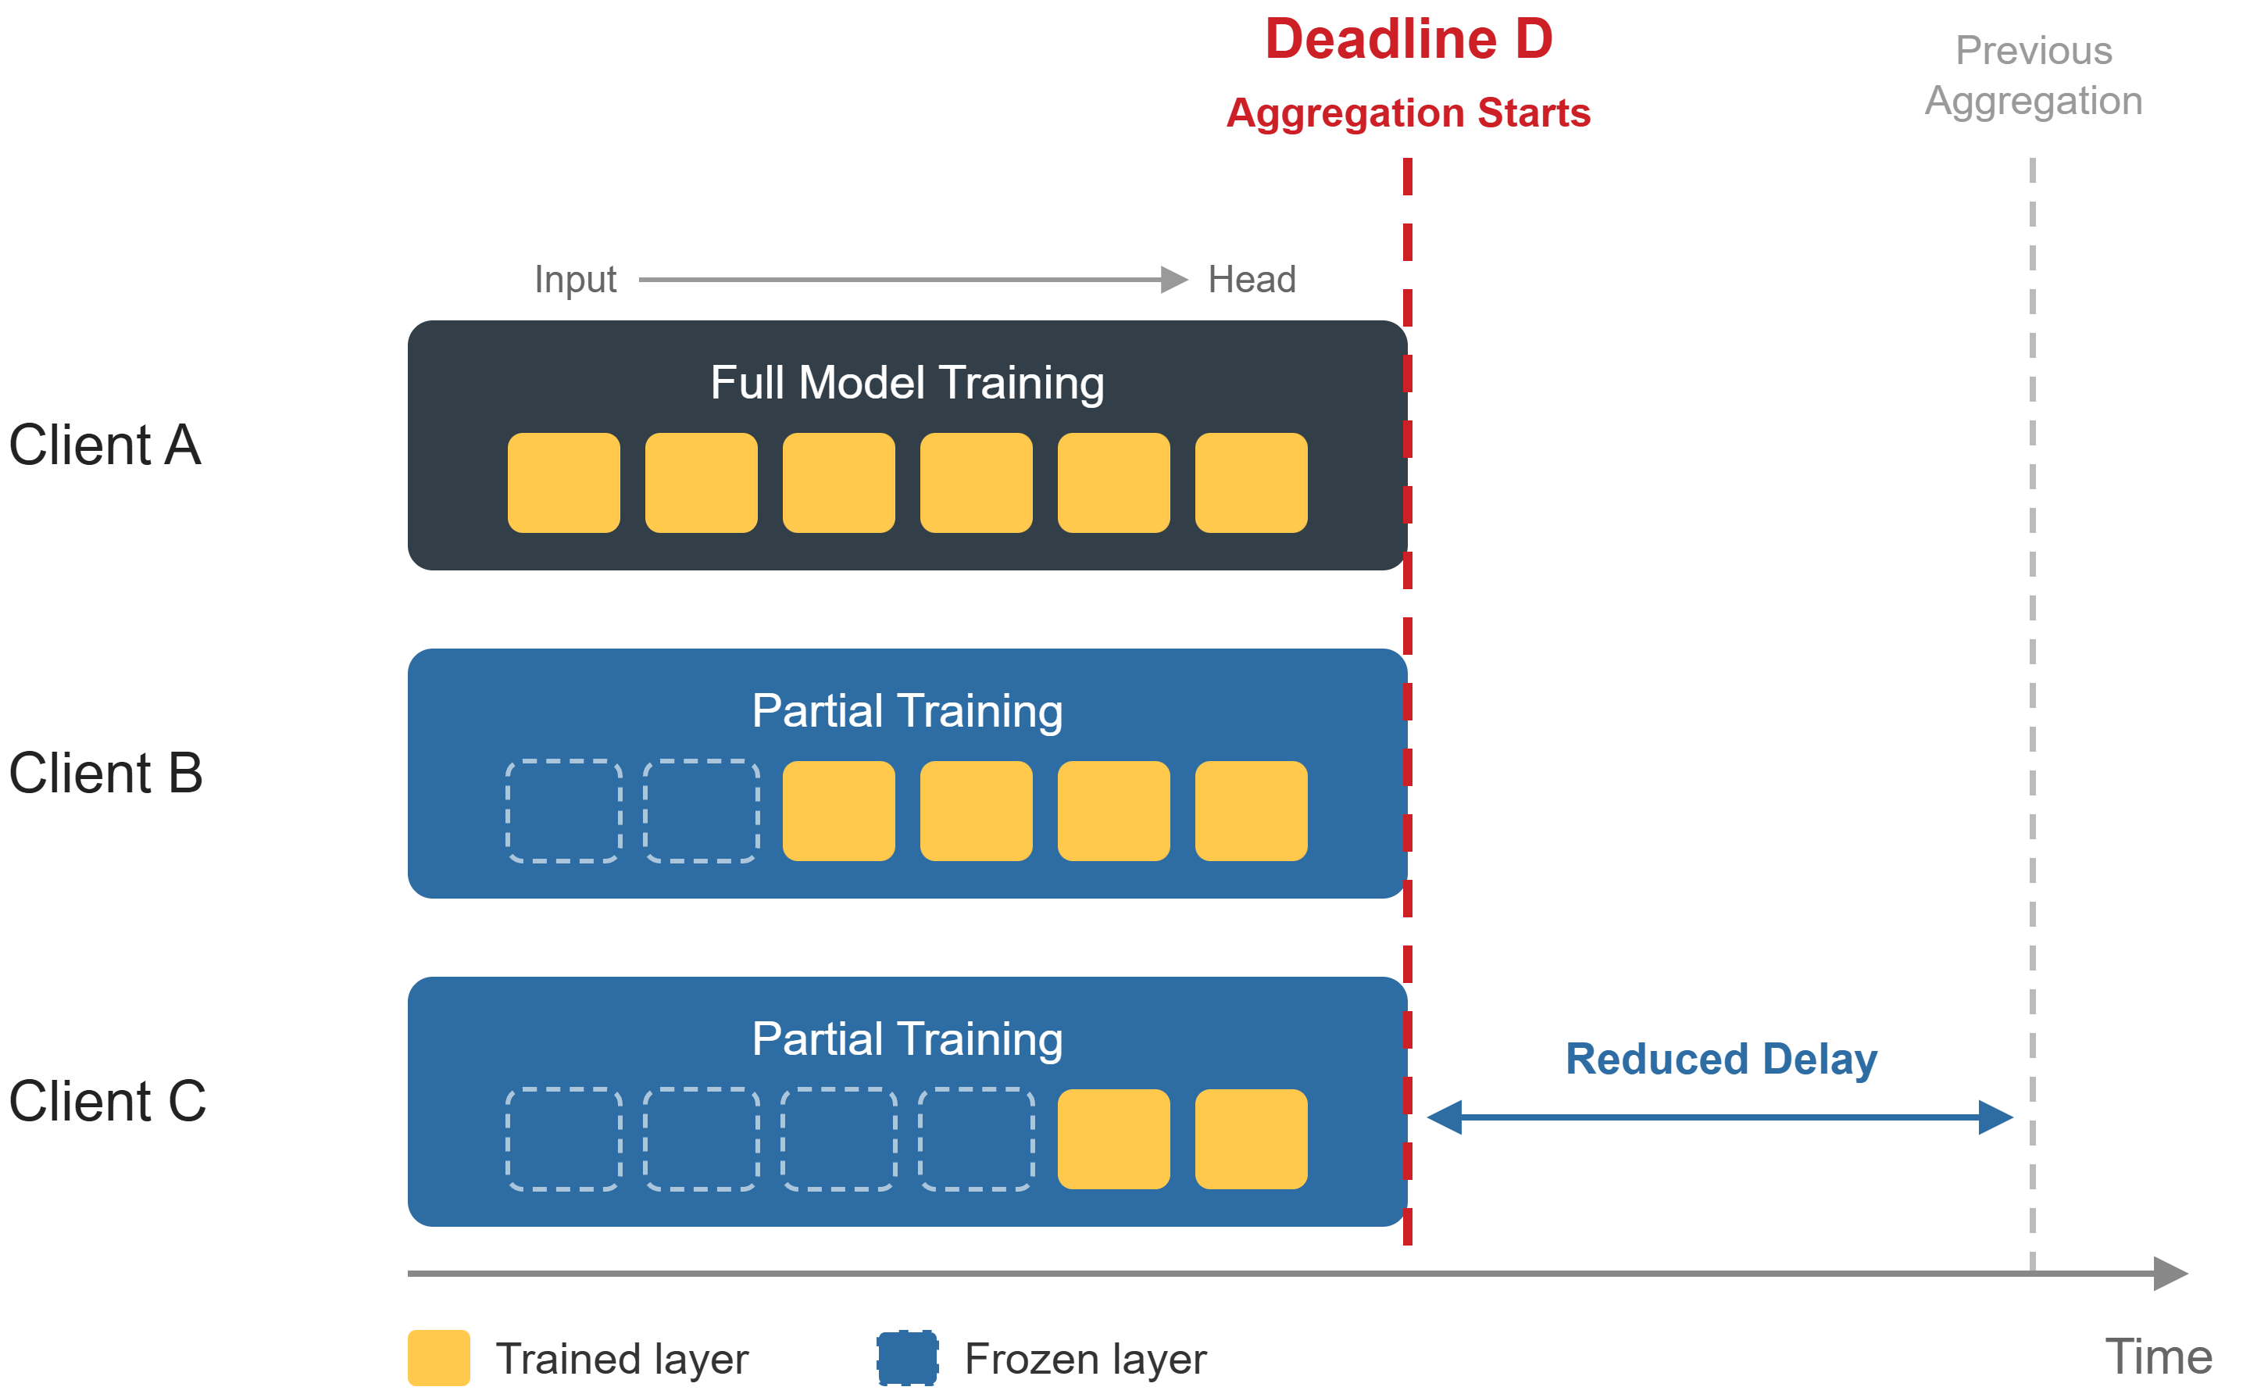
Related Work
Partial Training
Partial Training
  Low-capability vehicles train and transmit only a subset of layers
  Training time is fixed
    Each vehicle trains as much as possible within that time
Benefit
  Reduced waiting for slow vehicles
    Lower aggregation delay
  Fewer transmitted parameters
Two types of existing schemes
  Fixed training start position
  Selecting training position
▲ Partial training

Slide 8
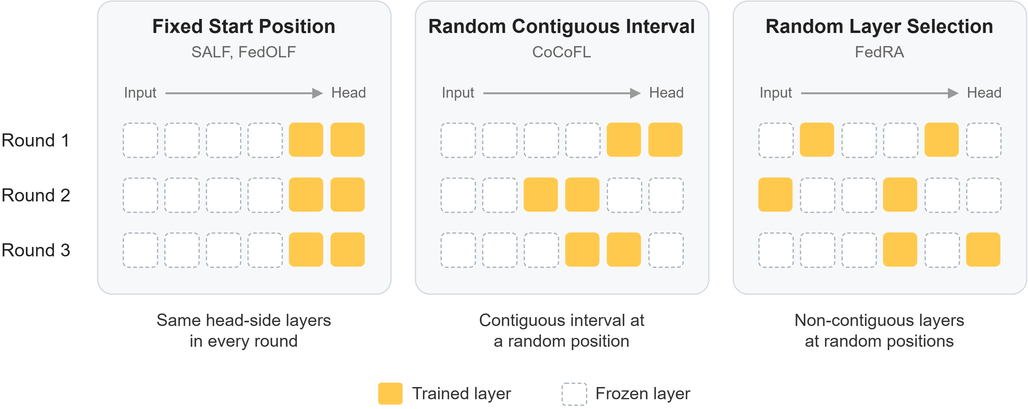
Related Work
Existing Partial Training Schemes
Fixed training start position
  SALF
    Trains from the head for a given time, layer-wise aggregation
  FedOLF
    Freeze layers by device capability, trains head-side layers
Selecting training position
  CoCoFL
    Randomly select one interval among candidates satisfying computation, communication, and memory constraints
  FedRA
    Randomly selects as many layers as the device can handle
▲ Layers trained by a slow vehicle over rounds

Slide 9
Challenging Issue
Limitations of Existing Partial Training
Fixed start position
  Low-capability vehicles always train only the layers near the head
  Input-side layers are trained only by a few high-capability vehicles
  Global model is biased toward the data of high-capability vehicles
Random position selection
  Layers trained in previous rounds are not considered
  Intervals far from the head are shorter
  → Overlapping layers are trained more often
  → Data of a vehicle are not reflected evenly across layers
Key question
  How can each vehicle select intervals so that its data is reflected evenly across all layers?

Slide 10
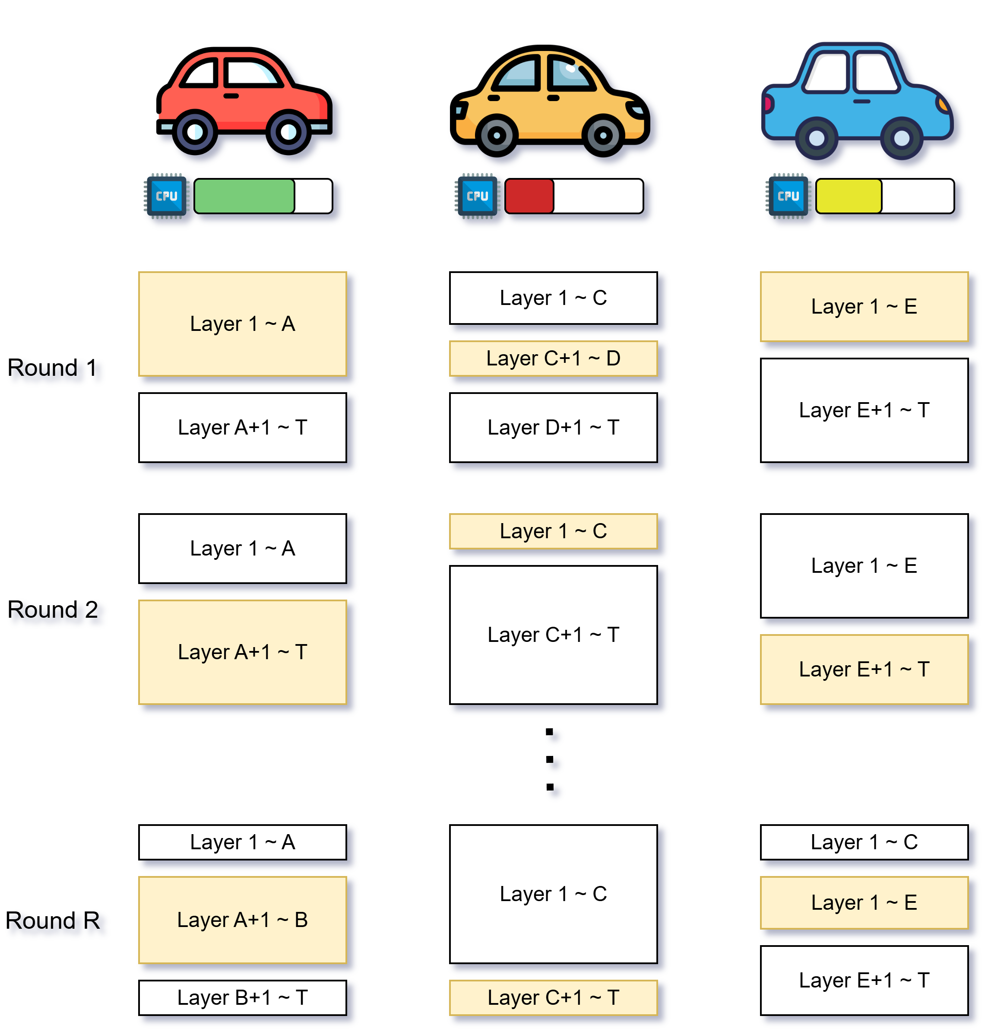
Proposed Scheme
Step 1: Candidate Intervals within Deadline
Key Idea
  Each vehicle trains only a contiguous block of layers
  It can finish within deadline D
  Fast vehicles train longer intervals
Training cost of interval
  Forward pass through the whole model
  Backward pass from the head to the start of the interval
  Parameter update only within the interval
  Intervals farther from the head cost more, so they are shorter
Candidate intervals
  The longest intervals that each vehicle can finish within D
  Each vehicle selects one of its candidates in every round
▲ System model of the Proposed scheme

Slide 11
Proposed Scheme
Step 2: Balanced Interval Selection
How it works
  Record
    Each vehicle remembers how often and how recently it trained each layer
  Select
    Intervals containing less-trained layers are selected with higher probability
  Train
  Update record
    Trained layers get a higher record, and old records gradually fade
  Aggregate
Lightweight design
  Selection and records are managed by each vehicle
  Server only performs aggregation
▲ Interval selection changing across rounds

Slide 12
Evaluation
Simulation Setup
Vehicles
  50 vehicles in 3 tiers by computational speed
    High (15): 1.0 / Mid (20): 0.7 / Low (15): 0.5
  Speed changes slightly every 5 rounds
Dataset & Model
  BDD100K real-world driving images, 7 object classes
  Each tier drives in different environments → Non-IID Data
  ResNet-18
Comparison schemes
  FedAvg, SALF, CoCoFL

Slide 13
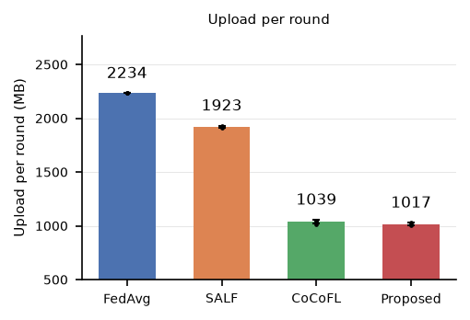
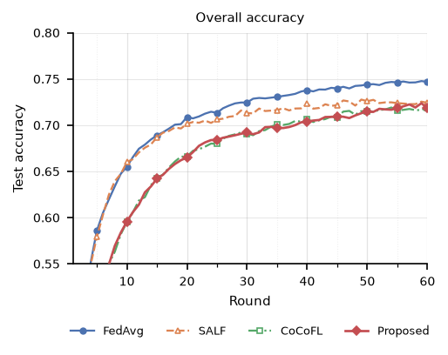
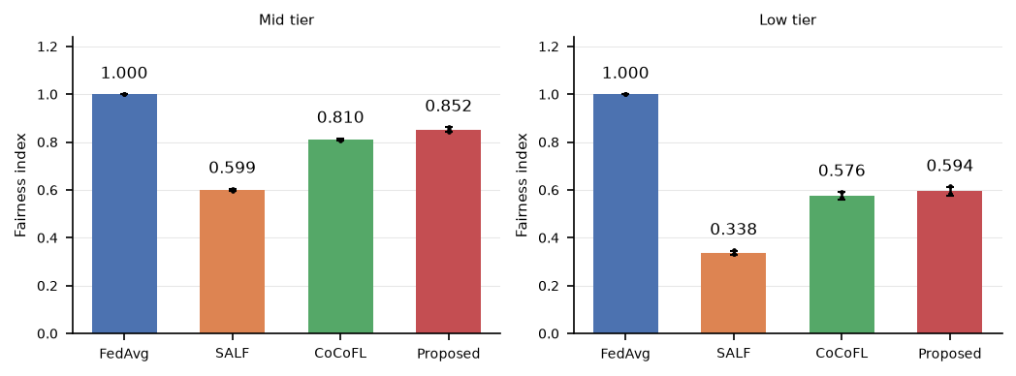
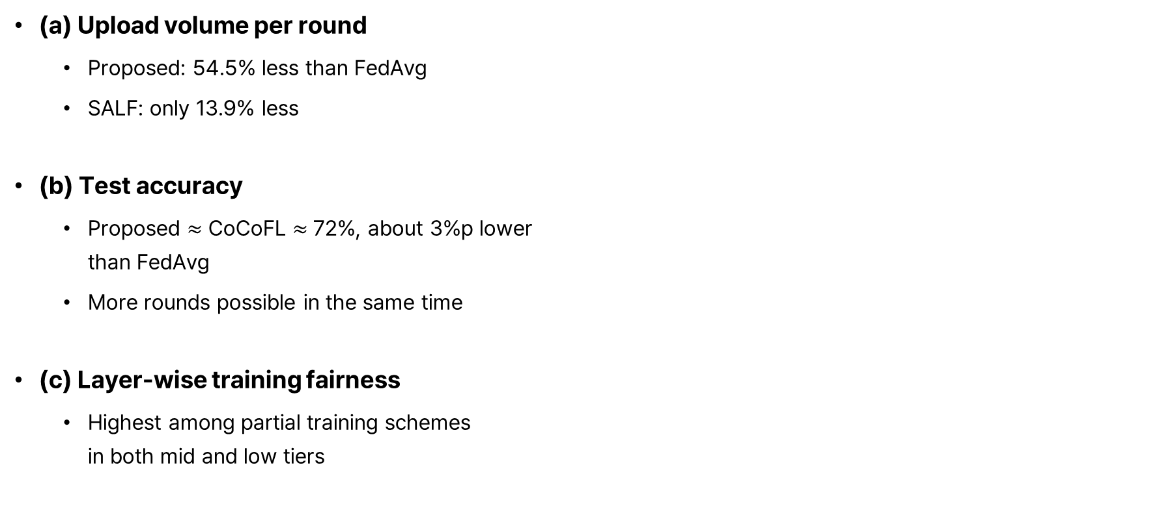
Evaluation
Simulation Results
(a) Upload volume per round
  Proposed: 54.5% less than FedAvg
  SALF: only 13.9% less
(b) Test accuracy
  Proposed $≈$ CoCoFL $≈$ 72%, about 3%p lower
  than FedAvg
  More rounds possible in the same time
(c) Layer-wise training fairness
  Highest among partial training schemes
  in both mid and low tiers
▲ (a) upload volume per round
▲ (b) Test accuracy over rounds
▲ (c) Fairness index for mid and low tiers
▲ Simulation results

Slide 14
Conclusion
Summary and Future Work
Summary
  Each vehicle trains a contiguous interval that it can finish within the deadline
  Intervals with less trained layers are selected with higher probability
  Vehicles manage selection and records
Result
  Upload time per round reduced by about 55% compared with FedAvg
  Highest layer-wise fairness among partial training schemes
Limitations & Future work
  Accuracy is similar to random selection → Turn fairness into accuracy gain
  Slow vehicles can’t train input-side layers → Enable their contribution
  Consider vehicle mobility

Slide 15
Thank You

