Slide 1

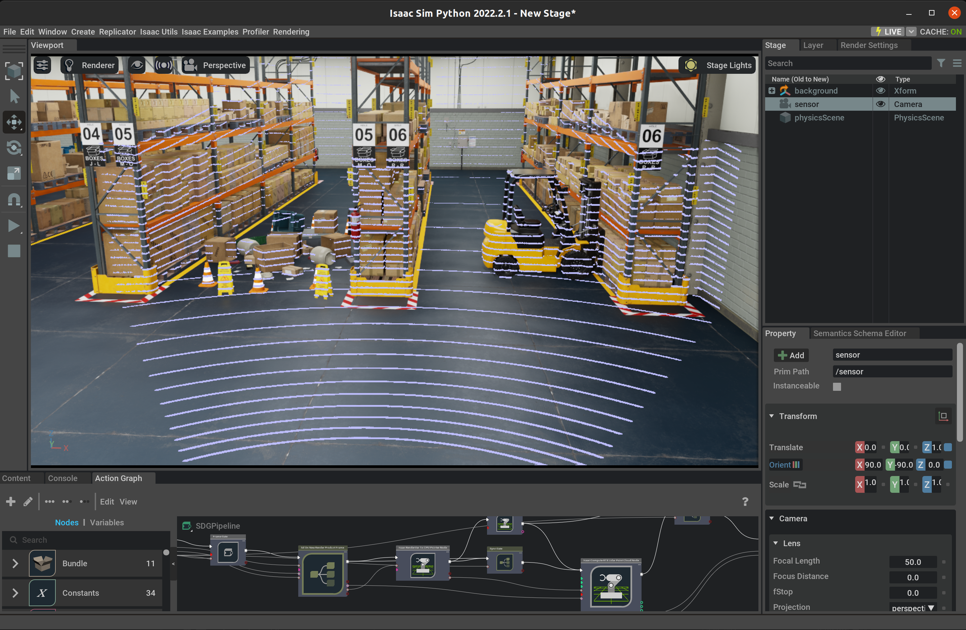
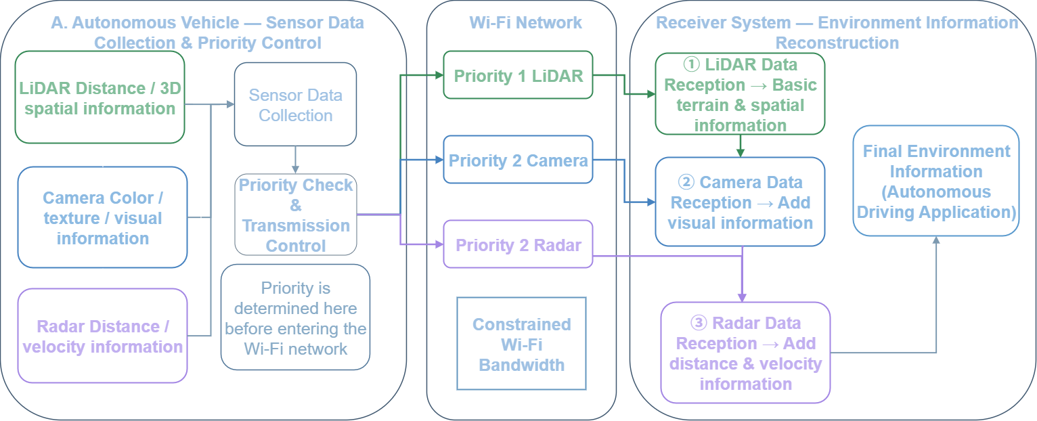
A Priority-Based Multimodal Data Transmission Mechanism
for Indoor Autonomous Mobile Robots over Wi-Fi
Heesung Kim¹, Sunghyun Kim¹, Youngjoon Yang¹, Dongkyun Kim¹*, Jongrak Hwang²
¹ Kyungpook National University, Daegu, Korea, ² Futuredrive, Daegu, Korea
yeonx5@knu.ac.kr, sunghyunkim@knu.ac.kr, youngj719@knu.ac.kr, dongkyun@knu.ac.kr, hjr@futuredrive.net
Introduction
Proposed Priority-Based Multimodal Data Transmission
Indoor Autonomous Mobile Robots (AMRs) use LiDAR, Camera, and Radar sensors to perceive their surroundings and navigate autonomously. However, transmitting large volumes of multimodal sensor data simultaneously over Wi-Fi can cause network congestion, packet loss, and transmission delays, potentially affecting environmental perception and navigation.
To address this issue, we propose a priority-based multimodal data transmission mechanism for indoor AMRs in Wi-Fi environments. The proposed method assigns Priority 1 to LiDAR data to acquire basic spatial and localization information first, followed by parallel transmission of Camera and Radar data with Priority 2. Simulation results are used to evaluate the proposed mechanism, which aims to enable early acquisition of essential environmental information before all sensor data has been received.
1) Priority-Based Transmission
After sensor data collection, the system identifies data types and their predefined transmission priorities.
LiDAR data (Priority 1) is transmitted first over Wi-Fi to obtain basic spatial information.
2) Parallel Transmission of Camera and Radar
After LiDAR data reception is completed, Camera and Radar data (Priority 2) are transmitted in parallel.
Camera provides visual information, while Radar provides object distance and velocity information to supplement environmental perception.
3) Environmental Information Integration
The received LiDAR, Camera, and Radar data are integrated to construct comprehensive environmental information.
Basic spatial information can be acquired through LiDAR before all sensor data has been received.
4) Expected Benefits
Adjusts the transmission order of sensor data according to the environmental perception process.
Enables early acquisition of essential spatial information for AMR navigation under bandwidth-limited Wi-Fi conditions.
▲ Fig. 1. Indoor AMR Simulation Environment Using NVIDIA Isaac Sim
Limitations of Existing Data Transmission Methods
1) Simultaneous Data Transmission
LiDAR, Camera, and Radar data may be transmitted simultaneously over the same Wi-Fi network.
Large volumes of sensor data can increase network traffic and compete for limited bandwidth.
2) Transmission Issues
Network congestion may cause packet loss and transmission delays.
Delayed sensor data reception can affect the timely acquisition of environmental information at the server or edge server.
3) Need for Priority-Based Transmission
Conventional simultaneous transmission does not prioritize data according to the AMR's environmental perception process.
A transmission mechanism is needed to acquire essential spatial information before all sensor data has been received.
▲ Fig. 2. Priority Control and Transmission/Reception Flow of
Wi-Fi-Based Multimodal Sensor Data for Indoor AMRs
Conclusion
A priority-based multimodal data transmission mechanism is proposed, transmitting LiDAR first, followed by parallel Camera and Radar transmission.
The mechanism enables early acquisition of essential spatial information under limited Wi-Fi bandwidth.
Future work will evaluate packet loss, latency, and transmission completion time under various network conditions.

