Slide 1

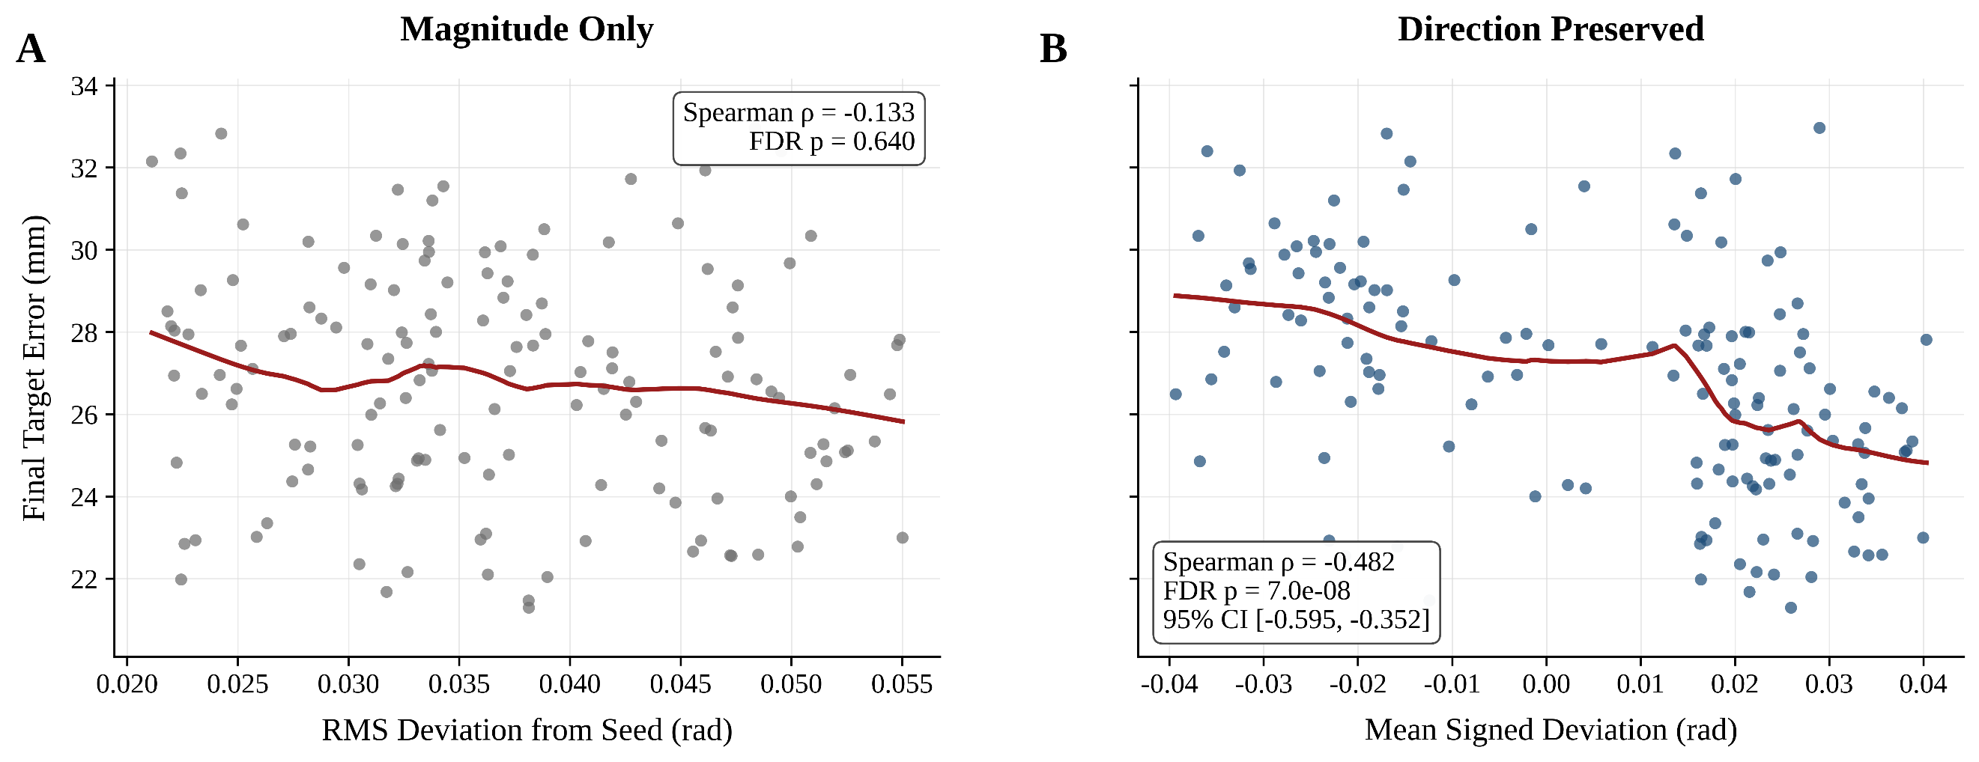
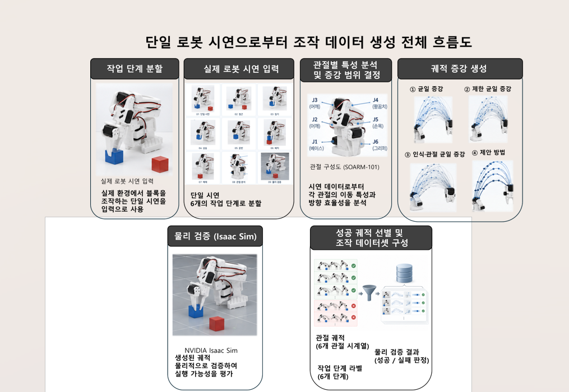
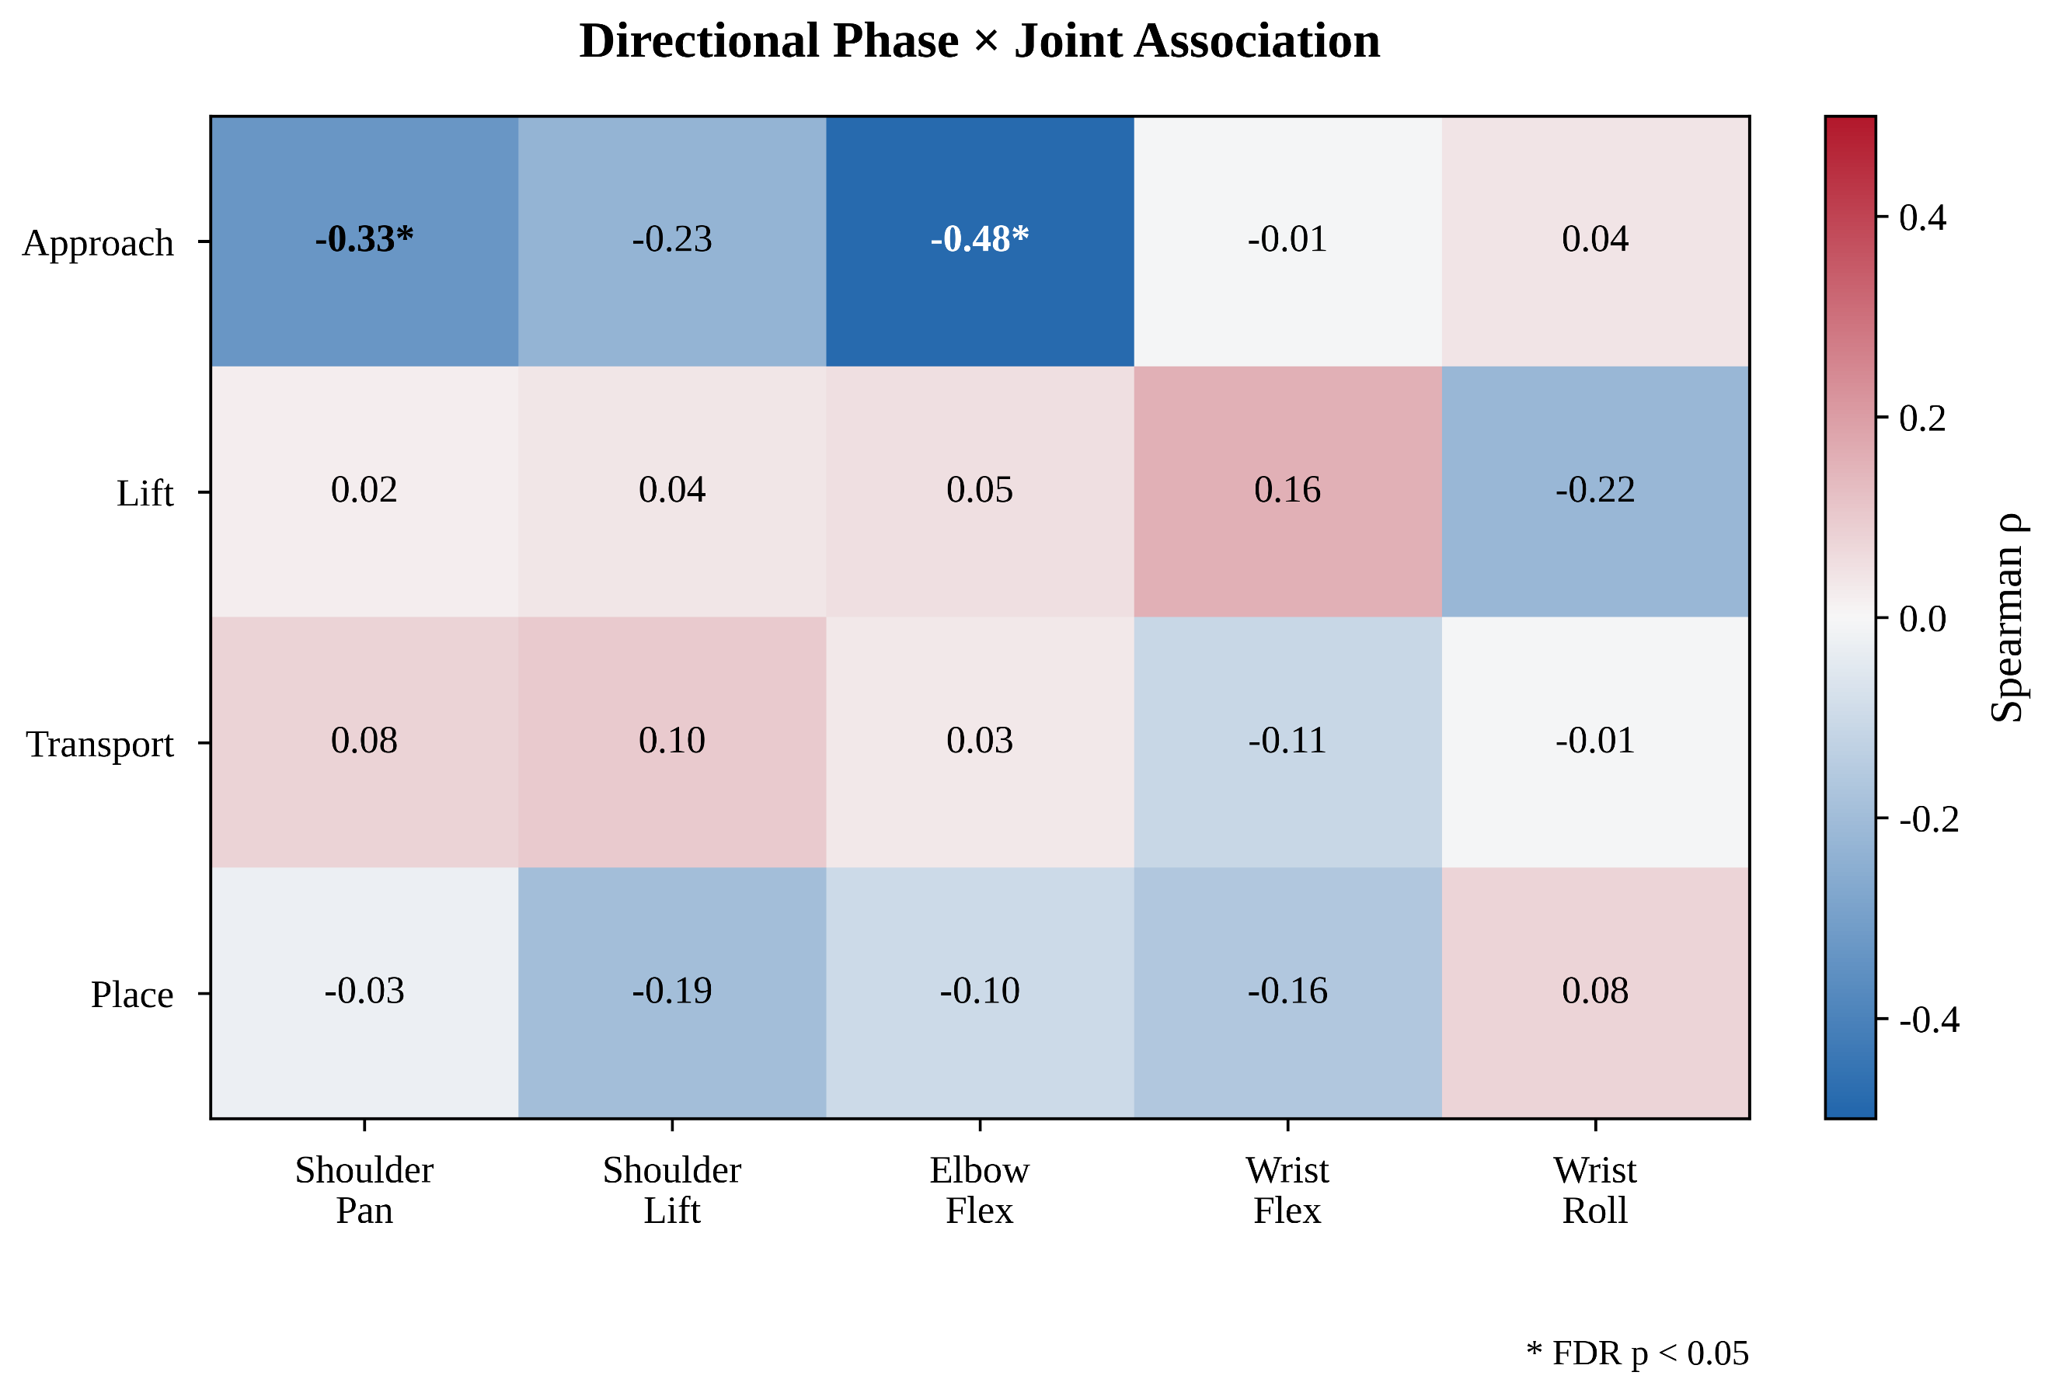
Beyond Deviation Magnitude:
ICCT 2026
Phase-Joint Directional Characterization of
Physics-Validated Manipulation Trajectories
from a Single Demonstration
Dohee Lee, Junghun Kim, and Sang-il Choi
School of Computer Software, Daegu Catholic University, Gyeongsan-si, Republic of Korea
Deviation direction reveals
accuracy-related structure
Magnitude only (ρ)
Signed deviation (ρ)
Median error gap
We compare phase-joint deviations with final placement accuracy
among physically successful trajectories from one demonstration.
−0.133
−0.482
≈2.90 mm
M = √mean(Δq²)
S = mean(Δq)
S < 0 vs S ≥ 0
01
Magnitude and direction
APPROACH × Elbow Flex, n = 150 successful trajectories. Spearman correlation with Benjamini–Hochberg FDR correction.
Fig. 1. Signed deviation has a stronger observed association with placement error. The plots share the same final-error scale.
02
Generation and physics validation
1 real SO-101 demonstration 9 task phases 5 arm joints + gripper 4,787 frames at ≈50 Hz 30.9 mm object
01
Real-robot demonstration
02
Task phase segmentation
03
Phase-joint analysis
One pick-and-place
demonstration supplies
the seed trajectory.
Nine task phases
J1 Shoulder Pan
J4 Wrist Flex
01
02
03
01 Preparation
06 Transport
J2 Shoulder Lift
J5 Wrist Roll
02 Approach
07 Place
J3 Elbow Flex
J6 Gripper
04
05
06
03 Close
08 Release
Motion rate, directional efficiency
and task semantics set the bounds.
04 Grasp Hold
09 Termination
07
08
09
05 Lift
04
Trajectory augmentation
05
Physics validation
06
Successful trajectory set
Uniform
Phase-Gated
Phase-Aware
Joint-Uniform
Proposed
Execute candidates
in NVIDIA Isaac Sim.
Check lift, transport,
placement and release.
Retain successful runs.
Joint-state time series
Task-phase labels
Validation records
Fig. 2. Generation workflow. Final planar target error remains a separate continuous outcome and is excluded from binary success.
03
Phase-joint associations
Actual perturbation amplitudes (°)
Phase | Shoulder Pan | Shoulder Lift | Elbow Flex | Wrist Flex | Wrist Roll
APPROACH | 2.50 | 6.00 | 6.00 | 1.00 | 6.00
LIFT | 0.03 | 2.96 | 0.06 | 1.71 | 0.05
TRANSPORT | 6.00 | 3.00 | 6.00 | 1.00 | 6.00
PLACE | 0.05 | 1.43 | 0.03 | 0.84 | 0.02
A = min(net seed displacement, freedom cap).
LOCK / LOW / MEDIUM / HIGH: 0° / 1° / 3° / 6°.
CLOSE, GRASP_HOLD and RELEASE remain locked.
Interpretation & scope
For APPROACH × Elbow Flex, the signed association remains stable under
bootstrap analysis and 1% tail trimming.
One seed and one task in simulation. These observational results do not
establish causal effects or policy-learning gains.
Fig. 3. Significant pairs occur in APPROACH:
Shoulder Pan (ρ = −0.33) and Elbow Flex (ρ = −0.48).
Signed ρ: bootstrap 95% CI [−0.595, −0.352]
References: Mandlekar et al., MimicGen, CoRL 2023. Xue et al., DemoGen, RSS 2025. Benjamini & Hochberg, JRSS B, 1995.
Notes:
Source: ICCT_이도희(5).docx, supplied by the user. Title, author order, affiliation and email are from the first page. DIL logo is the separately supplied original PNG.
Methods: Sections II and III. One SO-101 demonstration, approximately 50 Hz, 4,787 frames, five arm joints plus gripper. Candidate execution and task-success validation occur in Isaac Sim. Final planar target distance is a continuous accuracy measure excluded from binary success.
Primary evidence: original Figure 2. APPROACH × Elbow Flex, n=150. RMS rho=-0.133, FDR p=0.640. Signed rho=-0.482, FDR p=7.0e-8, bootstrap 95% CI [-0.595,-0.352]. These are reported observational associations; no test of the difference between correlations is reported.
Robustness: Section IV.B. Approximately 2.90 mm difference in median final target errors between S<0 and S>=0 groups. The paper does not report the individual medians, group sizes, or exact trimmed rho. Trimming the top and bottom 1% of extreme final-error or signed-deviation values changed the association little.
Table: exact rounded Figure 3 coefficients, with the original two significance markers. Columns: Shoulder Pan, Shoulder Lift, Elbow Flex, Wrist Flex, Wrist Roll. Rows: Approach [-0.33,-0.23,-0.48,-0.01,0.04]; Lift [0.02,0.04,0.05,0.16,-0.22]; Transport [0.08,0.10,0.03,-0.11,-0.01]; Place [-0.03,-0.19,-0.10,-0.16,0.08]. Asterisk denotes FDR-adjusted p<0.05.
Scope: a single demonstration, task and simulation setup. The poster does not claim causal accuracy improvement, real-robot validation of generated trajectories, augmentation success rate, or learned-policy improvement.
Selected references are abbreviated from the supplied manuscript bibliography: A. Mandlekar et al., MimicGen: A Data Generation System for Scalable Robot Learning using Human Demonstrations, CoRL, PMLR 229, 2023, pp. 1820–1864. Z. Xue et al., DemoGen: Synthetic Demonstration Generation for Data-Efficient Visuomotor Policy Learning, RSS 2025, doi:10.15607/RSS.2025.XXI.157. Y. Benjamini and Y. Hochberg, Controlling the False Discovery Rate: A Practical and Powerful Approach to Multiple Testing, JRSS B 57(1), 1995, pp.289–300, doi:10.1111/j.2517-6161.1995.tb02031.x.
Additional source method details: object size 30.9 mm. Actual perturbation amplitudes in degrees follow Section III.C, ordered Shoulder Pan, Shoulder Lift, Elbow Flex, Wrist Flex, Wrist Roll: APPROACH [2.50,6.00,6.00,1.00,6.00]; LIFT [0.03,2.96,0.06,1.71,0.05]; TRANSPORT [6.00,3.00,6.00,1.00,6.00]; PLACE [0.05,1.43,0.03,0.84,0.02].
A(p,j)=min(D(p,j),B(c(p,j))). E(s)=64s^3(1-s)^3, 0<=s<=1. The envelope is C2-continuous at the phase boundaries. CLOSE, GRASP_HOLD, RELEASE remain locked.
Figure 1 uses the user-supplied workflow schematic with English native text and unchanged source illustration crops. The first two headings are aligned with their content. Task-phase count and joint names follow the manuscript: nine task phases, five arm joints plus gripper. Original Figure 2 panels A and B and complete original Figure 3 are retained. Panel B shares the final-error scale with A.
Workflow source: user attachment f10de7b8-da32-4441-8bc1-463ce292aa42.png. Four method labels follow the manuscript: Uniform, Phase-Gated, Phase-Aware Joint-Uniform, Proposed. Workflow imagery is schematic. Final target error remains outside binary success criteria.
Current poster figure numbering follows visual order: Figure 1 contains original manuscript Figure 2 paired scatterplots; Figure 2 is the supplied workflow schematic with native English labels; Figure 3 is the complete original manuscript Figure 3 heatmap. The native perturbation table is retained. Transparent DIL logo uses imagegen background extraction of the user-supplied logo. Study claims and numeric results are unchanged. The three headline numbers refer to APPROACH × Elbow Flex in 150 successful trajectories; approximately 2.90 mm is a difference between sign-group medians, not a causal improvement. In the displayed metric definitions, delta q is generated minus seed joint angle, averaged within each phase and joint.

