Slide 1
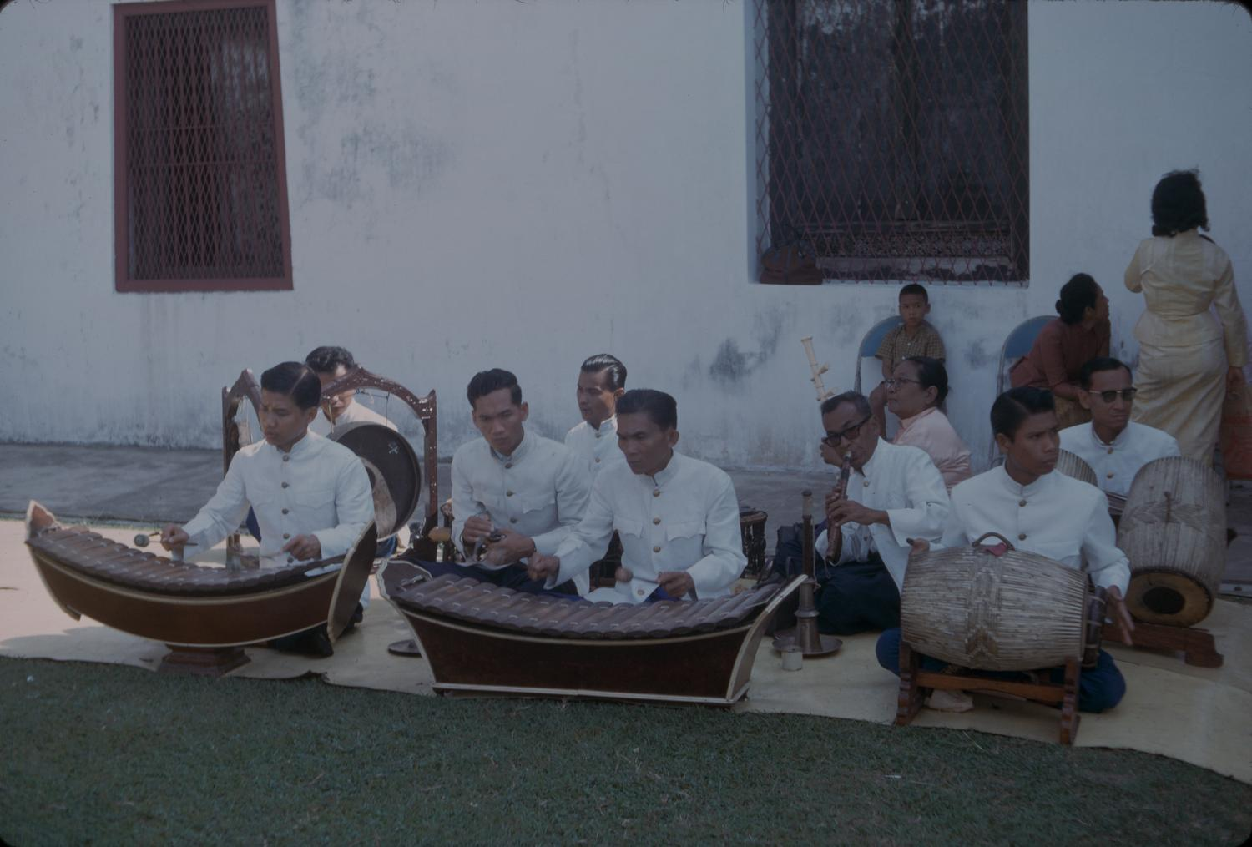



Automatic Music
Transcription of Six
Thai Musical Instruments
The 9th International Conference
on Culture Technology · ICCT 2026
ICCT 2026 · SHANGHAI · 29–31 OCTOBER 2026
From transcribed notes to validated notation and a simulated six-instrument performance
Thaphon Chinnakornsakul · Atipong Wamaloon · Somchoke Ruengittinun · Worasait Suwannik
Computer Science, Kasetsart University, Bangkok, Thailand
Photo: S. J. Carlquist, 1963 [9]
Notes:
Good [morning/afternoon]. I’m [presenter name] from Kasetsart University. Our paper is about the step after automatic music transcription: taking notes transcribed from a recording and turning them into notation and a simulated performance for six Thai instruments from the piphat ensemble. The photo is a piphat ensemble in Bangkok around 1963, just to show the instrument family.

Slide 2


Transcription says what was played — not how another ensemble should play it
ICCT 2026
Shanghai · 29–31 Oct
INPUT
AMT [1]
THIS WORK
Recording or MIDI
Note events
Six Thai parts
Any source ensemble
Onset, offset, pitch, source instrument
Notation, playing instructions, audio stems
The missing step needs decisions AMT does not make: which voice to keep, timing, tuning, register, and playing instructions for a fixed target ensemble.
Chinnakornsakul et al. · ICCT 2026
2
Notes:
Multi-instrument AMT models such as MuScriptor give us note events and source-instrument labels. But they tell us what was played, not how a different ensemble should play it. If we want six Thai instruments to perform a piece, we still have to decide which voice carries the melody, how to quantize timing, how to map pitches onto a Thai tuning, which register to use, and how each instrument should articulate. That downstream transformation is what this paper studies.

Slide 3
The target: six instruments of the piphat ensemble
ICCT 2026
Shanghai · 29–31 Oct
INSTRUMENT
ROLE IN THIS SYSTEM
Ranat ek
Main melodic grid
Khong wong yai
Lower reinforcement of the main line
Pi nai
Counterline or selected source phrases
Ching / chap
Establishes the metrical cycle
Taphon
Energy-driven rhythmic accompaniment
Klong that
Strong accents, percussion passages
Piphat ensemble, Bangkok, c. 1963 [9]. Illustrates the instrument family, not our exact configuration.
Gold melodic · green rhythmic
Chinnakornsakul et al. · ICCT 2026
3
Notes:
The target is a fixed set of six instruments drawn from the piphat ensemble: ranat ek, a treble xylophone; khong wong yai, a circle of tuned gongs; pi nai, a quadruple-reed oboe; the small cymbals ching and chap; the taphon hand drum; and the klong that drum pair. The table shows the role each one has in our system. An important boundary: these rules define a contemporary computational transformation. We do not claim this is traditional piphat arranging. Thai notation is context-dependent and measured Thai tunings vary, so we avoid assuming a fixed equal-step model.

Slide 4
Contributions and research questions
ICCT 2026
Shanghai · 29–31 Oct
CONTRIBUTIONS
1 · Deterministic pipeline
RESEARCH QUESTIONS
Audio or MIDI to validated notation for six Thai instruments; every source note traced in an audit ledger
RQ1 How much labeled melody and supporting material does the core keep on symbolic pop music?
RQ2 How much does real-audio transcription change the notation versus a reference-MIDI path?
2 · Six sound engines
One audio stem per instrument from the same event timeline
RQ3 How does the same comparison behave on controlled synthetic audio?
3 · Stage-separated evaluation
RQ4 Do the sound engines obey notation constraints and rerender repeatably?
Transcription error, intentional omission, end-to-end agreement, renderer conformance
Chinnakornsakul et al. · ICCT 2026
4
Notes:
We make three contributions. First, a deterministic pipeline from audio or MIDI to validated notation for the six instruments, where every source note is traced in an audit ledger. Second, six sound engines that render that notation into one audio stem per instrument. Third, an evaluation that keeps the stages apart, so transcription error is not confused with notes we omit on purpose. We ask four questions: RQ1 on symbolic pop music, RQ2 on real audio, RQ3 on synthetic audio, and RQ4 on the renderer.

Slide 5
One pipeline for audio and MIDI, checked at every stage
ICCT 2026
Shanghai · 29–31 Oct
Top row: processing. Audio and MIDI share the same analysis, notation and rendering stages.
Dashed box: four separate checks, so each number has one meaning.
Chinnakornsakul et al. · ICCT 2026
5
Notes:
Here is the whole system. Along the top: source audio goes through AMT to transcribed notes; MIDI input skips that step and joins at voice analysis. Then voice analysis and arrangement, musical notation with playing instructions, simulated performance on six instruments, and finally mixed audio plus one track per instrument. The dashed box at the bottom is the evaluation: AMT is checked against reference notes, conversion against the MIDI input, the end-to-end arrangement by comparing the reference-MIDI path with the audio path, and the renderer for pitch, repeatability, clipping and stem summation. I’ll walk through the processing stages first.

Slide 6

From audio to normalized voices
ICCT 2026
Shanghai · 29–31 Oct
01
02
03
Transcribe
Separate voices
Segment and quantize
MuScriptor Medium [1] estimates onset, offset, pitch and source instrument.
Normalize tempo, meter, sustain and overlaps. Split polyphony with a directed note graph: pitch distance, gap, overlap, meter, contour, continuity.
Sections from markers and tempo changes, else bar-level novelty [8]. Each room has four slots; event order is kept.
Room = the notation’s metrical unit, a project term rather than a universal Thai-notation claim.
Chinnakornsakul et al. · ICCT 2026
6
Notes:
Stage A. MuScriptor Medium transcribes the audio. Normalization then handles tempo and meter maps, PPQN or SMPTE timing, sustain, program changes and incomplete note-offs. Polyphonic sources are split into lines with a directed note graph whose edge costs combine pitch distance, gap, overlap, metrical position, contour and continuity. Exact duplicates are merged for analysis but keep their IDs in the audit ledger. Sections come from markers and tempo or meter changes; if those don’t describe the form, we use bar-level novelty. Finally onsets and durations are quantized to four slots per room. “Room” is our project’s name for the metrical unit.

Slide 7
Choosing the main line, room by room
ICCT 2026
Shanghai · 29–31 Oct
1
2
3
4
5
6
7
8
Segmental dynamic program
Voice A
Score voices on density, prominence, monophony, continuity, repetition, meter [6], [7]. Switching costs less at rests and weak boundaries. NONE when no line dominates.
Voice B
Voice C
NONE
Illustrative path across 8 rooms (gold = chosen voice, green = NONE); not experimental data.
Tonal mapping per section
Test 12 tonics against 7 degrees of the tuning profile; map to nearest degree and octave, logging every change [4], [5].
Chinnakornsakul et al. · ICCT 2026
7
Notes:
Stage B picks the main line. Each candidate voice is scored on note density, inter-onset intervals, pitch and duration prominence, velocity, monophony, continuity, repetition and metrical salience. Then a segmental dynamic program chooses, for every room, one candidate or an explicit NONE state. Switching sources is penalized, but less at rests and weak boundaries. NONE wins when the material is silent, chordal, or has no dominant line. Up to two dissimilar high-ranked paths are kept as secondary material. The grid on the left is just an illustration of such a path. For pitch, each section tests all twelve tonic classes against the seven degrees of the selected tuning profile, weighting sustained and cadential notes and penalizing unnecessary tonic changes. Notes go to the nearest degree and octave, and every change is logged.

Slide 8

Arrangement: one job per instrument
ICCT 2026
Shanghai · 29–31 Oct
Ranat ek
Khong wong yai
Pi nai
Plays the main grid
Reinforces the main line at a lower level
Counterline or selected source phrases; source notes only, circular-breath cue on long lines
Ching / chap
Taphon
Klong that
Establishes the room cycle
Enabled by aggregate energy or percussion evidence
Strong drum evidence and percussion-only passages
Audit ledger: every input note is represented or arrangement_omitted; dropped stays at 0.
Chinnakornsakul et al. · ICCT 2026
8
Notes:
Arrangement gives each instrument one job. Ranat plays the main grid and khong reinforces it at a lower level. Secondary paths become independent parts, source texture fills in when the main material is absent, and unused source notes may bridge short gaps. Pi only uses notes from a suitable monophonic source path: depending on its rests and motion it plays a counterline, or takes selected phrases while ranat carries the complement. Articulation follows the source timing, and long lines get an explicit circular-breath cue instead of an invented rest. We never compose decorative pi notes. Percussion is metrical accompaniment, not a remapping of MIDI drums: ching sets the room cycle, taphon is enabled by energy, klong that marks strong drum evidence. These are contemporary heuristics, not named traditional patterns. The audit ledger accounts for every input note, and none are silently dropped.

Slide 9

The .piphat notation: validated before any sound
ICCT 2026
Shanghai · 29–31 Oct
Excerpt of a generated melodic line (velocity options omitted)
| . . . ท^ | - ล^ - ซ^ | - . ซ^ - |
ด ร ม ฟ ซ ล ท
^ _
- . ( )
| 4 slots |
Thai solfege degrees
Octave up / down
Sustain, rest, subdivide a slot
One room; a line holds 8 rooms
Format
Parse back
Validate slots + playability
Compile timeline
Any failure stops the run; there is no fallback score.
Chinnakornsakul et al. · ICCT 2026
9
Notes:
The output of arrangement is a UTF-8 text format we call .piphat. It records Thai solfege degrees do-re-mi as ด ร ม ฟ ซ ล ท, octave marks, timing, playing instructions and percussion patterns. Each room has four slots; a dash sustains, a dot rests, and parentheses subdivide a slot. A line holds eight rooms. This is our project notation, not a replacement for traditional notation. Before anything is saved, the score is formatted as text, parsed back, validated against slot structure and instrument playability, and compiled into the event timeline that the renderer uses. If any step fails, the run stops — there is no fallback score.

Slide 10
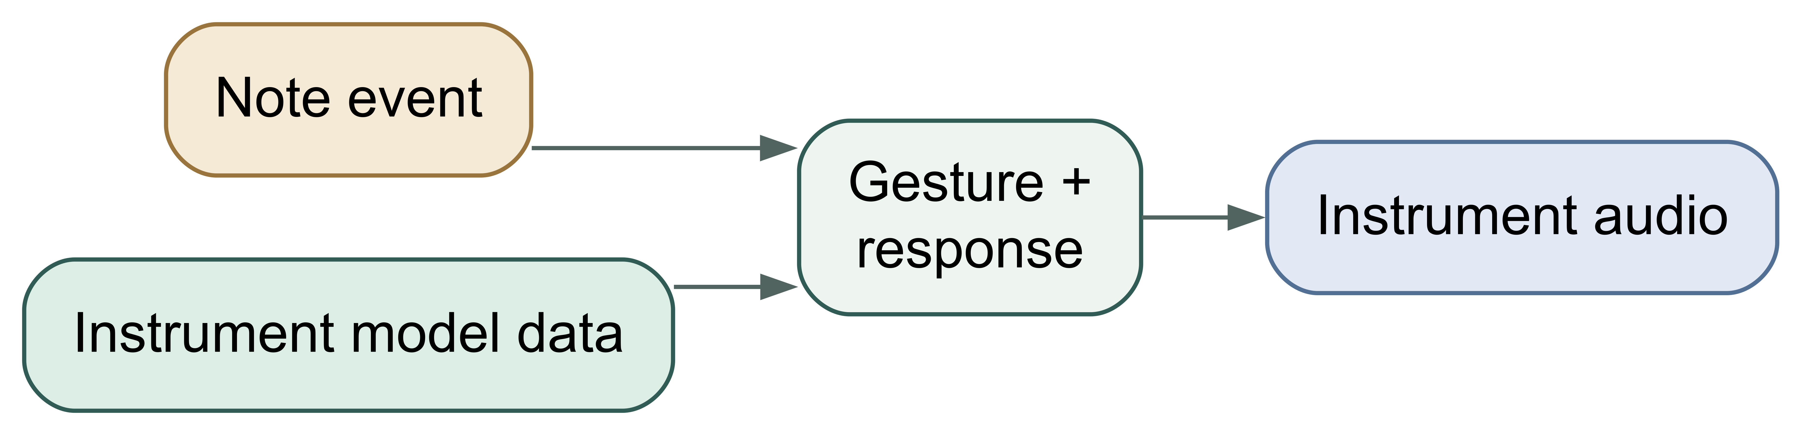
Six sound engines, one shared event timeline
ICCT 2026
Shanghai · 29–31 Oct
Notation instructions and stored response data drive a simulated gesture for each stem. One shared gain normalizes all stems and the master.
Instrument | Stored representation and runtime response
Ranat ek | Measured impulse responses for 15 bars, extended to 21 pitches; convolved with a mallet impulse
Khong wong yai | 16 bosses as damped inharmonic modes, excited by a mallet transient
Pi nai | 24 tones, six-hole fingerings [10]; whole phrase rendered in one pass [12]
Taphon | Seven hand strokes; coupled membrane modes and shell response
Ching / chap | Open and closed contacts with metallic modes and damping
Klong that | Loaded-membrane clusters, pitch relaxation, opposite-head coupling
Chinnakornsakul et al. · ICCT 2026
10
Notes:
All six engines read the same event timeline: instrument, pitch or stroke, timing, velocity and playing instructions; pi also gets fingering, tongue contact, pressure and breath. Each note event and the instrument’s stored model data drive a simulated gesture and response. Ranat is the only audio-domain model, built from measured impulse responses of 15 bars and extended to 21 pitches. The others store numeric acoustic parameters. They follow the common excitation–resonator organization, but they are not physical models calibrated against recordings of these instruments. For pi, a continuous phrase is rendered in a single pass, so phase, pressure, vibrato and breath noise carry across note boundaries.

Slide 11
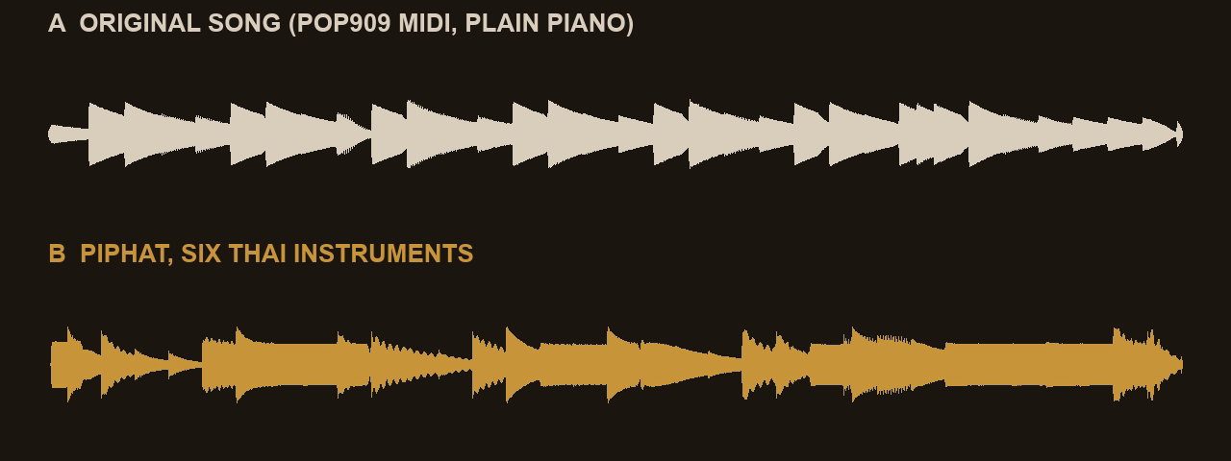
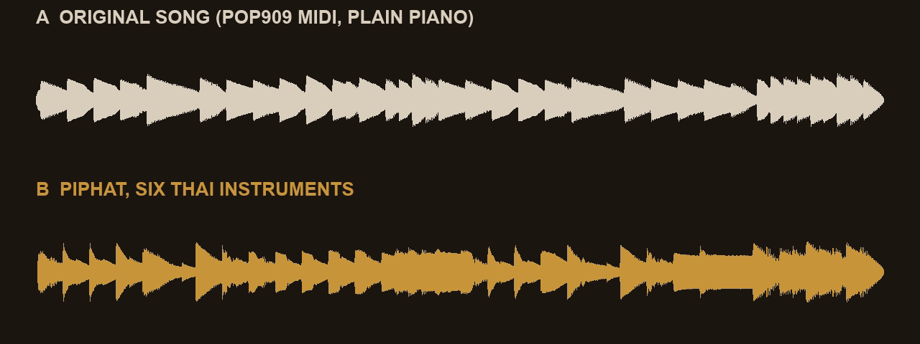
Songs you know, played by six Thai instruments
ICCT 2026
Shanghai · 29–31 Oct
LISTEN · CLICK A CLIP: A PLAYS, THEN B
月亮代表我的心
晴天
The Moon Represents My Heart · POP909 #526
Qing Tian (Sunny Day) · POP909 #516
A: the POP909 MIDI [13] played on a plain piano. B: the same MIDI → Piphat 2.1 core → six stems; no hand editing; levels matched.
Chinnakornsakul et al. · ICCT 2026
11
Notes:
Before the numbers, two songs you probably know. Both come from POP909, the symbolic pop corpus, so this is the MIDI path with no transcription step. Each clip plays the same opening verse twice: A is the original MIDI on a plain piano, so you can hear the tune; B is what Piphat makes of it with six Thai instruments. [Click The Moon Represents My Heart.] The melody moves to ranat and khong, mapped onto the Thai seven-degree tuning, which is why some intervals sound slightly different. [Click Qing Tian.] Melody-transfer F1 is 97.7 and 99.4 percent for these two songs; the corpus mean is 86.2 percent, so these are better than average. On real audio, as we will see, agreement is much lower because transcription errors come first. The evaluation does not measure perceived quality.

Slide 12
Evaluation: one corpus per stage
ICCT 2026
Shanghai · 29–31 Oct
Corpus | N | Input | Examines
POP909 [13] | 909 | MIDI | Melody and source-role retention
URMP [14] | 44 | Real audio | Transcription loss before arrangement
BabySlakh [16] | 20 | Synthetic audio | Controlled audio–MIDI comparison
Probes | 61 | Note events | Pitch and renderer conformance
METRICS
AMT note F1: onset within 50 ms, pitch within 50 cents (mir_eval [17])
Arrangement F1: section, room, slot and mapped degree; reference-MIDI path vs audio path
Reporting: macro mean, 95% bootstrap CI (10,000 resamples); failures stay in the denominator
URMP and BabySlakh: 30 s from the first reference onset; both paths share one 120-BPM absolute-time grid.
Chinnakornsakul et al. · ICCT 2026
12
Notes:
Each corpus examines one stage. POP909 has 909 pop songs as MIDI with labeled melody, bridge and piano tracks, so it tests the core without transcription. URMP gives 44 real chamber-music recordings with aligned notes, which shows what transcription does before arrangement. BabySlakh gives 20 synthetic mixtures as a controlled check. And 61 note-event probes test the renderer. For audio we compare two paths: one built from the reference MIDI and one from the transcribed audio, on the same 120-BPM time grid. AMT F1 uses the standard mir_eval tolerances. Arrangement F1 compares multisets of section, room, slot and mapped degree between the two paths. All results are macro means with 10,000-resample bootstrap confidence intervals, and failures stay in the denominator.

Slide 13
Melody is kept; supporting material is reduced on purpose
ICCT 2026
Shanghai · 29–31 Oct
RQ1 · POP909 · 909/909 MIDI RUNS COMPLETED
86.2%
79.6%
57.7%
14.3%
Melody-transfer F1
Melody coverage
Bridge coverage
Piano coverage
95% CI 84.9–87.5
95% CI 78.1–81.1
95% CI 56.3–59.0
95% CI 13.8–14.8
Source-free pitched events and playability violations: mean 0.0. F1 checks room–slot–degree placement; coverage counts labeled notes represented.
Chinnakornsakul et al. · ICCT 2026
13
Notes:
RQ1. On all 909 POP909 songs, every MIDI run completed. Melody-transfer F1 is 86.2 percent and melody coverage 79.6 percent. These answer different questions: F1 asks whether source melody notes land in matching room, slot and degree positions; coverage counts how many labeled melody notes are represented at all. Bridge coverage is 57.7 percent and piano only 14.3 percent. So the core keeps most of the melody and deliberately thins the supporting parts, which is what an arrangement for six instruments should do. No pitched event appears without a source, and there are no playability violations.

Slide 14
Transcription is the main source of disagreement
ICCT 2026
Shanghai · 29–31 Oct
RQ2 · RQ3 · AUDIO PATH VS REFERENCE-MIDI PATH
Corpus | Audio runs | AMT note F1 | Arrangement F1 | Strict onset–pitch F1
URMP (real) | 43/44 | 60.4 [52.8–67.4] | 35.6 [28.4–42.7] | 13.8
BabySlakh (synthetic) | 20/20 | 49.8 [44.6–54.7] | 27.4 [21.1–33.6] | 8.4
RQ2: real audio
RQ3: synthetic audio
Substantially alters the notation: 35.6% arrangement F1, 13.8% with exact target onset and pitch.
Does not close the gap: 27.4% arrangement F1.
Macro F1 (%), 95% bootstrap CI. Columns use different matching rules and must not be subtracted; agreement does not mean one arrangement is musically better.
Chinnakornsakul et al. · ICCT 2026
14
Notes:
RQ2 and RQ3 compare the audio path with the reference-MIDI path. On real URMP audio, 43 of 44 excerpts completed; the one failure, a four-player excerpt, produced no note events and stays in the denominator. AMT note F1 is 60.4 percent, but arrangement F1 between the two paths is only 35.6 percent, and 13.8 percent when exact target onset and pitch must match. On synthetic BabySlakh, all 20 completed, and the numbers are lower: 49.8 and 27.4. So synthetic audio does not reduce the gap. Two cautions: these F1 values use different matching rules, so you cannot subtract them; and lower agreement doesn’t tell us that either arrangement is musically worse.

Slide 15
The engines obey the notation and rerender identically
ICCT 2026
Shanghai · 29–31 Oct
RQ4 · RENDERER PROBES
1.23
7.12
0.966
0
Median pitch error, cents
95th-percentile pitch error, cents
Median pi legato RMS continuity
Clipped or non-finite samples
61 pitched target keys
Repeated renders identical; stems sum to master
Same 61 keys
0 detected clicks
An engineering conformance result, not a judgment of sound quality.
Chinnakornsakul et al. · ICCT 2026
15
Notes:
RQ4 is about the renderer. Across 61 pitched target keys, the median pitch error is 1.23 cents and the 95th percentile is 7.12 cents. For pi, the median RMS continuity across legato boundaries is 0.966, with zero detected clicks. Every probe sample is finite, nothing clips, repeated renders are bit-identical, and the stems sum to the master. So the answer to RQ4 is yes — but this is engineering conformance, not a claim about how good it sounds.

Slide 16



Limitations and future work
ICCT 2026
Shanghai · 29–31 Oct
Corpora
No Thai recordings
No listening test
Symbolic pop, Western chamber music without percussion, and synthetic audio
No matched recordings of the six target instruments; engines are not calibrated against them
Naturalness, cultural authenticity and listener preference remain unevaluated
NEXT
Collect licensed target recordings · evaluate Thai and non-Thai repertoire separately · have Thai musicians and listeners judge part assignment and sound quality
Chinnakornsakul et al. · ICCT 2026
16
Notes:
The limitations are important. POP909 is symbolic pop, URMP is Western chamber music without percussion, and BabySlakh is synthetic. None of them contain matched recordings of the six Thai target instruments, and we ran no listening test and no assessment by Thai music experts. So our objective checks cannot establish naturalness, cultural authenticity or listener preference. Next we want licensed recordings of the target instruments, separate evaluation of Thai and non-Thai repertoire, and Thai musicians and listeners judging the part assignment and the sound.

Slide 17
Thank you · Questions?
ICCT 2026
Shanghai · 29–31 Oct
Conclusion
RQ1 Symbolic input keeps most labeled melody (86.2% F1) and selectively reduces supporting parts.
RQ2–3 Audio transcription drives disagreement: 35.6% arrangement F1 on real audio, 27.4% on synthetic.
RQ4 The renderer is accurate in pitch (1.23 cents median) and fully repeatable.
Perceived quality and traditional arranging validity still need Thai musicians.
thaphon.c@ku.th
Chinnakornsakul et al. · ICCT 2026
17
Notes:
To conclude. On symbolic input the system keeps most of the labeled melody while selectively reducing supporting parts. On audio, transcription is the main source of disagreement: arrangement agreement with the reference-MIDI path is 35.6 percent on real audio and 27.4 percent on synthetic audio. The renderer is accurate in pitch and fully repeatable. What we cannot claim yet is perceived quality or validity as traditional arranging — that needs evaluation by Thai musicians. Thank you, and I’m happy to take questions.

Slide 18
References
ICCT 2026
Shanghai · 29–31 Oct
[1] S. Rouard et al., “MuScriptor: An open model for multi-instrument music transcription,” arXiv:2607.08168, 2026.
[10] S. Saeng-arun, “Pi nai,” International Double Reed Society, pp. 53–58.
[2] S. Eambangyung, G. Schwörer-Kohl, W. Purahong, “Manual conversion of sadhukarn to Thai and Western music notations…,” Data, 7(11):150, 2022.
[11] J. O. Smith III, Physical Audio Signal Processing. W3K Publishing, 2010.
[3] M. Wisuttipat, “Pimai pipat: Trace of musical culture,” Fine Arts J., SWU, 25(2):67–82, 2021.
[12] P. Guillemain, “A digital synthesis model of double-reed wind instruments,” EURASIP J. Appl. Signal Process., 2004(7):990–1000.
[4] J. Rahn, “‘Equiheptatonic’ tuning in Thai classical music: Strict propriety and step sizes,” Music & Science, vol. 2, 2019.
[13] Z. Wang et al., “POP909: A pop-song dataset for music arrangement generation,” Proc. ISMIR, 2020, pp. 38–45.
[5] N. Wisuttipat, “Relative nature of Thai traditional music through its tuning system,” IJCAS, 2(1):86–97, 2015.
[14] B. Li et al., “Creating a multitrack classical music performance dataset for multimodal music analysis,” IEEE Trans. Multimedia, 21(2):522–535, 2019.
[6] Z. Jiang, R. B. Dannenberg, “Melody identification in standard MIDI files,” Proc. SMC, 2019, pp. 65–71.
[15] E. Manilow et al., “Cutting music source separation some Slakh,” Proc. IEEE WASPAA, 2019, pp. 45–49.
[7] F. Simonetta et al., “A convolutional approach to melody line identification in symbolic scores,” Proc. ISMIR, 2019, pp. 924–931.
[16] E. Manilow et al., “BabySlakh,” Zenodo dataset, 2019, CC BY 4.0.
[8] O. Nieto et al., “Audio-based music structure analysis: Current trends, open challenges, and applications,” TISMIR, 3(1):246–263, 2020.
[17] C. Raffel et al., “mir_eval: A transparent implementation of common MIR metrics,” Proc. ISMIR, 2014, pp. 367–372.
[9] S. J. Carlquist, “Piphat ensemble in Bangkok, Thailand,” photograph, 1963, The Portal to Texas History, CC BY 4.0.
[18] mir_eval contributors, “mir_eval.transcription: Note transcription evaluation,” online documentation.
Chinnakornsakul et al. · ICCT 2026
18
Notes:
Backup slide: the full reference list from the paper, for questions about sources.

