Slide 1


Designing an Application to Support Waste Identification and Disposal Decisions among International Students
Service Design Approach for BARO,
A QR-Based Waste Sorting App
Presented by
Koran-Gyamfi
Keren-Happuch.
Dongseo University • BK21 Four Service Design driven Social Innovation Educational Research Team

Slide 2
  According to the Global Waste Index (GWI) 2025, South Korea holds a score of 99.6, having one of the best waste management systems in the world.
  With this, not only native residents, but foreign residents are required to separate waste into different categories.
  But as the population of international students increase, reaching a high of 253,434 as of 2025, many of these students face challenges, one being encountering rules that may differ from practices in their home countries.
Introduction
Background & Context of the Research
THE DESIGN OPPORTUNITY
  At Dongseo University’s Institute for Korean Language Education, labels and categorized bins were available, yet students still hesitated or discarded items without checking.
Support the decision at the moment of disposal.
Students may want to sort correctly but lack confidence in identifying the right category quickly.

Slide 3
Review of Research Works
Research Focus & Objectives
  Awareness alone does not ensure correct sorting
  Intention-action gap exists in waste disposal
  Existing apps focus on education before disposal
  Focus shifted to point-of-disposal decision support
Move from general education to in-the-moment decision support
This study asks the following:
What waste-sorting challenges do international students face?
At what point is digital support most needed?
Conceptual lens:
The Fogg’s Behavior Model connotates motivation, ability and prompt must converge for action.
How can a fast, culturally responsive app support disposal decisions?

Slide 4
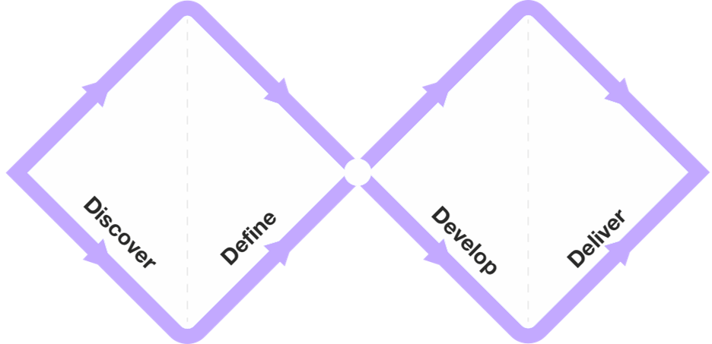


Research Methodology
A service design process grounded in observation and user research
01.
02.
03.
04.
Discover
Define
Develop
Deliver
Observe the service context
Synthesize user pain points
Translate findings into user needs
Prototype and evaluate
1-hour sessions for 5 days with 140 students.
Online survey with 25 international students.
Service requirements for BARO concept & flow
Figma prototype usability review with 8 people.
Data Sources
  Field notes and non-identifying photographs.
  Online survey (2–6 Sep 2025).
  Customer journey map.
  Post-use Likert ratings and open comments
Research setting
  Institute for Korean Langage Education (IKLE), Dongseo University

Slide 5

Findings
100%
80%
20%
68%
Survey results point to uncertainty at the point of disposal
Experienced Confusion
Had Disposed Incorrectly
Felt Confident Sorting
Willing to Use an App
25 out of 25 correspondents
20 out of 25 correspondents
5 out of 25
correspondents
17 out of 25 correspondents
Pain Point & Design Implication
Therefore the critical pain point becomes the decision-making moment at disposal station.
Simplify the choice, show only relevant instructions, and make guidance available right at the bin.

Slide 6
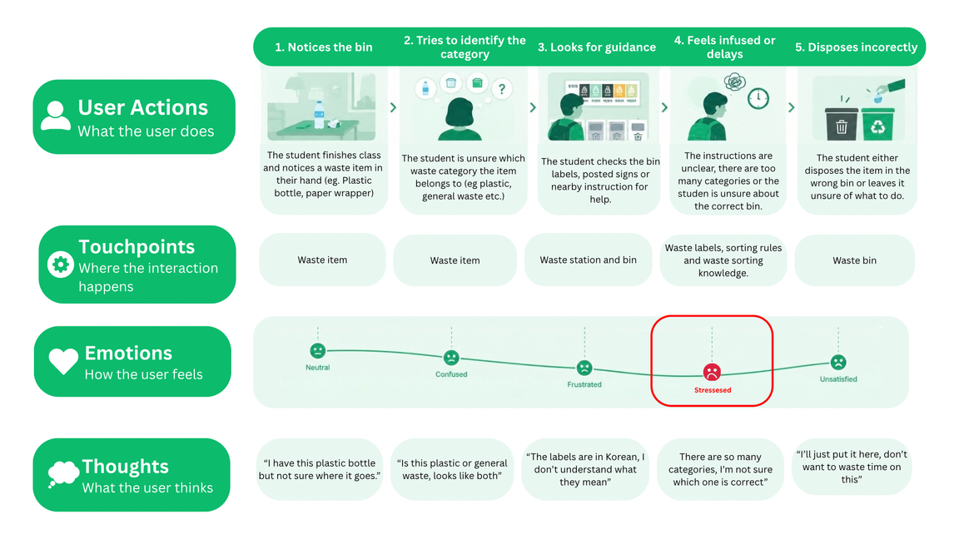
Experience Synthesis
The customer journey reveals a critical moment of uncertainty
A customer journey map helps to understand the user’s view of the current flow and pin the intervention point, which is the decision stage. This is when the user must classify an item quickly despite limited certainty.

Slide 7
Proposed Solution
바로 (Right away), is a QR-based web application designed to support the disposal of a specific item, not to teach every rule before the user starts.
BARO brings building-specific guidance to the waste station
1
2
QR Access
Item Scan
Loads the rules for that building or station.
Helps users identify the item to discard.
Four Design Principles
  Fast
  Building-specific
  Minimal interaction
  Plain-language and
  visual
3
4
Relevant Answer
Language + Guide
Shows the category and preparation steps only.
Offers language options and a fuller waste guide.
Waste-item recognition was simulated in Figma; it was not technically implemented.

Slide 8
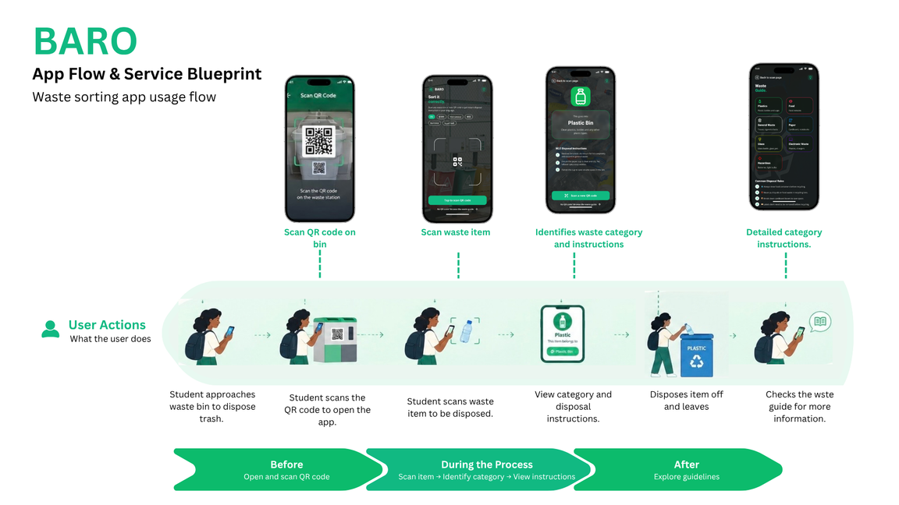
Interface & Interaction Design
With no mandatory user login, the user sequence starts by scanning the station QR → scan the item → view category and preparation instructions → dispose → consult the guide if needed.
A short flow prioritizes an answer before detailed learning

Slide 9
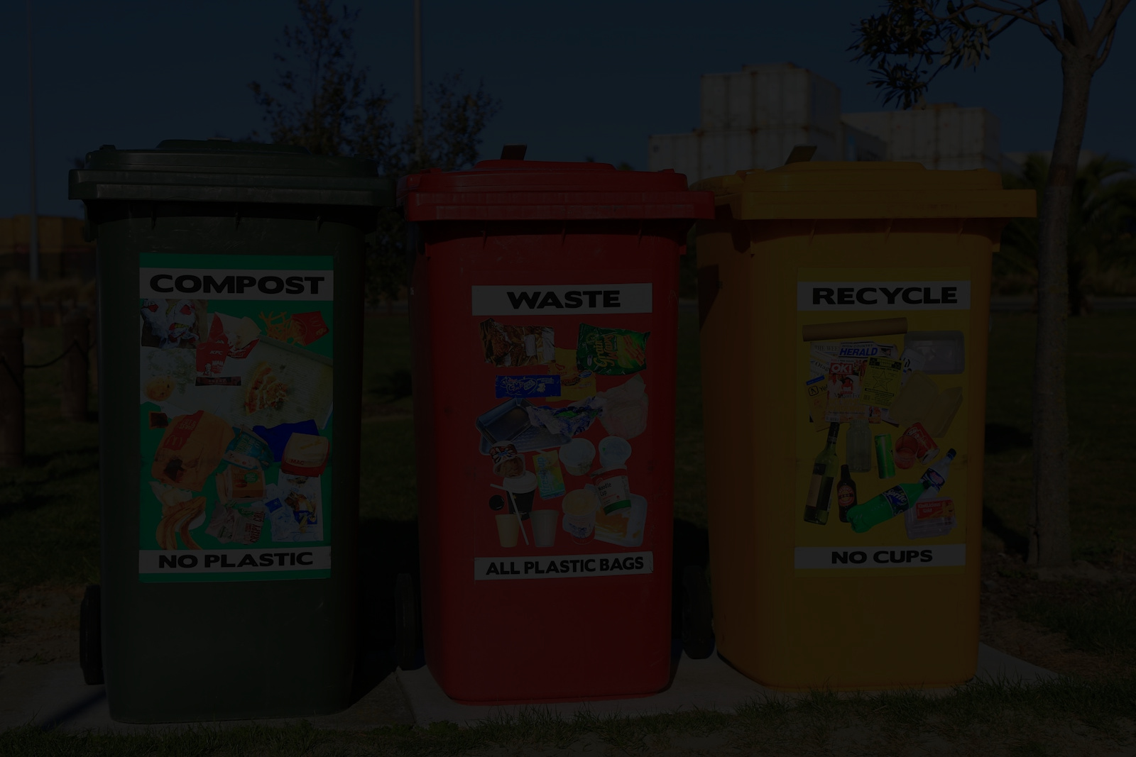
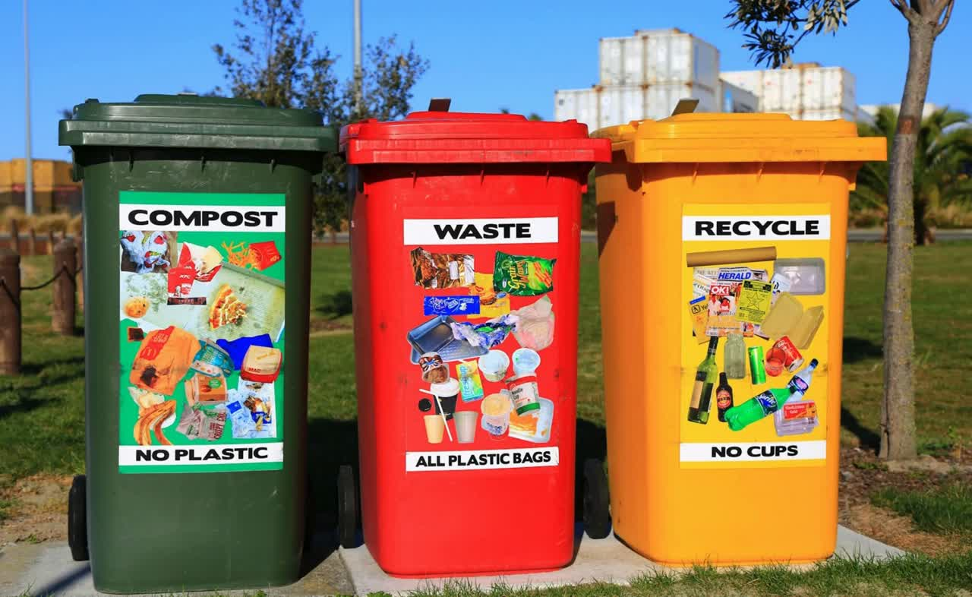

Slide 10

Preliminary Usability Testing
Participants most clearly recognised the problem-solving value
Participants made suggestions to add more languages, and also connect to official municipal information to be certain on the proper disposal methods. They also suggested to allow feedback on missing or unclear guidance.

Slide 11
Discussions & Conclusion
Contribution
A point-of-disposal service design approach for international students, connecting user research to service requirements and interface decisions.
Design for the moment when knowledge must become action
What We Learned
Users recognised the problem-solving potential most clearly; ease of use was less convincing and needs refinement.
Key Takeaway:
BARO is a promising prototype for immediate decision support, not yet evidence of improved real-world disposal behaviour. This is because it was limited by a small sample size, simulated recognition, and hypothetical use.
Future Steps
Implement real item recognition; test in a live disposal setting; measure accuracy, task time and errors; establish an information-update process.

Slide 12

Thank You
Questions and Open Discussion

