Slide 1
ICCT CONFERENCE PAPER PRESENTATION
Hiding the Eyes: Narrative Effects of Hidden-Eye Close-Ups in Anime
Christa Springs & Sunghoon Cho
Dongseo University, Busan, South Korea

Slide 2
TABLE OF CONTENTS
Introduction & Research Question
Research Methodology
1
6
Reason for Study
Case Studies: Sound! Euphonium & Re:Zero
2
7
Defining the Hidden-Eye Close-up Shot
Comparative Analysis
3
8
Theoretical Framework of Omission
Conclusion
4
9
Coding of Eye Omission
5

Slide 3
INTRODUCTION: Eyes - The Window to the Soul
Traditional Expectation
Anime Subversion
"The eyes are the windows to the soul" (anonymous) – Close-ups deepen empathy and grant immediate access to internal emotions.
Japanese animation frequently reverses this by obscuring eyes, turning a revealing device into one of withholding and ambiguity.
[1] A. Brown, “Narrative technique: Point of view,” vol. 1, 2024. Unpublished.
[2] I. Ribó, Prose Fiction: An Introduction to the Semiotics of Narrative. Cambridge, UK: Open Book Publishers, 2019, pp. 2–3.
[3] J. E. Cutting, “Narrative theory and the dynamics of popular movies,” Psychon. Bull. Rev., vol. 23, p. 1713, 2016.

Slide 4
RESEARCH QUESTION
PRIMARY QUESTION
How are Hidden-Eye Close-Ups used as narrative devices in anime?
ANALYTICAL SCOPE
SELECTED CORPUS
Investigating specific narrative contexts in selected anime episodes
Key scenes from Sound! Euphonium (S2E10) and Re:Zero (S3E1).
Notes:
To investigate the narrative function of hidden-eye close-up shots in Sound! Euphonium, Season 2 Episode 10 and Re:Zero - Starting Life in Another World, Season 3 Episode 1.

Slide 5
REASON FOR THE STUDY
To investigate the narrative function of hidden-eye close-up shots in Sound! Euphonium, Season 2 Episode 10 and Re:Zero - Starting Life in Another World, Season 3 Episode 1.

Slide 6
Hidden-Eye Close-Up
Definition: A close-up of a character’s face that intentionally and obviously omits the character’s eyes, leaving the final emotional state open to interpretation.

Slide 7
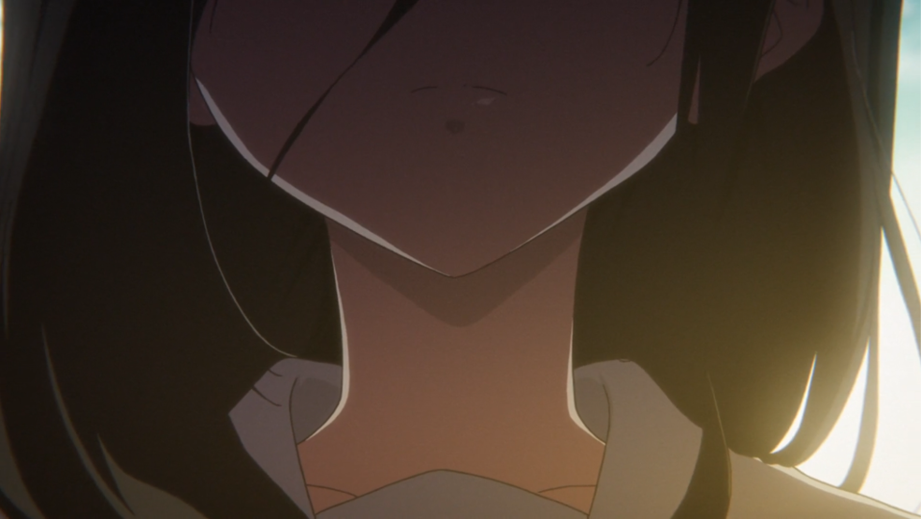
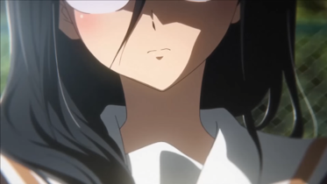
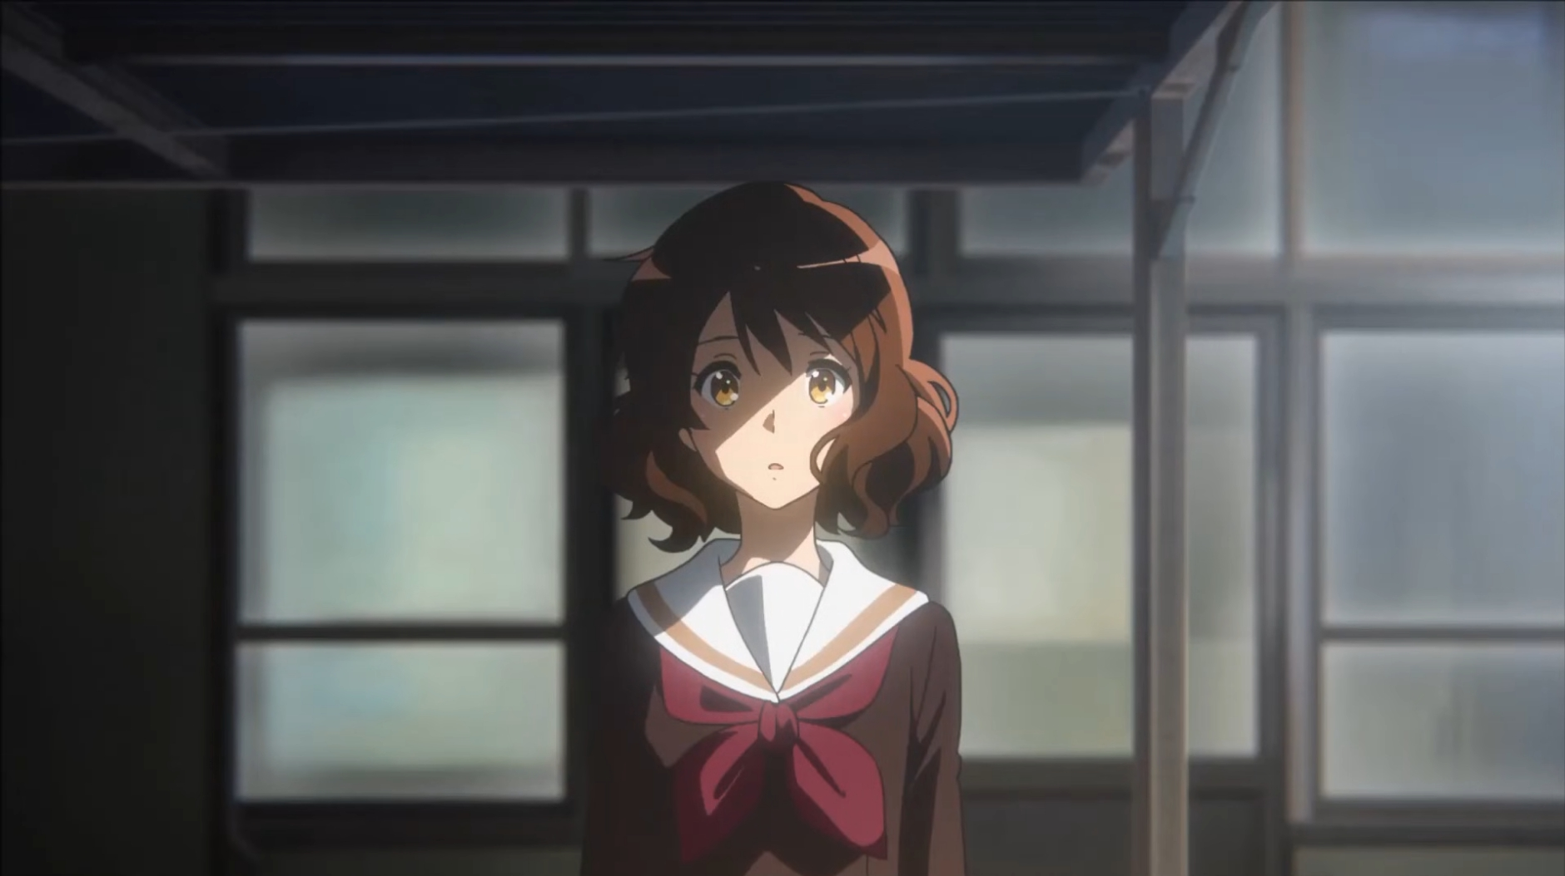
FRAMEWORK: OMISSION
Hanich: “What is left out is not a mere lack here – it results from the conscious artistic act of leaving things open”
Omission
Suggestion
Completion
Something is intentionally left out of the frame. This intentionality is communicated to the audience.
Visual or oral cues (lighting, music, posture, set-up, etc) encourage audience participation to complete the image.
Audience completes the process by filling in the film’s gaps through their own imaginative process.
[6] J. Hanich, “Omission, suggestion, completion: Film and the imagination of the spectator,” Screening the Past, no. 43, 2018.

Slide 8
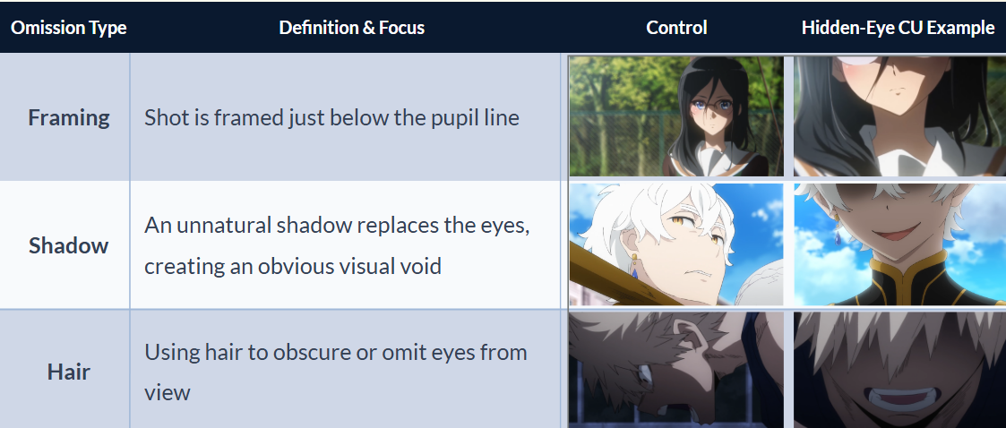
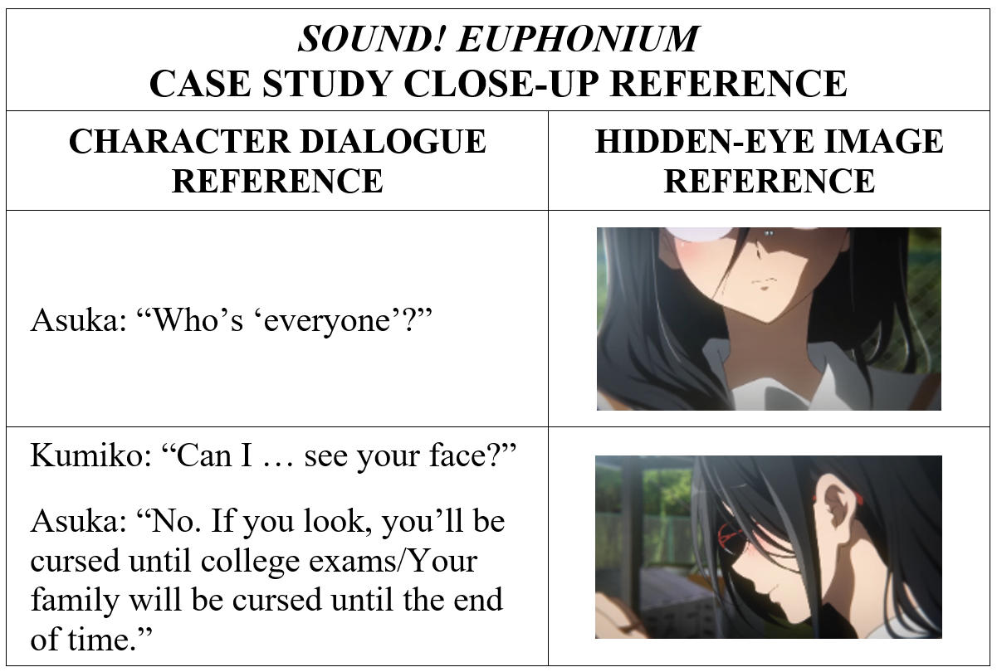
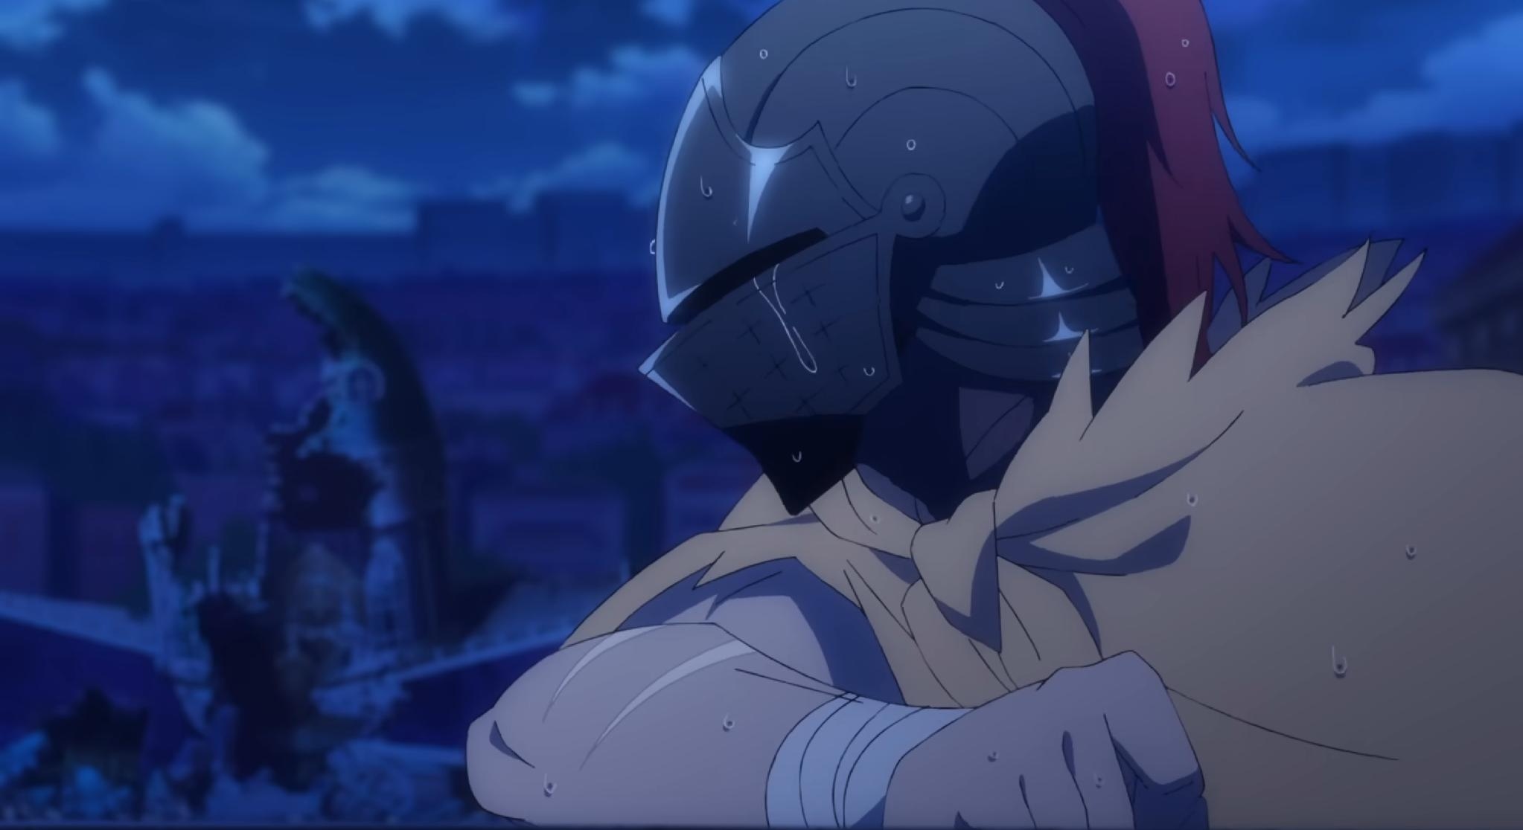
RESEARCH METHODOLOGY
Qualitative Research Method:
Deliberate Omission: Compared the Hidden-Eye Close-Up to other shots in the same scene where eyes ARE visible.
Visual Mechanism: Identifying how the eyes were omitted
(cropping, shadows, or hair obstruction)
Narrative Context: Analyzed dialogue interactions
(cross-referenced via OpenAi Whisper/Whisper-4o), music, lighting, framing, and other scene elements
Exclusion: Excluded characters who wore masks or veils as a part of the character design.

Slide 9
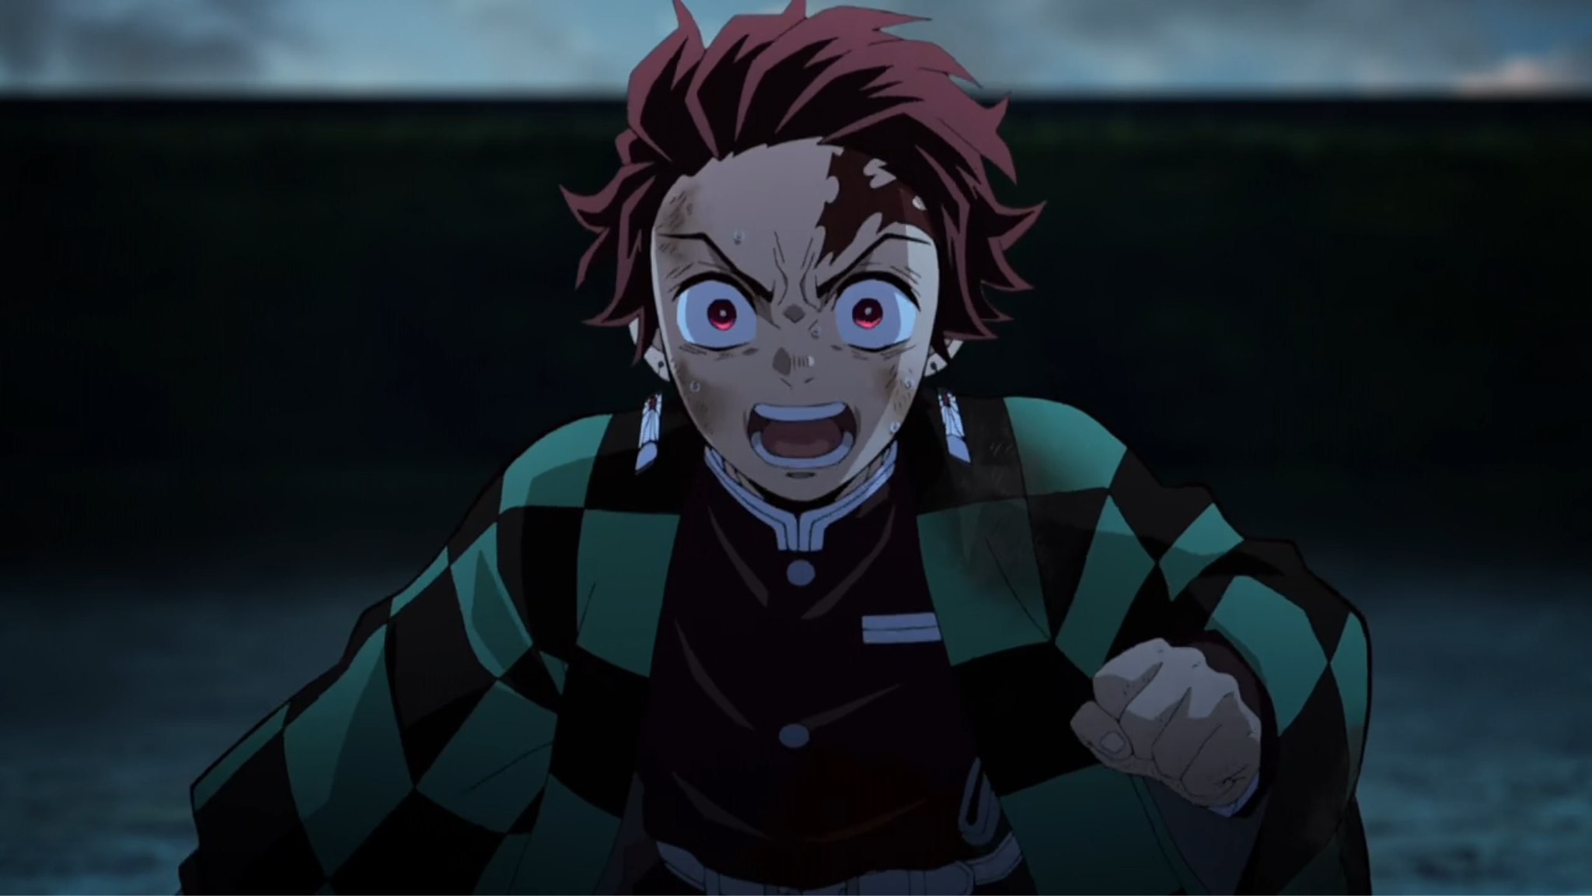
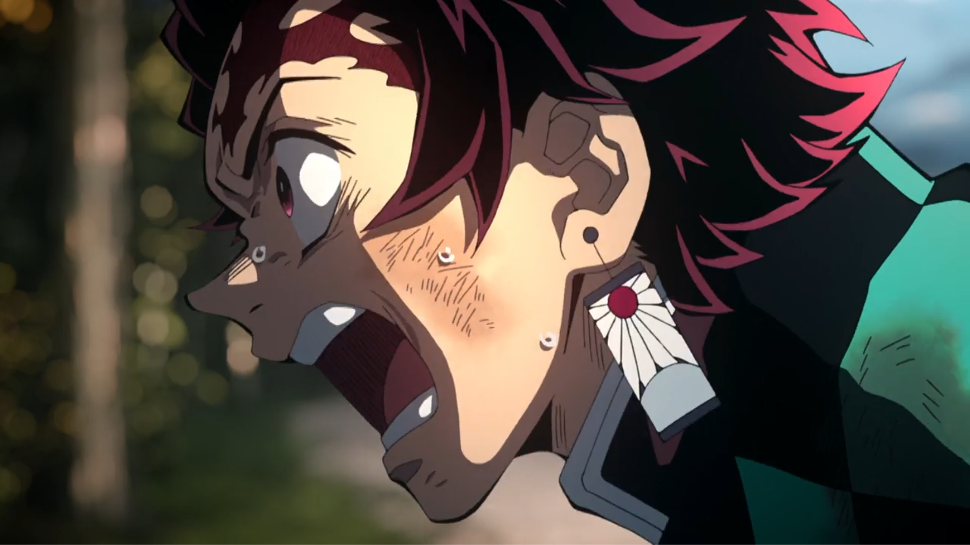
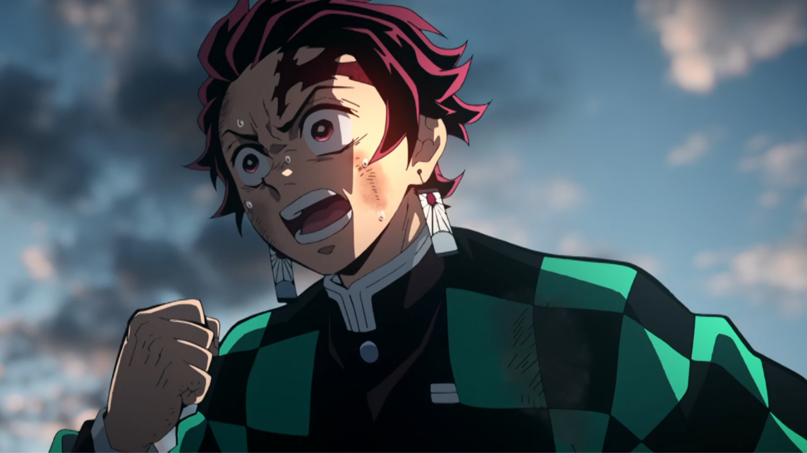
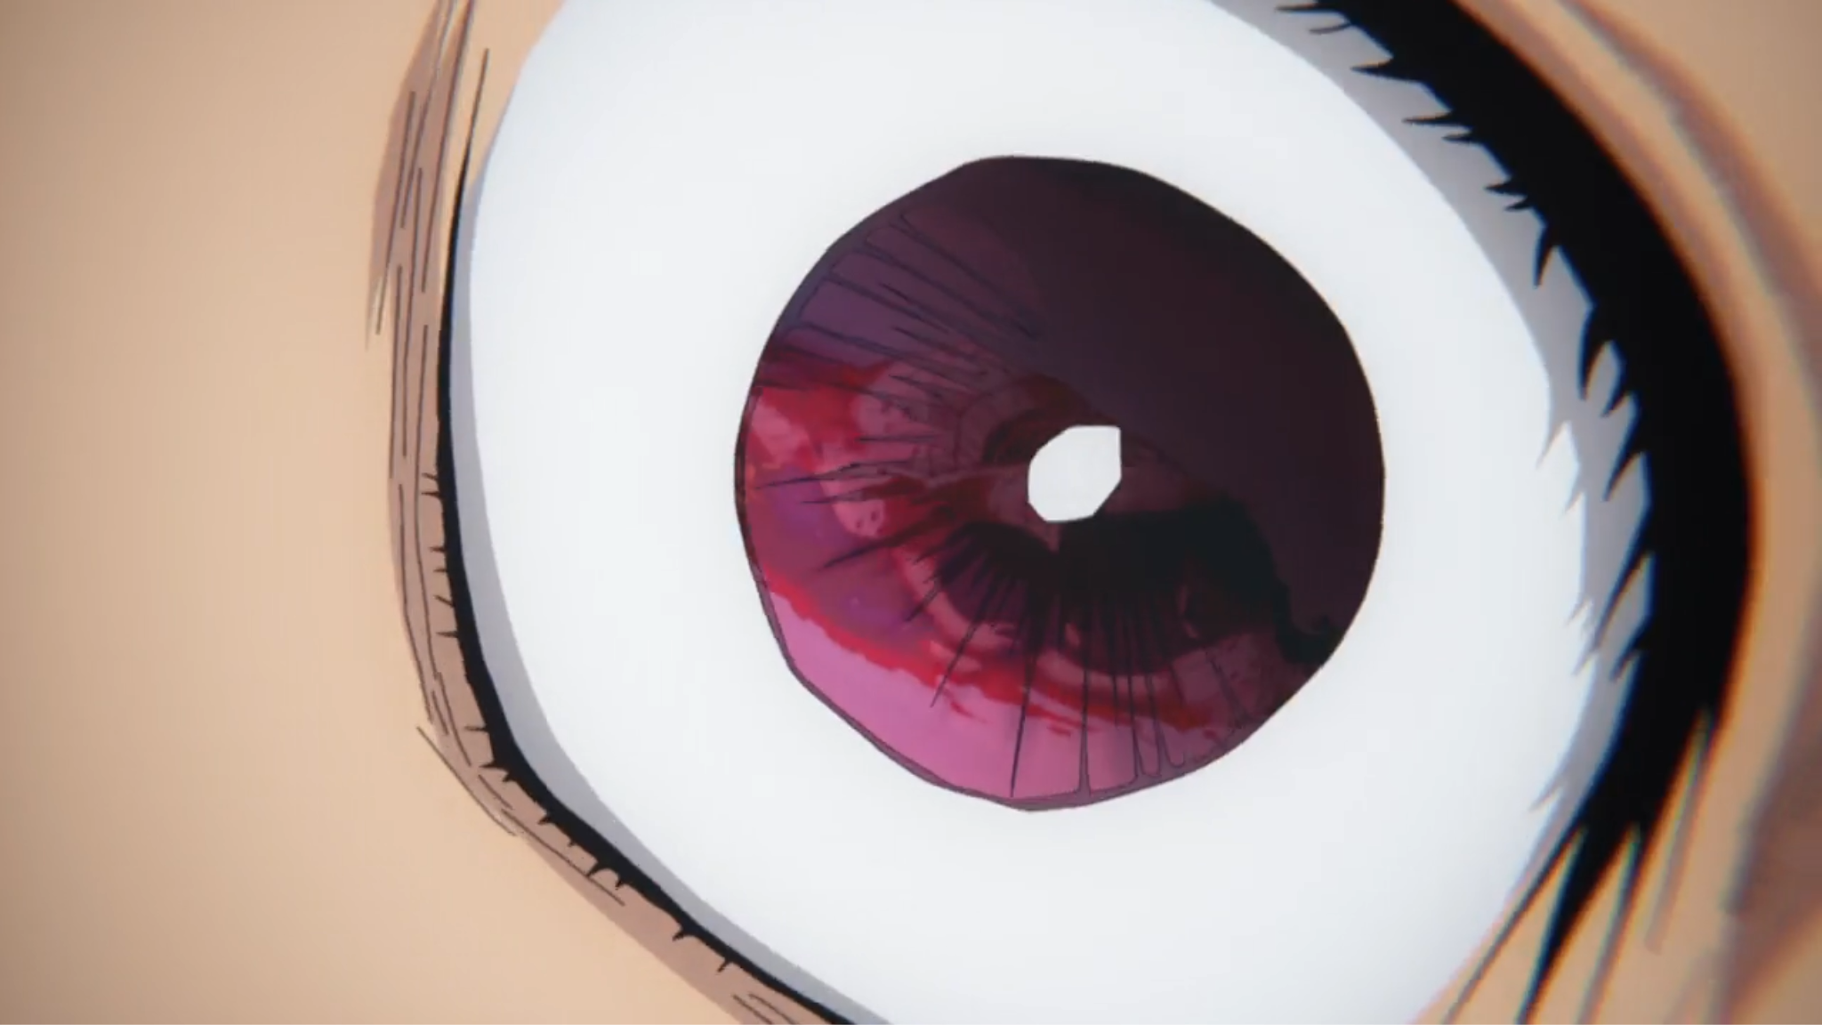
WHAT IS A CLOSE-UP SHOT?
Examples of a “Close-Up” Shot
Medium Close-Up: Shot from the chest or waist upward | Close-up (CU): Shot from upwards from the neck or shirt pockets | Choker: Shot from the top of the head to the chin | Extreme Close-up (ECU): Focuses on one element or detail
Figures: Examples of types of close-up shots where the eyes are used to accentuate the character’s emotional state. Images from Sotozaki , Demon Slayer: Kimetsu no Yaiba – The Movie: Mugen Train, 2020
[4] F. E. Beaver, Dictionary of Film Terms: The Aesthetic Companion to Film Art, 2nd ed. New York, NY: Peter Lang Publishing, 2007, p. 45.
[5] A. Orsi, “The close-up,” in Early Film Theories in Italy 1896–1922: The Little Magic Machine, F. Casetti, S. Alovisio, and L. Mazzei, Eds. Amsterdam, Netherlands: Amsterdam University Press, 2021, p. 136.

Slide 10
TYPES OF HIDDEN-EYE CLOSE-UPS
Images: Sound! Euphonium, Season 2, Ep. 10, “After school obligato,” Directed by T. Ishihara. Japan: Kyoto Animation, Nov. 30, 2016. [TV series episode].
Re:Zero – Starting Life in Another World, Season 3, Ep. 1, “Theatrical malice,” Directed by M. Shinohara. Japan: White Fox, Oct. 2, 2024. [TV series episode].
My Hero Academia, Season 3, Ep. 22, “A talk about your quirk,” Directed by K. Nagasaki. Written by Y. Kuroda. Japan: Bones, Sep. 8, 2018. [TV series episode].

Slide 11
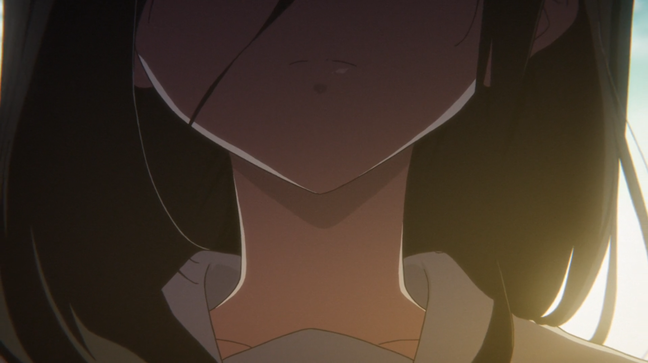
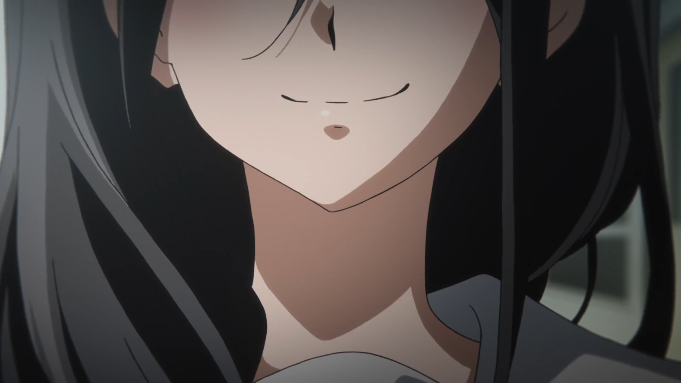
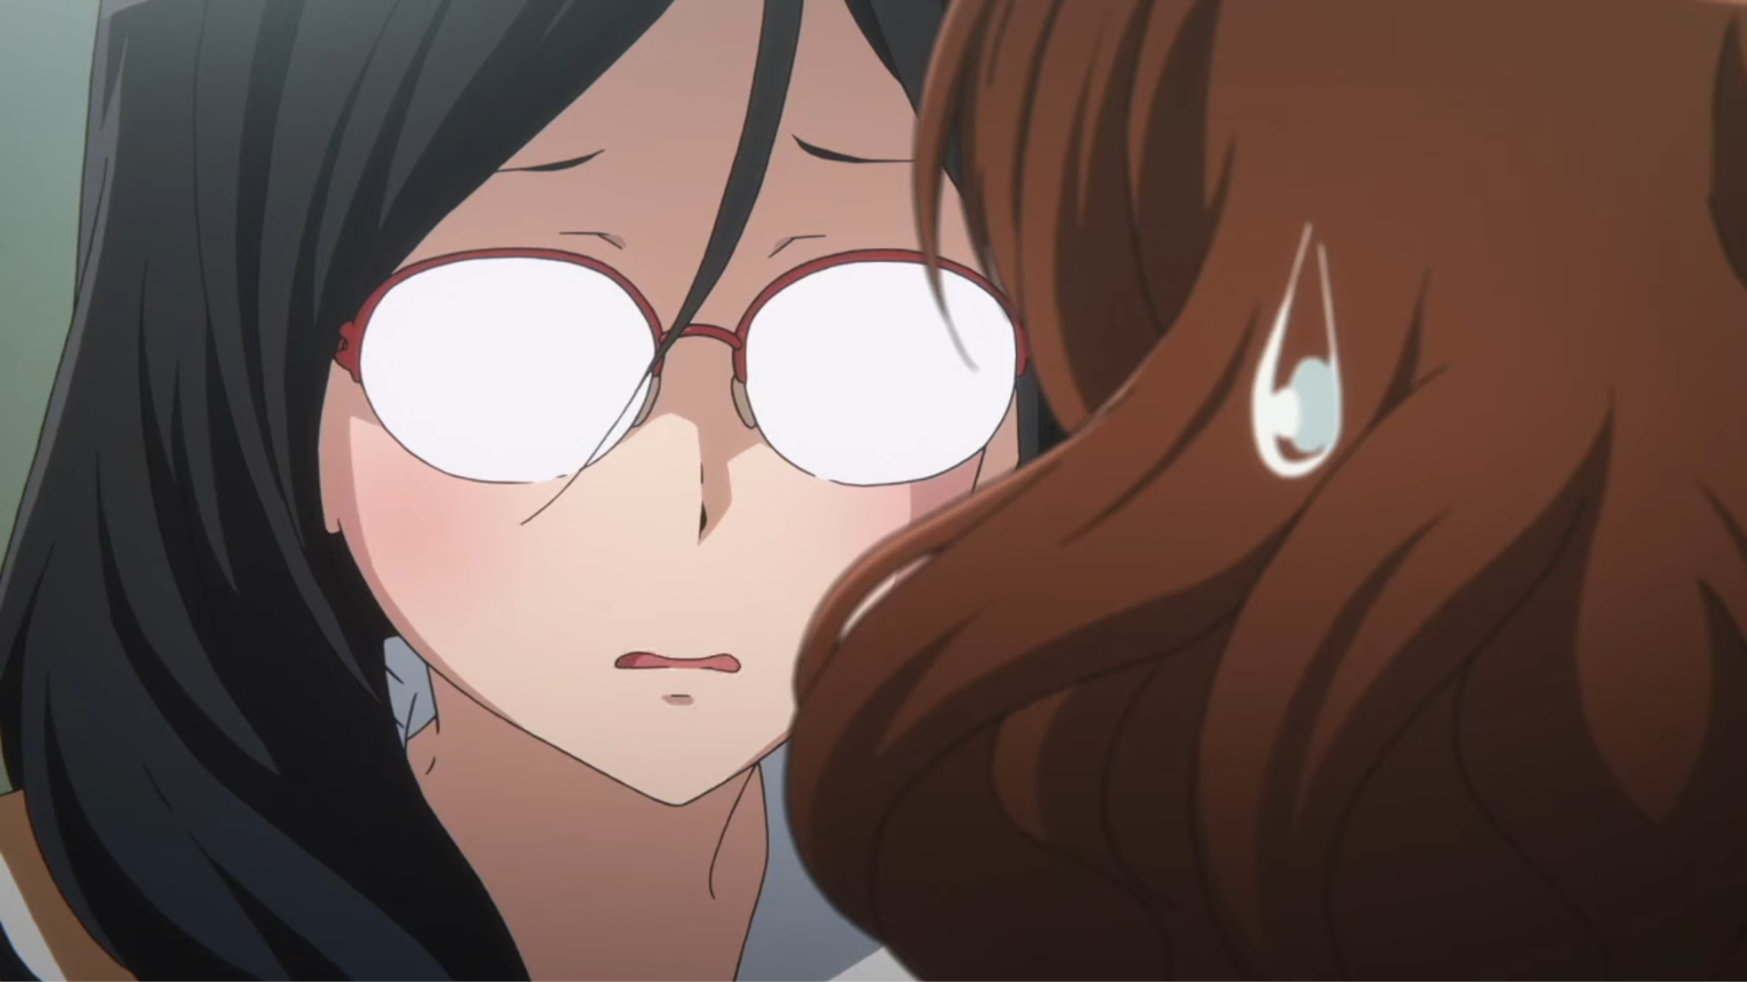
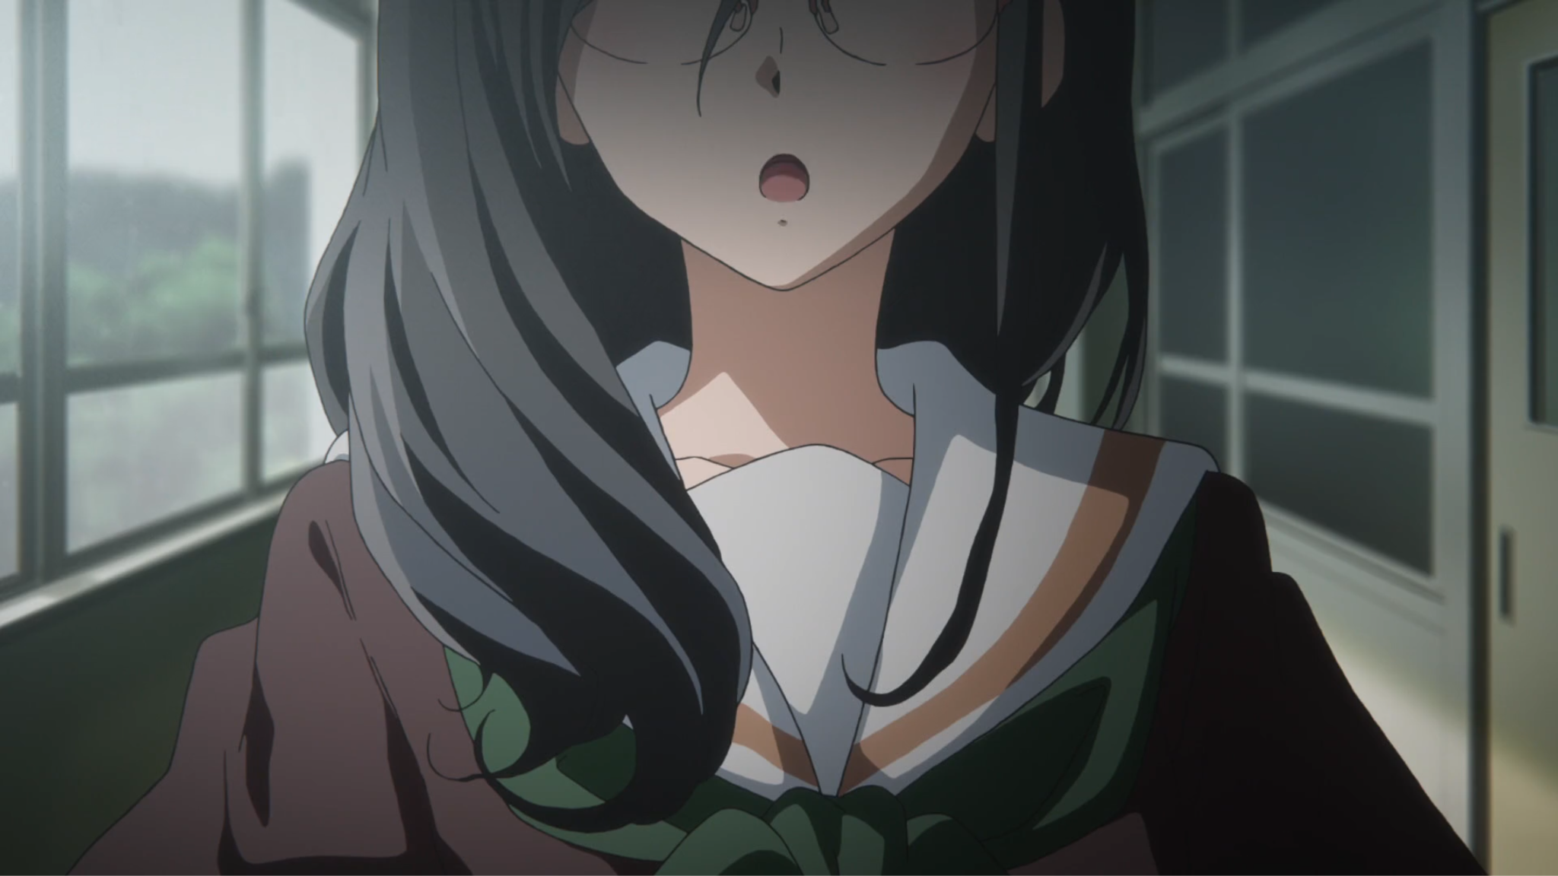
CASE STUDY: SOUND! EUPHONIUM
Fig 1. Additional occurrences of visual obstruction with Asuka during emotional moments
Tanaka Asuka
EMOTIONAL ELUSIVITY
Hidden-eye close-ups reflect Asuka’s persistent emotional distance during high-stakes interpersonal confrontations.
Sound! Euphonium, Directed by T. Ishihara. Japan: Kyoto Animation, Nov. 30, 2016. [TV series episode].
Notes:
Describe Asuka’s character in general first.
Director Tatsuya Ishihara predominantly employs hidden-eye close-ups for Asuka's character throughout the series. These unexplained moments are emphasized by the reactions of the surrounding characters, specifically frustration from the mystery surrounding Asuka’s intentions.

Slide 12

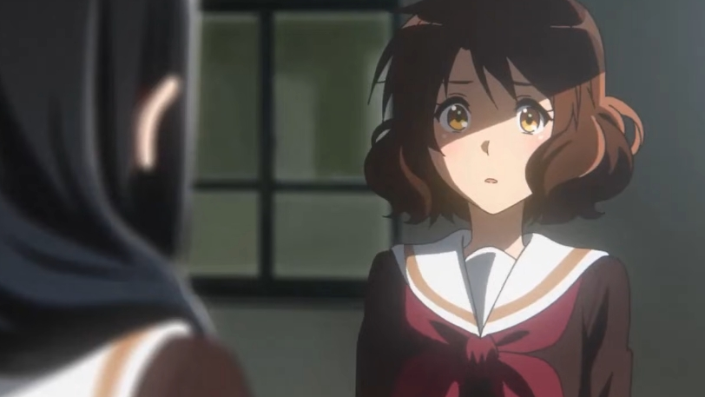
CASE STUDY: SOUND! EUPHONIUM
Tanaka Asuka
Hidden-eye close up shots reflect the character’s emotional elusivity
•
Narrative Context: Confrontation; protagonist Kumiko seeks to understand Asuka’s aloofness.
Hidden-Eye CU Shot: Brief, 1.22s shots; cropped pupil lines & opaque glasses reflection.
Narrative Effect: Turns intimacy into dissonance and mirroring Kumiko’s lack of access.
Kumiko: …
•
•
Sound! Euphonium, Season 2, Ep. 10, “After school obligato,” Directed by T. Ishihara. Japan: Kyoto Animation, Nov. 30, 2016. [TV series episode].
Notes:
Narrative Context: scene where Asuka is arguing with the main character, oddly enough, where the main character seeks to understand Asuka’s motives.
Visual Mechanism: The scene is about 6 minutes long, during which Asuka’s eyes and expressions are presented clearly except for two shots. The first shot is just 1.22 seconds long. It disrupts this back and forth flow of conversation with this jarring shot, which is a hidden-eye close up. A close up shot of Asuka’s face, framed just below her eyes. Blink and you will miss it. Were it not for the other character’s shocked expression, it could be easily thought of as a mistake. But the tone of the conversation begins to shift from this point at well.
Can I see your face?
disrupted flow; Protagonist’s reaction

Slide 13
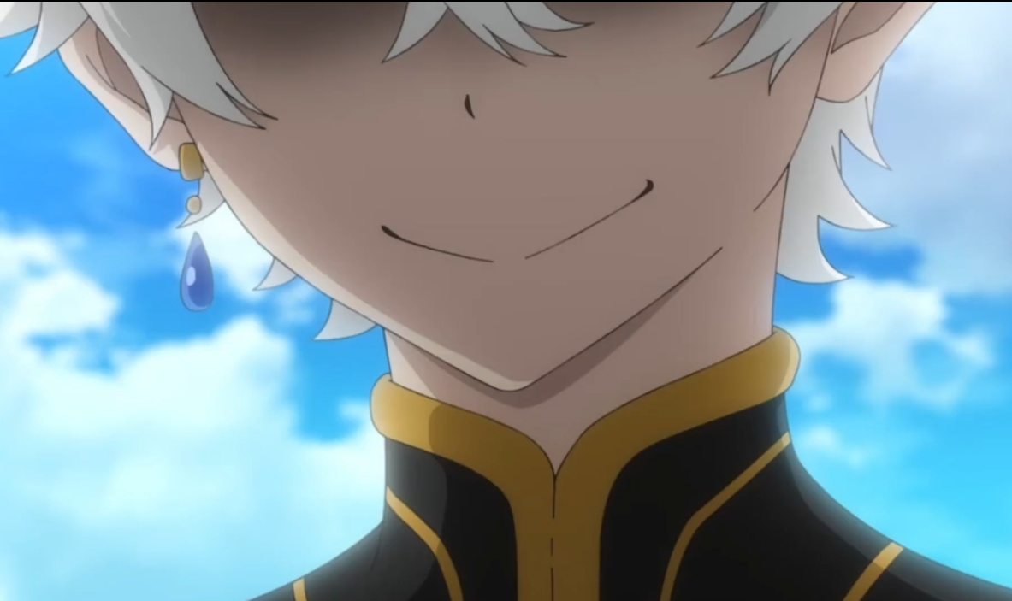

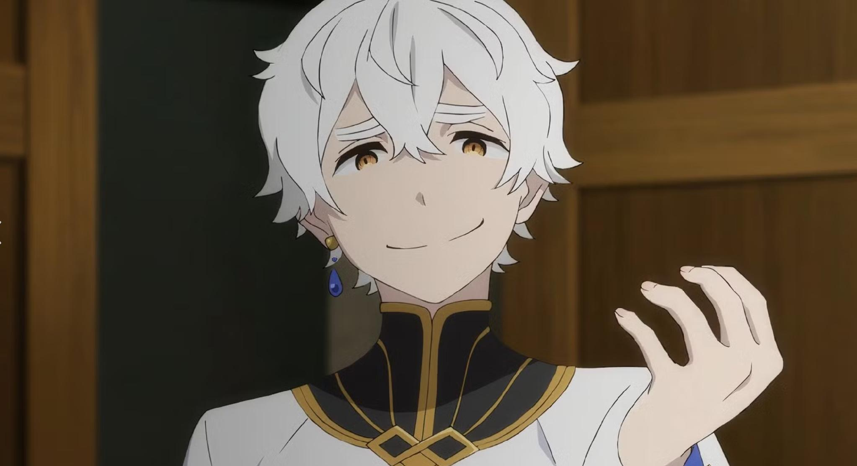

CASE STUDY: RE:ZERO
Fig 2. Control shots of Regulus in other scenes prove the character has eyes and his evil nature
Regulus Corneas
VISUAL WARNING
Reintroducing a Character: Shinohara introduces Regulus for the 3rd time in the series, yet obscures his face. In episode 1 of the third season, Regulus’s face is concealed for the entire introduction. The question is why?
Re:Zero – Starting Life in Another World, Season 3, Directed by M. Shinohara. Japan: White Fox, Oct. 2, 2024. [TV series episodes].
Notes:
Reintroducing a Character: Shinohara introduces Regulus for the 3rd time in the series, yet obscures his face. In episode 1 of the third season, Regulus’s face is concealed for the entire introduction. The question is why?

Slide 14
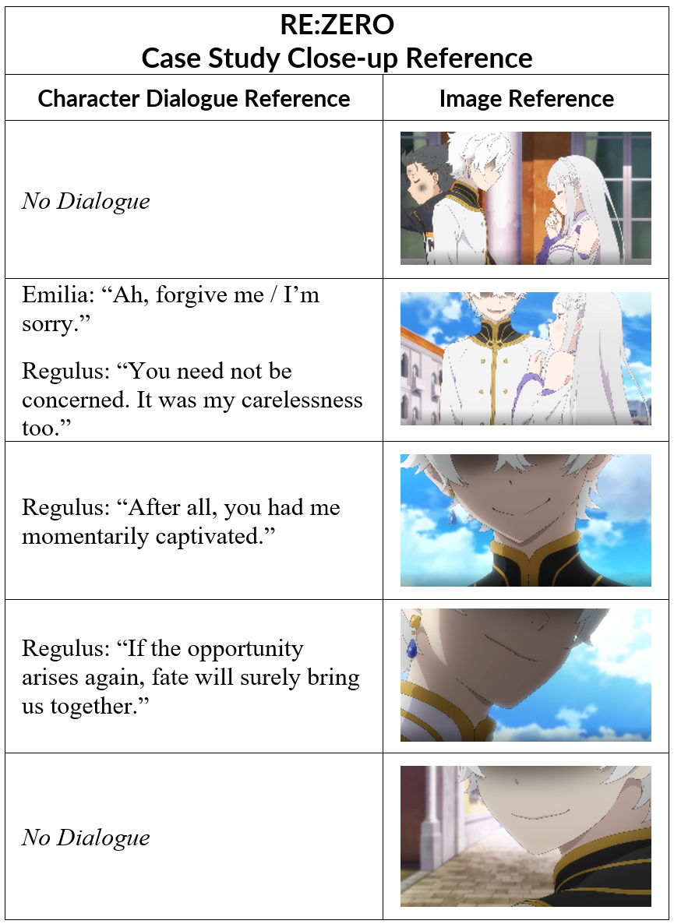
CASE STUDY: RE:ZERO
Regulus Corneas: Visual Warning
Concealment signals psychological instability despite outward polite pleasantries.
•
Narrative Context: Character introduction
Visual Mechanism: Persistent unnatural heavy shadow independent of scene lighting.
Narrative Effect: Polite pleasantries vs. constant visual concealment creates unease.
•
•
Re:Zero – Starting Life in Another World, Season 3, Ep. 10, “Theatrical malice,” Directed by M. Shinohara. Japan: White Fox, Oct. 2, 2024. [TV series episode].

Slide 15
COMPARATIVE ANALYSIS RESULTS
Metric | Sound! Euphonium (2.10) | Re:Zero (3.01)
Character | Tanaka Asuka | Regulus Corneas
Mechanism | Framing / Hair Obstruction | Shadow / Framing Omission
Frequency | Twice (Strategic) | Seven Times (Introductory)
Effect | Awkwardness & Empathy Block; Thematic | Threat, Instability & Unease

Slide 16
RESEARCH QUESTION
PRIMARY QUESTION
How are Hidden-Eye Close-Ups used as narrative devices in anime?
ANALYTICAL SCOPE
SELECTED CORPUS
Investigating specific narrative contexts in selected anime episodes
Key scenes from Sound! Euphonium (S2E10) and Re:Zero (S3E1).
Notes:
To investigate the narrative function of hidden-eye close-up shots in Sound! Euphonium, Season 2 Episode 10 and Re:Zero - Starting Life in Another World, Season 3 Episode 1.

Slide 17
Thank you!
Hiding the Eyes: Narrative Effects of Hidden-Eye Close-Ups in Anime

