Slide 1
Dual-Phase Anatomical Prior Learning for Liver Lesion Segmentation on Non-Contrast CT
¹Thi Thanh Thuy Nguyen, ¹Hyunji Lee, ²Yu Rim Lee, ²Soo Young Park,
²Won Young Tak, ¹Soon Ki Jung*
¹School of Computer Science and Engineering, Kyungpook National University, South Korea
²Department of Internal Medicine, College of Medicine, Kyungpook National University, South Korea

Slide 2
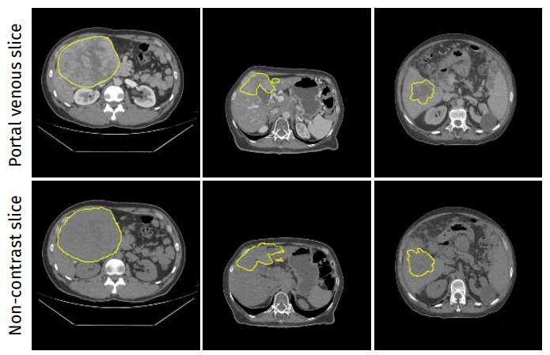
Dual-Phase Anatomical Prior Learning for Liver Lesion Segmentation on Non-Contrast CT
Introduction
NCCT liver lesion segmentation is challenging because lesions often have low contrast and indistinct boundaries
Portal venous CT provides clearer lesion information, offering complementary cues that can support NCCT segmentation during training.
Our goal is to exploit this cross-phase information while preserving NCCT-only inference.
Fig. 1. Representative paired portal venous (top row) and non-contrast CT (bottom row) axial slices from the TriALS dataset.

Slide 3
Dual-Phase Anatomical Prior Learning for Liver Lesion Segmentation on Non-Contrast CT
Research Question
Can registered portal venous CT provide complementary anatomical information to improve NCCT liver lesion segmentation while preserving NCCT-only inference?
Research Objectives
Learn a shared anatomical prior from NCCT and registered portal venous CT during training.
Introduce position-guided codebook learning to organize the learned prior with spatial anatomical information.
Improve NCCT liver lesion segmentation by fusing the learned prior with U-Net features, while requiring only NCCT at inference.

Slide 4
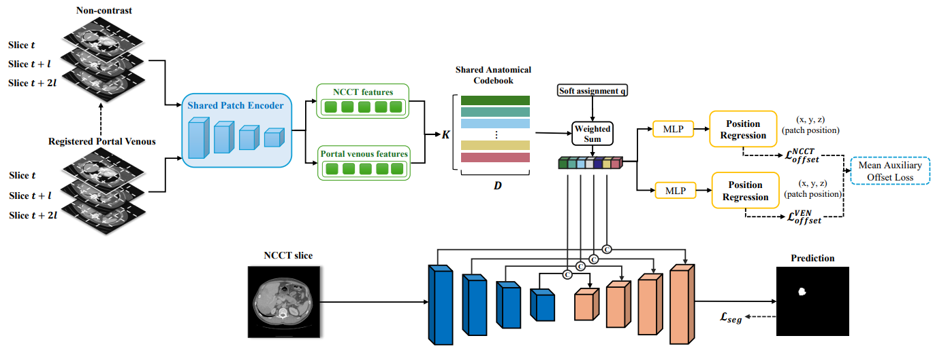
Dual-Phase Anatomical Prior Learning for Liver Lesion Segmentation on Non-Contrast CT
Methodology
Fig 2. Overview of the proposed dual-phase anatomical prior learning framework.

Slide 5

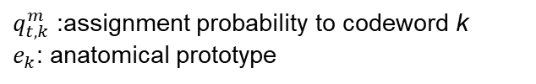
Dual-Phase Anatomical Prior Learning for Liver Lesion Segmentation on Non-Contrast CT
Methodology
Dual-Phase Patch-Level Anatomical Prior Learning
Shared anatomical codebook
NCCT and registered portal venous patches use the same patch encoder and codebook
Both phases jointly contribute to a common set of anatomical prototypes
Soft assignment retrieves a codebook-derived prior for each patch
Position-guided supervision
Relative 3D offsets between foreground patches are used as spatial supervision
This encourages the shared prototypes to encode anatomical location, not only appearance
$q_{t, k}^{m}$ :assignment probability to codeword k
$e_{k}$: anatomical prototype
Notes:
z^{m}_t is the corresponding patch embedding
K is the number of codewords and e_{k} denotes the k-th codeword
For patch t from phase m ∈ {N, V }, the soft assignment probability to codeword k is computed as:
where q m t,k denotes the assignment probability of patch t to codeword k, s(·, ·) is the feature-similarity function,
τ is the temperature parameter, and j indexes all codewords in the softmax normalization.
where v^{m}_t denotes the codebook-derived anatomical prior representation of patch t from phase m
where p^{m}_t denotes the physical 3D location of patch t
where P^{m} denotes the set of foreground patch pairs, σ(·) is the sigmoid function, and α and β are scaling coefficients.

Slide 6


Dual-Phase Anatomical Prior Learning for Liver Lesion Segmentation on Non-Contrast CT
Methodology
NCCT Segmentation with Anatomical Prior Fusion
A 2D U-Net extracts multi-scale features from the NCCT input
Codebook-derived anatomical priors are spatially rearranged and fused with the corresponding U-Net features
The segmentation model therefore combines local NCCT appearance with position-aware anatomical context
The NCCT and venous prior objectives are averaged:
The complete training objective is:

Slide 7
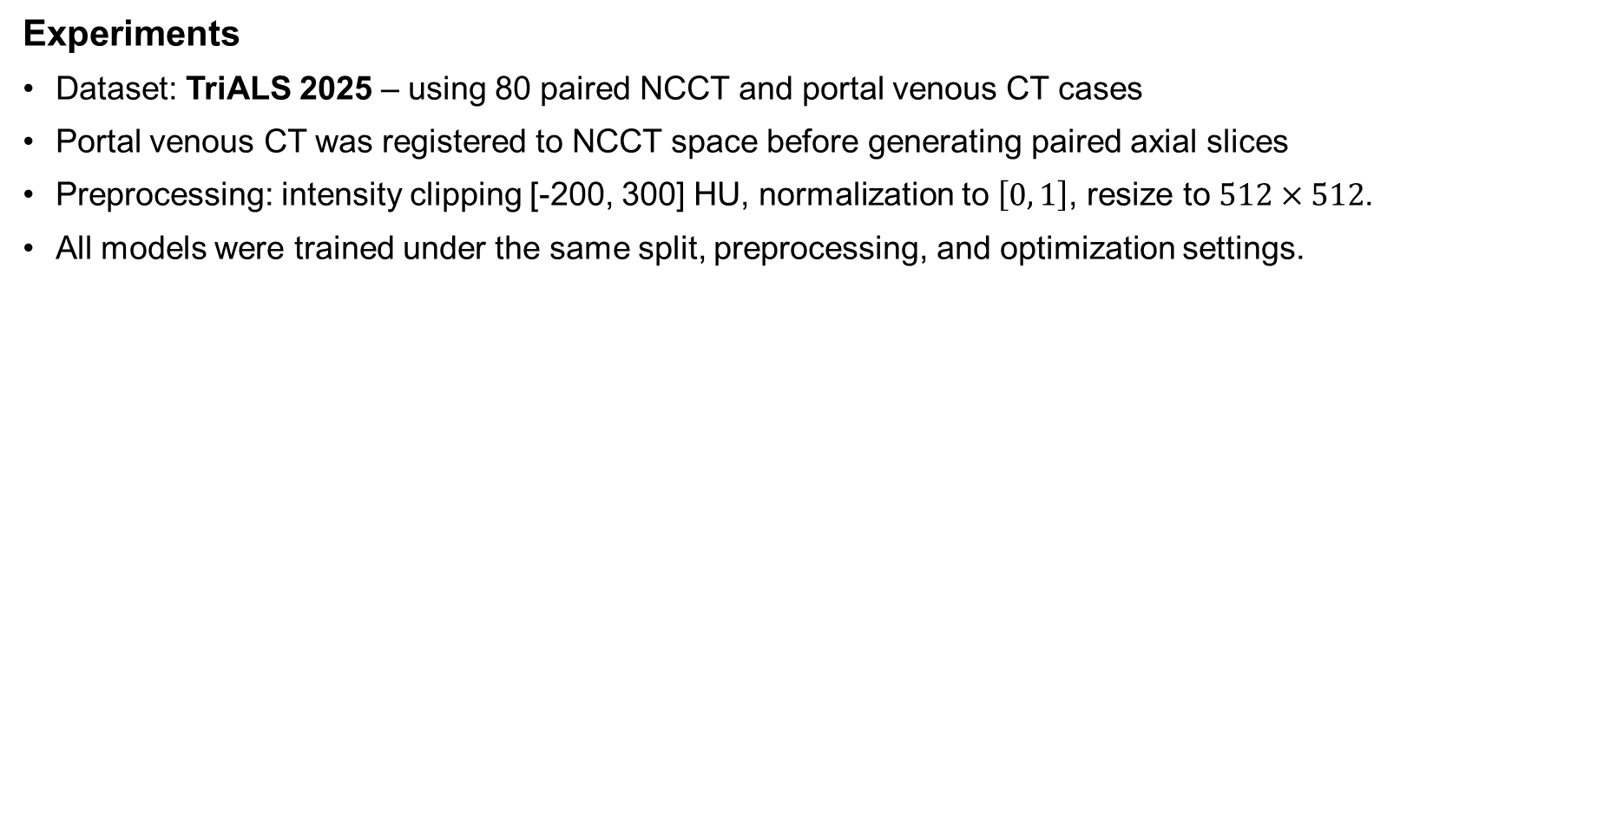
Dual-Phase Anatomical Prior Learning for Liver Lesion Segmentation on Non-Contrast CT
Experiments
Dataset: TriALS 2025 – using 80 paired NCCT and portal venous CT cases
Portal venous CT was registered to NCCT space before generating paired axial slices
Preprocessing: intensity clipping [-200, 300] HU, normalization to $\left[0 , 1\right]$, resize to $512×512$.
All models were trained under the same split, preprocessing, and optimization settings.

Slide 8
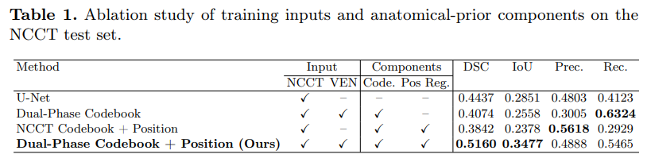
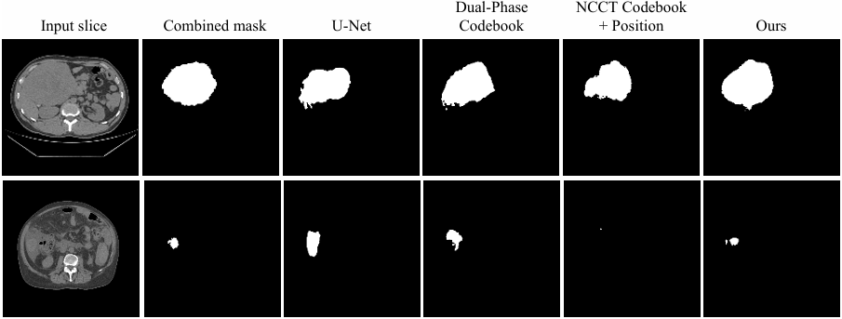
Dual-Phase Anatomical Prior Learning for Liver Lesion Segmentation on Non-Contrast CT
Results
Fig 3: Qualitative results

Slide 9
Thank you for your attention!

