Slide 1
Study on the Relationship Between Observation Posture and Vergence When Viewing 360-Degree Images
Hisaki Nate
Tokyo Polytechnic University

Slide 2
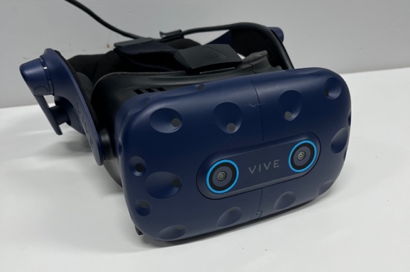
Fields where VR Goggle is used
VR headset is used in various fields.
  Training : Flight simulation
  Education: Example of masters
  Experience: Accident simulation
  Communication: VR Chat

Slide 3
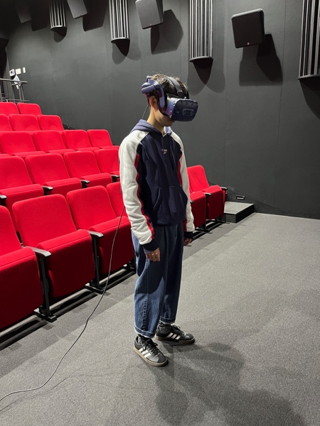
Experiment conducted in this study
Vergence was measured, when subjects viewed 360-degree images through a VR goggle.

Slide 4
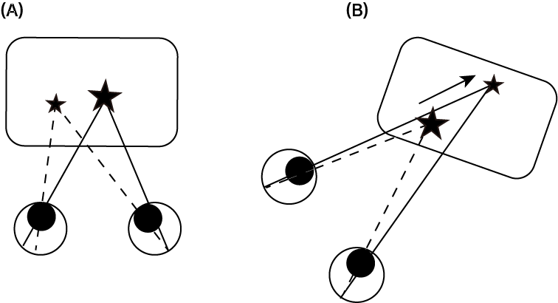
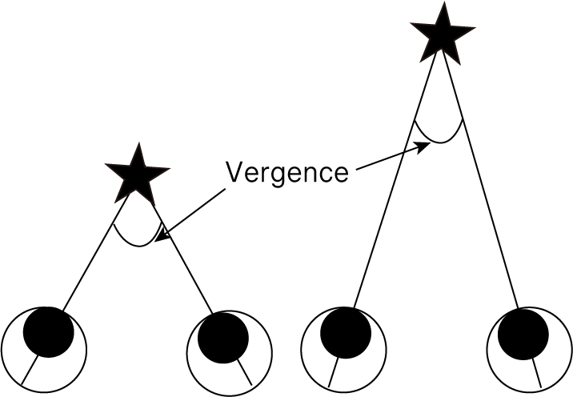
Why does vergence need to be measured?
Vergence is the angle of visual axes.
Theoretically, when viewing a 2D image, vergence is always same value (A). But it is affected by other factors like accommodation. There might be a possibility perspective information can vary vergence (B).

Slide 5
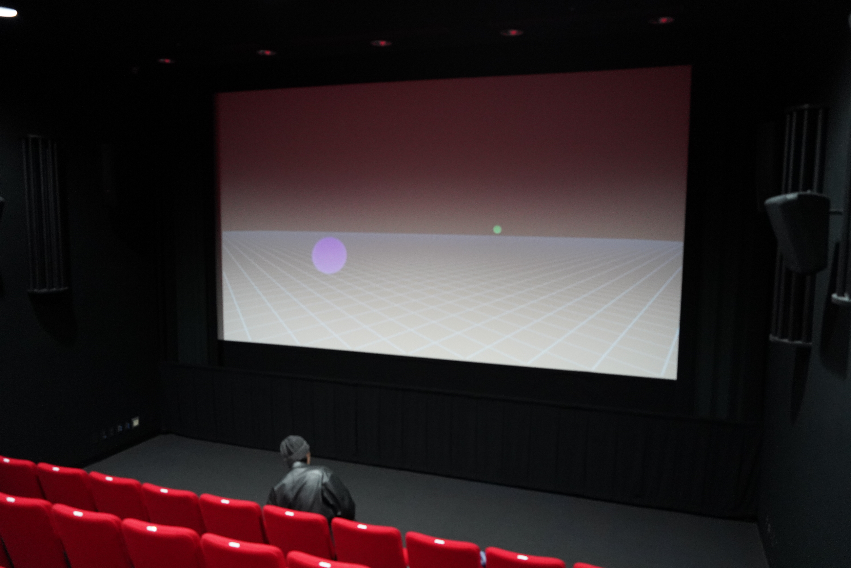
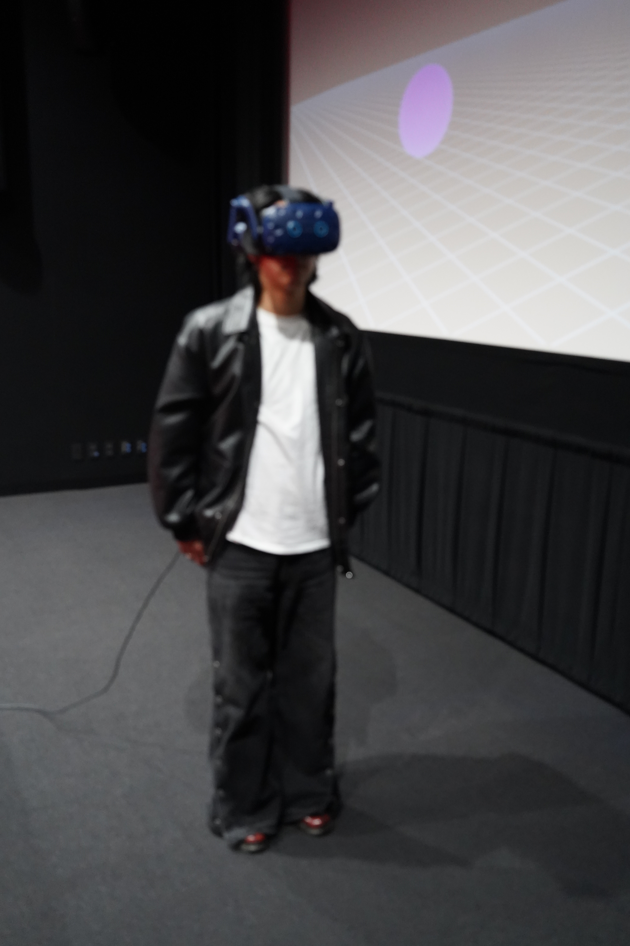
Previous our study (INTERACTION 2024)
Vergence between a 2D large display and a 360-degree image from a VR goggle was compared.
→Only in 360-degree images where the target was stationary, vergence was shifted according to the depth position of the target object.
Compare
Large screen used in the experiment
VR goggle used in the experiment

Slide 6
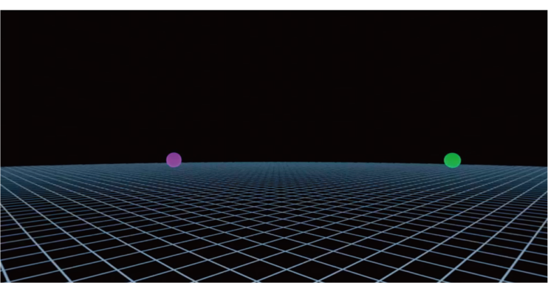
360-degree images used in the experiment

Slide 7
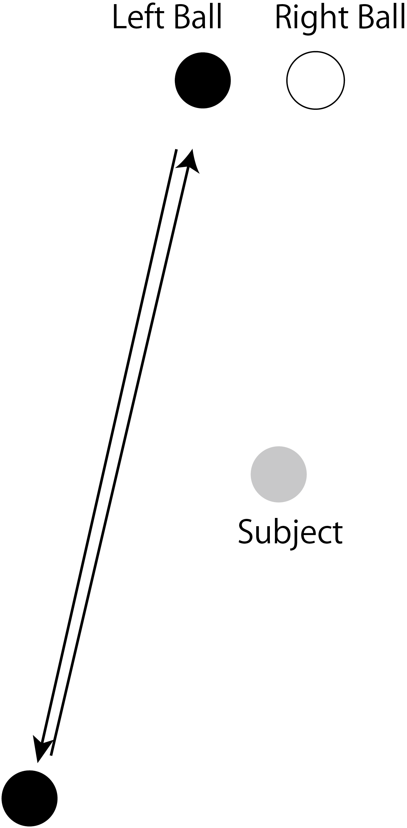
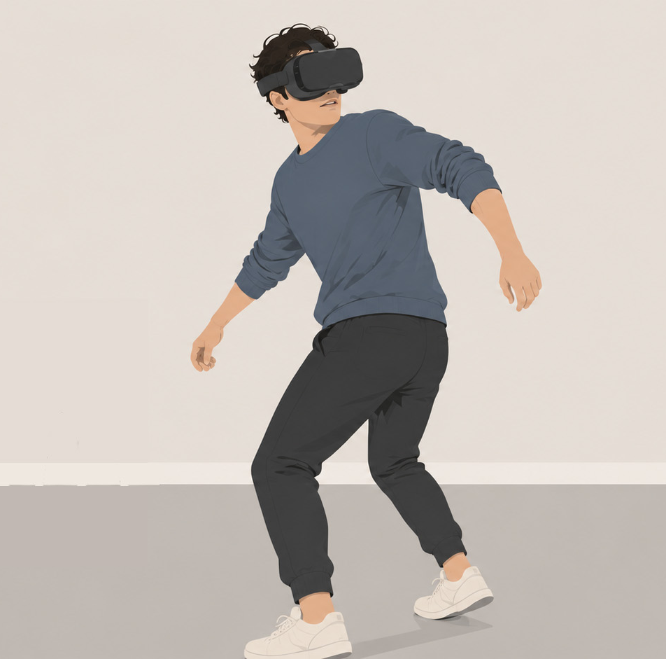
Aim of the study
I examined whether vergence changed or not as the observers changed their posture. To induce this postural change, the target was behind them.

Slide 8
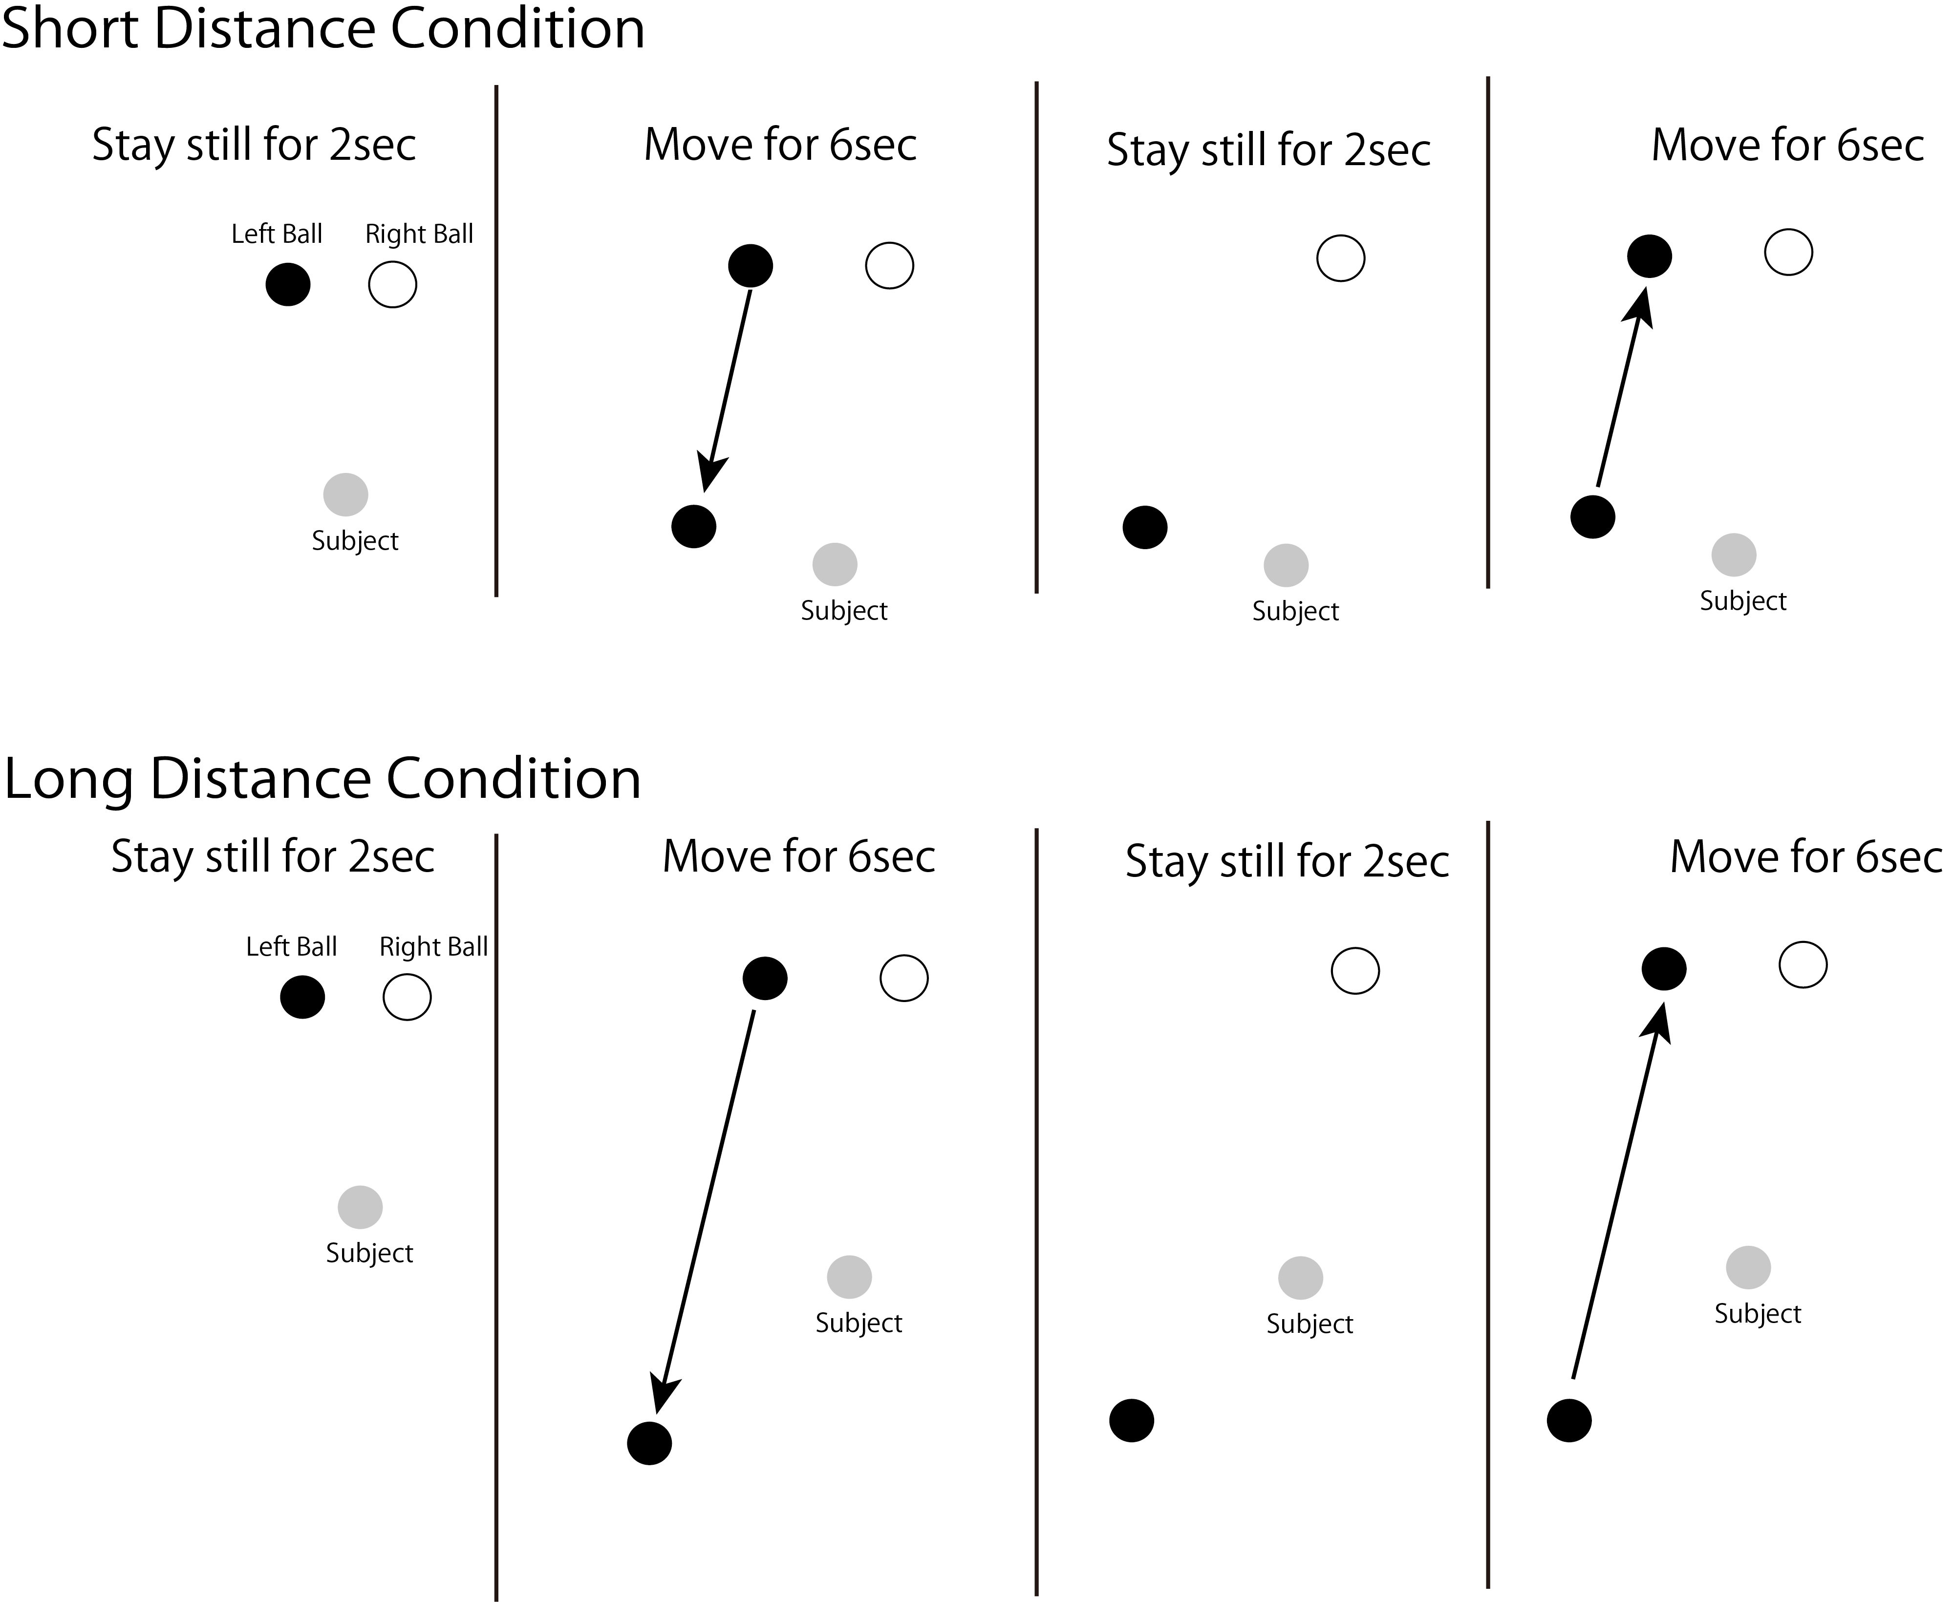
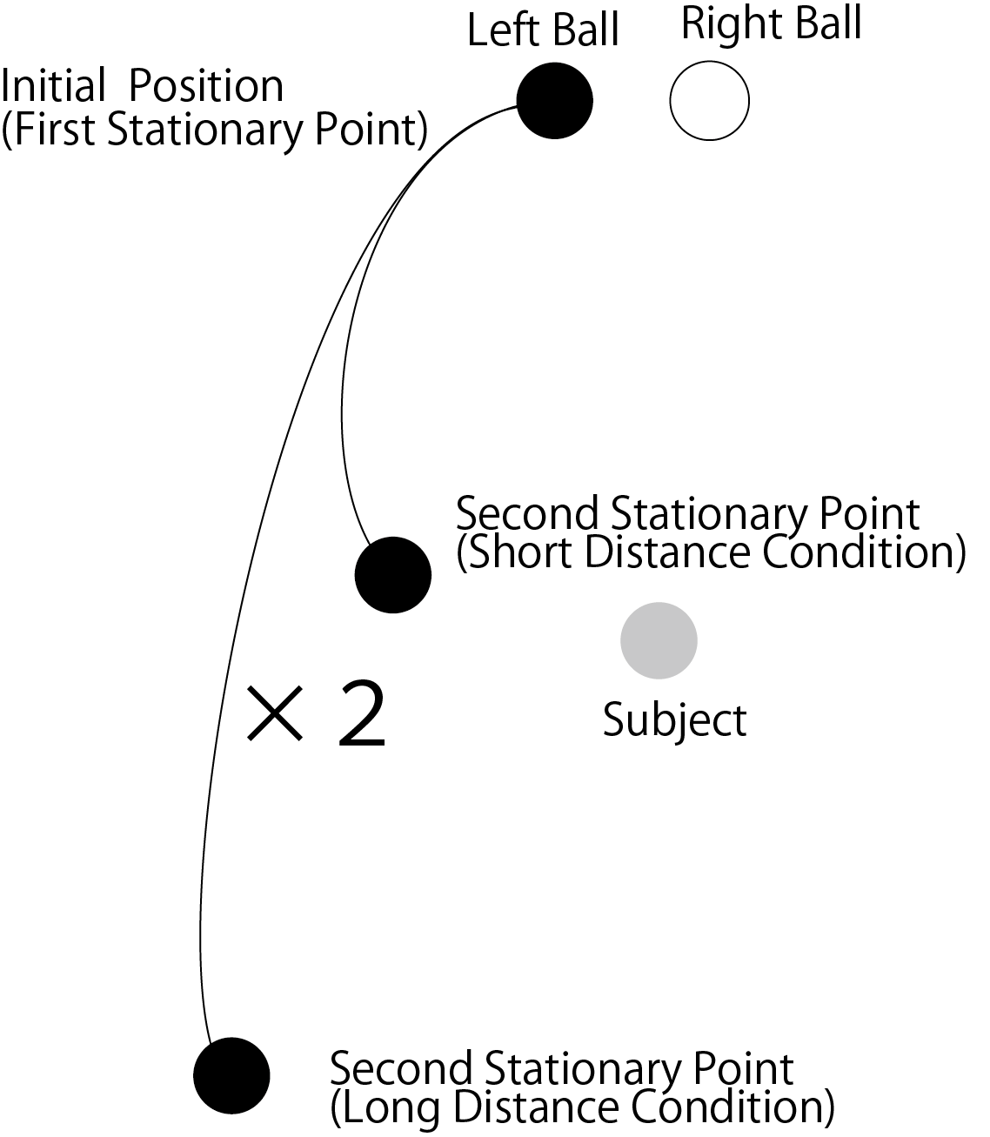
Left Ball’s Movement Path in Each Condition

Slide 9
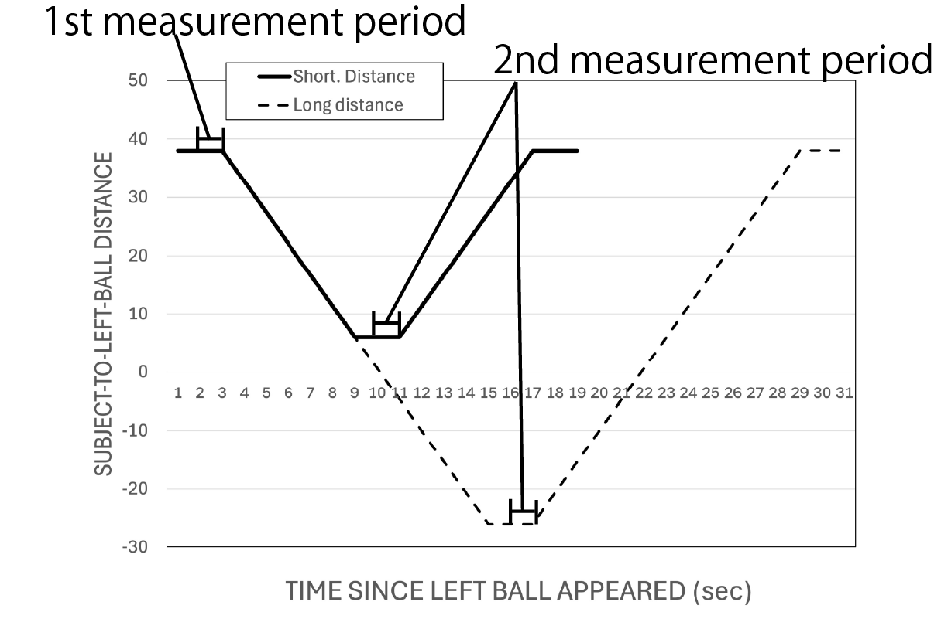
How to Calculate of Measurement Value
Measurement period:
1st. period:
The last one second of Initial stationary period
2nd period:
The last one second of stationary period after the left ball had approached
Vergence difference
=Ave.Vergence_{(2nd interval)} – Ave.Vergence_{(1st interval)}
Prediction:
If the perspective information had effect on vergence, the vergence difference in short distance is greater than long distance.

Slide 10
Viewing condition and the way of measurement
Subjects viewed 360-degree images using the VR goggle (VIVE PRO EYE)
Subjects' task was to gaze at the left ball.
Each images was displayed at 5 times.
Vergence was measured with the eye tracking software (Tobii Pro Lab: sampling rate120Hz) using data exported from the VR goggle.
Eight subjects who participated in the experiment were in their twenties and had normal vision.

Slide 11
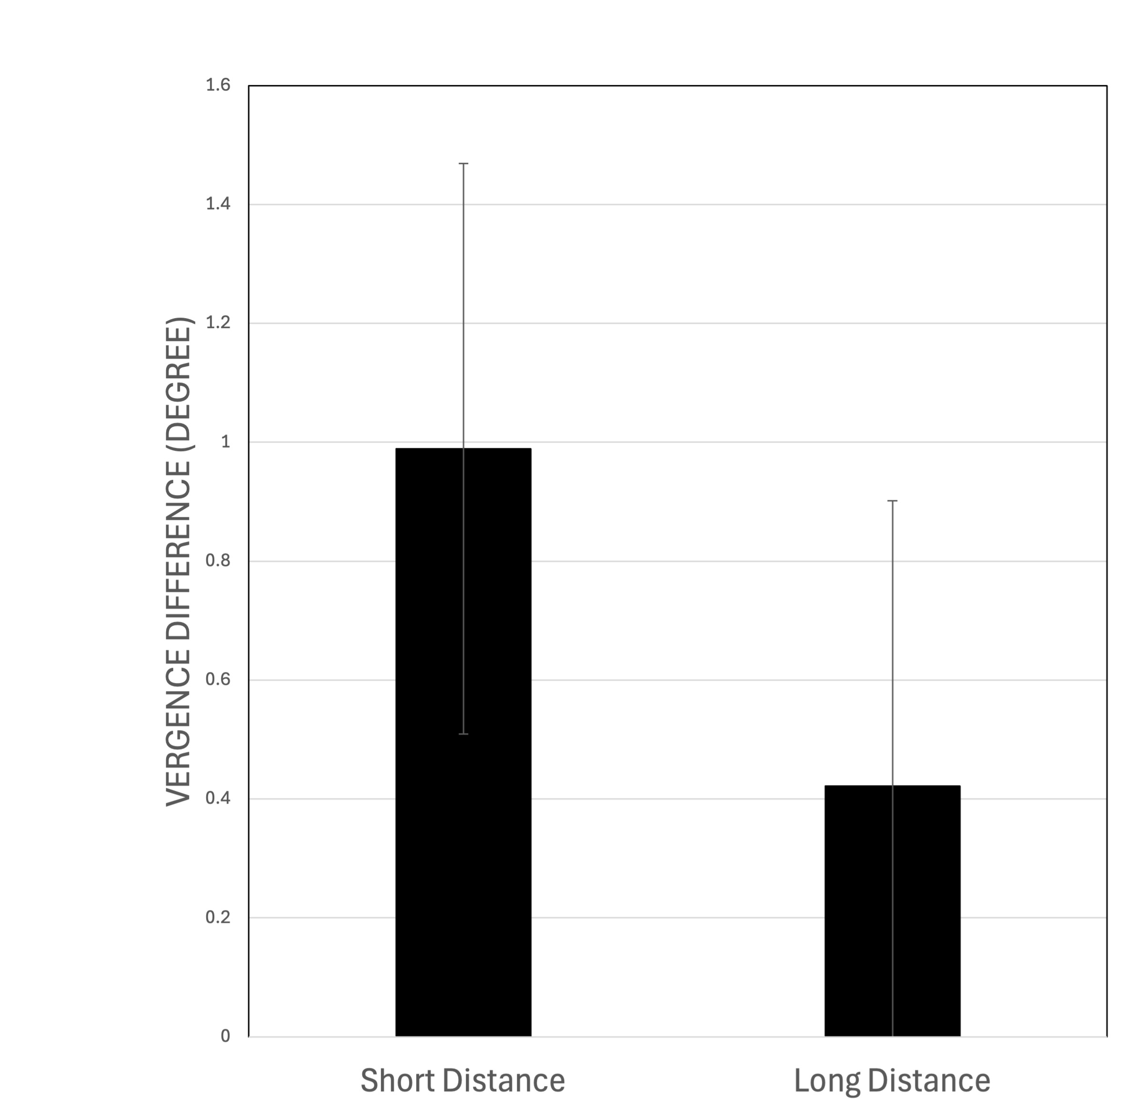
Vergence Difference in Each Condition
The vergence difference in the short distance condition was higher than in the long distance condition.
It indicated that the vergence in the short distance condition was greater than in the long distance condition.
But there wasn’t significant difference between distance conditions.

Slide 12
Why?
One possible explanation was the effect of the changes in subjects’ posture
In the long-distance condition, their distance perception may have been less accurate while they turned around.

Slide 13
Future Problem
I plan to veryfy whether a similar trend of distance perception is observed for objects in real space when subjects move their heads.

