Slide 1

How the Success of Kpop Demon Hunters (2025) Could Provide a Framework for Invigorating the Korean Animated Film Industry through Use of Cultural Representation.

Slide 2
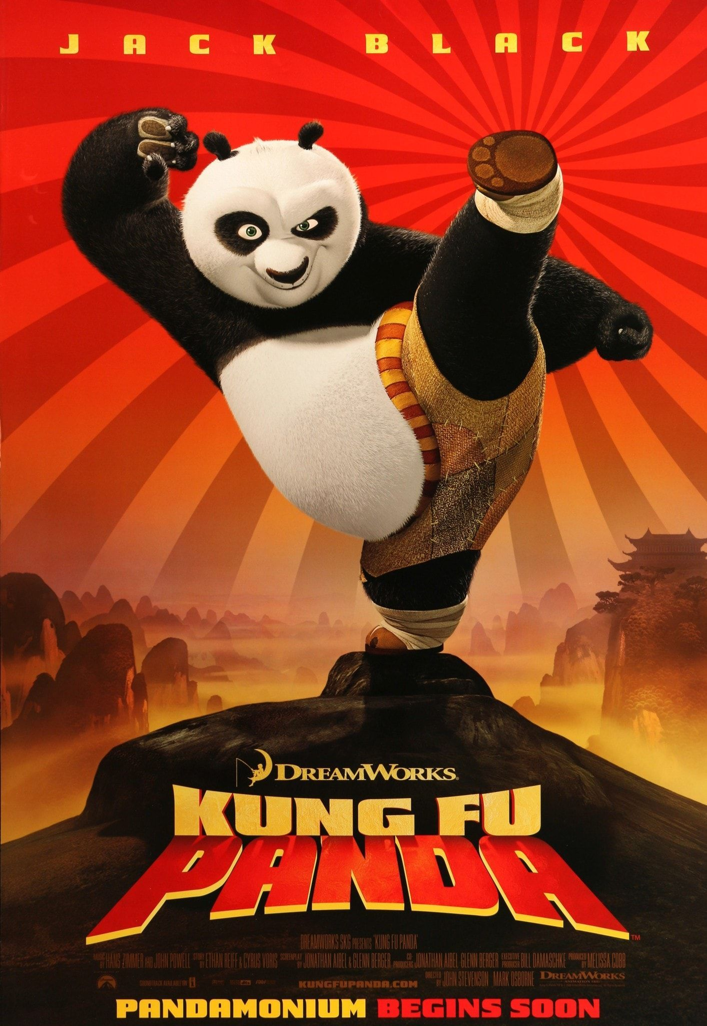


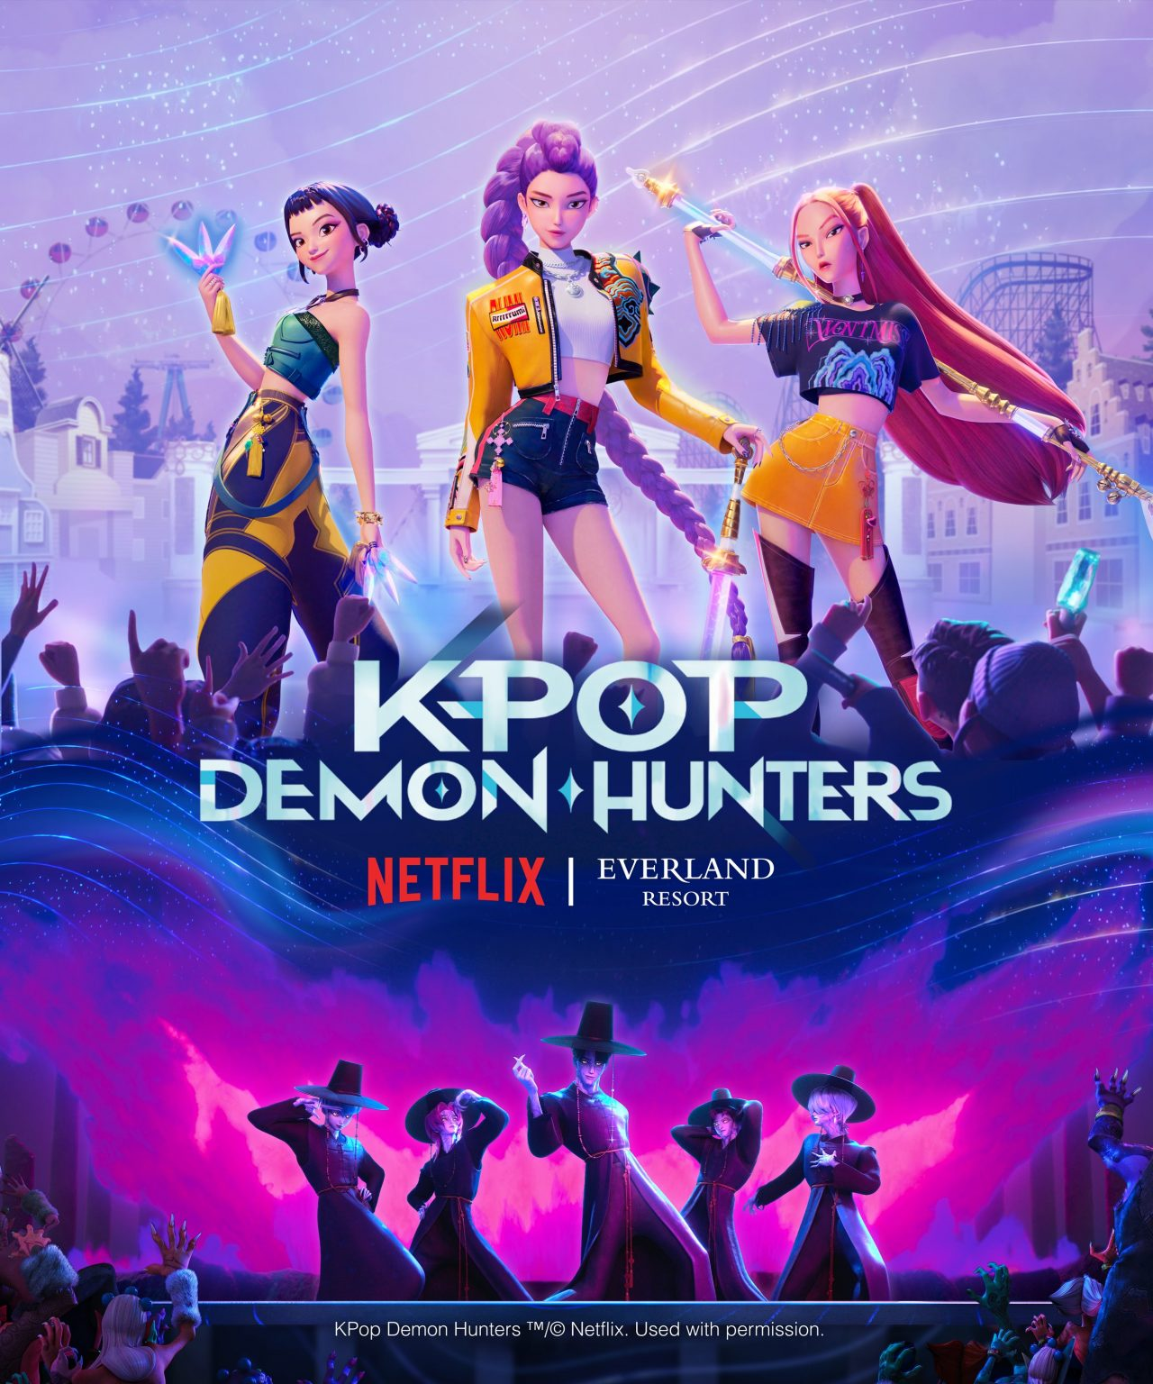
Overview
Korean Animation History
Statistical Analysis
Case Study 1: Kpop Demon Hunters
Case Study 2: Kungfu Panda

Slide 3

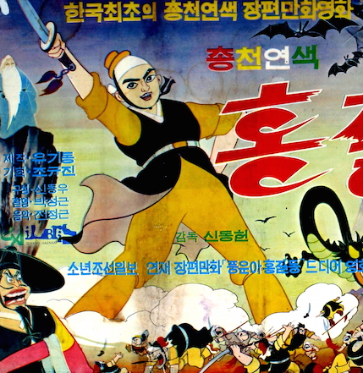
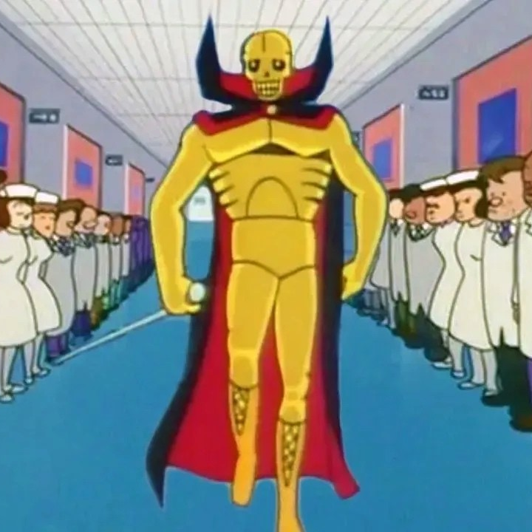
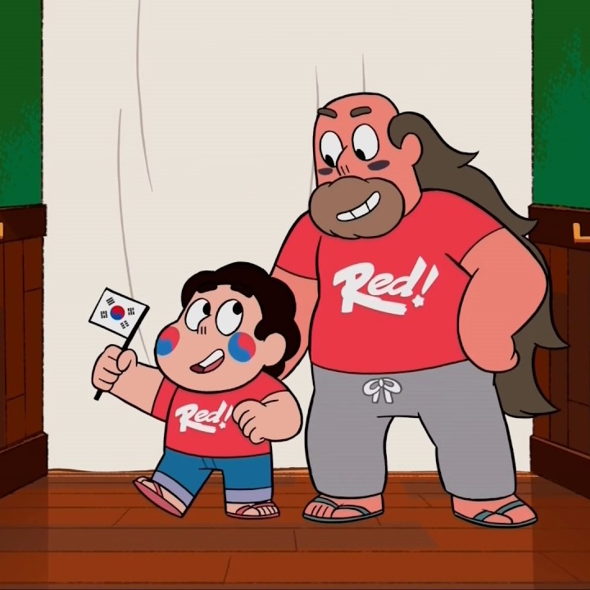
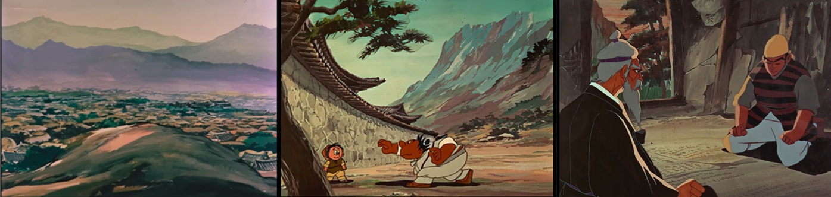
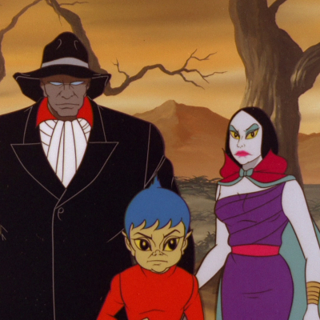

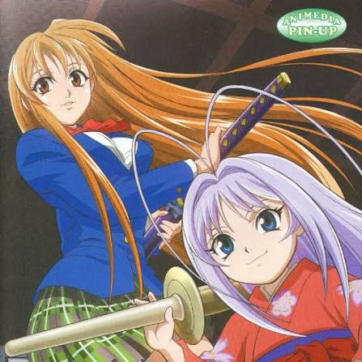
History of Animation in Korea
1967 - First feature length Korean animated film:
Hong Gil-dong [홍길동], Shin Dongheon.
Mid to late 1960’s - Jeil Donghwa begins subcontracting for Toei Animation in Japan. Korean animation production under Japanese studios continues.
1990’s onwards – Korean animation studios begin subcontracting for American animated television programs. (Such as; The Simpsons, Steven Universe, The Legend of Korra)

Slide 4
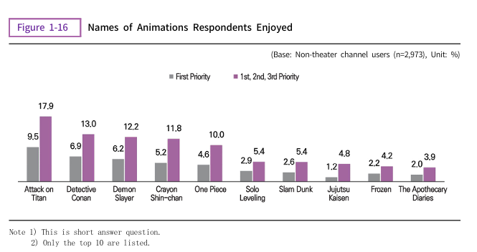
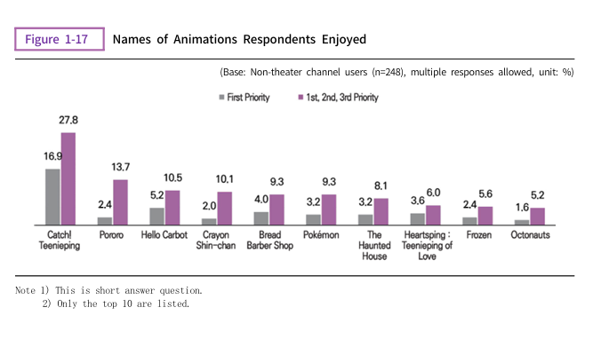
KOCCA White paper
Most enjoyed Animation among respondents aged 10-69:
Most enjoyed animation among respondents aged 3-9:
2025 KOCCA Industry White Paper

Slide 5
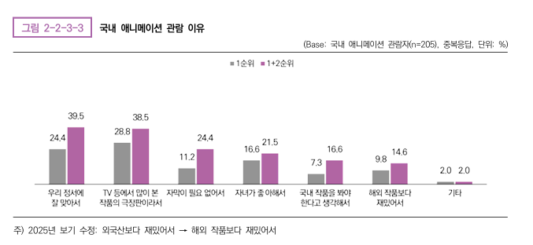
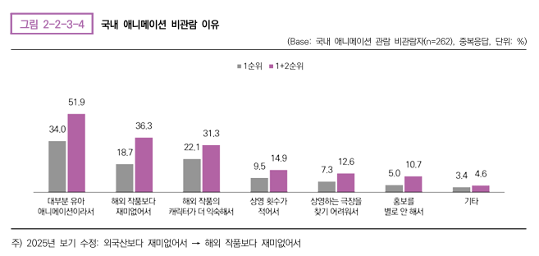
KOCCA White paper
Reasons for watching domestic animation among respondents aged 10-69:
Top response: “It fits our sensibilities well”
Reasons for not watching domestic animation among respondents aged 10-69:
Top response: Most (domestic) animation is for small children.
2025 KOCCA Industry White Paper

Slide 6
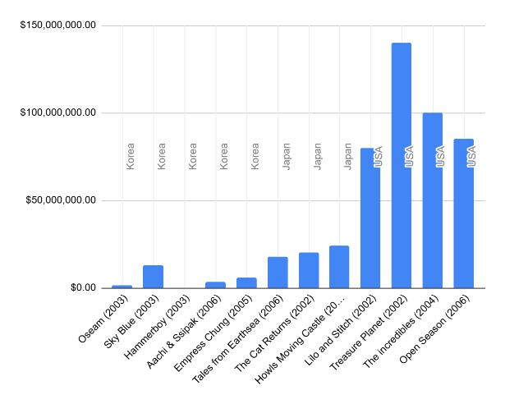
Animation production budgets
Important considerations for animation investment:
Animation is expensive and time consuming. Generally higher allocation of funds is needed.
Higher budgets do not equal better quality or better returns on investment.
Investing in newest technology does not always improve production time or quality.
Considerations of target markets - Investing in heavy use of AI in animated film production could put off western consumers.
Comparison of selected animated film budgets across USA, Japan and Korea from 2002 to 2006

Slide 7
Kpop Demon Hunters
(2025)
Kpop Demon Hunters has strong cultural references that have engaged Korean and international viewers.
Engagement is seen not just through Netflix views but also:
Merchandise sales
Sales of related products (IP unrelated merchandise)
Social media engagement: Dance shorts, lip-syncs, Cosplay, video analysis
Sing-a-longs and theatre release

Slide 8
Kung fu Panda
(2008)
At time of release, Kung Fu Panda was the highest grossing animated film of all time in China, and the 6th highest grossing film overall for 2008.
Creators engaged in a lot of visual research into the geography of China, as well as in representing small details.
References to Chinese philosophy.
References to Chinese filmmaking and story types.
Storytelling and comedy remains much more American in style, though is generally quite broad.

Slide 9
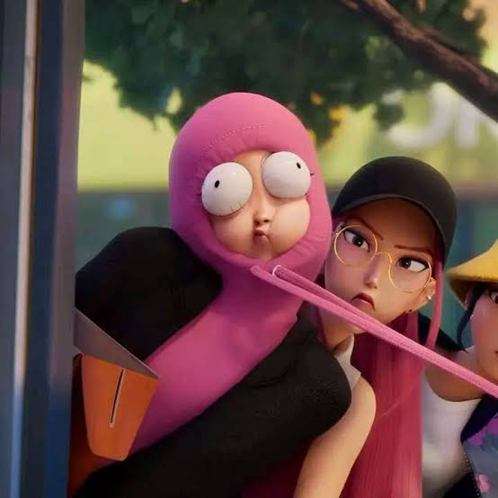
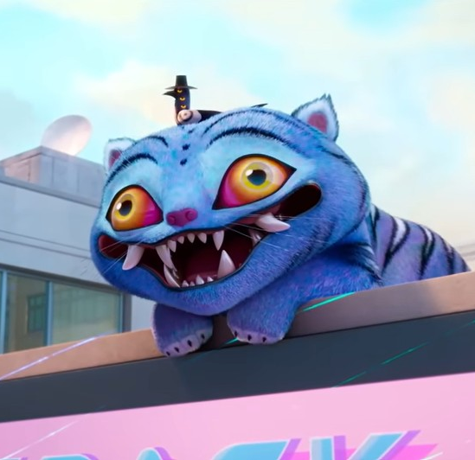
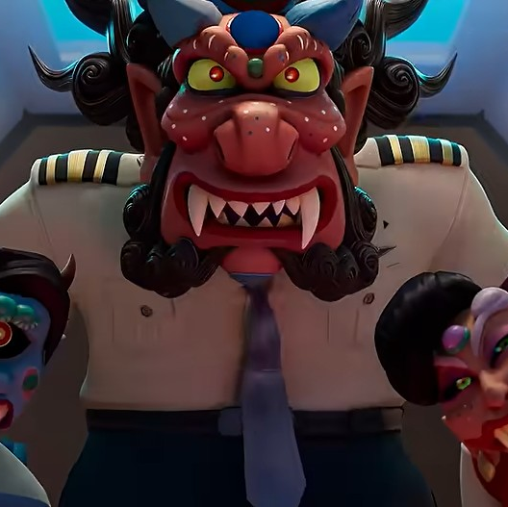

Closing
How do we invigorate the Korean animation industry?
Project Selection
  Aim for animation productions that can be successful and appealing to domestic audiences.
  Back projects with the right amount of artistic vision and broad appeal.
  Consider the importance of comedy that can be enjoyed across many cultures.
  Look for projects that represent Korean culture or are based on Korean folklore. Projects that do it with appreciation and authenticity.
Overcoming preconceived ideas
  Moving away from the association with Japanese and western animation.
  Move away from content aimed at toddlers/infants.
Strategic investment
  Realistic understanding of animation production budgets and timelines.

Slide 10

There’s pride in seeing something we love being seen by the whole world. Like a part of yourself is famous.
Siobhan Nicole Pigott
Dohun Kim
Dongseo University

