Slide 1
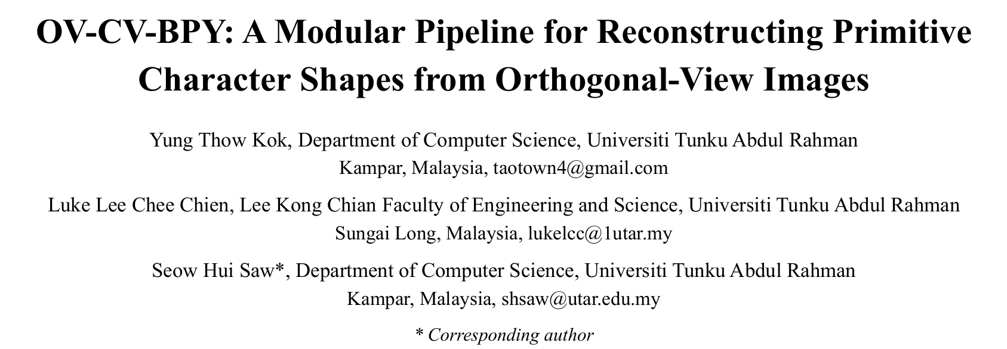
ICCT 2026 · 31 October 2026
A Modular Pipeline for Reconstructing Primitive Character Shapes from Orthogonal-View Images
1 out of 16 Pages

Slide 2
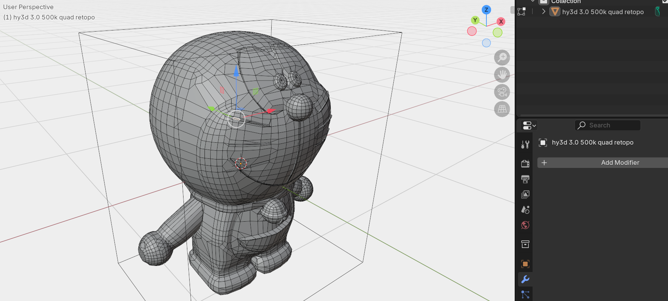
The problem: visual quality ≠ editable structure
Generative 3D outputs may be visually detailed but difficult to modify by individual parts.
Production workflows need:
• Separately editable character parts
• Predictable primitive topology
• Efficient artist-guided refinement
2 out of 16 Pages

Slide 3
Research objective & contributions
• Generate a structured 3D character blockout from four orthogonal images.
• Map 2D part masks into a consistent 3D Cartesian frame.
• Reconstruct per-part AABBs and generate editable Blender primitives.
• Evaluate speed, mesh complexity and object organization against baselines.
3 out of 16 Pages
Notes:
The innovation is a modular workflow and coordinate-to-AABB reconstruction, not a new trained neural model.

Slide 4
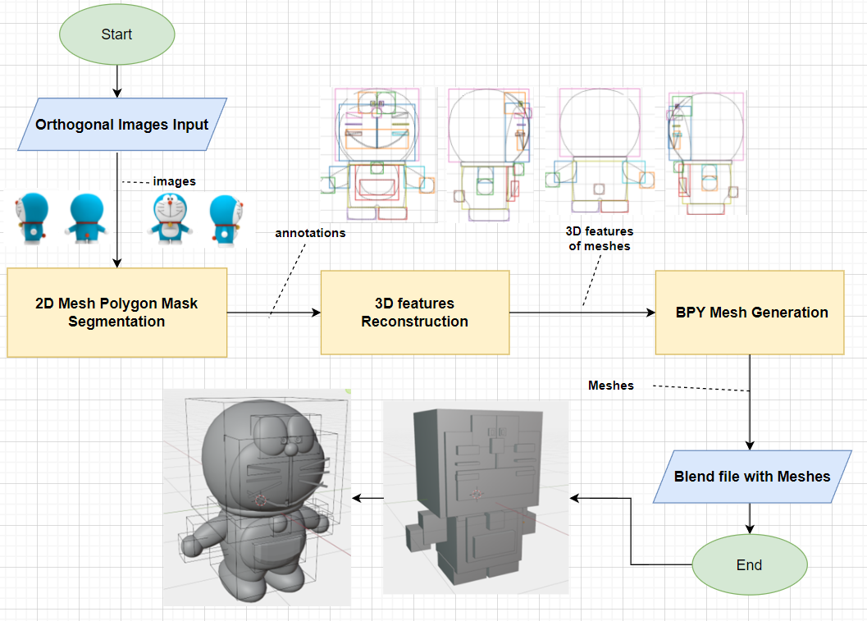
OV-CV-BPY: Overview
4 out of 16 Pages
Notes:
image preparation, SAM2-assisted masks, normalized coordinates and AABB, then Blender Python output. Manual refinement happens after the automatic pipeline.

Slide 5
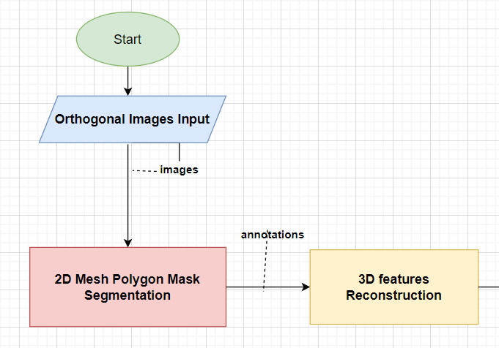
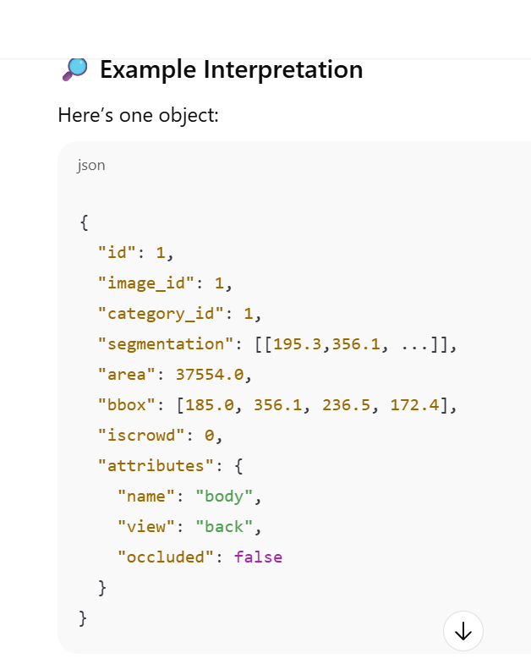
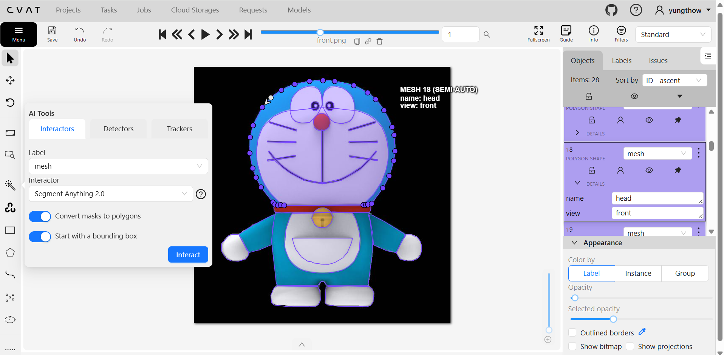
Input & segmentation
(Fig. a) Highlighted Interactive Segmentation module
Four aligned 608 × 608 views; 29 annotated character parts.
• Front, left, back and right images
• CVAT interactive segmentation with SAM 2
• Each mask labeled by part name and view
• COCO 1.0 annotations exported
(Fig. c) exported JSON file with annotations
(Fig. b) Segmenting Polygon Mask of Doraemon Parts via CVAT
5 out of 16 Pages
Notes:
SAM 2 is assisted interactive segmentation, not fully automatic segmentation. Corresponding parts are associated using name/view attributes.

Slide 6
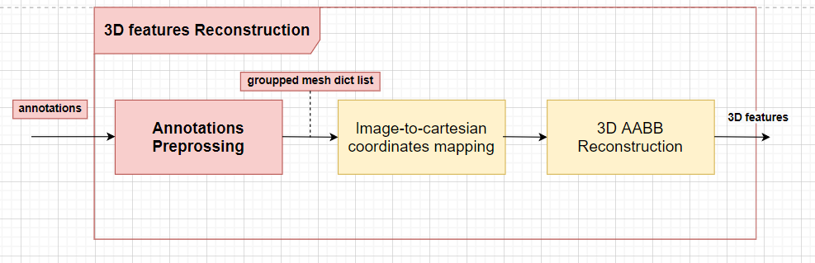
3D feature reconstruction
Three submodules transform 2D masks into per-part 3D bounds.
    Mesh Dict instance 1 {
    name: “head”
    segmentations: {“front”: (123, 342, 456, …), “left”: (567, 578. …), …}
    }
    Mesh Dict instance 2 { …
Head = {{x1,x2,…},{y1,y2,…},{z1,z2,…}}
AABB List{
mesh1{(X1min, Y1min, Z1min), (X1max, Y1max, Z1max)},
…
6 out of 16 Pages
Notes:
Group annotations by part, normalize coordinates, then take minima and maxima across all available view points.

Slide 7
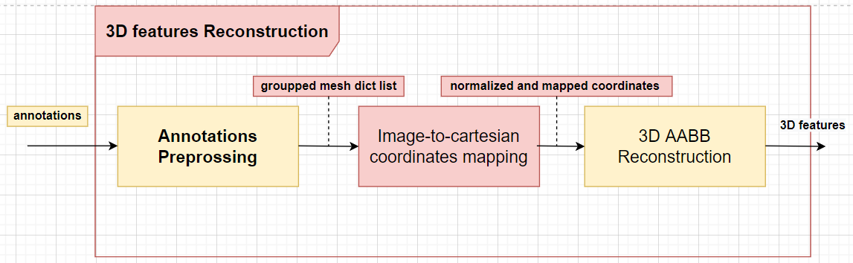
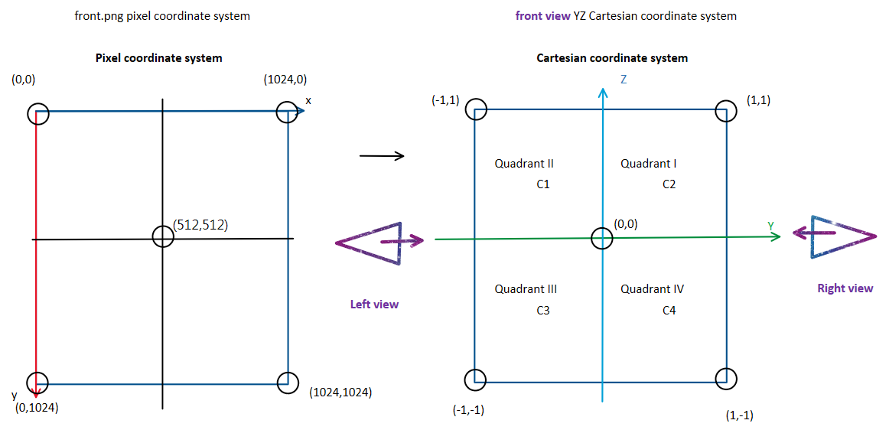
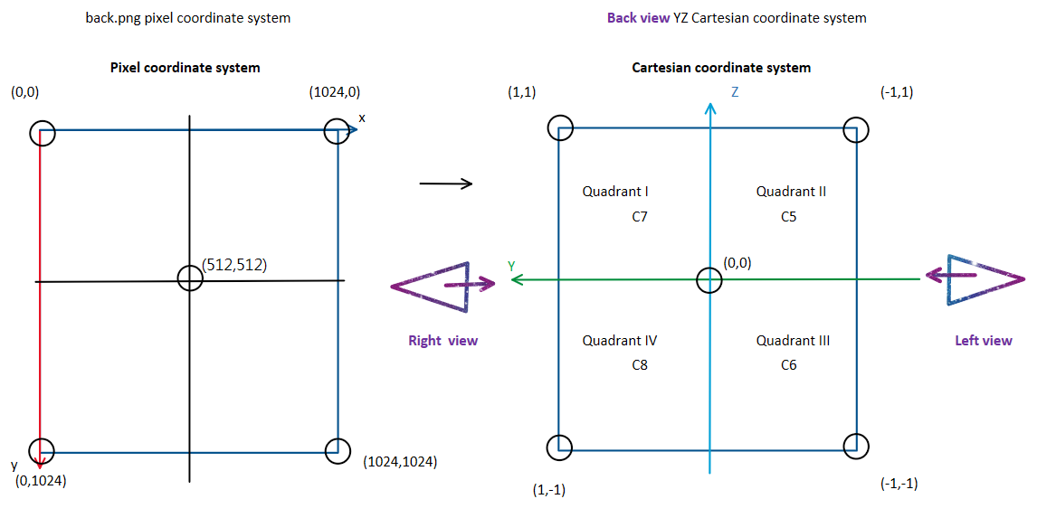
Coordinate mapping: the core idea
Horizontal pixels → y (front/back) or x (left/right); vertical pixels → z
Hcart = 2Hpixel / W − 1 (front / left)
Hcart = 1 − 2Hpixel / W (back / right)
Vcart = 1 − 2Vpixel / H (all views)
Opposite views are mirrored to maintain consistent spatial orientation.
7 out of 16 Pages
07
Notes:
W and H are image width and height. This is a normalized coordinate convention adapted from the OpenGL viewport mapping.

Slide 8
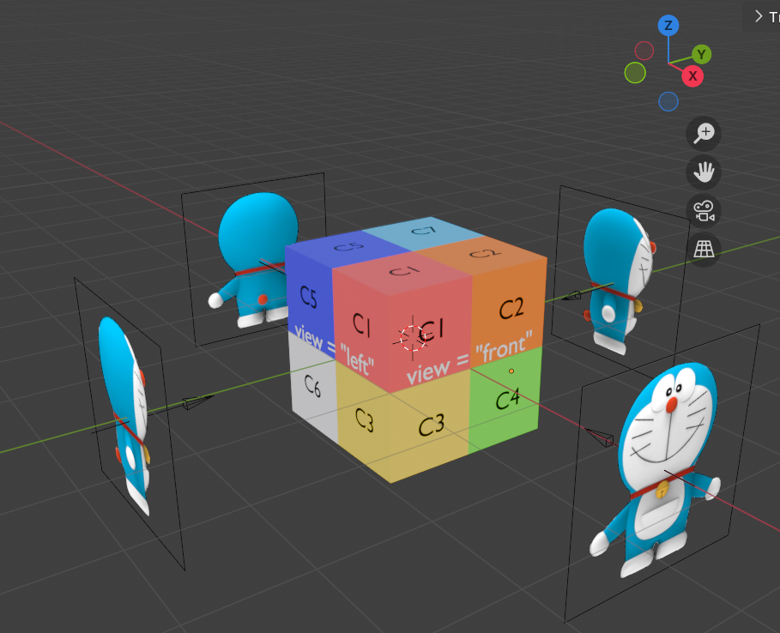
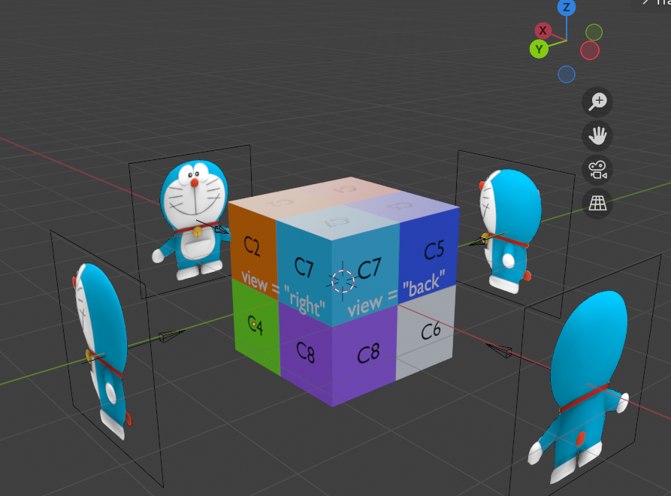
    Figures above illustrates the coordinates mapping: from each of the view, different surfaces are observed. Eg: left eye = {{x1,x2,…},{y1,y2,…},{z1,z2,…}}
8 out of 16 Pages

Slide 9
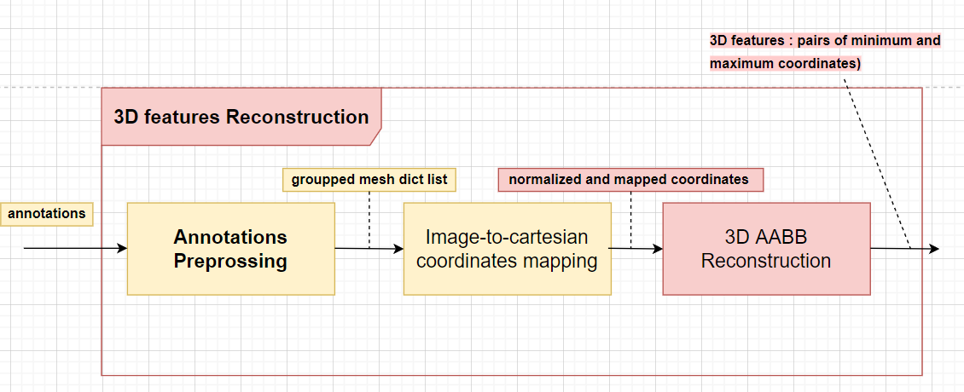
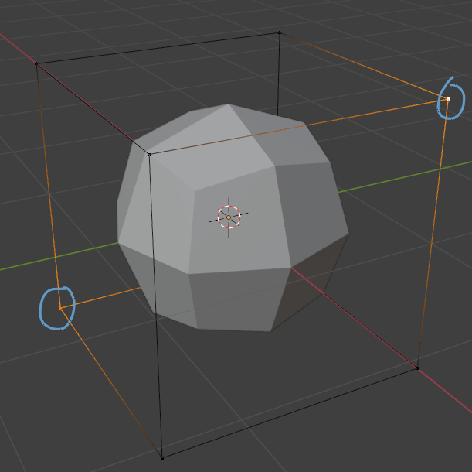
From coordinates to an AABB
A bounding box summarizes the spatial extent of each annotated part.
Pmin = (min x, min y, min z)
Pmax = (max x, max y, max z)
Cube center = (Pmin + Pmax) / 2
Cube dimensions = Pmax − Pmin
AABB List{
mesh1{(X1min, Y1min, Z1min), (X1max, Y1max, Z1max)},
mesh2{(X2min, Y2min, Z2min), (X2max, Y2max, Z2max)},
}
=
,
Mesh 1
Mesh 2
9 out of 16 Pages
Notes:
The AABB captures approximate extent, not curvature, concavity or exact surface geometry. Values come from normalized polygon points across views.

Slide 10
Blender Python: editable primitives
• Create one cube per named part
• Scale using AABB dimensions
• Position using AABB center
• Save editable objects in a .blend file
10 out of 16 Pages
Notes:
The primitive blockout as a starting point for manual box modeling and sculpting.

Slide 11
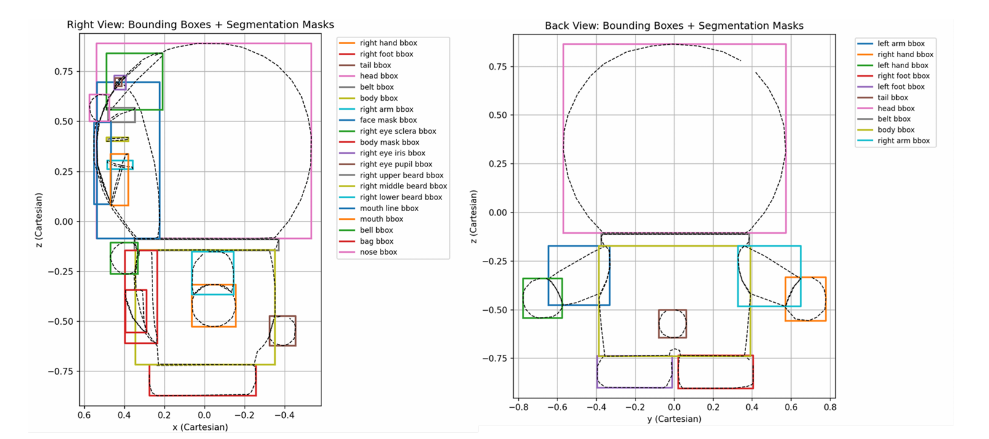
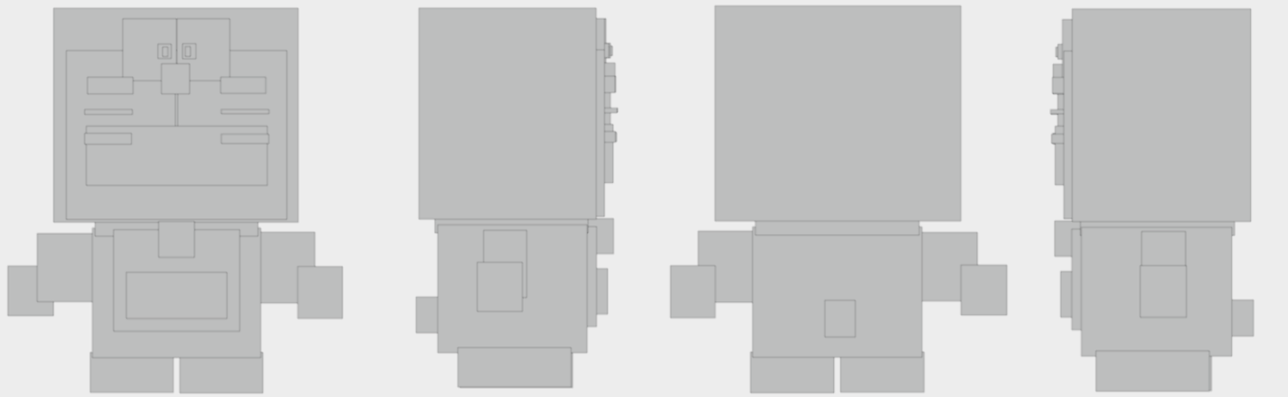
Raw reconstruction: what the pipeline produces
29 independent cube primitives generated before manual refinement.
11 out of 16 Pages

Slide 12
Quantitative results: raw mesh
Same four-view input, different generation approaches.
Metric
ChatGPT spheres
OV-CV-BPY
Hunyuan3D 2.5
Objects
19
29
1 / 3
Vertices
9,158
232
290,399
Faces
9,728
174
499,994
Generation time
~5 s
< 1 s
~2 min
Reported times include network latency for external baselines; not a controlled compute benchmark.
12 out of 16 Pages
Notes:
232 vs 290399 vertices is about 1252x fewer, and <1 s versus ~120 s is more than 120x faster in the reported setup. Avoid claiming equivalent geometric fidelity.

Slide 13
After manual refinement: trade-offs
Metric
OV-CV-BPY + manual
Hunyuan3D 2.5
Hunyuan3D 3.0
Objects
18
1 / 3
1 / 3
Vertices
8,342
3,661
4,519
Triangles
16,446
7,312
8,959
Time
~10 min
~5 min
~5 min
Manual effort improves geometry; OV-CV-BPY prioritizes separate editable objects, not best immediate visual fidelity.
13 out of 16 Pages
Notes:
18 reflects merged/grouped symmetry objects. Manual refinement time varies with artist skill. Do not combine raw runtime with refined quality as if both are automatic.

Slide 14
Limitations & future directions
• Single character / single four-view case study; generalization remains untested.
• No mask-IoU or broad geometric-accuracy benchmark was reported.
• AABB cubes do not recover curved or detailed surfaces.
• Next: additional views, local part-relative boxes, semantic features and parent-child rigging.
14 out of 16 Pages
Notes:
This as feasibility evidence rather than proof of superiority across all character modeling scenarios.

Slide 15
Conclusion
Fast, structured blockouts for artist-controlled 3D modeling.
• A modular 2D-to-3D pipeline for independent character parts.
• 29 primitive objects and 232 vertices in under one second in the case study.
• A complementary workflow to high-fidelity generative 3D, not a replacement.
• Future work will assess accuracy and broader character diversity.
15 out of 16 Pages
Notes:
Final message: trading initial fidelity for editable structure, speed and artist control.

Slide 16
Thank you
Questions & Discussion
16 out of 16 Pages
Notes:
Be ready to explain coordinate mirroring, AABB limitations, and fairness of the runtime comparison.

