Slide 1
A Rough Set-Based Teacher Education Evaluation System for
Secondary School Information Technology Teachers
Naixin Zhang, Fei Hao*
School of Artificial Intelligence and Computer Science
Shaanxi Normal University, Xi'an, China

Slide 2
Contents
01
Research Background
04
Evaluation Indicator System
02
Literature Review
05
Evaluation Model
03
Theoretical Foundations and Research Roadmap
06
Experiments, Comparison and Conclusions
A Rough-Set-Based Teacher Education Evaluation System for Secondary School Information Technology Teachers
2

Slide 3
Research Background
Evaluation favors judgment over development
Mainly serves title review and pay; little guidance for growth.
Traditional methods are highly subjective
Self-, peer and KPI appraisal yield biased conclusions.
Mainstream weighting depends on priors
AHP and fuzzy evaluation rely on expert experience.
Research on the IT discipline is almost absent
A generic system cannot evaluate IT teaching objectively.
IT teachers: +0.61 pp in 2022 vs. 2020 — from the margins to a workforce that can no longer be ignored.
A Rough-Set-Based Teacher Education Evaluation System for Secondary School Information Technology Teachers
3

Slide 4
Literature Review
International: mature systems emphasizing process and evidence
Domestic: higher and vocational education; schools still use "morality, diligence, performance, ability"
▪ Tennessee, USA SGPM portfolio-based evaluation
▪ New York State, USA Multi-source data; process–result unity
▪ Japan Nationwide PDCA cycle with interview feedback
▪ Research subjects skew upward Mostly university and vocational teachers
▪ Primary and secondary schools keep the four-character frame "Morality, diligence, performance, ability"
▪ Professionalism is poorly reflected Generic frames miss IT teaching features
Common gap: IT teacher evaluation is scarce, and existing studies lack objectivity.
A Rough-Set-Based Teacher Education Evaluation System for Secondary School Information Technology Teachers
4

Slide 5
Research Content
How can secondary school information technology teachers be evaluated in a scientific, objective and interpretable way?
Core Research Question
Research Content
Establish a discipline-specific indicator system
4 first-level, 7 second-level and 23 third-level indicators.
Carry out the empirical study with real data
108 IT teachers nationwide; the full route completed.
1
3
Build a rough-set-based evaluation model
Reduction → entropy weighting → scores and ranking.
Systematic comparison with two other methods
Discernibility matrix and BP network: efficiency, accuracy, interpretability.
2
4
A Rough-Set-Based Teacher Education Evaluation System for Secondary School Information Technology Teachers
5

Slide 6
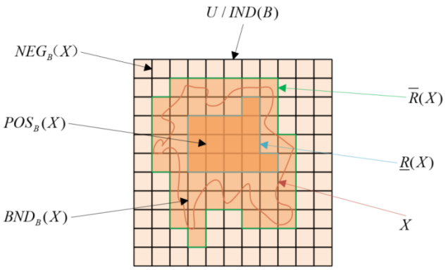
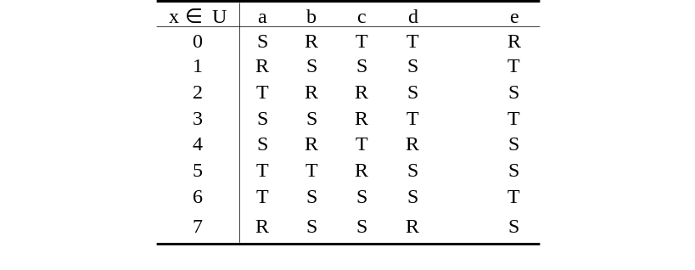
Theoretical Foundations
Core Concepts
Fig. 2-1 Schematic Diagram of Rough Set Approximation
▪ Information system S = (U, A, V, f) Objects, attributes, values and mapping
▪ Indiscernibility relation Ind(B) Same values on B → one knowledge granule
▪ Upper / lower approximation and the three regions Positive, negative and boundary regions
▪ Dependency degree and attribute significance Zero significance ⇒ reducible
Table 2-1 Example of an Information System
Reduction: delete an attribute, keep classification unchanged — the source of "objectivity".
A Rough-Set-Based Teacher Education Evaluation System for Secondary School Information Technology Teachers
6

Slide 7
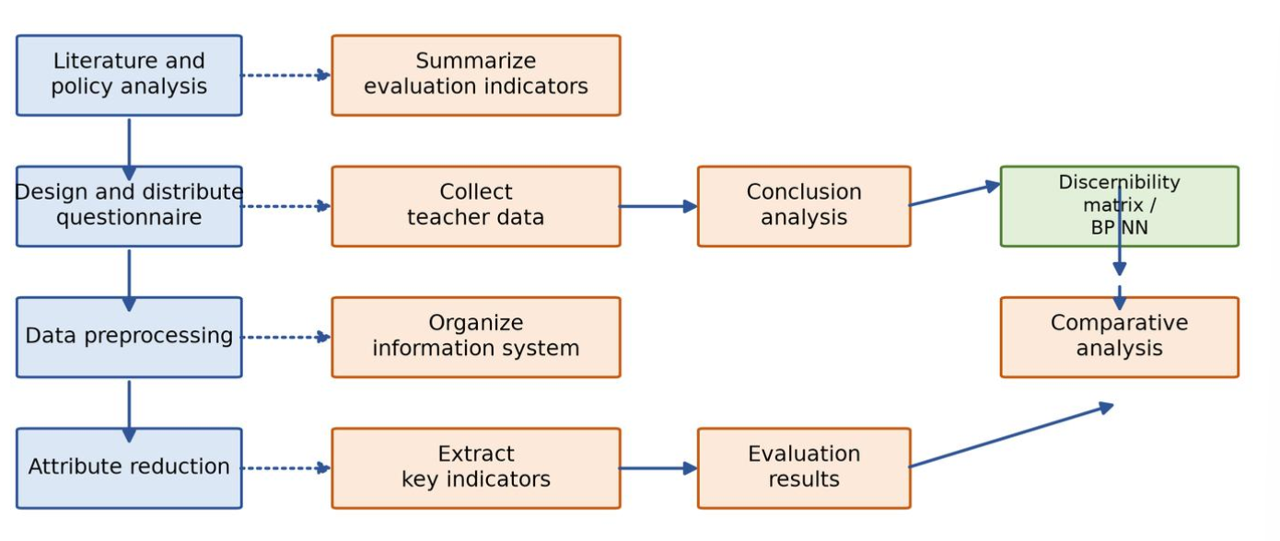
Research Roadmap
Literature and policy analysis
High-frequency indicators → initial indicators.
1
Fig. 1-1 Framework of Information Technology Teacher Evaluation
Questionnaire design and distribution
Real data from IT teachers nationwide.
2
Data preprocessing and table construction
Build S = (U, A, V, f).
3
Attribute reduction and weighting
Remove redundancy; entropy-based weights.
4
Comprehensive evaluation and comparison
Weighted scores, ranking, comparison.
5
A Rough-Set-Based Teacher Education Evaluation System for Secondary School Information Technology Teachers
7

Slide 8
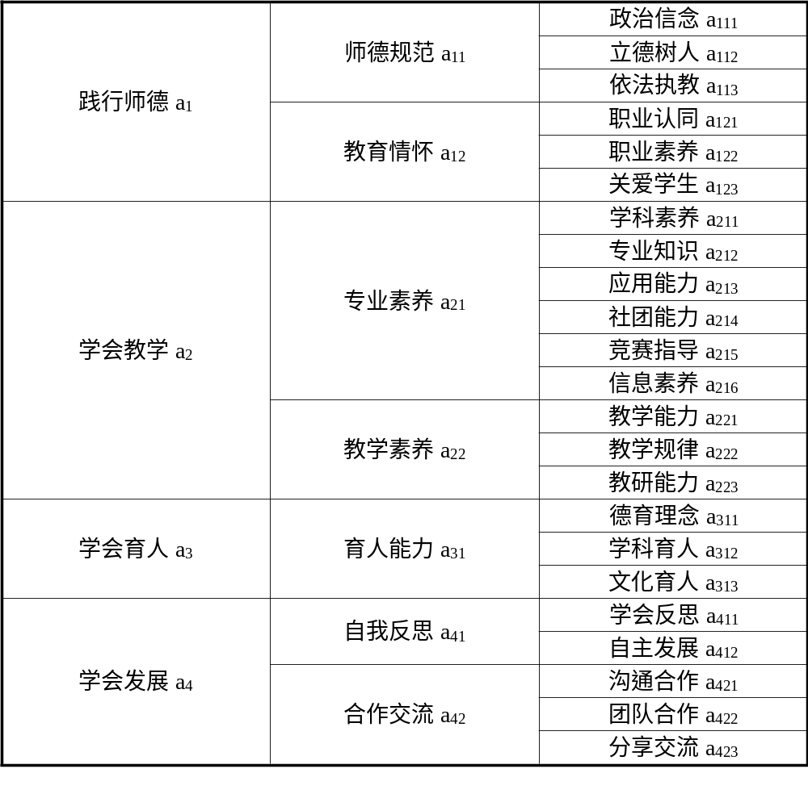
Evaluation Indicator System and Rough Set Model
Four Stages of the Model
Construct the initial information system
23 indicators × teachers, on a 1–10 scale.
1
Attribute reduction
Remove indicators that cannot distinguish teachers.
2
Compute attribute weights
Entropy significance, then normalize.
3
Weighted comprehensive evaluation
Weighted sum → score and ranking.
4
A Rough-Set-Based Teacher Education Evaluation System for Secondary School Information Technology Teachers
8

Slide 9
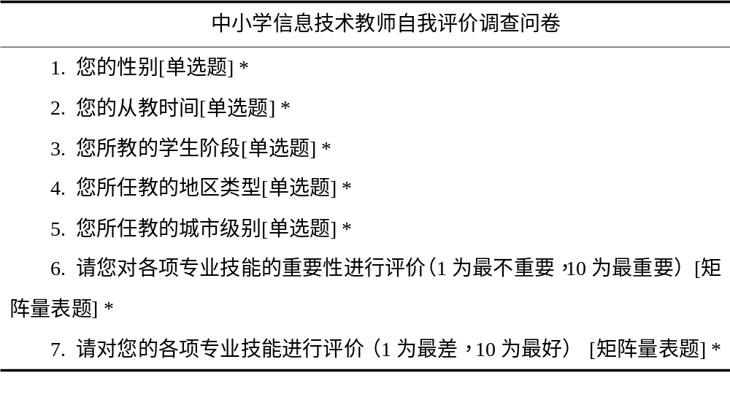
Data Sources and the Information System
Structure of the Information System
Questionnaire (Wenjuanxing Platform)
Element | Meaning | Value in this study
Objects U | Teachers being evaluated | 108 teachers
Attributes A | Evaluation indicators at all levels | 23 third-level indicators
Value domain V | Range of attribute values | 1–10 (1 = worst, 10 = best)
Mapping f | Object × Attribute → Value | Questionnaire score
Two kinds of questionnaire data
"Importance preference" validates; "self-assessment score" is the input.
108
Valid questionnaires
1–10
Attribute value range
23
Number of attributes (indicators)
The sample covers the whole country
Cross-regional, not limited to a single school.
A Rough-Set-Based Teacher Education Evaluation System for Secondary School Information Technology Teachers
9

Slide 10
Attribute reduction
Indicators after reduction:
Code | Key indicator | First-level indicator
a113 | Law-based teaching | Practicing teacher ethics
a121 | Professional identity | Practicing teacher ethics
a123 | Caring for students | Practicing teacher ethics
a213 | Application ability | Learning to teach
a216 | Information literacy | Learning to teach
a223 | Teaching research ability | Learning to teach
a311 | Moral education philosophy | Learning to educate
a412 | Self-directed development | Learning to develop
a422 | Teamwork | Learning to develop
Ind(A) = Ind(A − {a_i}) ⇒ a_i is redundant
Delete an attribute, keep classification unchanged ⇒ remove it.
Example: a111 (political conviction) cannot distinguish objects ⇒ reduced.
A Rough-Set-Based Teacher Education Evaluation System for Secondary School Information Technology Teachers
10

Slide 11
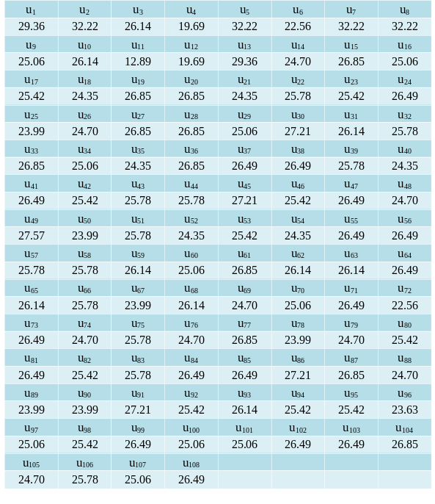
Weight Calculation
SGF_A−{a}(a) = H(A) − H(A−{a})
Entropy difference before and after deleting the attribute.
w(a_i) = SGF(a_i) / Σ SGF(a_i)
Weight = normalized attribute significance.
H(a11) = 1.57 ⇒ w(a112) = 1.00
Worked example: third-level weights under a11.
F = Σ Σ ( w(a_ji) · F_ji · w(a_j) )
Third-level scores weighted, then aggregated by second-level weights.
A Rough-Set-Based Teacher Education Evaluation System for Secondary School Information Technology Teachers
11

Slide 12
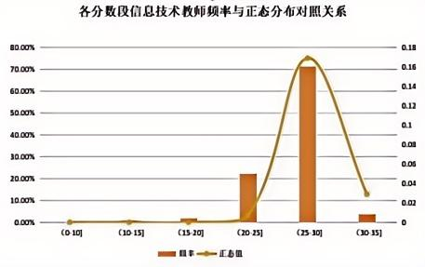
Distribution of Teacher Scores
Approximately normal overall
More in (20, 25], fewer in (30, 35].
Most teachers are above the average line
70% in (25, 30]; 20% in (20, 25].
Excellent teachers remain a minority
Teachers scoring above 30 are still few.
25.72
Average score
32.22
Highest score
12.89
Lowest score
A Rough-Set-Based Teacher Education Evaluation System for Secondary School Information Technology Teachers
12

Slide 13
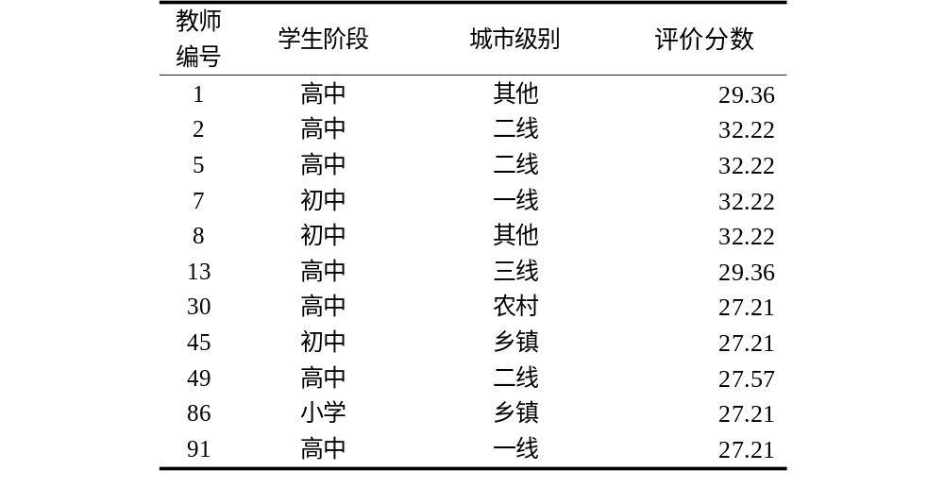
Data Characteristics
Table 4-6 Profile of High-Scoring Teachers (score above 27)
Highly concentrated city distribution
Most from third-tier cities or above; few from rural areas.
Significant differences across school stages
One indicator set can hardly fit primary schools.
An evaluation tool is also a diagnostic tool
Urban–rural gap amplified in the high-score segment.
A Rough-Set-Based Teacher Education Evaluation System for Secondary School Information Technology Teachers
13

Slide 14
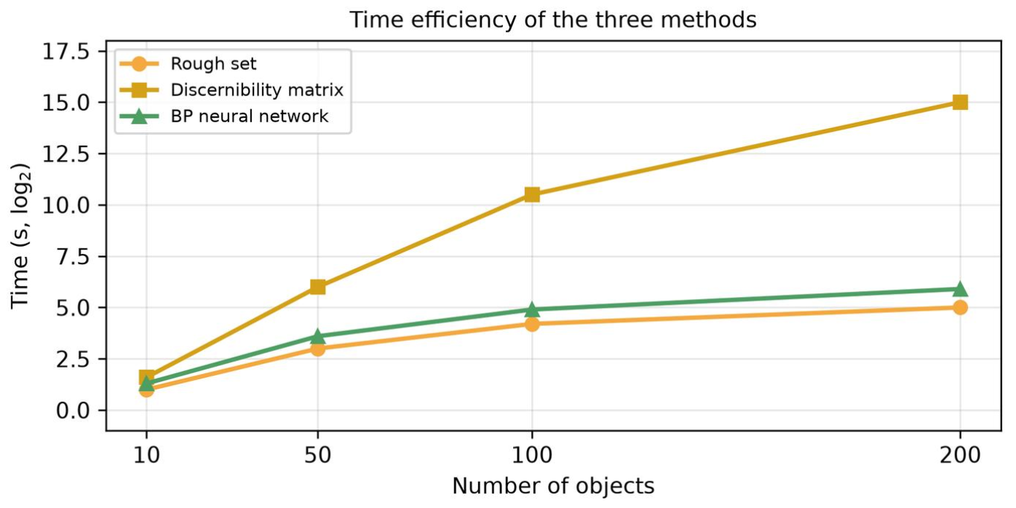
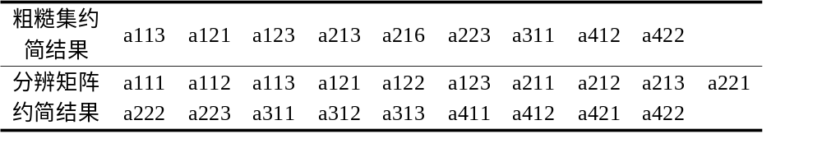
Method Comparison — Discernibility Matrix
Efficiency: exponential rise vs. flat growth
Matrix time rises exponentially; rough set nearly flat.
Reduction granularity: 18 vs. 9 indicators
The matrix retains about twice as many indicators.
Table 4-7 Comparison of Reduction Results: Rough Set vs. Discernibility Matrix
Ranking conclusions are basically consistent
Top six identical; bottom five the same.
A Rough-Set-Based Teacher Education Evaluation System for Secondary School Information Technology Teachers
14

Slide 15
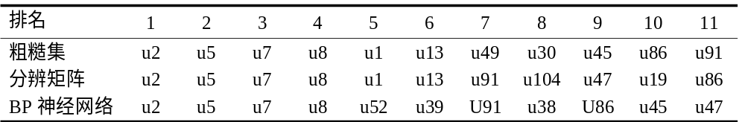
Method comparison — Neural network
Method | Time efficiency | Reduction granularity | Interpretability
Rough set (this study) | High | High (9 retained) | Strong
Discernibility matrix | Low (exponential rise) | Medium (18 retained) | Strong
BP neural network | Medium | Not applicable | Weak
Time cost: fast on small samples, slightly slower on large ones
BP is faster on small samples, slightly slower on large ones.
Ranking: 7 overlapping teachers, but marked differences
Same 7 in the top 10%, but different ranks.
Table 4-8 Comparison of Teacher Rankings (top 10%)
Interpretability is the decisive difference
BP cannot explain its process; transparency is required.
A Rough-Set-Based Teacher Education Evaluation System for Secondary School Information Technology Teachers
15

Slide 16
Advantages and Limitations
Advantages of the proposed method
Limitations of this study
▪ Objectivity No prior weights; conclusions from the data itself
▪ High efficiency Less redundancy; time grows slowly with scale
▪ Interpretability Weights and process traceable; feedback to teachers
▪ Balance Best trade-off among efficiency, accuracy, interpretability
▪ Sample size 108 questionnaires; cross-regional but limited
▪ Data source Self-assessment may carry perception bias
▪ Applicable stage Fits secondary schools better than primary
▪ System refinement Stability needs more real cases
A Rough-Set-Based Teacher Education Evaluation System for Secondary School Information Technology Teachers
16

Slide 17
Future Work
▪ Broaden the research subjects To other subjects and teacher types
▪ Refine the indicator system Adaptability across stages and regions
▪ Expand the research sample Test stability of reduction and weights
▪ Integrate AI and big data More intelligent and efficient evaluation
The core direction
for the next step
Upgrade the static indicator system into an open framework — updatable with new data, transferable across school stages.
A Rough-Set-Based Teacher Education Evaluation System for Secondary School Information Technology Teachers
17

Slide 18
Thank You Very Much!
Fei Hao fhao@snnu.edu.cn
Shaanxi Normal University

