Slide 1
StealthWarp: Repurposing Field-of-View Distortion as an Adversarial Attack on Face Recognition
¹Minsu Shin, ¹Seongmin Lee, ²Jinhyeong Park, ¹Soon Ki Jung*
¹School of Computer Science and Engineering, Kyungpook National University, South Korea

Slide 2
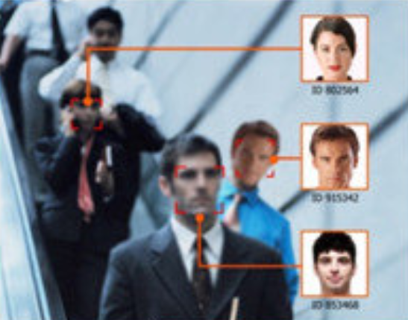
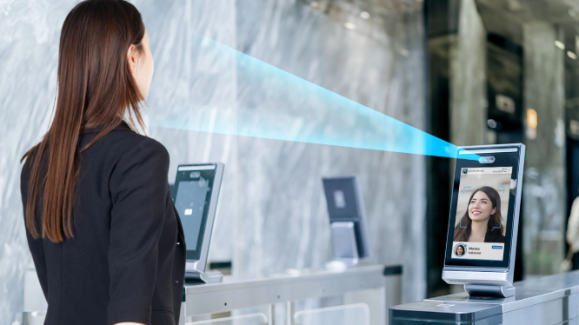
Face Recognition
Face Recognition systems (FR) [1,2] identify individuals by extracting unique facial embeddings from images or video.
FR is widely deployed across security authentication, surveillance, payment verification, and access control — unlocking smartphones to border control and banking KYC.
Because security breaches in these safety-critical applications pose severe risks, investigating adversarial attacks is essential to preemptively uncover vulnerabilities and build more robust FR systems.
Figure 1. Surveillance and tracking using face recognition [3].
Figure 2. Access control in an airport by using face recognition [4].
Notes:
Fr은 하나의 인코더로 구성되며 얼굴 이미지의 신원을 대표하는 하나의 벡터로 함축하는 모델이다.
누군가의 감시, 추적 / 보안 시스템 통과와 같이 어떤 개인의 신원이 필요할때 많이 사용된다.

Slide 3

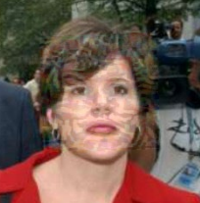
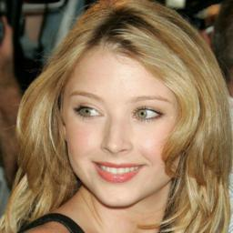
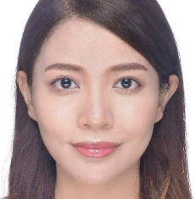
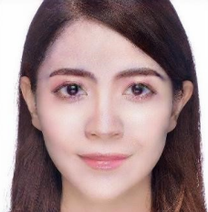
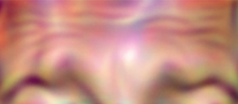
Face Adversarial Attack
To fool face recognition (FR) systems, subtle adversarial perturbations are applied to images.
However, existing attack methods [1,2,3] produce visually unnatural outputs that are easily distinguishable by the human eye, limiting their imperceptibility in real-world scenarios.
There is a need for face adversarial attack methods with enhanced naturalness.
Noise-based [1]
Patch-based [2]
Makeup-based [3]
Figure 3. Groups of perturbation methods with the original image on the left.
Notes:
(교란 기법 설명)비식별화 방법 중 개인의 identity를 바꾸지 않으면서 미세한 노이즈를 입히는 교란 기법이 있습니다.(사진을 보여주며 설명)
현존하는 교란 기법은 개인의 신원을 해치지 않는데도, 그 입힌 노이즈나 후처리가 부자연스러워 실제 분야에서 적용하기에 부담스러운 문제가 있습니다.
그래서 현실에 적용가능한 자연스러운 비식별화 교란 기법이 필요합니다.

Slide 4
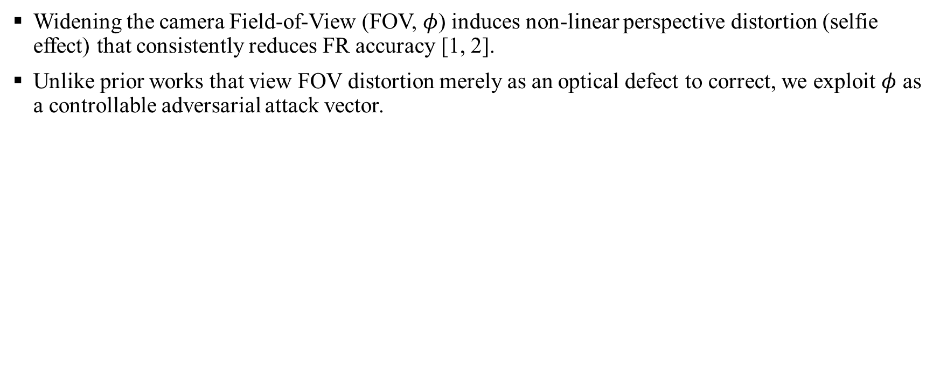
Field-of-View
Widening the camera Field-of-View (FOV, $φ$) induces non-linear perspective distortion (selfie effect) that consistently reduces FR accuracy [1, 2].
Unlike prior works that view FOV distortion merely as an optical defect to correct, we exploit $φ$ as a controllable adversarial attack vector.
Figure 4. ptical geometry of Field-of-View (FOV) mapping the captured scene onto the camera sensor through a lens.
Notes:
(교란 기법 설명)비식별화 방법 중 개인의 identity를 바꾸지 않으면서 미세한 노이즈를 입히는 교란 기법이 있습니다.(사진을 보여주며 설명)
현존하는 교란 기법은 개인의 신원을 해치지 않는데도, 그 입힌 노이즈나 후처리가 부자연스러워 실제 분야에서 적용하기에 부담스러운 문제가 있습니다.
그래서 현실에 적용가능한 자연스러운 비식별화 교란 기법이 필요합니다.

Slide 5
Research Question & Objectives
Research Question
Can natural camera FOV lens distortion be systematically transformed into a controllable, stealthy, and real-time adversarial attack vector against modern face recognition systems?
Research Objectives
Validate Vulnerability: Empirically validate the degradation of facial identity similarity across sweeps of the FOV parameter.
Demonstrate Stealthiness: Demonstrate that localized geometric distortion achieves visual naturalness without compromising attack efficacy.
Benchmark Performance: Validate superior ASR and execution efficiency compared to representative digital and physical baselines.

Slide 6
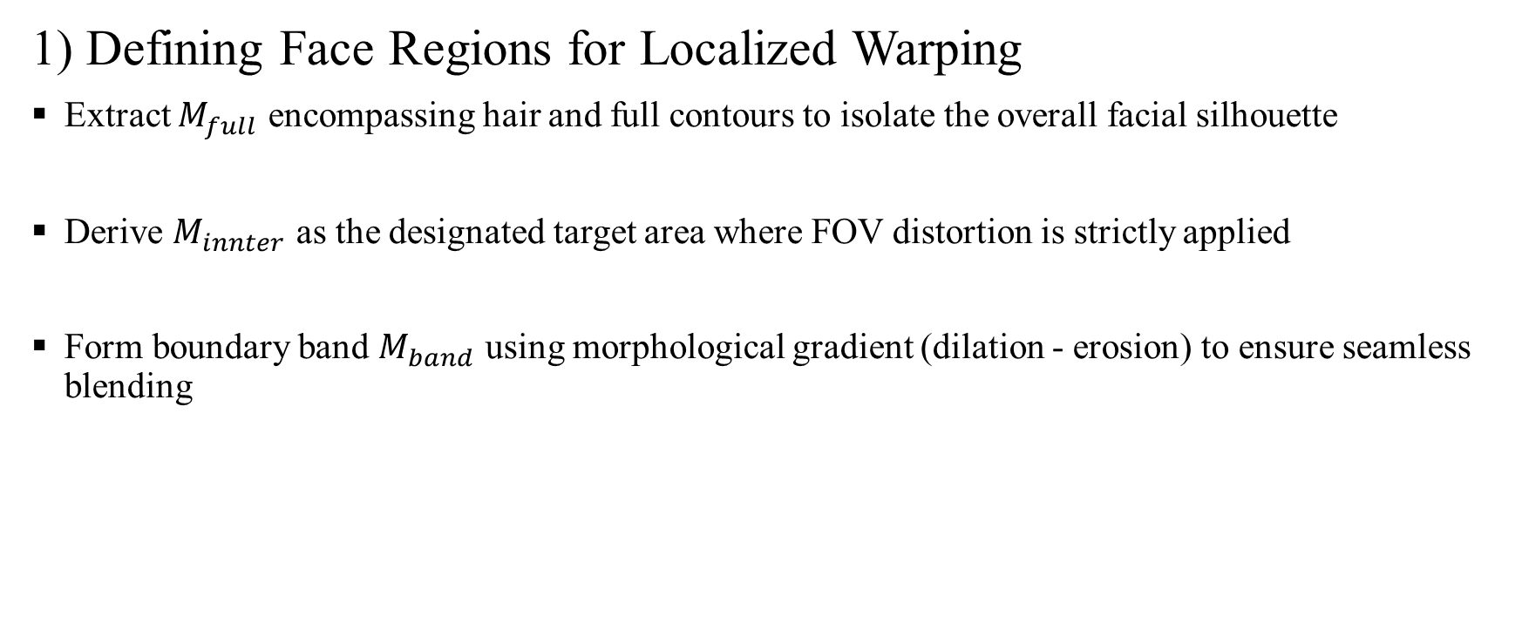
Methodology
1) Defining Face Regions for Localized Warping
Extract $M_{full}$ encompassing hair and full contours to isolate the overall facial silhouette
Derive $M_{innter}$ as the designated target area where FOV distortion is strictly applied
Form boundary band $M_{band}$ using morphological gradient (dilation - erosion) to ensure seamless blending

Slide 7
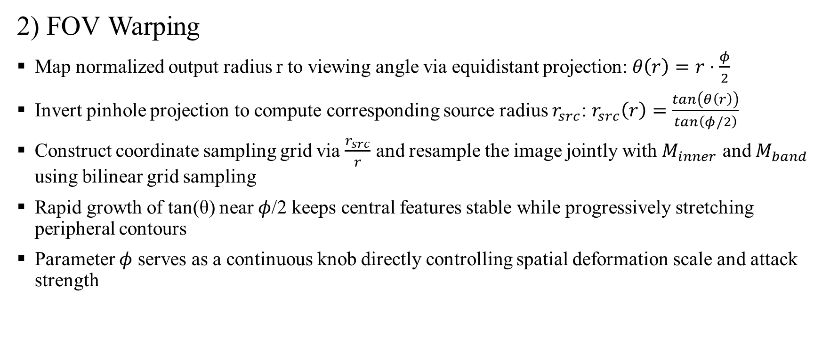
Methodology
2) FOV Warping
Map normalized output radius r to viewing angle via equidistant projection: $θ\left(r\right)=r⋅\frac{φ}{2}$
Invert pinhole projection to compute corresponding source radius $r_{src}$: $r_{src}\left(r\right)=\frac{tan⁡\left(θ\left(r\right)\right)}{tan⁡\left(φ/2\right)}$
Construct coordinate sampling grid via $\frac{r_{src}}{r}$ and resample the image jointly with $M_{inner}$ and $M_{band}$ using bilinear grid sampling
Rapid growth of tan(θ) near $φ$/2 keeps central features stable while progressively stretching peripheral contours
Parameter $φ$ serves as a continuous knob directly controlling spatial deformation scale and attack strength

Slide 8
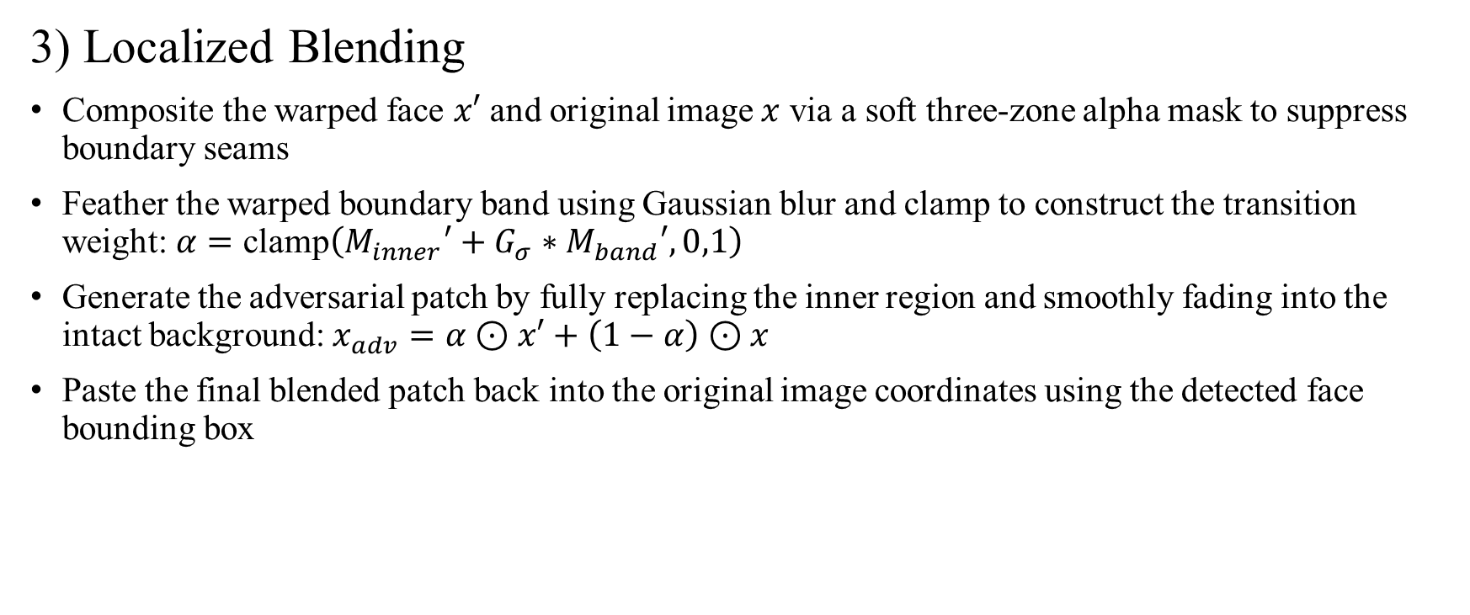
Methodology
3) Localized Blending
Composite the warped face $x′$ and original image $x$ via a soft three-zone alpha mask to suppress boundary seams
Feather the warped boundary band using Gaussian blur and clamp to construct the transition weight: $α=\text{clamp}\left(M_{inner}′+G_{σ}∗M_{band}′,0,1\right)$
Generate the adversarial patch by fully replacing the inner region and smoothly fading into the intact background: $x_{adv}=α⊙x′+\left(1−α\right)⊙x$
Paste the final blended patch back into the original image coordinates using the detected face bounding box

Slide 9
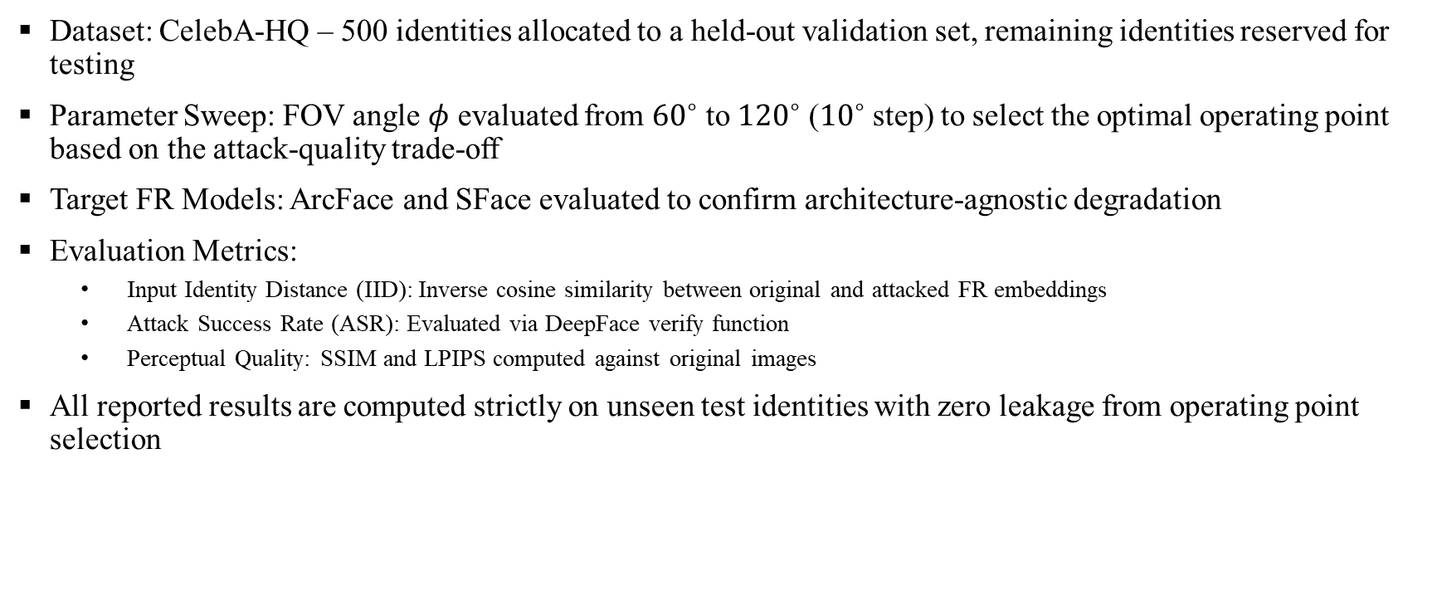
Experiments Setup
Dataset: CelebA-HQ – 500 identities allocated to a held-out validation set, remaining identities reserved for testing
Parameter Sweep: FOV angle $φ$ evaluated from ${60}^{∘}$ to ${120}^{∘}$ (${10}^{∘}$ step) to select the optimal operating point based on the attack-quality trade-off
Target FR Models: ArcFace and SFace evaluated to confirm architecture-agnostic degradation
Evaluation Metrics:
  Input Identity Distance (IID): Inverse cosine similarity between original and attacked FR embeddings
  Attack Success Rate (ASR): Evaluated via DeepFace verify function
  Perceptual Quality: SSIM and LPIPS computed against original images
All reported results are computed strictly on unseen test identities with zero leakage from operating point selection

Slide 10
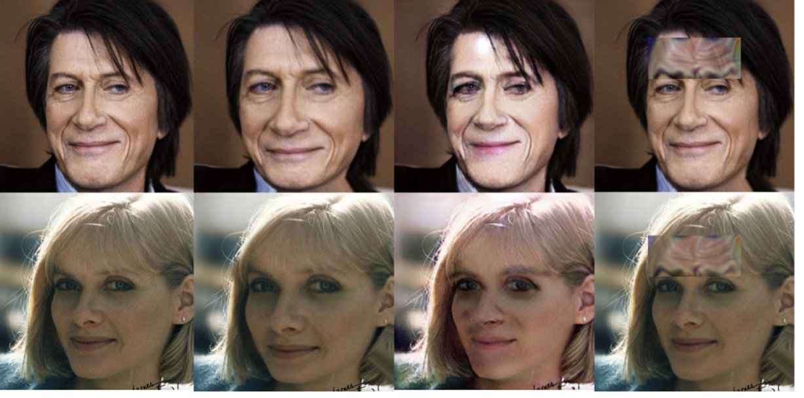
Results
Baseline attacks tend to leave noticeable visual cues, such as synthetic makeup changes in AMT-GAN or visible forehead patches in AdvHat.
Ours produces more natural-looking facial images with fewer perceptual artifacts while achieving higher attack success rates than the baselines.
Original Image
Ours
AMT-GAN
ADVhat
Figure 4. Qualitative comparison of StealthWarp and other attack baselines, including physical (AdvHat) and digital (AMT-GAN) methods.

Slide 11
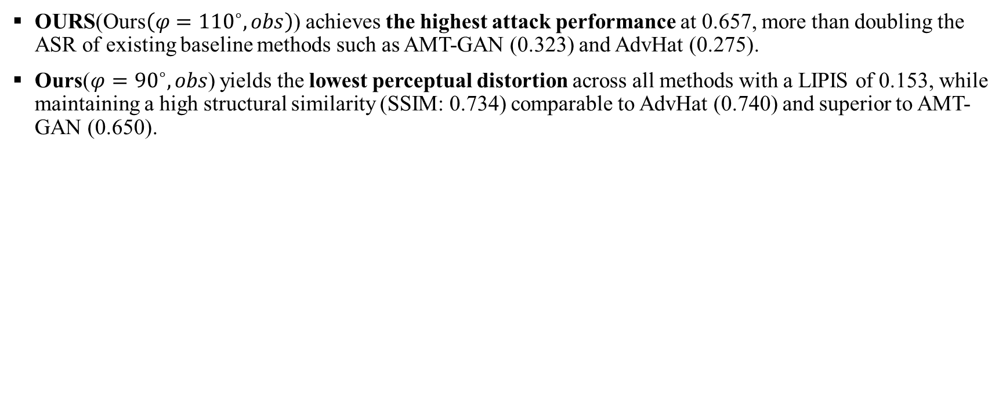
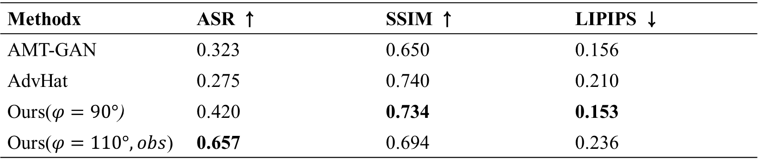
Results
OURS($\text{Ours}\left(φ={110}^{∘},obs\right)$) achieves the highest attack performance at 0.657, more than doubling the ASR of existing baseline methods such as AMT-GAN (0.323) and AdvHat (0.275).
Ours($φ={90}^{∘},obs$) yields the lowest perceptual distortion across all methods with a LIPIS of 0.153, while maintaining a high structural similarity (SSIM: 0.734) comparable to AdvHat (0.740) and superior to AMT-GAN (0.650).
Methodx | ASR ↑ | SSIM ↑ | LIPIPS ↓
AMT-GAN | 0.323 | 0.650 | 0.156
AdvHat | 0.275 | 0.740 | 0.210
Ours($φ=90°$) | 0.420 | 0.734 | 0.153
Ours($φ=110°,obs$) | 0.657 | 0.694 | 0.236
Table 1. Comparison with baseline attacks (AMT-GAN, AdvHat) at our selected operating point (90°) and 110°.

Slide 12
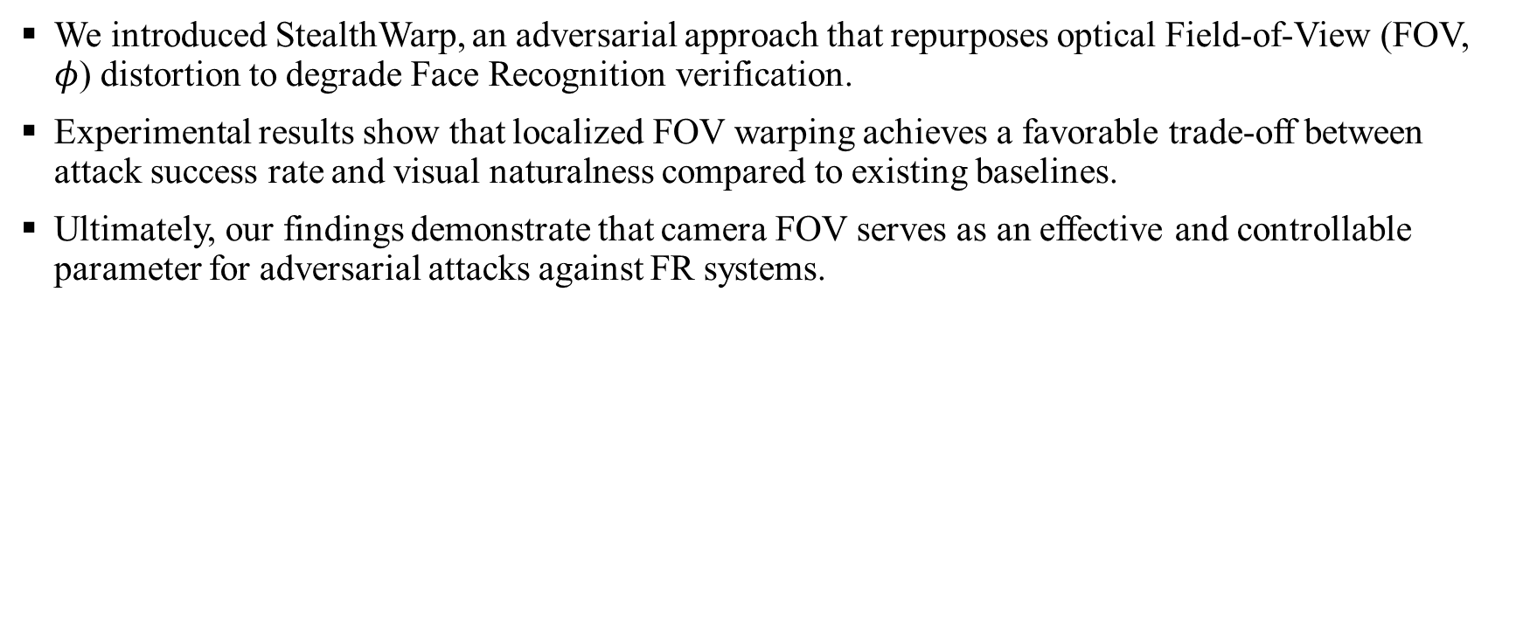
Conclusion
We introduced StealthWarp, an adversarial approach that repurposes optical Field-of-View (FOV, $φ$) distortion to degrade Face Recognition verification.
Experimental results show that localized FOV warping achieves a favorable trade-off between attack success rate and visual naturalness compared to existing baselines.
Ultimately, our findings demonstrate that camera FOV serves as an effective and controllable parameter for adversarial attacks against FR systems.

