Slide 1
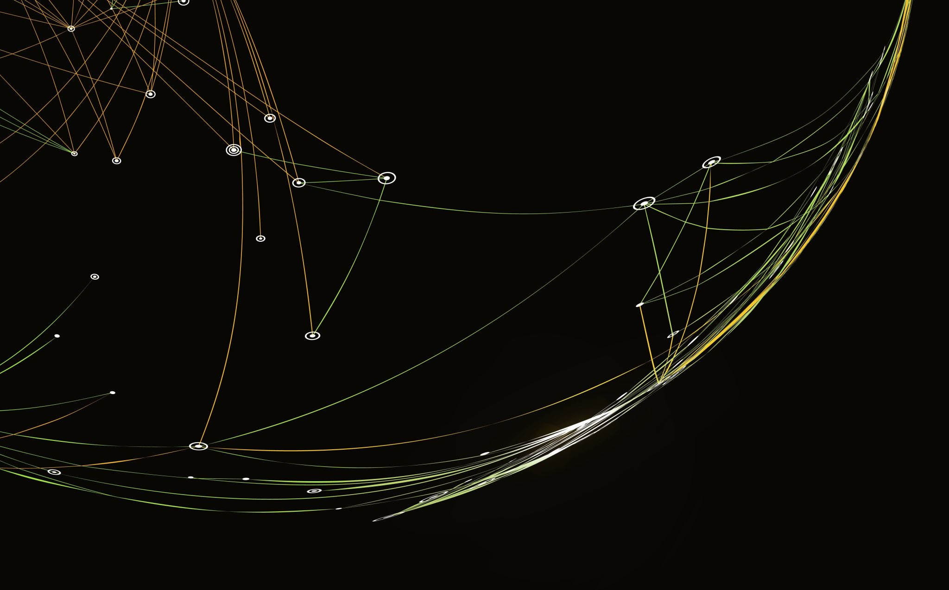
Gaze and Memory
Narrative Practices in Player Photography in Red Dead Redemption 2
Presenter:Zhang Xiaotong

Slide 2


Research Background
From Playing a World to Framing a World
Modern games provide detailed virtual worlds and flexible camera tools.
Players can become observers, photographers, and visual storytellers.
Screenshots can express personal interpretations of the game.
Core Idea
Player photography does not only record gameplay. It can create new visual meanings and preserve personal memories.
Case Study: Red Dead Redemption 2

Slide 3
Research Questions
Two Questions Guide the Study
RQ1: Character Narrative
How do players reconstruct character stories, especially Arthur Morgan’s story, through photography?
RQ2: Emotional Memory
How does player photography capture and express personal game memories and emotions?
Research Aim
To understand player photography as a narrative practice, not simply as screenshot-taking.

Slide 4
Theoretical Framework
1. Photography and Visual Memory
Roland Barthes: Small visual details can trigger strong emotions.
Susan Sontag: Photographs allow people to collect and preserve moments.
2. Games as Art and Narrative Space
Game worlds allow players to explore, interact, and create meaning through camera angles, timing, and composition.
3. Participatory Culture
Henry Jenkins: Players are not only consumers. They can also become creators who reinterpret and extend original media.

Slide 5
Methodology
Qualitative Case Study and Visual Narrative Analysis
01
Data Source
Player photography posts shared on Xiaohongshu.
02
Sample Selection
Recent posts with high interaction, aiming for diversity and in-depth analysis.
03
Image Analysis
Examine themes, narrative elements, composition, camera angles, colors, lighting, emotions, and memories.
04
Comparison
Compare visual strategies and explore how players reinterpret the game's original narrative.
Note: The original paper does not specify the exact number of images analyzed.

Slide 6
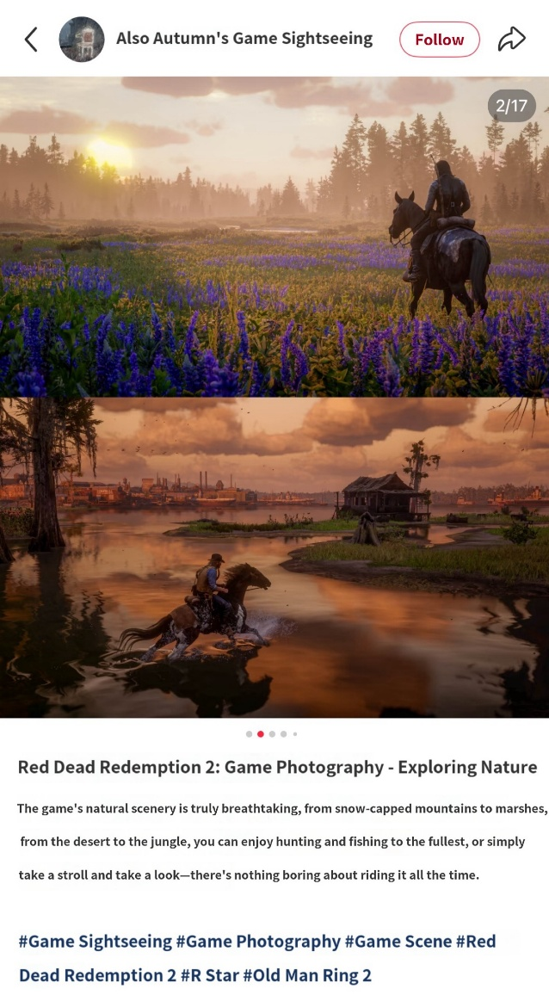
Findings 1: Reproduction of Virtual Space
Location: Open landscapes can express solitude, freedom, and vastness.
Time and Weather: Twilight and rain can create loneliness or a tragic atmosphere.
Landscape: Mountains and plains can emphasize freedom and adventure.
Key Finding
The virtual world is not only reproduced. It is reinterpreted through players' visual choices.

Slide 7
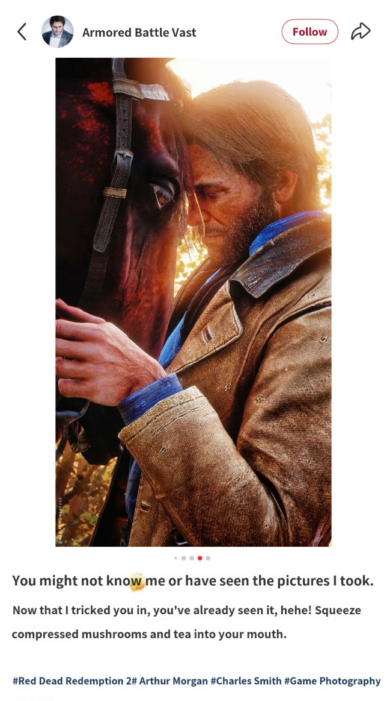
Findings 2: Gaze and Character Narrative
Visual Choices Shape How We Understand Characters
Subject and Framing: Players decide who or what deserves attention.
Camera and Depth: Foreground, middle ground, and background create visual relationships.
Light and Color: Warm tones may suggest hope, while dark or cool tones may suggest sadness.
Focus and Detail: Facial expressions and objects can become emotional clues.
Key Finding
Players extend character narratives by using visual language to express their own interpretations.

Slide 8
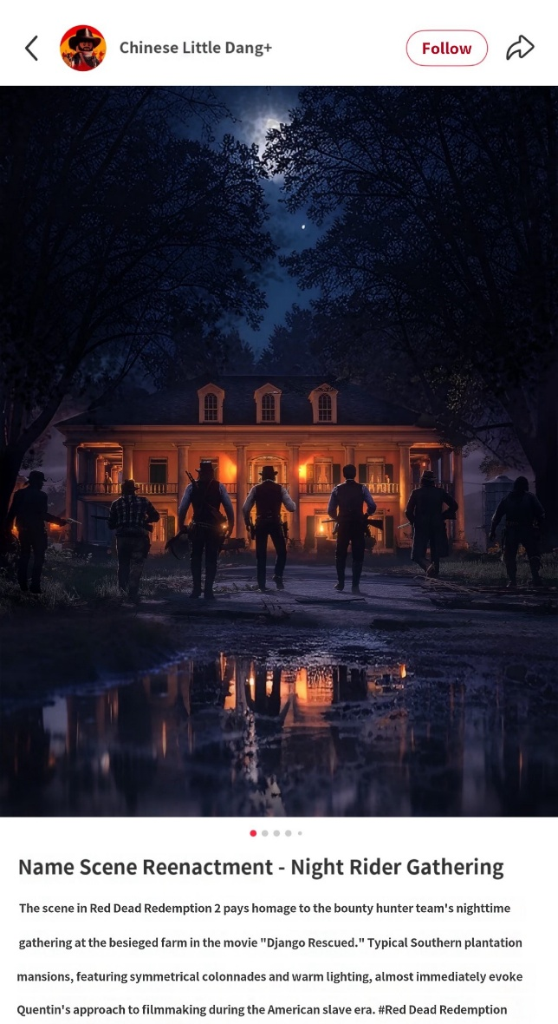
Findings 3: Emotional Memory and Narrative Reconstruction
Screenshots Can Carry More Than One Meaning
Example: The Burning of Braithwaite Manor
Game Event: The image captures a dramatic event in the game.
Emotional Atmosphere: Firelight and character actions emphasize tension, danger, and betrayal.
Cultural Interpretation: The scene can also invite comparisons with cinematic imagery, including Django Unchained.
Key Finding
Player photography can connect game events, emotional experiences, and cultural references. It preserves the original story while adding new layers of meaning.

Slide 9
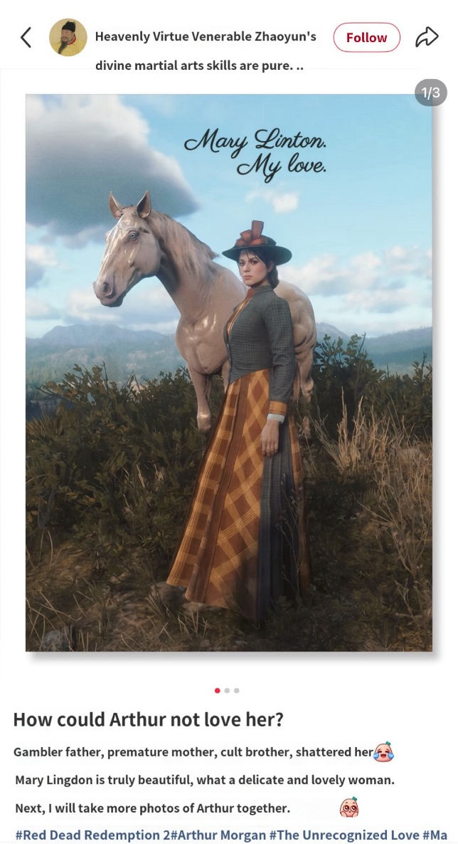
Findings 4: Player Agency and Creative Reinterpretation
From Player to Creator
01. Player
Experiences the game world.
02. Photographer
Selects the subject, camera angle, composition, and lighting.
03. Co-Creator
Adds personal stories and new meanings to the original game.
Sharing these images also connects individual creativity with community participation.
Key Finding
Players become both narrative agents and visual creators.

Slide 10
Conclusion
This study shows that player photography in Red Dead Redemption 2 is more than a way to record the game. Through camera angles, composition, lighting, and color, players can express their own understanding of characters, stories, and emotions. They can also connect game events with personal memories and cultural references, creating new meanings beyond the original narrative. In this process, players are not only experiencing the game but also becoming visual storytellers and creative participants in digital culture. Future research can explore player photography in different game genres, virtual reality environments, and AI-assisted creative tools.

Slide 11
Thank You

